Slide 2
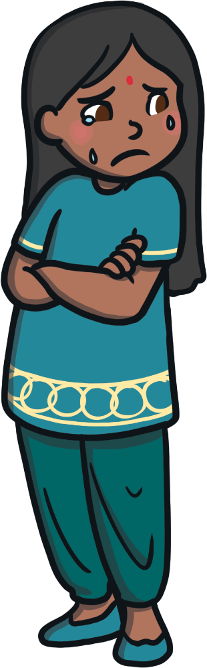
What is Conflict?
Conflict is when we have a disagreement with our friends or our families.
When this happens people might get angry, upset or scared.
Sometimes we have disagreements over small things and sometimes over big things.
Have you ever had a disagreement with someone? What happened?
Did you make up with them afterwards?

Slide 3
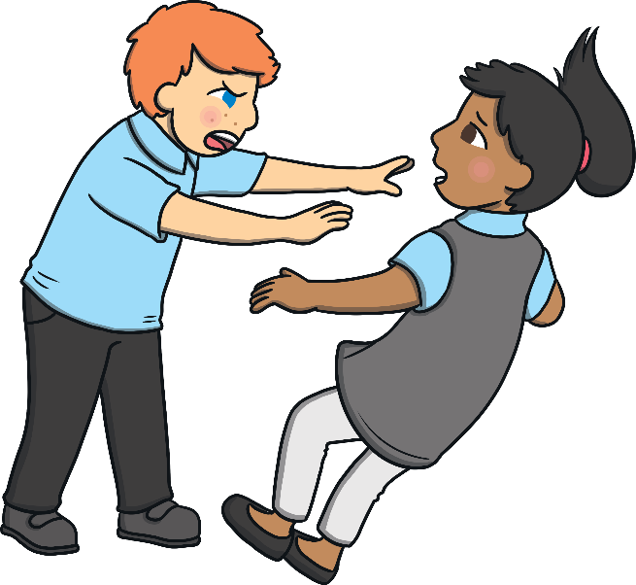
A Big Disagreement
A big disagreement can happen between you and your family or you and your friends.
A big disagreement could be a time when your friend did something to hurt you.
Maybe your brother or sister were playing with their friends and would not let you join in.

Slide 4
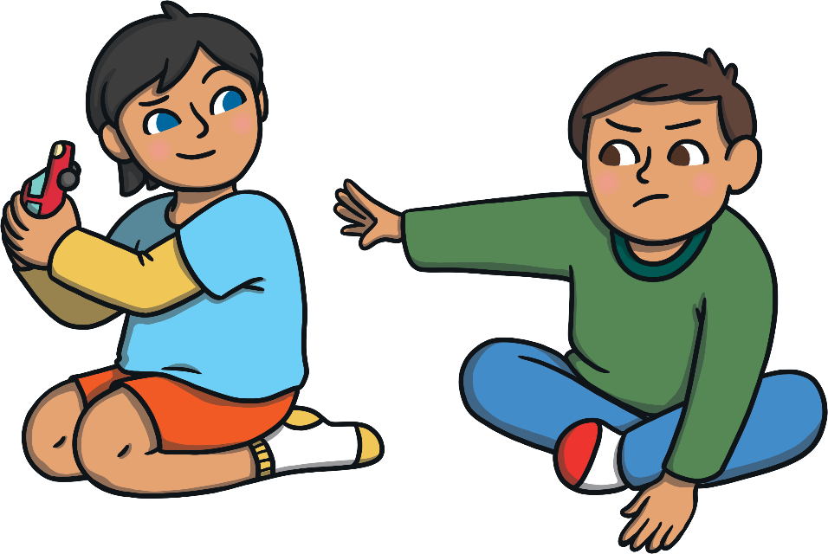
A Small Disagreement
A small disagreement can also happen between you and your family or you and your friends.
A small disagreement could be if your friend took your book or game.
Maybe your brother or sister would not let you have the remote for the television.

Slide 5

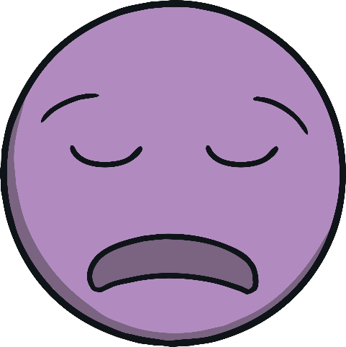

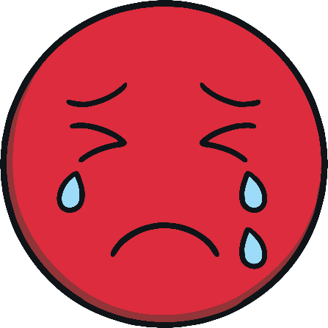


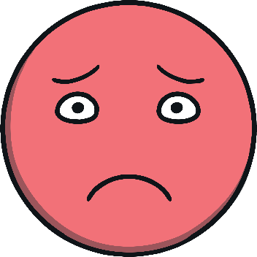
Big and Small Disagreements
There is a difference between big and small disagreements.
A good way to figure out if you are having a big or small disagreement is to check in with your emotions.
Are you feeling hurt, embarrassed, frustrated?

Slide 6
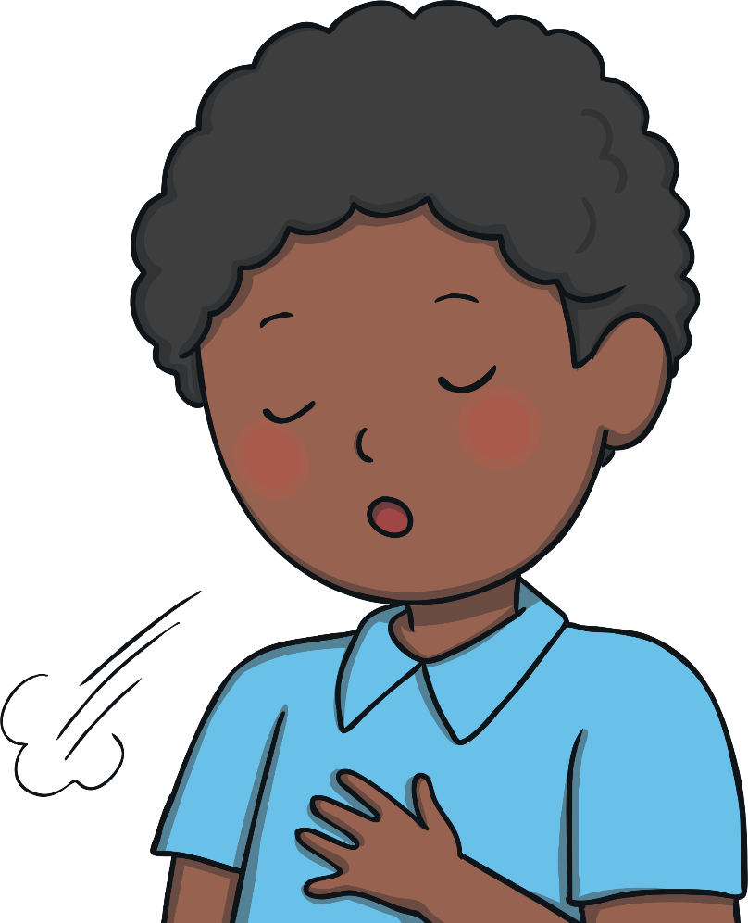
What Should You Do When a Disagreement Happens?
When you have a disagreement with someone the best thing to do is:
Remain calm, try not to shout (it will not make you or anyone else feel good).
Remember what it is that made you upset, sad or mad so you can talk about it with the other person.
Take a deep breath.

Slide 7

Traffic Light Emotions
Try using the traffic light emotions. Think about time when you had a disagreement, what colour were you at when it first happened?
What colour were you when it was all sorted out?
I am angry
I am upset
I am calm

Slide 8
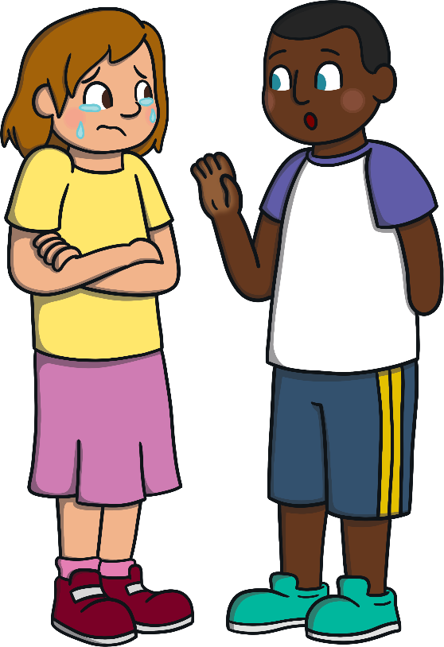
How Can We Solve a Disagreement?
1. Calm down and count to 10.
2. Talk and listen to each other.
3. Discuss what you both need to do to move on
from the disagreement.
4. Talk about your feelings.

Slide 9
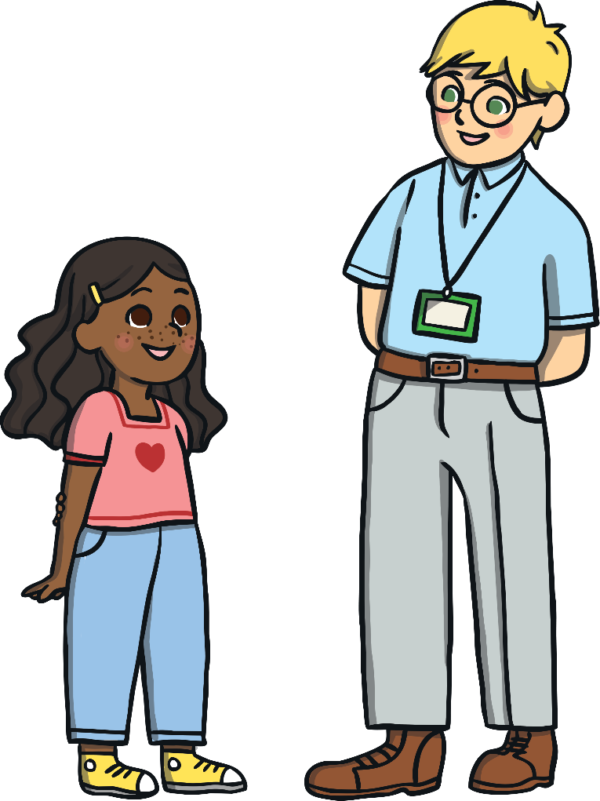
What Happens if You Cannot Solve a Disagreement?
Sometimes, you might not agree with what the other person is saying, or you might not be able to agree on how to resolve the issue.
If that happens you could:
1. Ask another friend to listen and help.
2. Tell an adult.

Slide 10

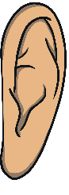
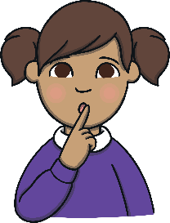
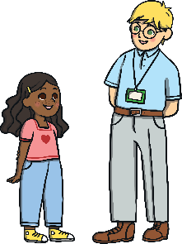
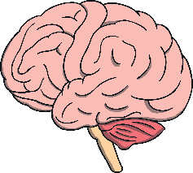

How to Listen Carefully to Another Person
Look at the person
Be ready to listen
Be quiet while they are
talking
Make sure to face the
other person
Think about what the
other person is saying
Care about what the person is saying

Slide 11
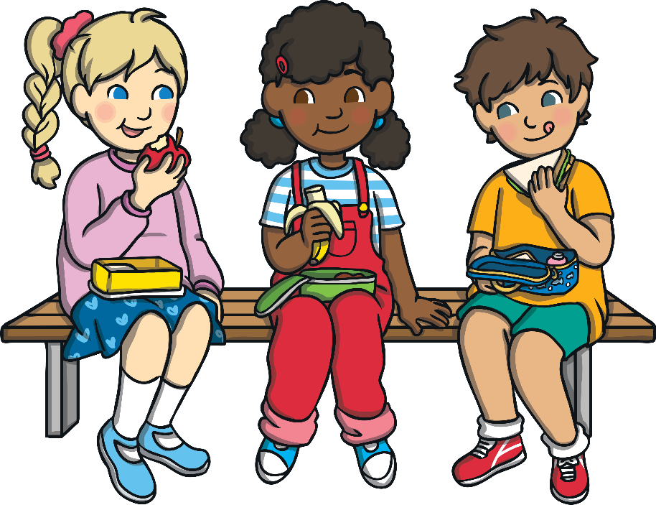
Reminder
Remember to treat other people just as you would like to be treated!

