Slide 1
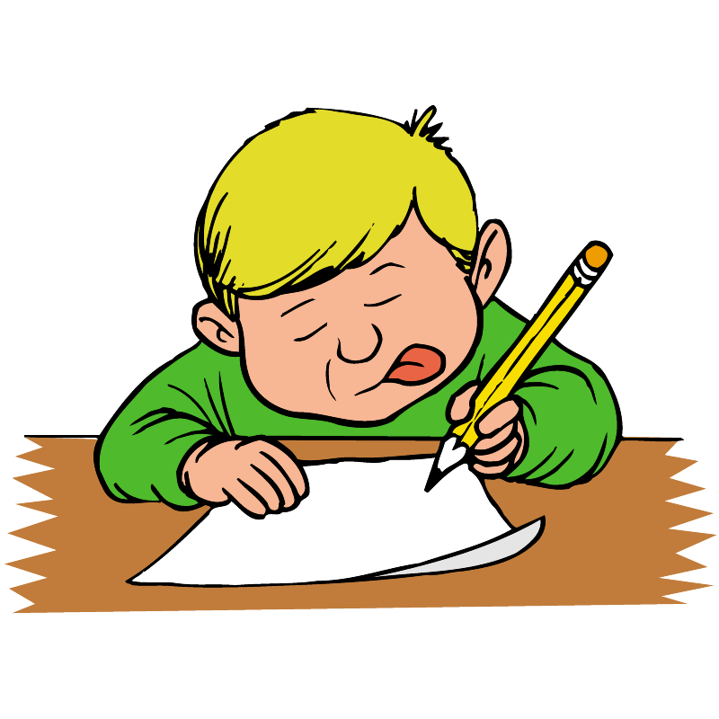
Friday 26 November 2021
LO: To write with purpose
To use sentences appropriately
Punctuate accurately
C: Formal letter

Slide 2
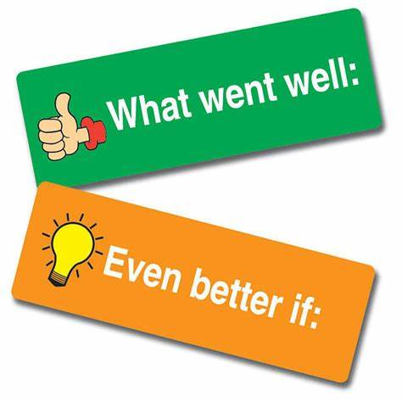
You have 5-10 minutes to look back at your work from the past couple of days​
What have you done well?​
What do you need to do to improve?

Slide 3

Read your letter to a family member.​
Discuss what is good about your letter and what you are going to do to improve.

Slide 4
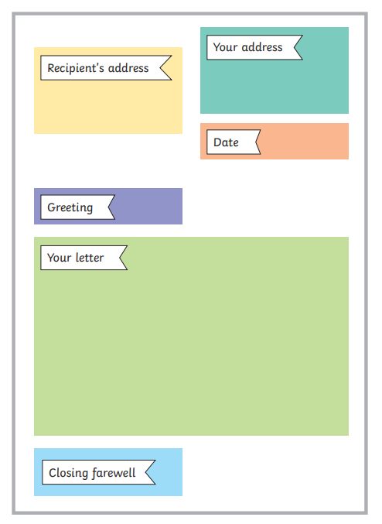
Write out your letter neatly from beginning to end, including added improvements.

