Slide 1
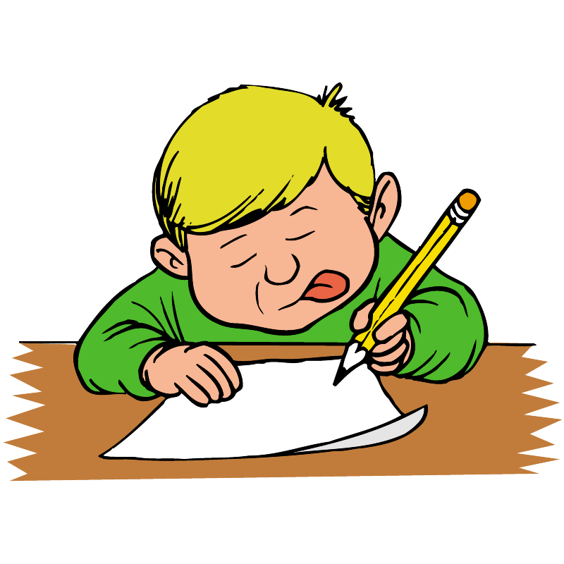
Thursday 25 November 2021
LO: To write with purpose
To use sentences appropriately
Punctuate accurately
C: Formal letter

Slide 2
Yesterday we thought of ideas for the main body
The best activity was...
It was so funny when...
I could not believe...
Remember to include fronted adverbials an conjunctions in your main body.
Can you include:
Furthermore, however,
In addition to this,

Slide 3
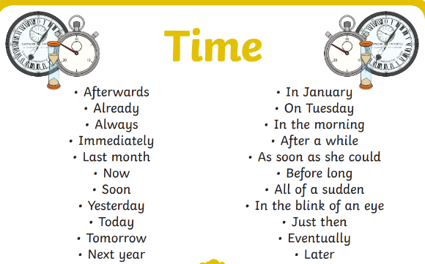

Slide 4
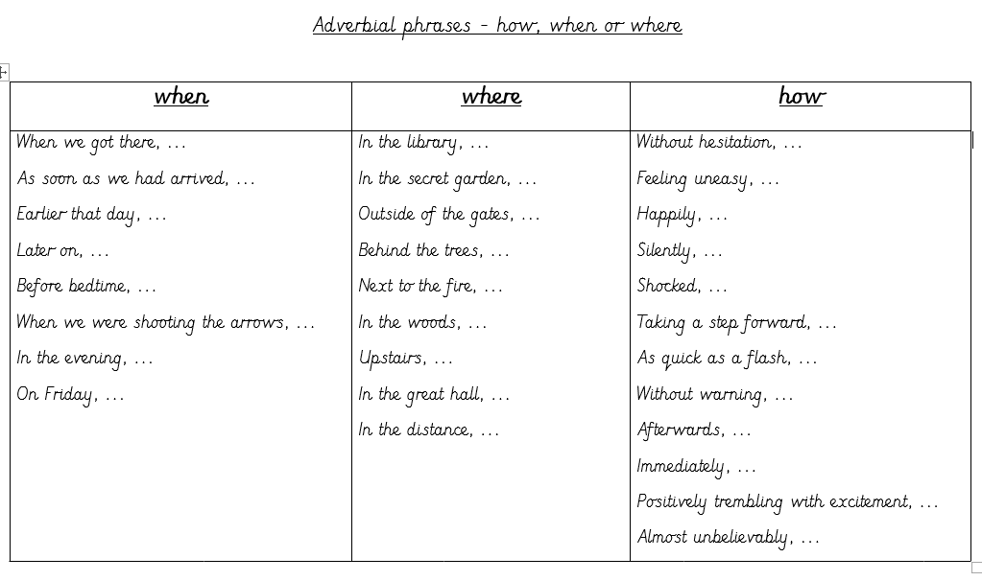

Slide 5
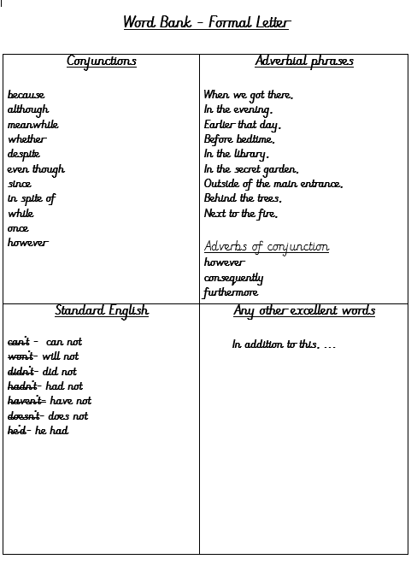
Add ideas to your word bank. Stick the word bank into your books and use it to help you in your writing today.

Slide 6
Main body
Remember to include your favourite bits about Ufton court using adverbials and conjunctions.
Red Pen: read back over your work and check it. Make any corrections you spot. Have you set your letter out correctly? Have you used formal language? Have you used conjunctions to add information? Have you used prepositions?
See if you can add them in to your letter if you have forgotten!

Slide 7
Checklist
Your address (sender) top right
Recipients address top left
Date under senders address
Greeting (salutation) Dear Mr John
Introduction- tells the reader what the letter is about
The first line gives your reason for writing
Clear paragraphs for each point
Formal language
Correct ending- Yours sincerely,
Your signature with your full name below it

