Slide 1

Wednesday 24 November 2021
LO: To write with purpose
To use sentences appropriately
Punctuate accurately
C: Formal letter

Slide 2

Who would you like to write to?
What kinds of things might we want to say in our thank you letter?

Slide 3
What we can include in our letters
Who we are
Why we are writing
Our best activity
I am writing to you because... TPS
The best activity was... TPS
It was so funny when...TPS
I could not believe... TPS
Remember to include conjunctions to help this link...
FANBOYS ISAWAWUBUB

Slide 4
Think about how you can move the conjunction from the middle to the beginning.
Because I was away from home, it was so much fun.
It was so much fun, because I was away from home.

Slide 5
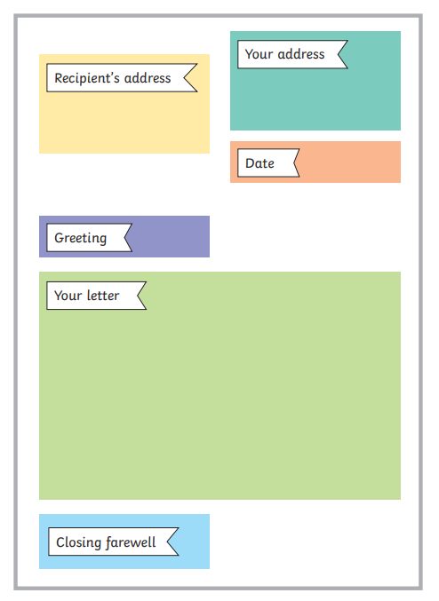
Today we are working on the introduction and conclusion of our letters.
Tomorrow we will work on the main body.

Slide 6
Introduction:
Example:
Dear Ufton Court,
My name is ______ and I am a pupil from Binfield School. I am writing to you to say thank you very much for allowing the Year 4 children of Binfield Primary School to visit earlier this month. It was an absolutely amazing experience, one which I will never forgot.

Slide 7
Conclusion:
Example:
Once again, thank you very much for having me and for being wonderful hosts. It was a totally unforgettable experience, from the décor and props to the clothes, food and activities. Despite missing my family and being slightly homesick, I had a truly magnificent time and would highly recommend Ufton Court to anyone interested in learning about the Romans.
Yours sincerely,
_____________
_____________

Slide 8
Now, write your own introduction and conclusion.

