Slide 1

Tuesday 23 November 2021
LO: To write with purpose
C: Formal letter

Slide 2
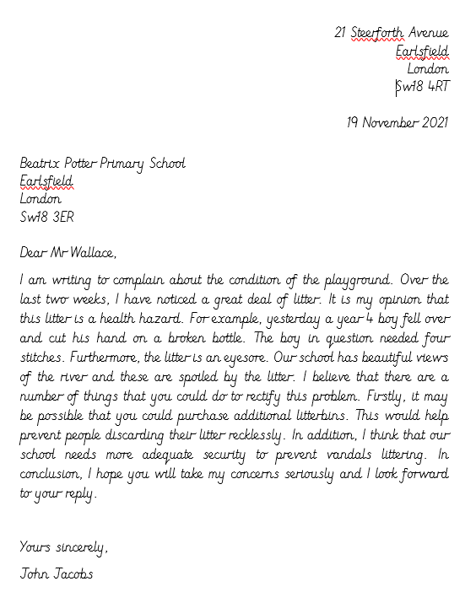
Let’s take a look at this piece of writing.
TPS: What do you think it is and why?
What features can you spot?

Slide 3

Yes, it is a letter.
This letter in particular is a formal letter which has many of the same features as our formal recount.

Slide 4
Read through the letters you have been given. Sort them from least to best favourite, best vocabulary to worst vocabulary and then informal to formal.

Slide 5

What is the difference between a formal and informal letter?
Using formal and informal language - Year 3 - P4 - English - Home Learning with BBC Bitesize - BBC Bitesize
Year 4 Formal and Informal Language Game | Classroom Secrets Kids

Slide 6
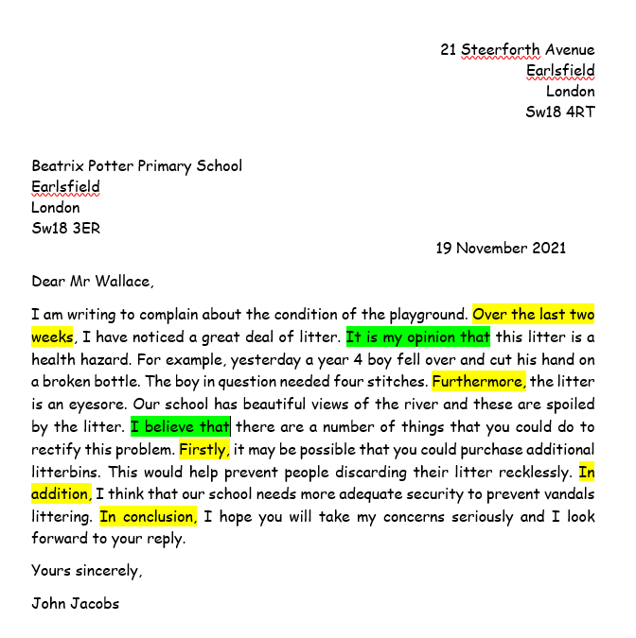
Write down
the adverbials and conjunctions you spot in the letters provided.

Slide 7
Create your own checklist of the features of formal letters

Slide 8
Checklist
Your address (sender) top right
Recipients address top left
Date under senders address
Greeting (salutation) Dear Mr John
Introduction- tells the reader what the letter is about
The first line gives your reason for writing
Clear paragraphs for each point
Formal language
Correct ending- Yours sincerely,
Your signature with your full name below it

Slide 9
We are going to write a letter to Ufton court or to someone who helped organise the whole trip. Would we write a formal letter or an informal letter? Why?

Slide 10
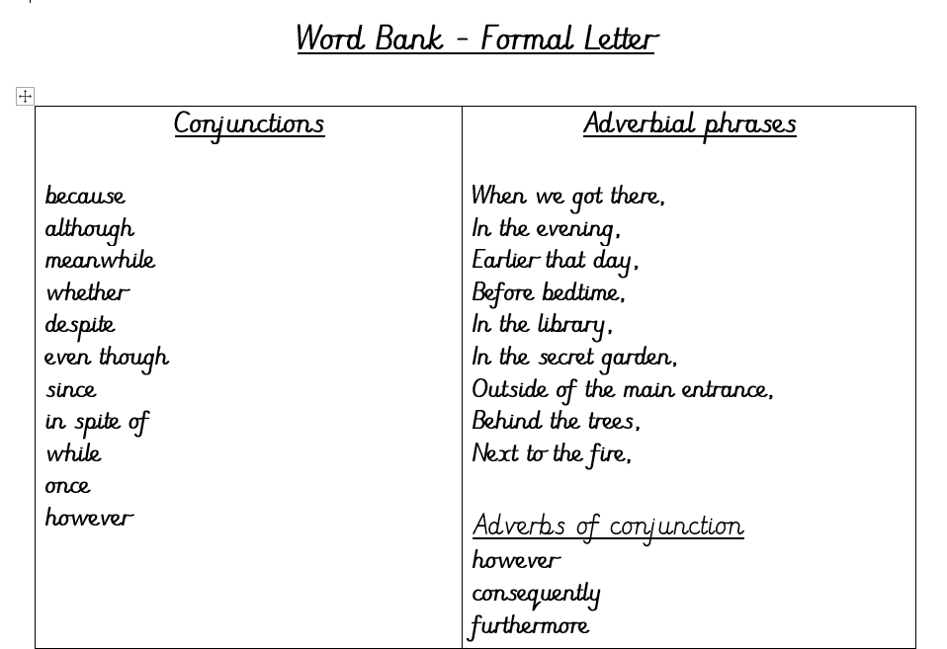
Our formal letters to Ufton Court need to include conjunctions and adverbials.

Slide 11
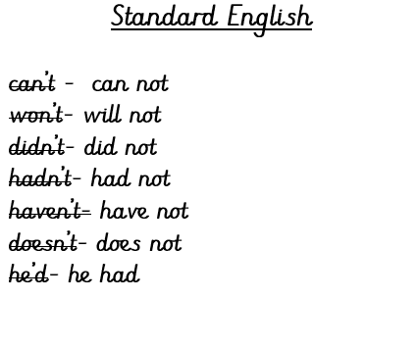
Formal letters include formal language. We call this standard English. We do not use contractions when writing formally.
Let’s play a contractions game
Paddling and snorkelling: Match the contraction to the standard English
Diving: Write the matching contraction next to the standard English

Slide 12
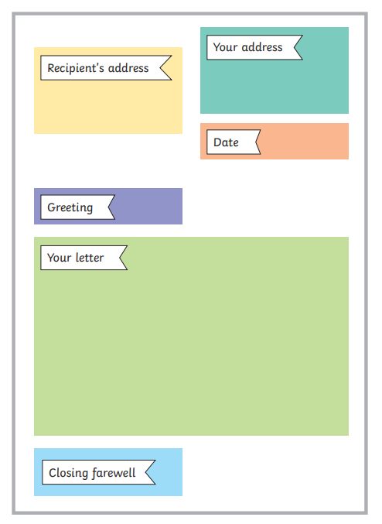
How to set out my formal letter

Slide 13
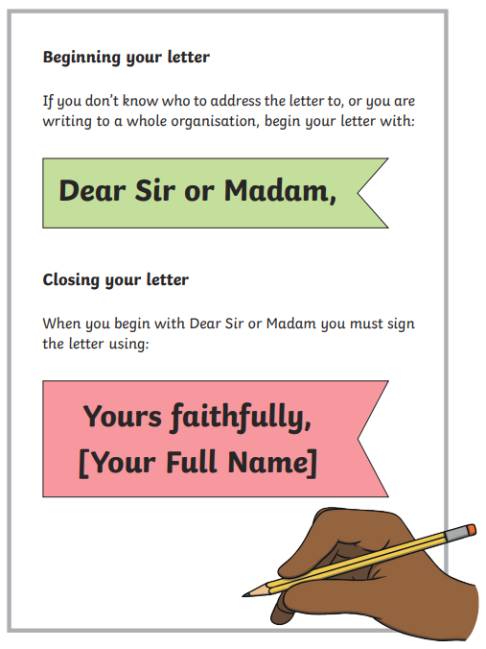
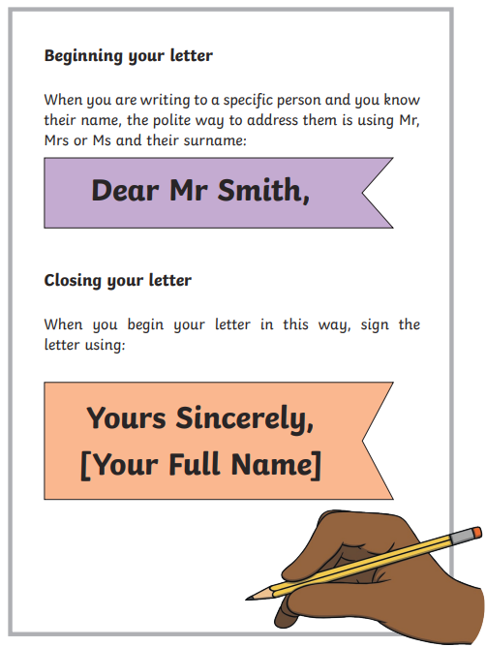

Slide 14
Print/ write out a formal letter and label the features.

