Slide 1
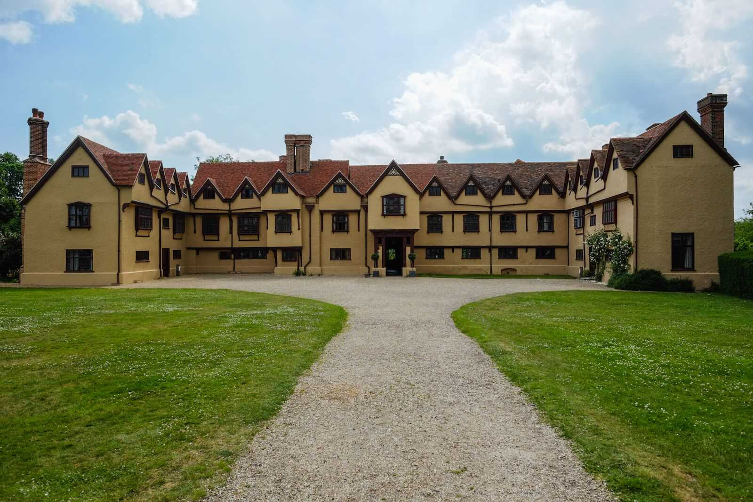
Monday 22 November 2021
LO: To write with purpose​
To organise writing appropriately​
To use sentences appropriately
C: Formal Recount

Slide 2
Features of a Formal Recount
Formal language- no contractions ( didn’t - did not)
Chronological order- using time adverbials
Paragraphs- introduction
main body
conclusion
Adverbials- fronted adverbials and time adverbials
Conjunctions
Past tense
Perfect past tense (after we had eaten breakfast, we headed out to the archery range)

Slide 3
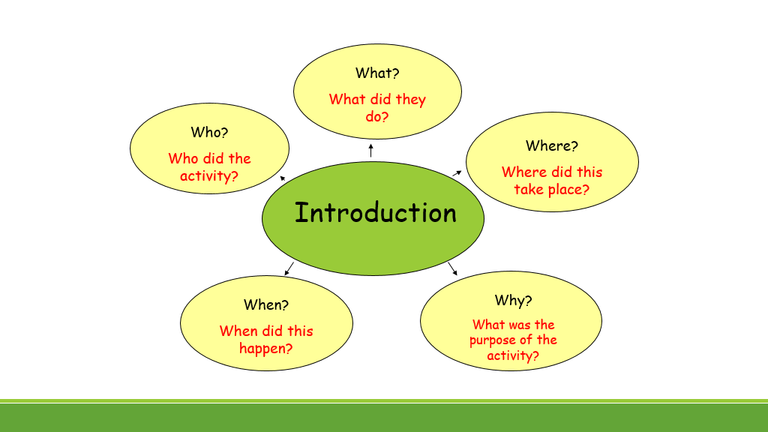

Slide 4
On Wednesday morning, the 3rd of November 2021, both Year 4 classes embarked on the annual Ufton Court trip, as part of our history curriculum. Positively trembling with excitement, I packed my suitcase under the coach and settled down ready for the short, scenic drive to Ufton. Once there, I settled in comfortably in preparation for our two night stay. I could not wait to start our first activity and find out more about life in Roman times.

Slide 5
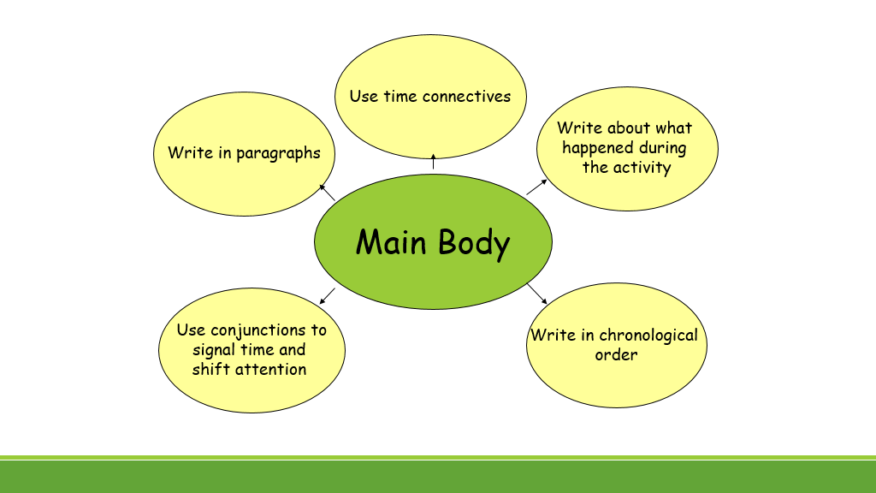

Slide 6
Main Body Ideas
On the first day
Military manoeuvres
Augury trail
Roman games
Romulus and Remus plays
Bedtime- bunkbeds
On the second day
archery
Fire lighting- flint and steel and fire strikers
Roman artefacts
Roman banquet- hosted by Julius Flavius: costumes, dancing, singing
On the last day
Boudicca’s Revolt
The Inceni tribe, led by queen Boudicca, rebelled against Rome. They refused to pay their taxes. There was an uprising and a battle took place.

Slide 7
Once settled, we headed outside to learn about how the Romans used military manoeuvers to train for a potential battle. After listening to instructions on how to create the formations, we worked as two teams to protect our fellow soldiers and leaders. Wielding a shield in our left hand and a gladius sword in our right, we prepared for battle by creating an impenetrable shield wall. Next, we created a wedge to penetrate enemy lines, then an orb around our leader and finally a testudo to protect our men against projectiles. Without a doubt, the testudo was my favourite formation, as the teachers threw soft, foam rocks at us, which was hilarious!
After that, we joined the augurs on an exciting expedition around the magnificent, tranquil grounds. I enjoyed repeating the chant with them and listening out for signs from the Gods. Unexpectedly, I was really good at the odd and even game and wished we could have played for longer. Mysteriously, a flock of birds were spotted overhead and I still think that it was a sign from Jupiter. We continued on our journey and found ourselves amongst animals. Never in my life had I seen a goat wink, but one did, which we were told meant good luck!

Slide 8
Sum up the visit
Say what you
enjoyed
Concluding
Paragraph
Say what you
learnt
Recommend others
who may
enjoy it

Slide 9
Friday 5th November 2021, was our last day at Ufton Court. Before leaving, we acted out Boudicca’s Revolt which ended a battle between the Romans and the Inceni tribe. I was a Roman soldier and I loved chanting, ‘all hail Rome!’ I learned so much about Boudicca and the Inceni tribe, as well as why they rebelled. I found it very sad that she drank poison at the end. I can imagine that the Romans were very mad that she outsmarted them! After lunch, it was time to gather our things and head back to school on the coach. I have many highlights from the trip, but my best are definitely shooting a real arrow and attending a real Roman banquet. I simply loved the food and the setting. Despite missing my parents, I had the most wonderful time at Ufton Court and I would certainly go again!

Slide 10
Let’s begin by reading over our work from last week. Edit and red pen any positive changes to your work.
(10 minutes)
Start writing out your introduction, main and conclusion in neat in your books.
Red Pen: look at the formal recount success criteria. Have you included everything you need to? Is there anything you have missed that you need to include? Write a sentence or two to meet any missing points from the success criteria.
Success Criteria for Formal Recount
Formal language
Fronted adverbials
Time adverbials
Conjunctions
Chronological order
Past tense
Paragraphs

