Slide 1
To understand beliefs and teachings.
To reflect.
To understand values.
C: Christianity.

Slide 2
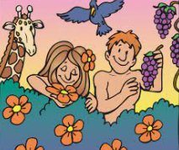
Can you remember the story of Adam and Eve?
In the story, God gave both Adam and Eve jobs. Can you remember what they were?
Let’s remind ourselves by listening to the story.
https://www.youtube.com/watch?v=leBCvqV3f3w

Slide 3
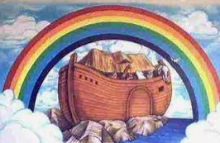
Think back to the story of Noah from last week.
What jobs did God give to Noah?
What rules did God give to humans after the floods had receded?
Let’s listen to the story to try to remember.
https://www.youtube.com/watch?v=_vjjhMWJ2wE

Slide 4
Both the creation and Noah stories show that people have responsibilities given by God – part of being the ‘People of God’ is trying to live by God’s commands.

Slide 5
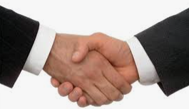
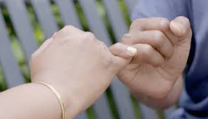
What does the word ‘pact’ mean?
Have you ever made a pact with anyone else?

Slide 6
Pact
A formal agreement between individuals or parties.
Our behaviour policy.
Our class charter.
A job offer.
Rules at home.

Slide 7
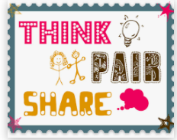
When God gives rules in the Noah story, he makes a covenant – a pact.
God is not just giving humans rules to obey, but he also has a promise to keep.
What was God’s covenant with Noah?

Slide 8
This is the first time in the Old Testament where we read of God establishing a covenant.
There are lots of promises and a covenant between God and his people in the Old Testament.
The covenants show people the correct beliefs, attitudes and behaviours that are needed for being in a relationship with God, but they also show what they can expect from God.

Slide 9
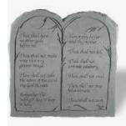
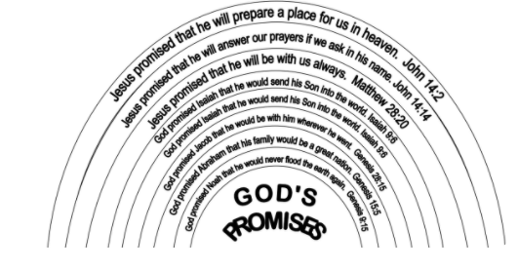
Can you think of any other covenants we have learned about in Christianity or Judaism?

Slide 10
Remember that God sent the flood to bring good into the world and wipe out evil and that after the flood he promises to stick with people – even though people often mess up; God keeps on forgiving.
Why do you think this is important to Christian and Jewish people?

Slide 11
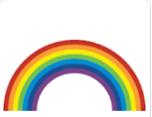
Activity 1
Draw a rainbow and fill it with all of the words you can think of to describe God.

Slide 12
Activity 2
You are going to retell the story in your books from either God’s or Noah’s point of view.
Noah: include what Noah might have been thinking and feeling as God instructed him to build the ark.
God: include what God might have been thinking and feeling as he saw the evil in the world and told Noah to build the ark.
Red Pen: why do you think God keeps on forgiving?

