Slide 1
20/9/21
LO: To round to the nearest 100.
C: To know and use number.

Slide 2
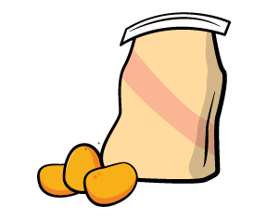
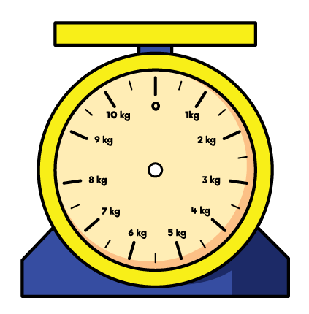

Year 4 | Week 2 | Day 4

Slide 4

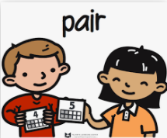
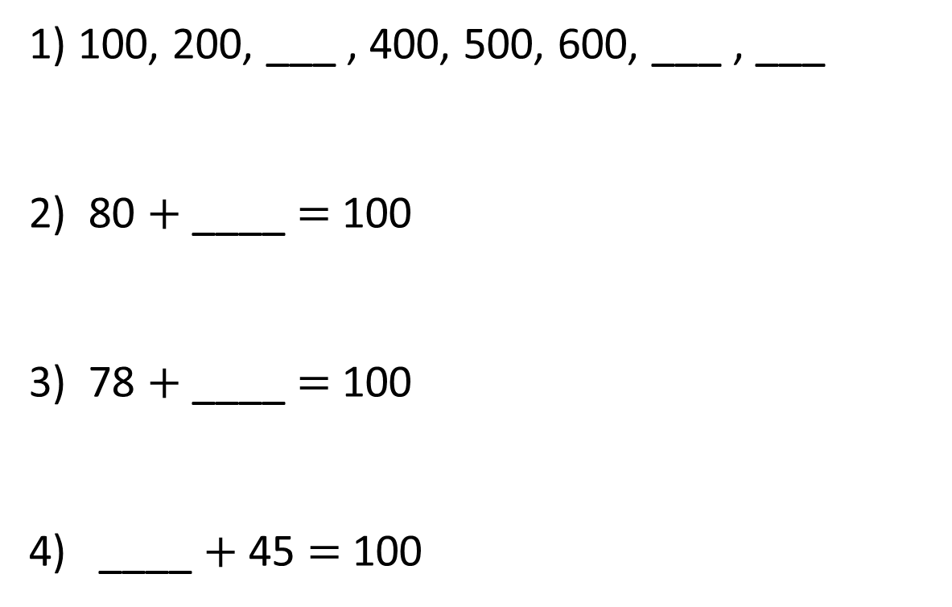
1) 100, 200, ___ , 400, 500, 600, ___ , ___
2) 80 $+$ ____ $=$ 100
3) 78 $+$ ____ $=$ 100
4) ____ $+$ 45 $=$ 100
Let’s warm our brains!

Slide 5
1) 100, 200, ___ , 400, 500, 600, ___ , ___
2) 80 $+$ ____ $=$ 100
3) 78 $+$ ____ $=$ 100
4) ____ $+$ 45 $=$ 100
300
700
800
20
22
55

Slide 7
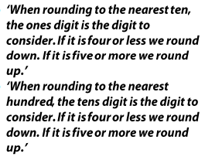


Slide 8

Round to the nearest 10
0
ones
1
one
2
ones
3
ones
4
ones
5
ones
6
ones
7
ones
8
ones
9
ones
Round to the nearest 100
0
tens
1
ten
2
tens
3
tens
4
tens
5
tens
6
tens
7
tens
8
tens
9
tens

Slide 9
Round 130 to the nearest 100
100
100
110
120
130
140
150
160
170
180
190
200
130 is between 100 and 200.
The previous multiple of 100 is 100.
The next multiple of 100 is 200.

Slide 10
Round 130 to the nearest 100
30
70
100
110
120
130
140
150
160
170
180
190
200
130 is closer to 100 than 200
130 rounded to the nearest 100 is 100

Slide 11
Round 138 to the nearest 100
38
62
100
138
200
138 is closer to 100 than 200
138 rounded to the nearest 100 is 100

Slide 12
Round the following numbers to the nearest 100.
170
340
651
904
475

Slide 13
Round the following numbers to the nearest 100.
170 = 200
340 = 300
651 = 700
904 = 900
475 = 500

Slide 14
21/9/21
LO: To round to the nearest 100.
C: To know and use number.

Slide 15

Year 4 | Week 2 | Day 5

Slide 16
Let’s recap!
Round to the nearest 10
0
ones
1
one
2
ones
3
ones
4
ones
5
ones
6
ones
7
ones
8
ones
9
ones
Round to the nearest 100
0
tens
1
ten
2
tens
3
tens
4
tens
5
tens
6
tens
7
tens
8
tens
9
tens

Slide 18
Look back at yesterday’s lesson. Round these numbers to the nearest 100
549
275
354
206

Slide 19
Answers
549 = 500
275 = 300
354 = 400
206 = 200

Slide 20
Task
As neatly as possible, round the following numbers to the nearest 100 by drawing number lines.
725
601
449
879
351
250

Slide 21
Task
As neatly as possible, round the following numbers to the nearest 100 by drawing number lines.
725 = 700
601 = 600
449 = 400
879 = 900
351 = 400
250 = 300

Slide 22
22/9/21
LO: To round to the nearest 100.
C: To know and use number.

Slide 23
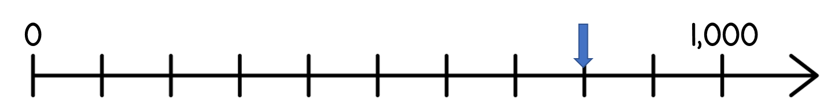
Year 4 | Week 3 | Day 1

Slide 24
Let’s recap!
Round to the nearest 10
0
ones
1
one
2
ones
3
ones
4
ones
5
ones
6
ones
7
ones
8
ones
9
ones
Round to the nearest 100
0
tens
1
ten
2
tens
3
tens
4
tens
5
tens
6
tens
7
tens
8
tens
9
tens

Slide 25
Round the following numbers to the nearest 100.
3170
7340
6519
9204
4725

Slide 26
Round the following numbers to the nearest 100.
3170 = 3200
7340 = 7300
6519 = 6500
9204 = 9200
4725 = 4700

Slide 27
23/9/21
LO: To round to the nearest 100.
C: To know and use number.

Slide 28
Year 4 | Week 3 | Day 2

Slide 29
Look again at the past lessons and complete today’s task

Slide 30
Task
In your books, as neatly as possible, round the following numbers to the nearest 100.
1725
6201
4749
8579
3501
2650

Slide 31
Task
In your books, as neatly as possible, round the following numbers to the nearest 100.
1725 = 1700
6201 = 6200
4749 = 4700
8579 = 8600
3501 = 3500
2650 = 2700

Slide 32
24/9/21
LO: To round to the nearest 100.
C: To know and use number.

Slide 33
Year 4 | Week 3 | Day 3

Slide 34

Dora is thinking of a number.
It rounds to 400 to the nearest 100
It rounds to 450 to the nearest 10
What could Dora’s number be?
445
446
447
448
449
450
451
452
453
454

Slide 35
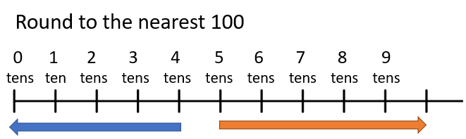
Round these numbers to the nearest 100
44
99
972

Slide 36
Answers
44 = 0
99 = 100
972 = 1000

Slide 37
Now, let’s round these numbers to the nearest 100
then the nearest 10.
462
827

Slide 38
Now, let’s round these numbers to the nearest 100
then the nearest 10.
462 = 460 to the nearest 10 and 500 to the nearest 100.
827 = 830 to the nearest 10 and 800 to the nearest 100.

Slide 39
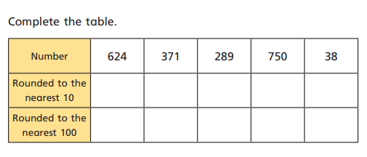
Task
Draw out and complete the table. Make sure you draw out the number lines for each one.
RP: A number with 5 ones will always round up to the next 100.
Always, sometimes never?

