Slide 1
Monday 20th September 2021
LO: To use imaginative description
C: Robin Hood

Slide 2

Starter: Adjectives
What is an adjective?
Why do we use adjectives?

Slide 3
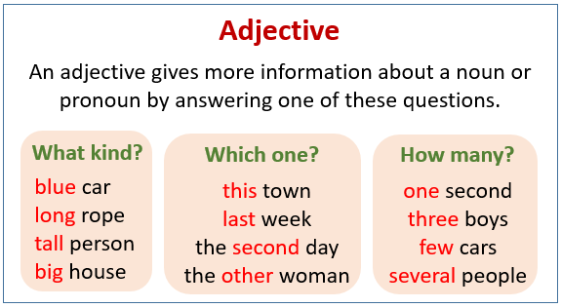
Starter: Adjectives

Slide 4
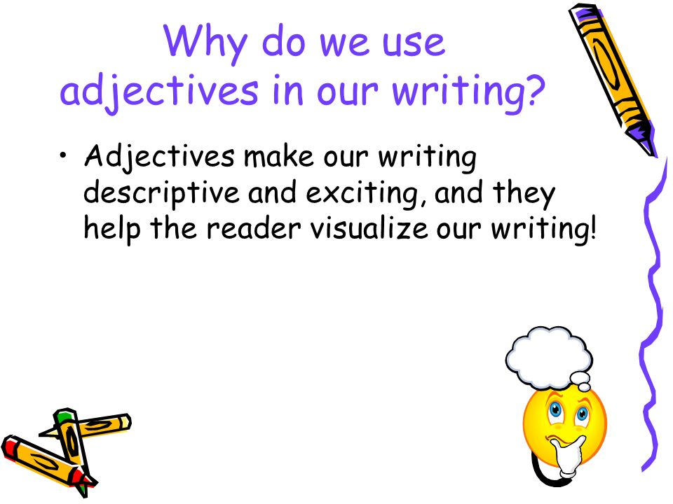
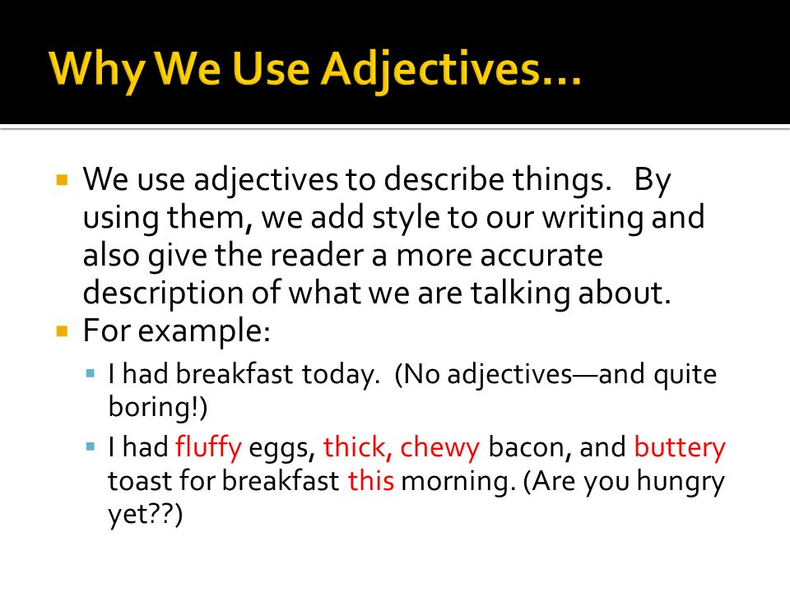

Slide 5

Starter: Spot the Adjectives
Fred has a red hat and blue shoes.
Lilly's scarf was blue.
Mrs Snagglenose picked up the broken box, the damp coat and the dusty cloak.
Gavin stared at the watery painting and gave a deep chuckle.

Slide 6
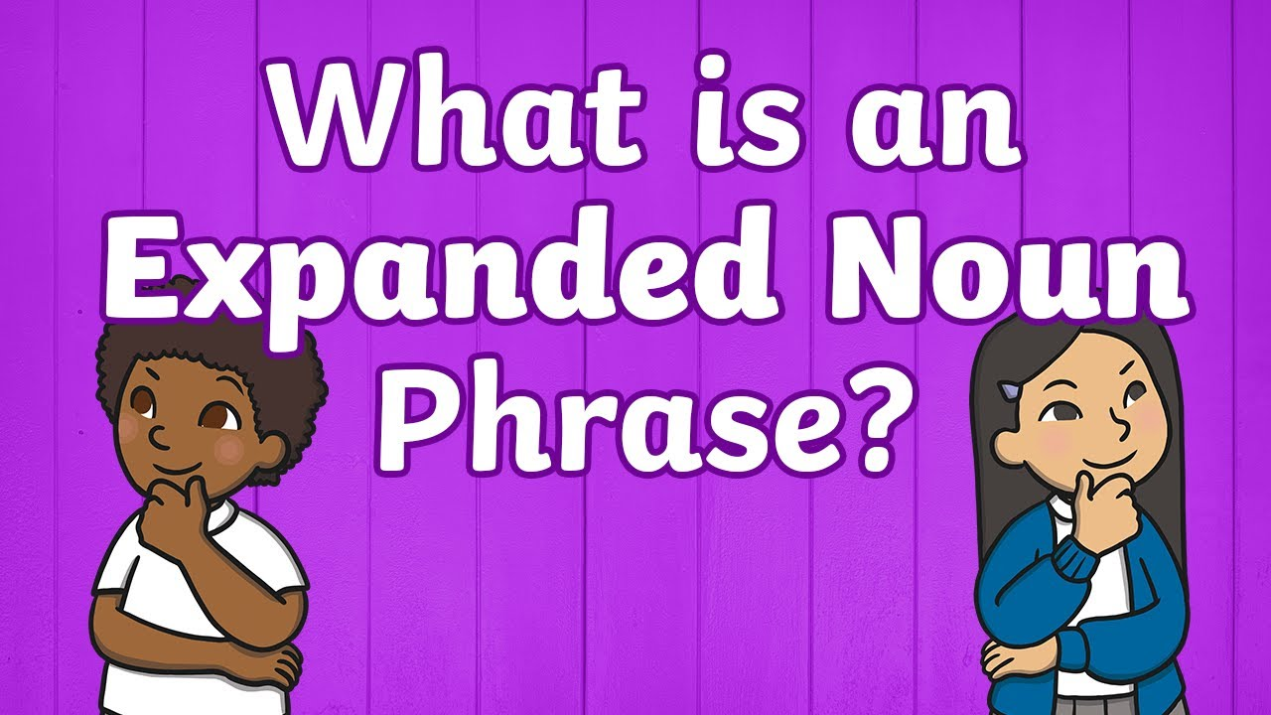
What is an expanded noun phrase?

Slide 7
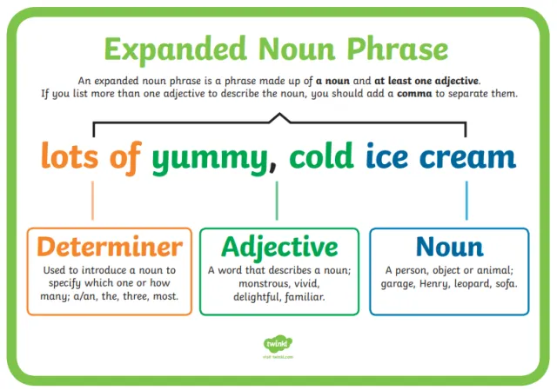
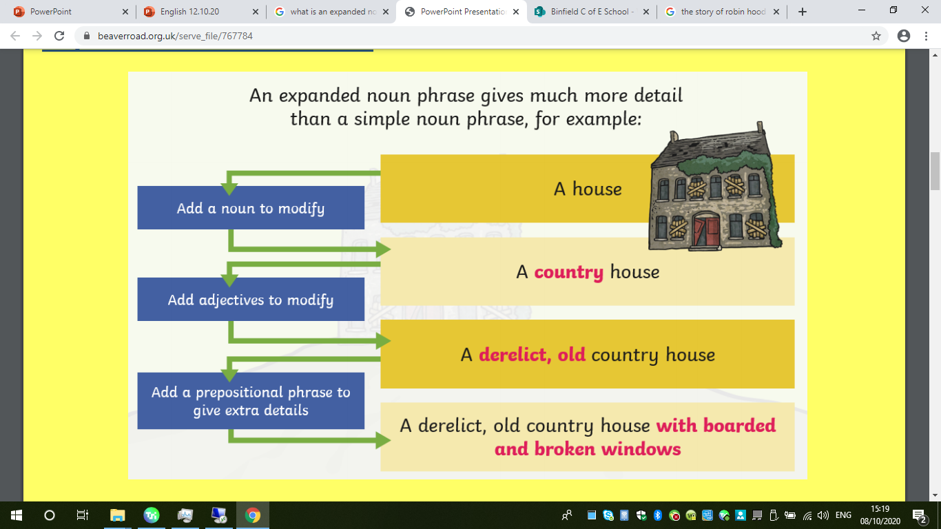

Slide 8
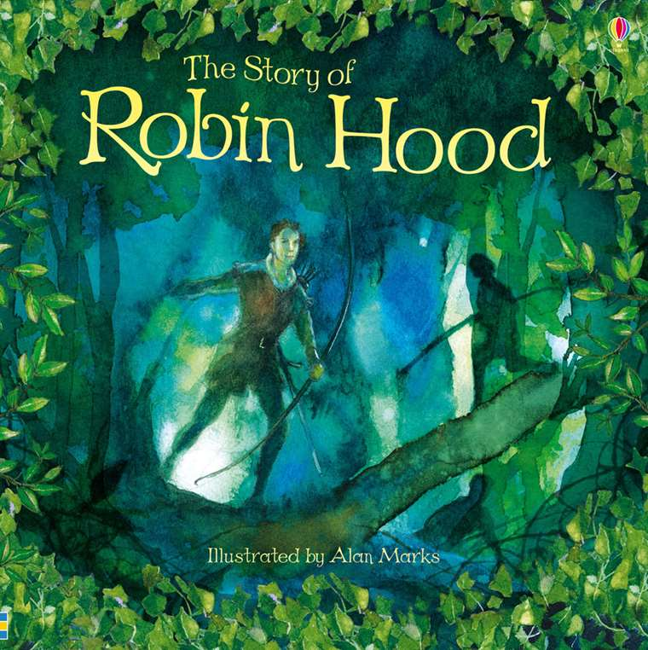
Has anyone heard the story of Robin Hood?
https://www.youtube.com/watch?v=F2bi3rDPYjM

Slide 9
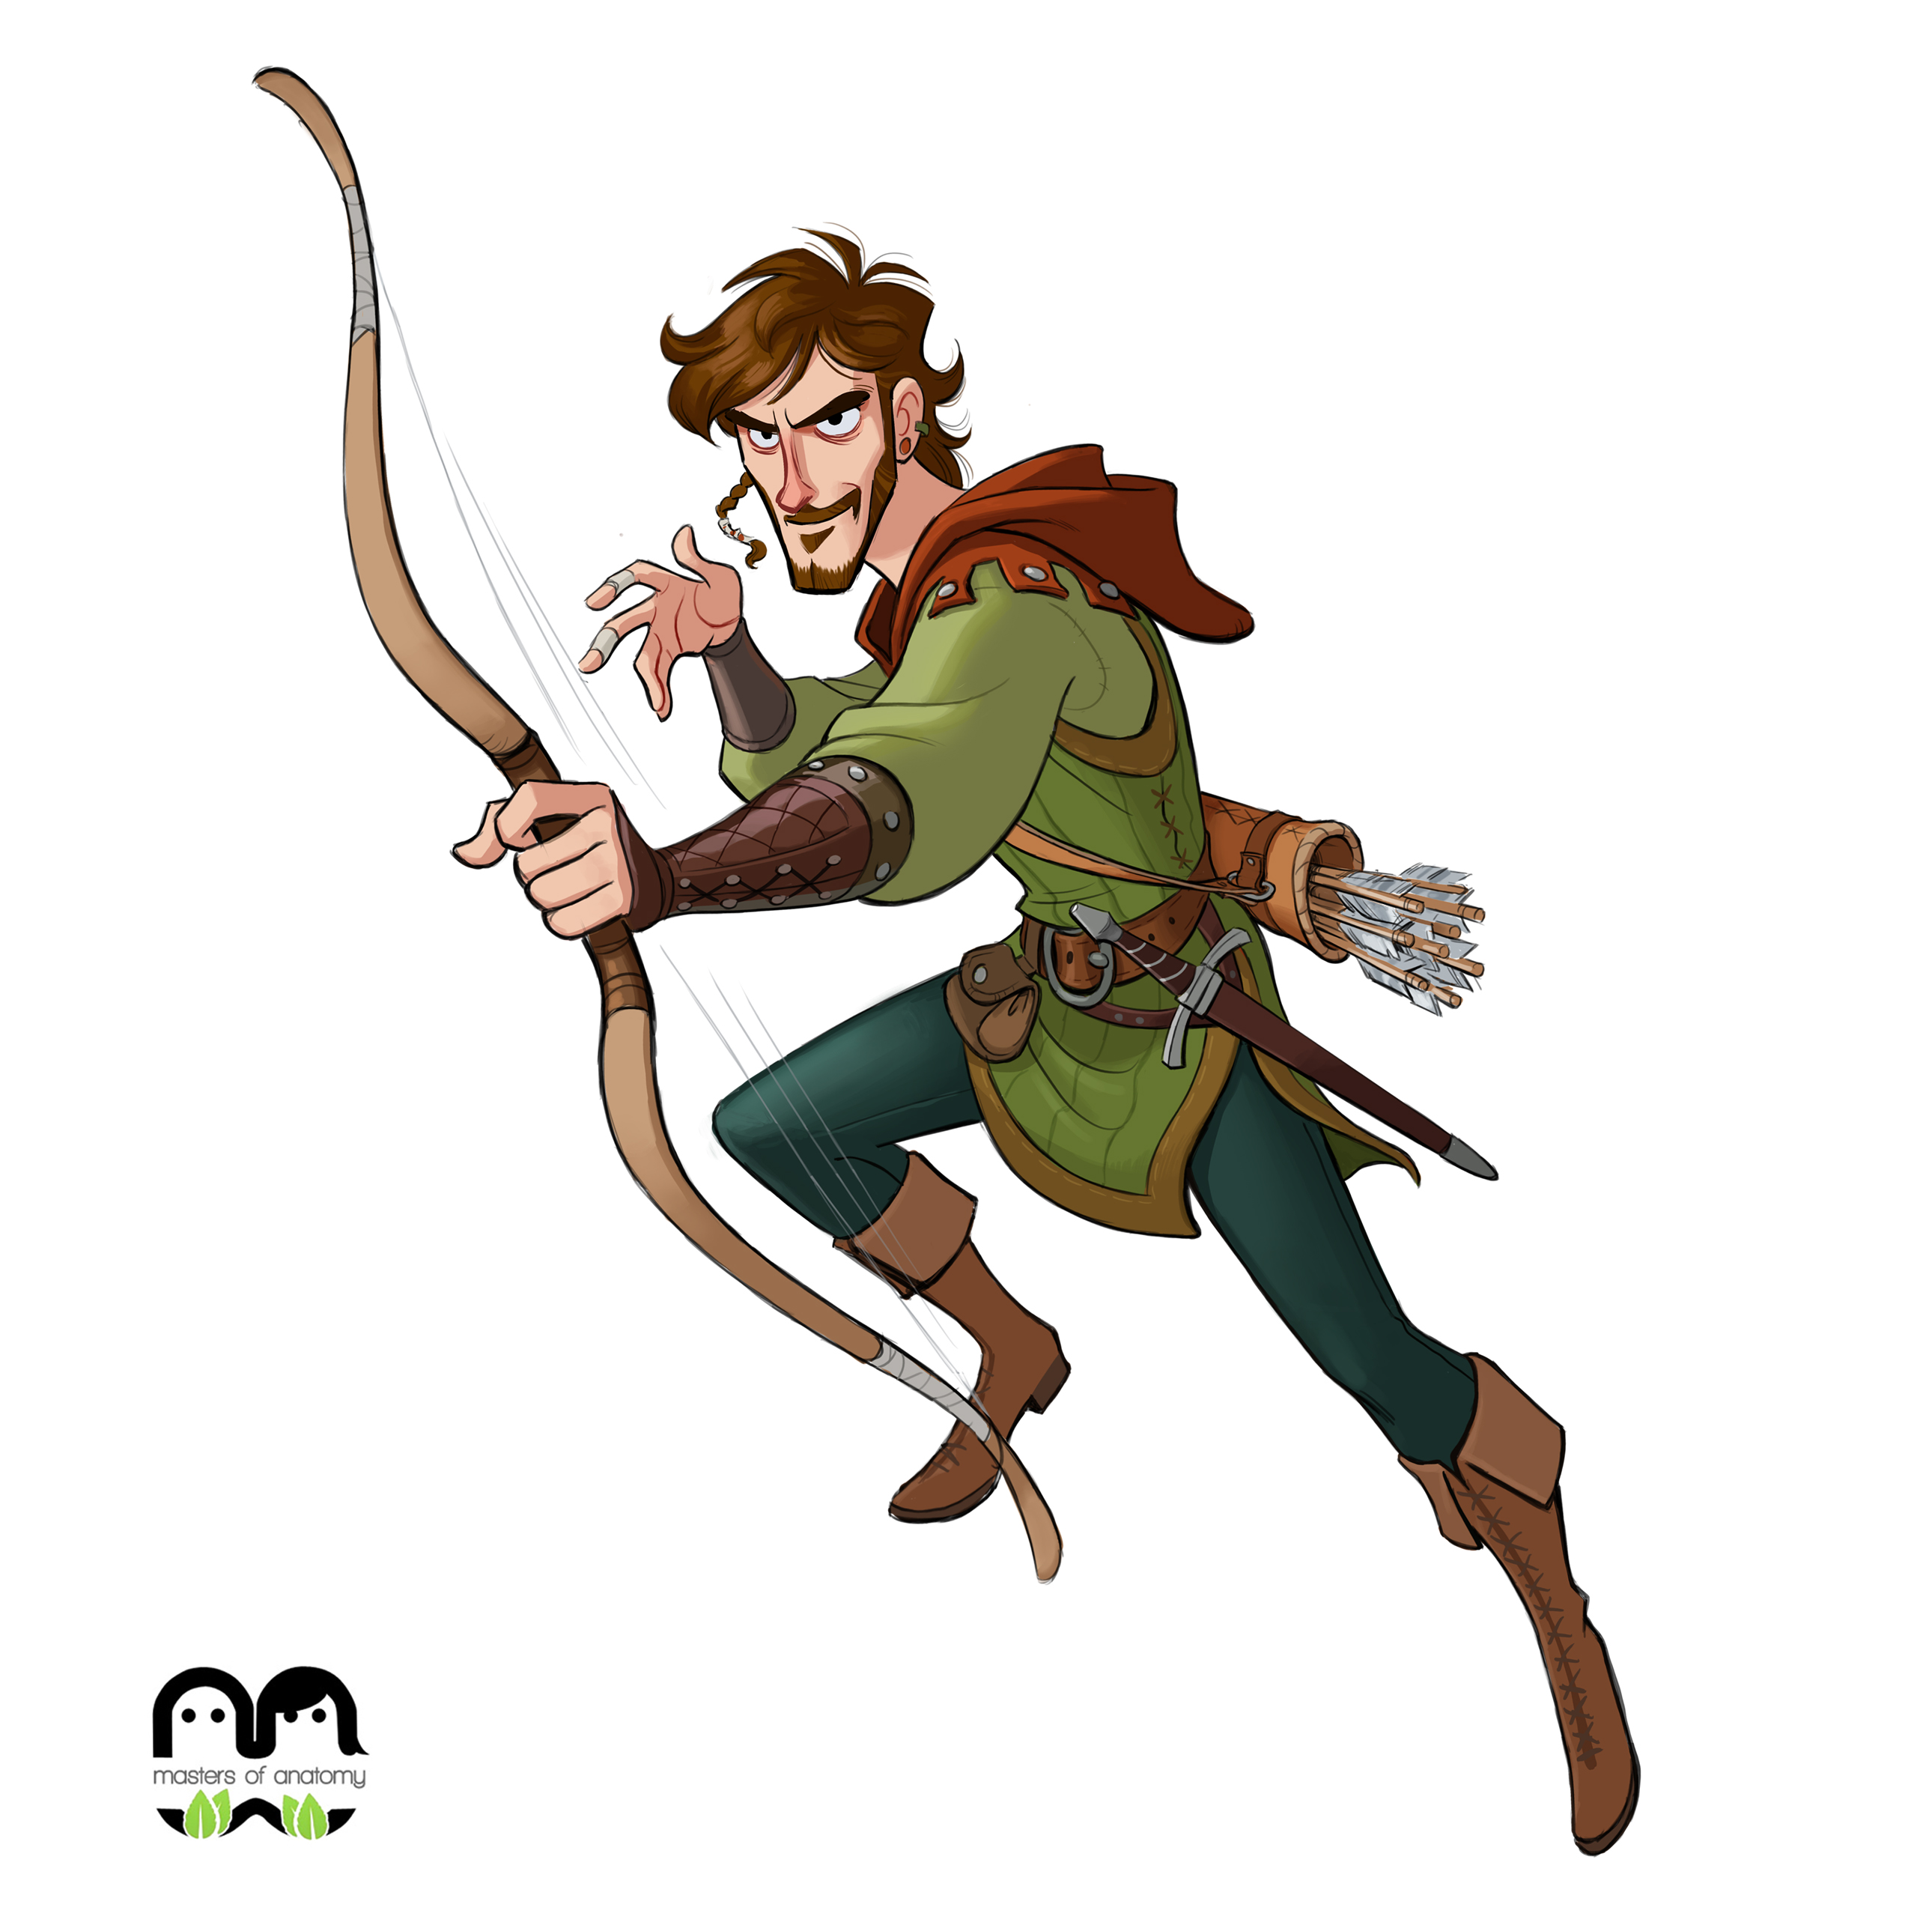
How could we describe Robin Hood?
What expanded noun phrases could we use?

Slide 10
Activity:
Stick in the picture of Robin Hood.
Write as many expanded noun phrases as you can think of around the picture.
Challenge: Try to improve your adjectives using a thesaurus.

Slide 11
Tuesday 21st September 2021
LO: To use sentences appropriately
C: Robin Hood

Slide 12
Starter: Spot the Sentence
I like to apple.
the dog is barking loudly.
The old ate all the doughnuts.
Fish like in water.
The tractor was painted bright red

Slide 13

What is a sentence?

Slide 14
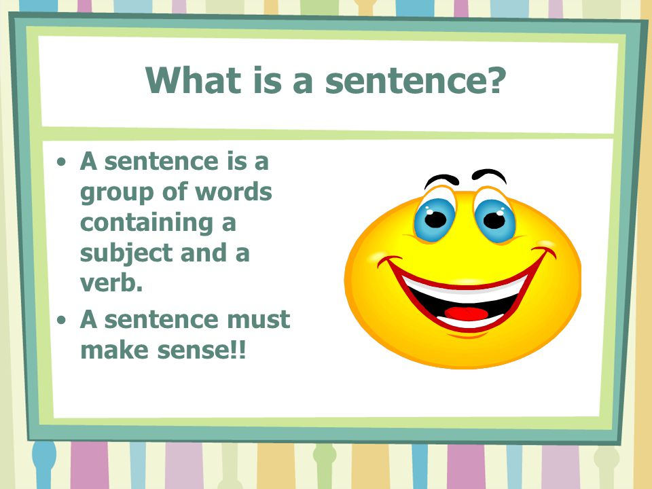
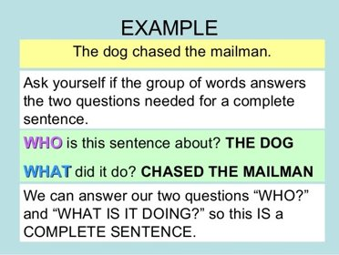

Slide 15
Look at your expanded noun phrases from last lesson.
We are going to turn our expanded noun phrases into sentences!
Let's do some together.

Slide 16
Activity:
Using your expanded noun phrases from last lesson, write sentences which describe Robin Hood.
Remember to punctuate your sentences correctly with capital letters and full stops.
Check your sentences make sense.
Challenge: Can you use an exclamation mark or a question mark?
Remember, exclamation marks start with 'how' or 'what.'
Why does Robin have a pointed, deadly bow?
How bright his long, green trousers are!

Slide 17
Wednesday 22th September 2021
Lo: To use sentences appropriately
C: Robin Hood

Slide 18
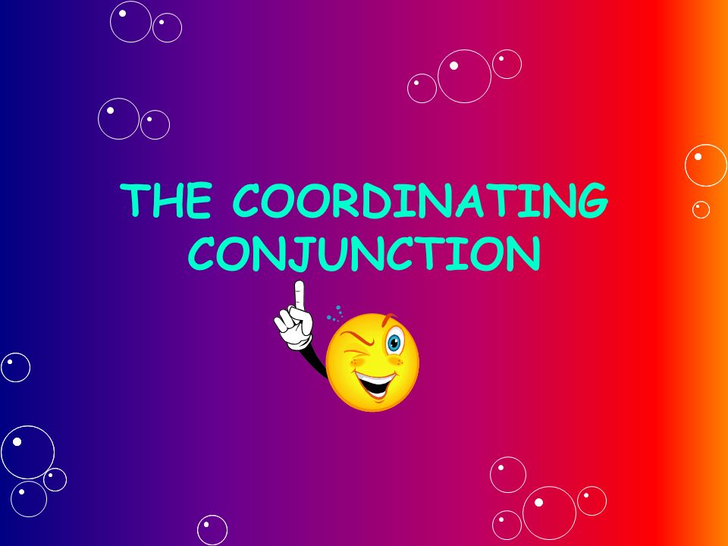
Co-ordinating Conjunctions
What is a co-ordinating conjunction?

Slide 19
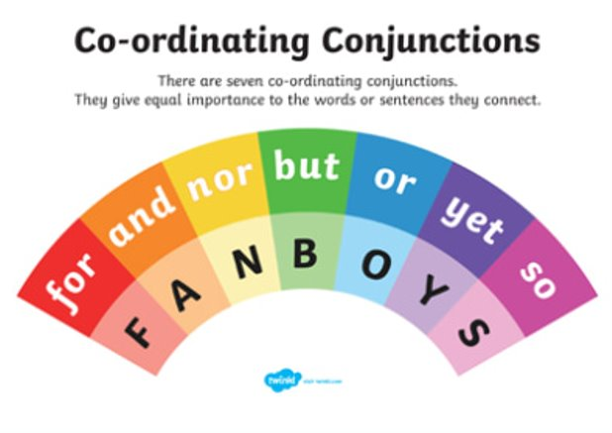
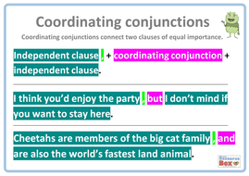

Slide 20
How many conjunctions should be in a sentence?

Slide 21
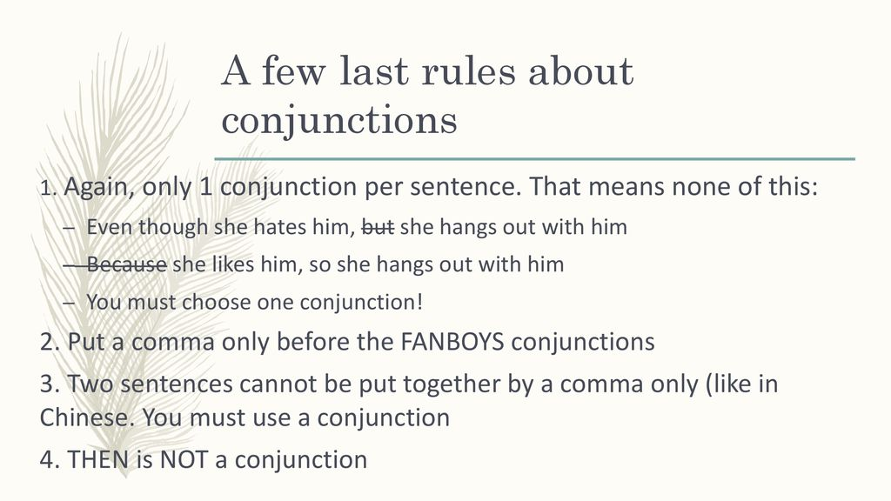

Slide 22
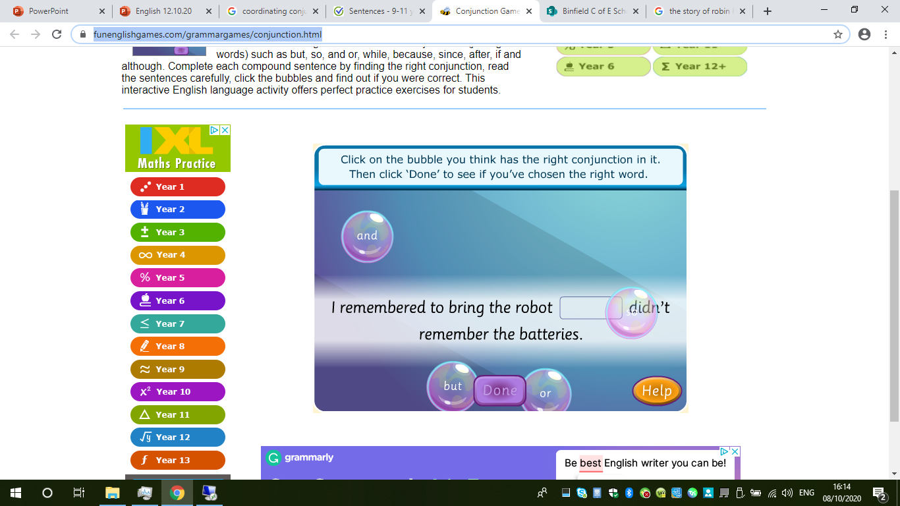
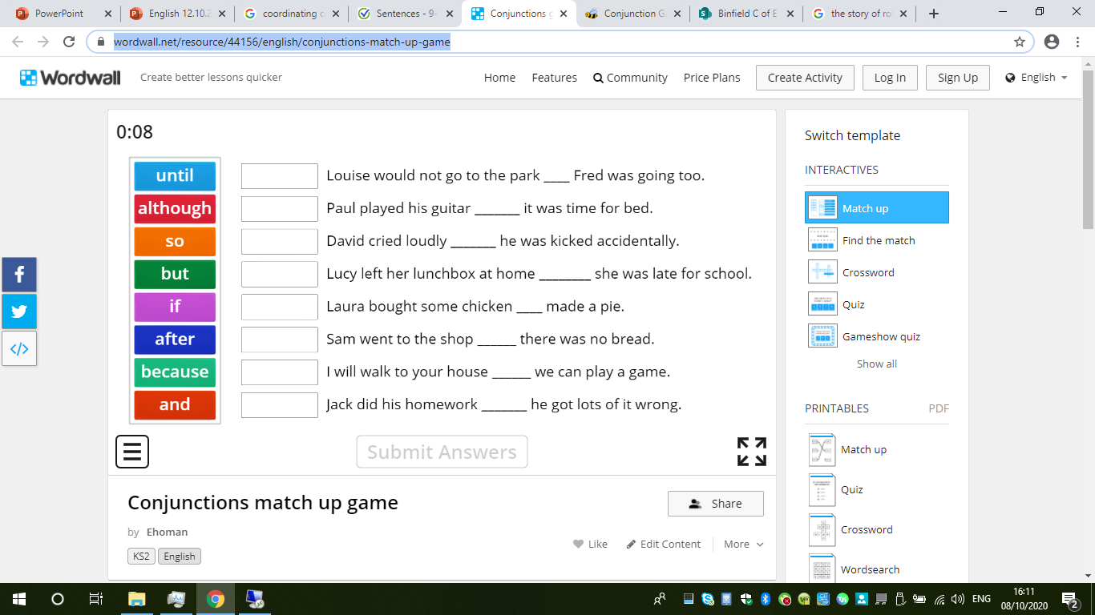
Co-ordinating Conjunctions Game
https://wordwall.net/resource/44156/english/conjunctions-match-up-game
https://www.funenglishgames.com/grammargames/conjunction.html

Slide 23
Look at your sentences from last lesson.
We are going to expand our sentences using coordinating conjunctions!
Let's do some together.

Slide 24
Activity:
Extend your simple sentences from last lesson using co-ordinating conjunctions.
Remember to punctuate your sentences correctly with capital letters and full stops.
Check your sentences make sense.
Challenge: Can you write a sentence for each of the FANBOYS conjunctions?

Slide 25
Thursday 23 September 2021
Lo: To use sentences appropriately
C: Robin Hood

Slide 26
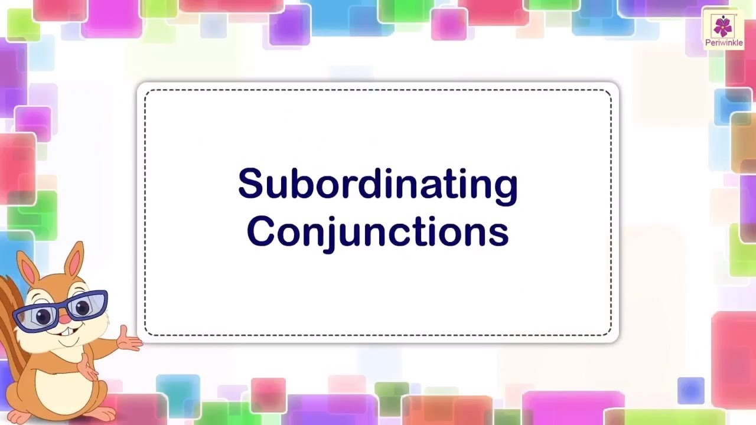
Subordinating Conjunctions
What is a subordinating conjunction?

Slide 27
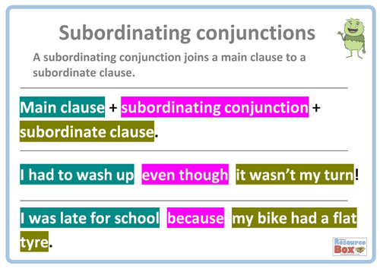
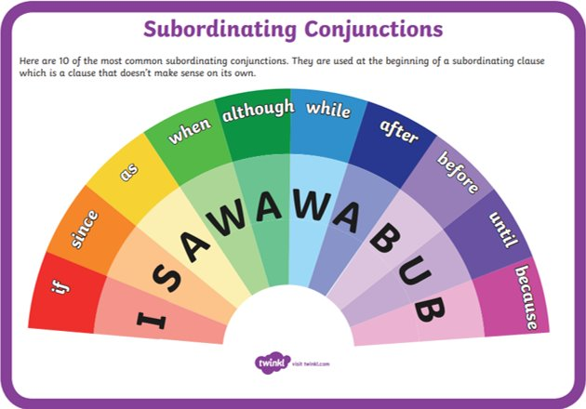

Slide 28
How many conjunctions should be in a sentence?

Slide 29
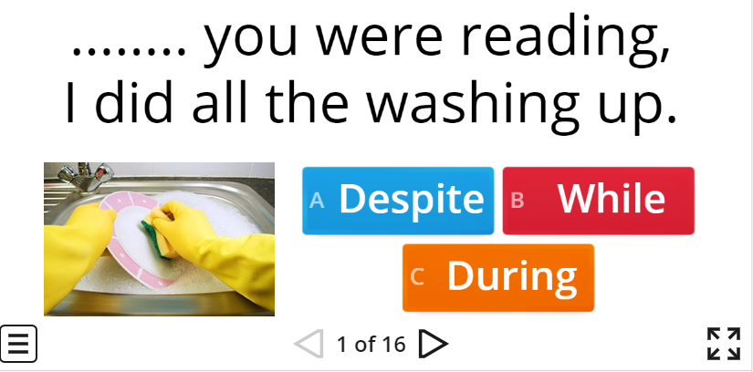
Subordinating Conjunctions Game
https://wordwall.net/resource/516002/conjunctions-level-1-2

Slide 30
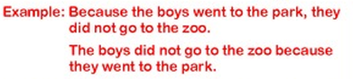
Look at your sentences from Tuesday's lesson.
We are going to expand these sentences using subordinating conjunctions!
Let's do some together.
Challenge: Can you start your sentence with a subordinating conjunction?

Slide 31
Activity:
Extend your simple sentences from Tuesday's lesson using subordinating conjunctions.
Remember to punctuate your sentences correctly with capital letters and full stops.
Check your sentences make sense.
Challenge: Can you start your sentence with a subordinating conjunction?
Write it out with the subordinating conjunction in the middle of the sentence and then write it out again with the conjunction at the beginning of the sentence!

