Slide 1

Thursday 2 December 2021
LO: To understand that everybody’s family is different and important to them
To appreciate my family/the people who care for me

Slide 2
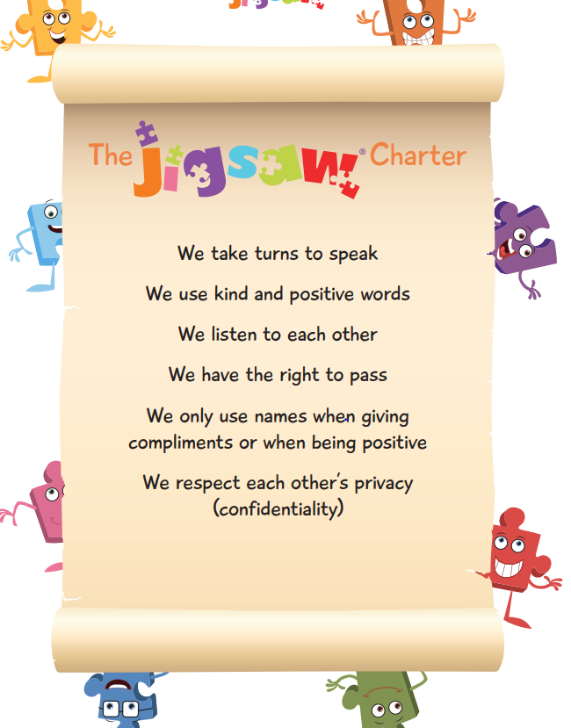

Slide 3
TSP: In pairs, identify one way your families are the same and one way they are different.
We will pass Jigsaw Jazz around. When he reaches you, say the sentences aloud: ‘one way our families are the same is…’ ‘one way our families are different is…’
Differences are something to celebrate!

Slide 4
Next, we are going to look at a few pictures.
TSP: I would like you to think about which pictures show a family and explain why you think this is so.
TSP: Which pictures show people who are married? Why do you think this is so?

Slide 5
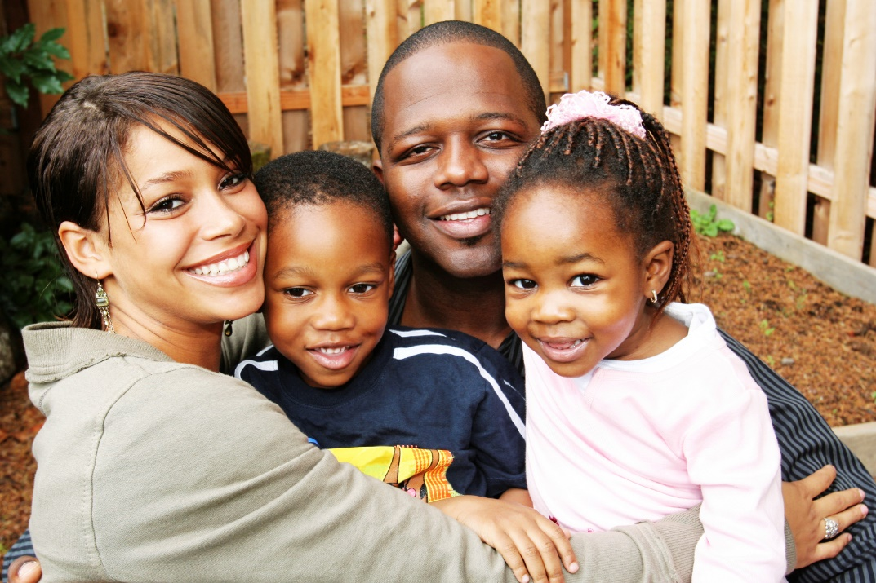
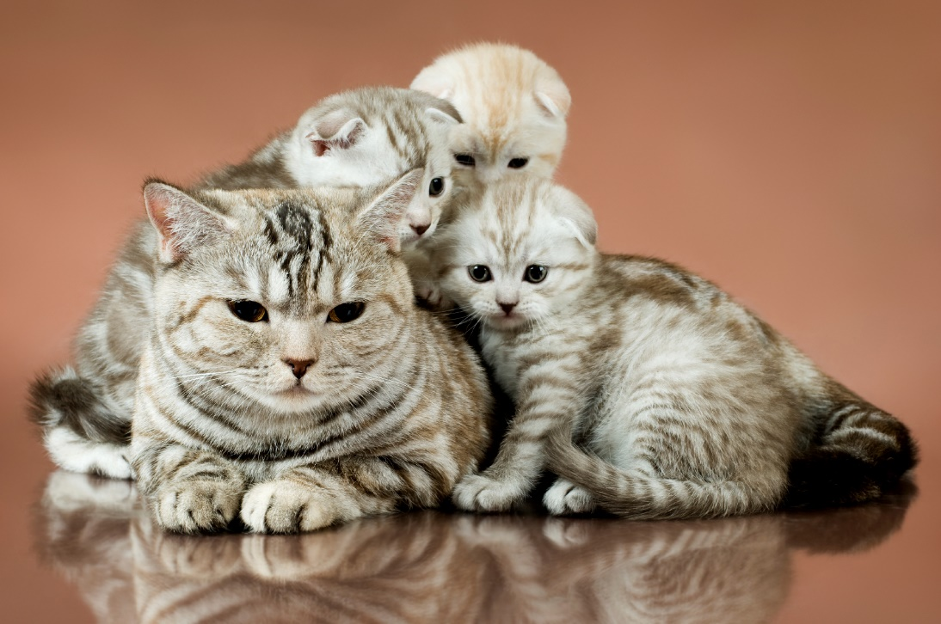
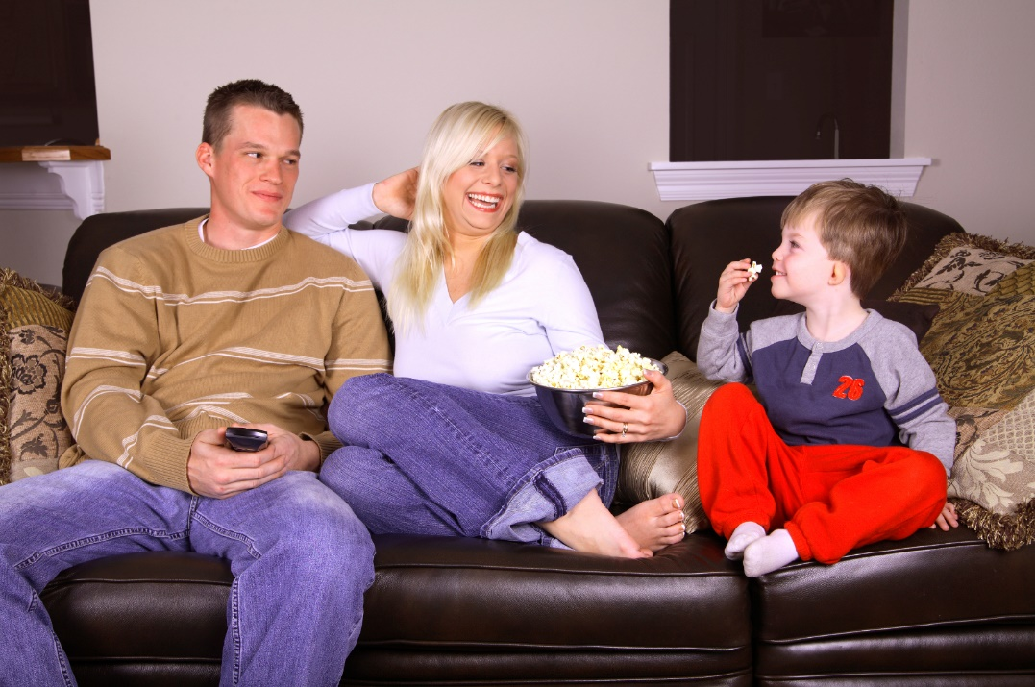
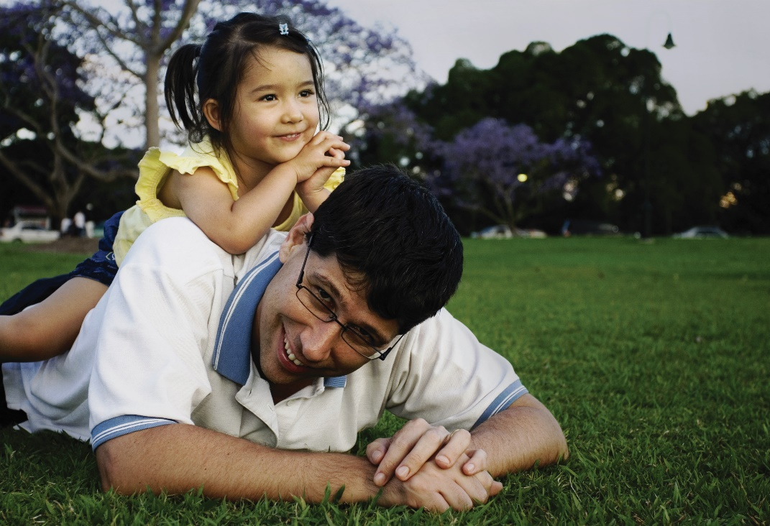

Slide 6
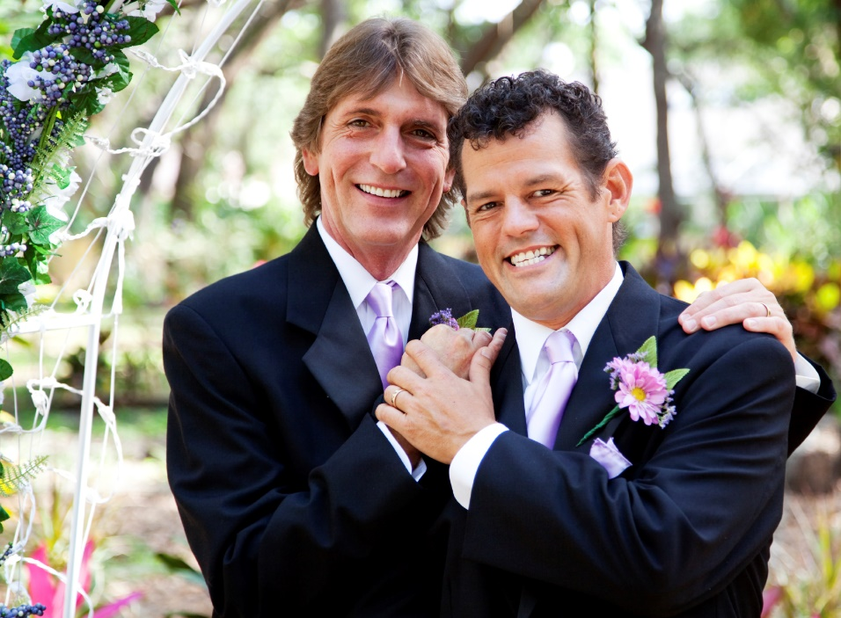
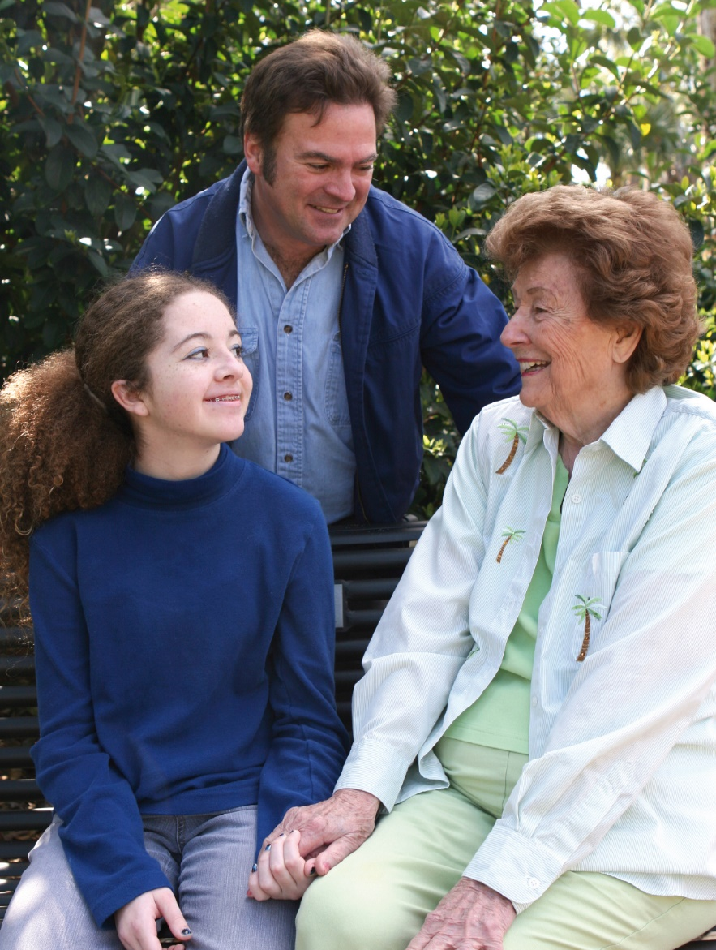
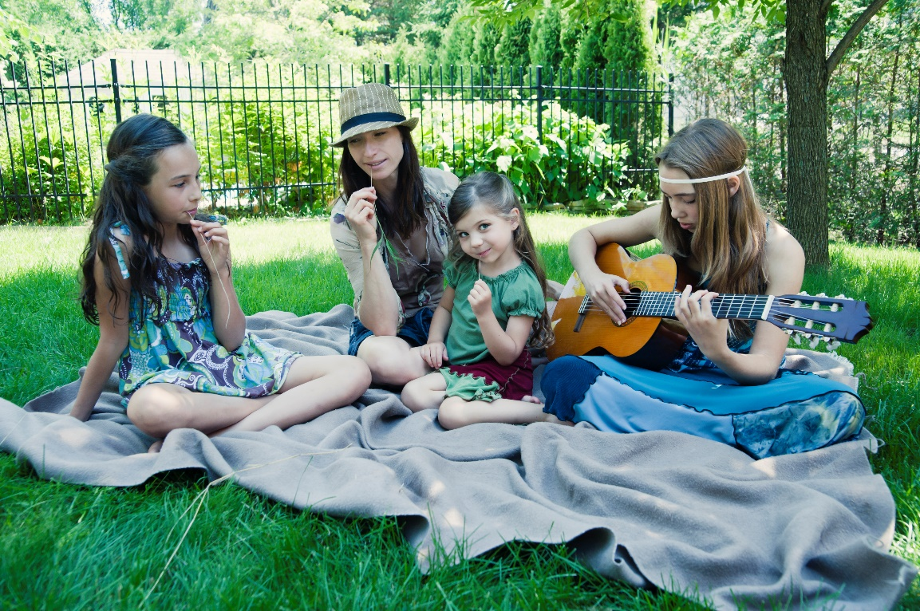

Slide 7
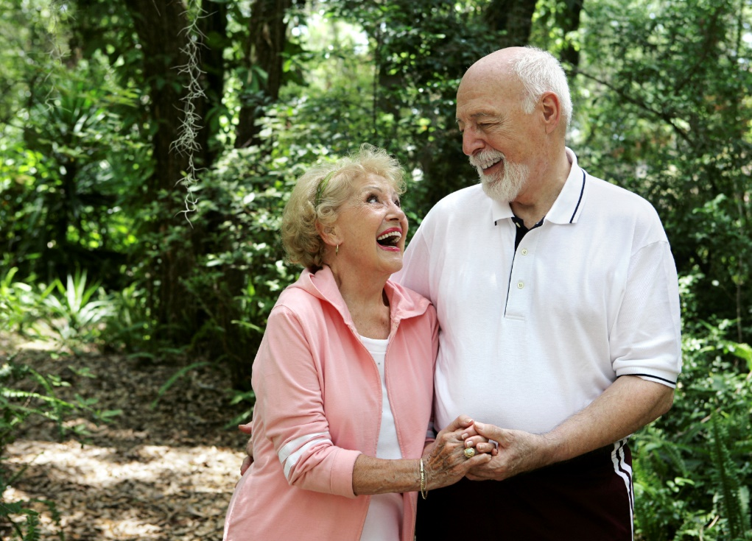
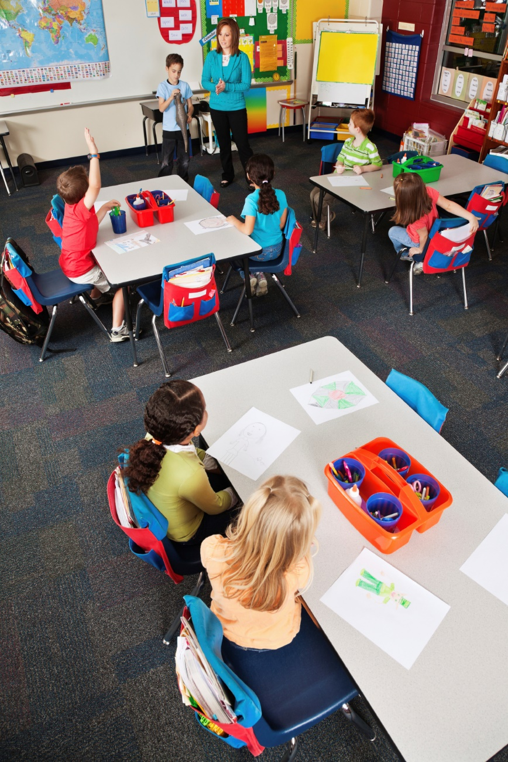
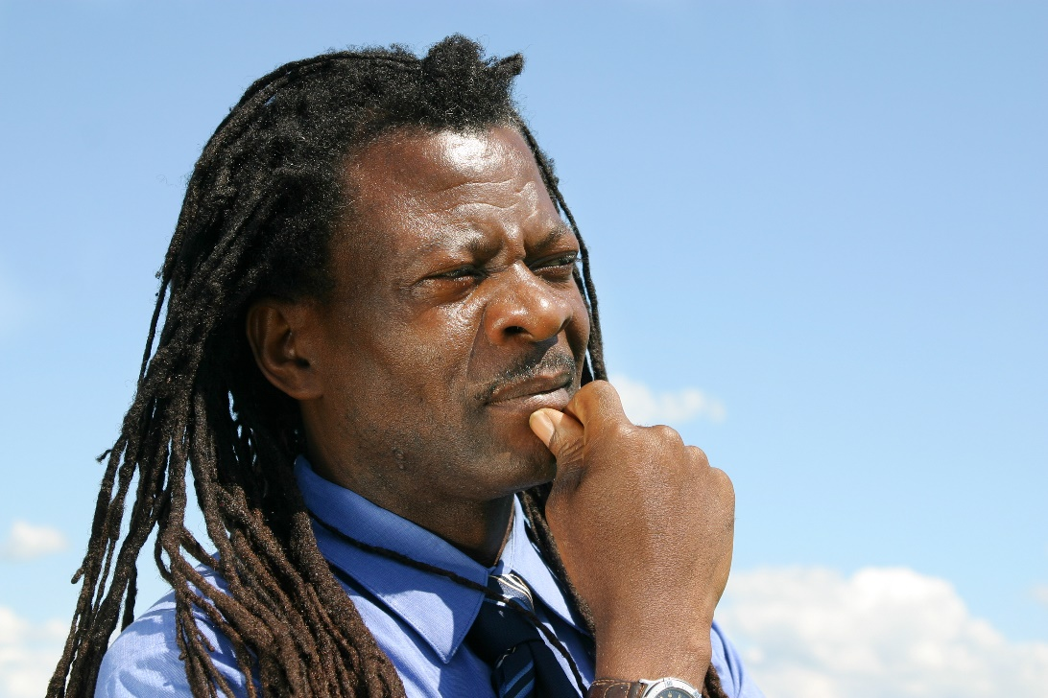

Slide 8
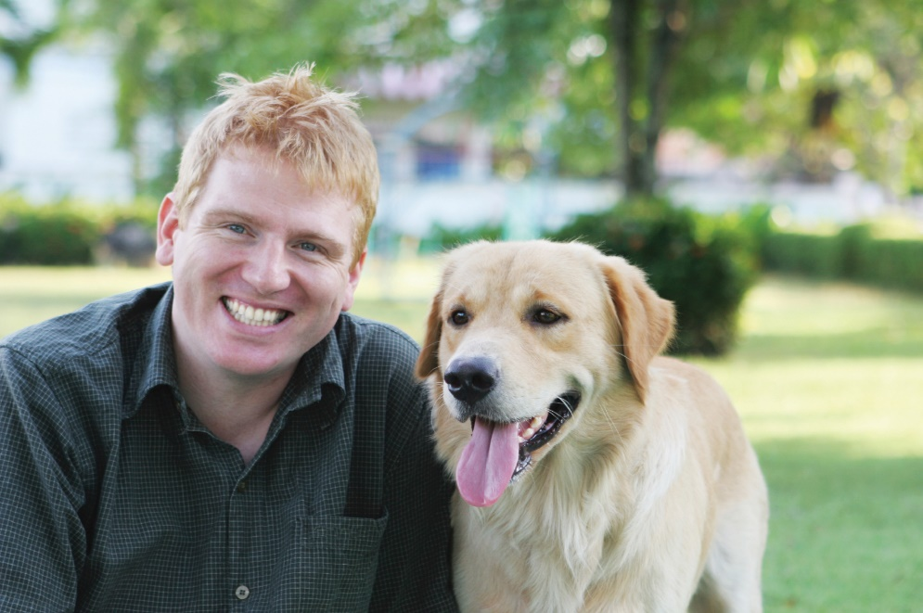
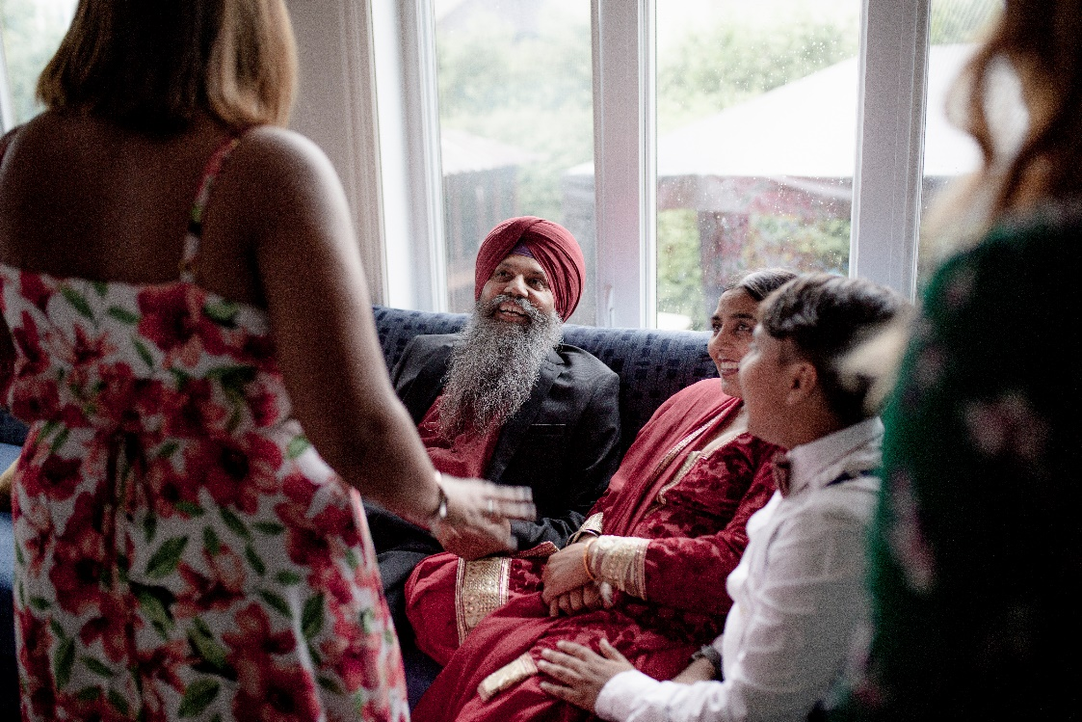

Slide 9
Any two adults can choose to get married.
Marriage is a legally recognised commitment which means two people make special promises to each other to love each other for their whole lives.
This can be two women, two men or a man and a woman.
Sometimes they don’t manage to keep their promises due to unforeseen circumstances, but when they get married they intend to.

Slide 10
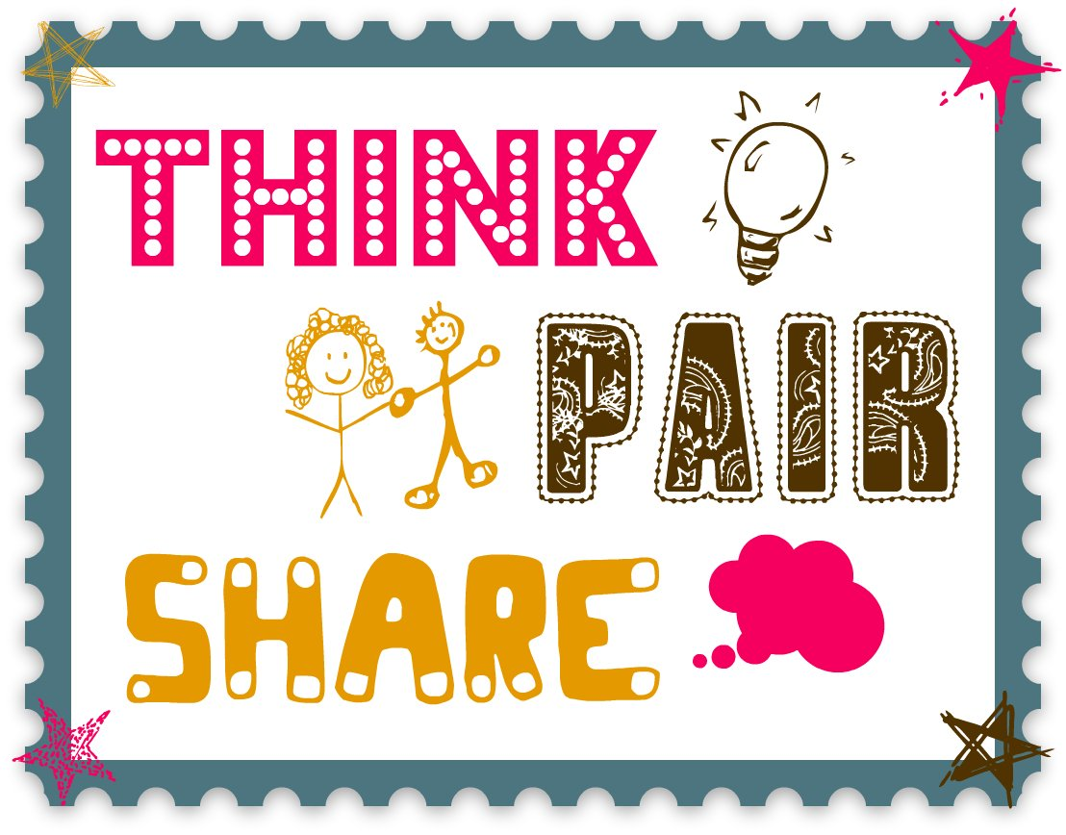
TSP: Are there families that are not represented by the pictures?

Slide 11
Families who have members that live in different countries
Families who have adopted or fostered children (could we tell this just from looking at a picture?)
Military families
Families who have help, for example baby-sitters or nannies (are these people part of the family?)

Slide 12
In groups, work together to come up with a definition for the stem sentence
A family is…
We will share our ideas and create a class bubble map

Slide 13
Activity
Draw a picture of your own family. Around the edge of the picture, write some words that explain what your family means to you.

