Slide 1
Wednesday 1st December 2021
LO: *to understand how beliefs are conveyed
*to reflect
C: Christianity

Slide 2
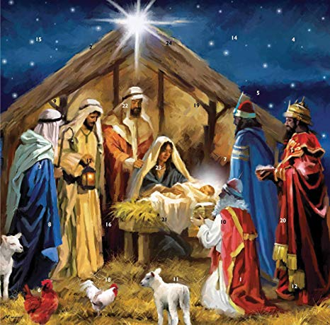
What have you learned about religious symbols at Christmas?
What different ways can they be presented?
In words/stories, in artwork, in songs

Slide 3
You are going to design your own piece of artwork which symbolises what Christmas means to Christians.
It doesn’t have to be a drawing! It could be a stained class window for a church, or a Christmas decoration – you can be creative!

Slide 4
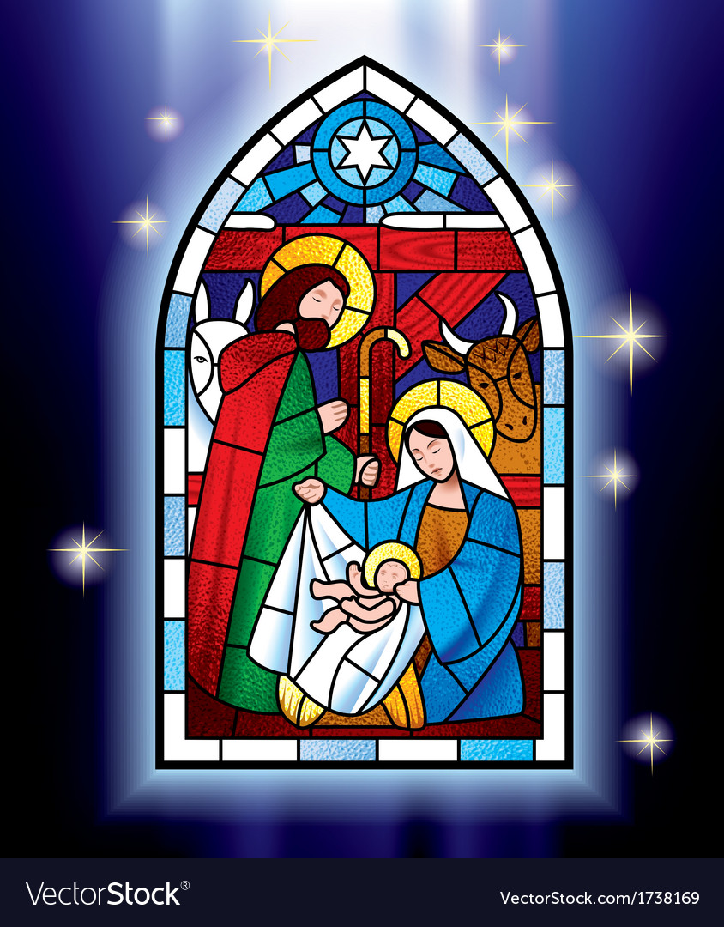
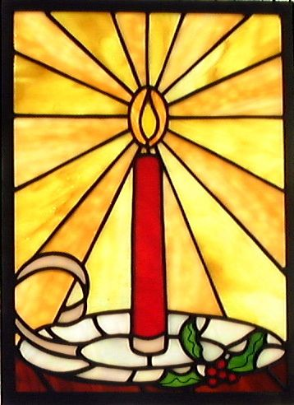
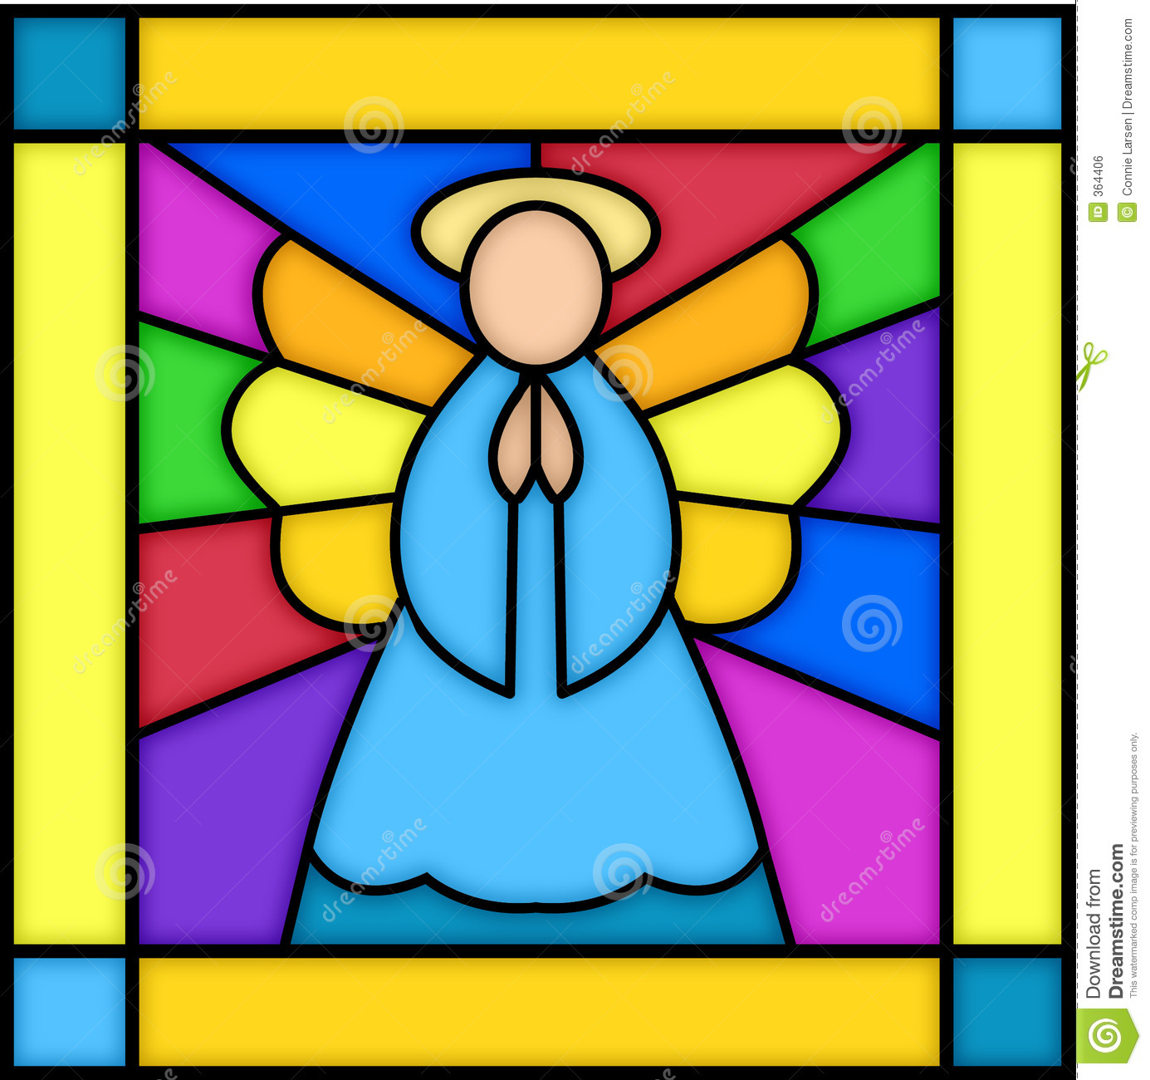
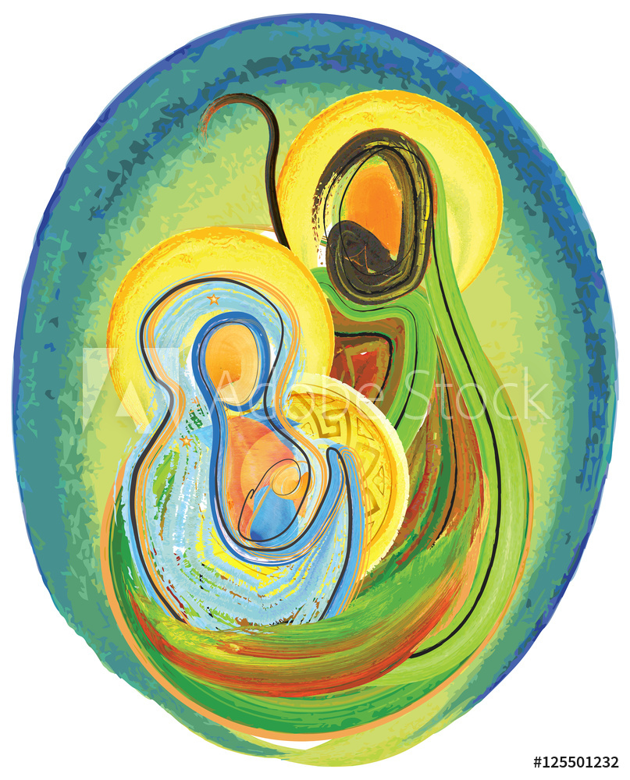
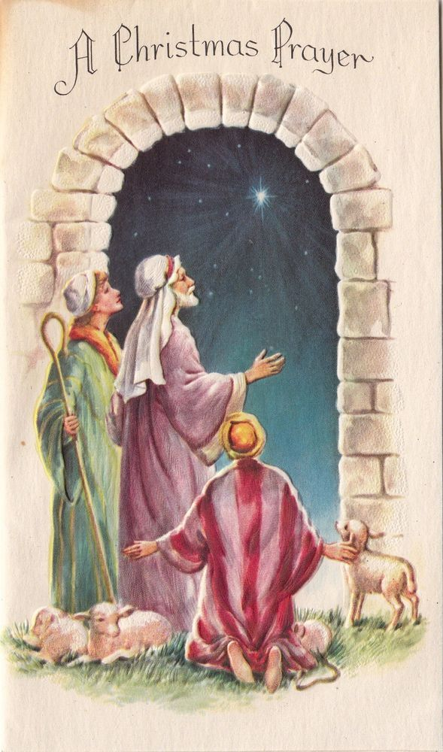
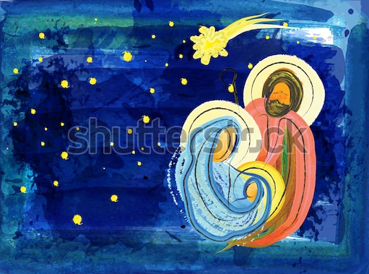
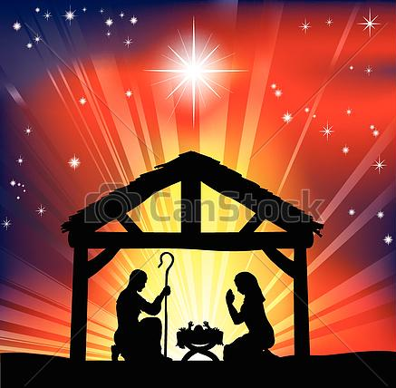
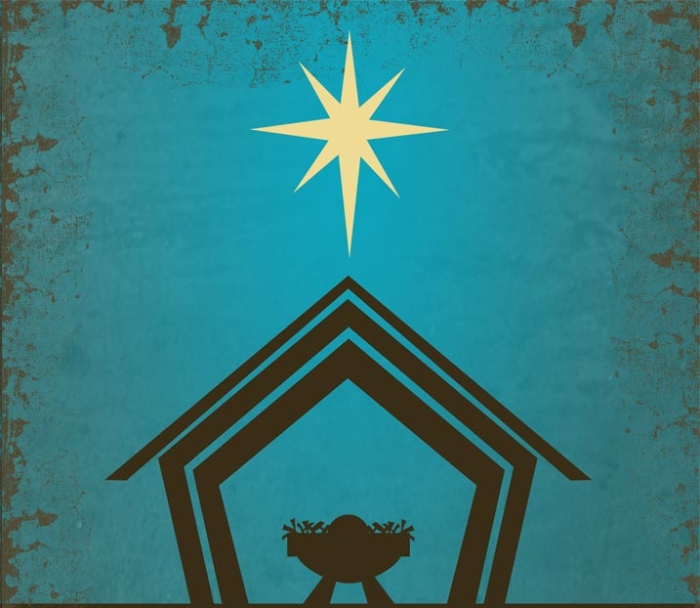

Slide 5
What artwork are you going to create?
What religious symbols are you going to include? How?
How will your artwork show the meaning of Christmas?

Slide 6

Paddling | Snorkelling | Diving
Create your own piece of artwork on a piece of paper/card which symbolises what Christmas means to Christians. Label the symbols you have used. Red Pen: Why have you chosen to include these symbols in your artwork? | Create your own piece of artwork on a piece of paper/card which symbolises what Christmas means to Christians. Explain the symbols you have used and why they are important. Red Pen: do you think it is important for people to be able to express their ideas and beliefs in different ways? Why? | Create your own piece of artwork on a piece of paper/card which symbolises what Christmas means to Christians. Explain the symbols you have used and why they are important. Red Pen: do you think it is important for people to be able to express their ideas and beliefs in a wide variety of ways? Why?

