Slide 1


27.1.2021
L.O: Multiplication and Division
C: 3 Times Table.

Slide 3



1) How many cookies?
2) How many pencils?
3) Here is an array.
How many groups of 3 are there?

Slide 4
1) How many cookies?
2) How many pencils?
3) Here is an array.
How many groups of 3 are there
9
18
4

Slide 6






What do you see?
3
3
There are ____ equal groups of ____
$+ + =$
3
3
3
9
$× =$
3
3
9

Slide 7



What do you see?
5
3
There are ____ equal groups of ____
3
3
15
$+ + + + =$
3
3
3
$× =$
5
3
15
$× =$
3
5
15

Slide 8


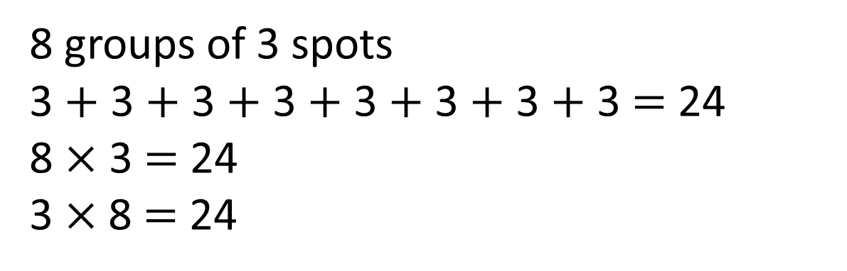
What do you see?
Have a think
8 groups of 3 spots
3 $+$ 3 $+$ 3 $+$ 3 $+$ 3 $+$ 3 $+$ 3 $+$ 3 $=$ 24
8 $×$ 3 $=$ 24
3 $×$8 $=$ 24

Slide 9


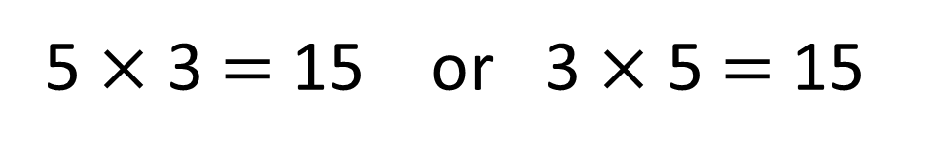
Draw a picture to represent each number story.
5 $×$ 3 $=$ 15 or 3 $×$ 5 $=$ 15
Have a think
Amir has 3 pots of pencils. There are 5 pencils in each pot.
Amir has 5 pots of pencils. There are 3 pencils in each pot.

Slide 10

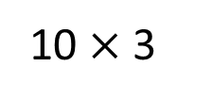

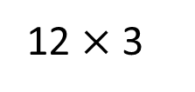
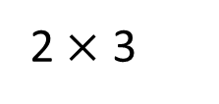
12 $×$ 3 $=$ 10 $×$ 3 $+$ 2 $×$ 3
Is Jack correct?
12 $×$ 3
10 $×$ 3
2 $×$ 3
Have a think

