Slide 1
LO: To build an overview of world history.
LO: To understand what life was like in Britain in Celt and Roman times.
C: The Roman invasion of Britain.

Slide 2
Enquiry Question:
What did the Romans do for me?

Slide 3
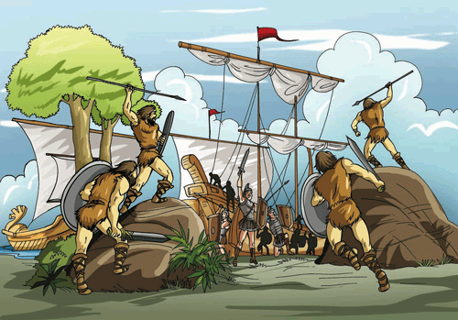
Why Did the Romans Invade Britain?

Slide 4
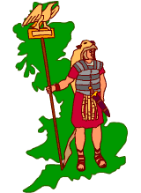
1. Britain had lots of goods which the Romans wanted
Lead
Wood
Tin
Wool
Slaves
Gold
Silver
Corn

Slide 5
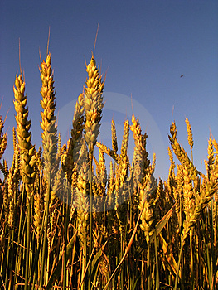
Corn
As the Roman Empire grew bigger, there were more and more people to feed.
More Romans started living in towns, leaving fewer people in the country to grow crops... Rome needed to import more food and Britain was a very fertile land...

Slide 6
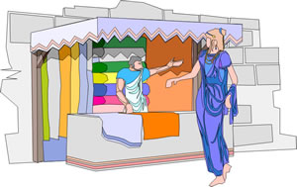
Raw Materials: Wool
Britain had a good supply of sheep and wool was needed for making Roman togas.

Slide 7
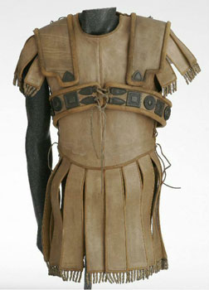
Raw Materials: Leather
The Roman army used a lot of leather in uniforms and for soldiers’ tents.
Leather was also used to make buckets.

Slide 8
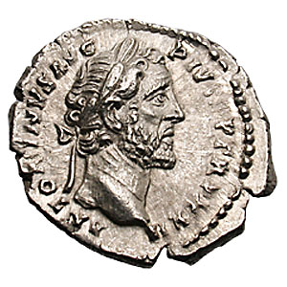
Valuable Metals: Silver
The Romans made their money out of silver – more coins were needed as the Empire grew.
Britain already had silver mines that the Romans knew about.
Silver was a luxury item for rich Romans – so there was a big demand for it.

Slide 9
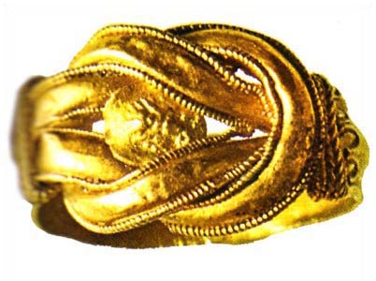
Gold
Gold was used for jewellery and was in great demand by the Romans.
Gold was very important in trade as a means of exchange but also for making gold coins.
There was a scarcity of gold across the Empire, but Britain had some...

Slide 10
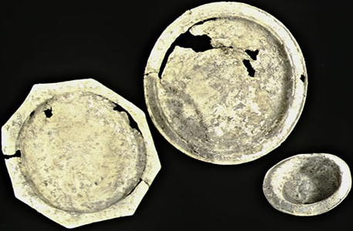
Tin
Britain also had tin mines. Tin and pewter were used for cups and plates.
Tin could be mixed with other metals to make strong, hard metals.

Slide 11
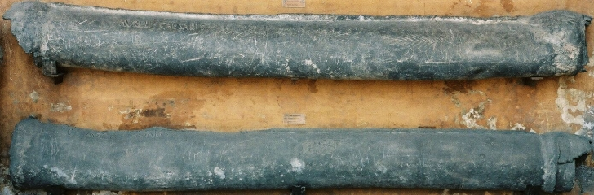
The Romans used a lot of lead!
Lead was really useful for the Romans and Britain had a good supply of it.
Lead was used to make water pipes and plumbing systems
Lead was also used to make coffins!

Slide 12
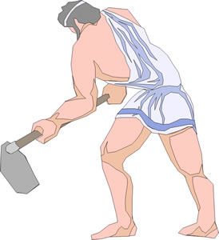
Slaves
Romans planned to use captured Britons as slaves.
Roman society ran on the basis of slave labour and there was big demand for slaves right across the empire.
Slaves were used to work in every type of industry, from nurse maids, to field hands, miners and as galley slaves to row Roman ships.

Slide 13
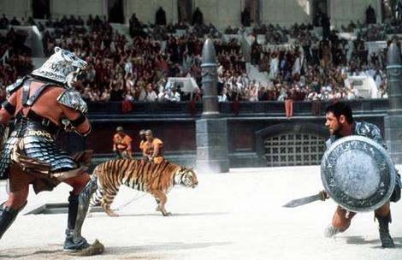
Slaves could also be made to fight as Gladiators, to entertain the Romans.

Slide 14
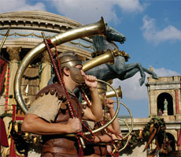

2. Power!
The Romans didn’t just want goods from Britain, they also wanted to invade to show how powerful they were.
By conquering more and more countries and making their Empire bigger, it made Rome more powerful.
The Romans also believed it was their duty to do this and make the world “civilised” like them. They felt the Celts were unclean savages!

Slide 15
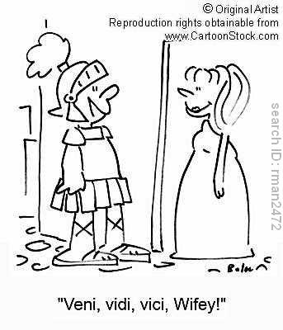
3. Ambition
Invading other countries and adding to the Empire was a way to become more powerful and popular.
The first invasions took place because Julius Caesar was ambitious and wanted power and glory.
Claudius had just become Emperor, in the 1st Century BC, and wanted to prove himself as a good leader of Rome, when his invasion took place.

Slide 16
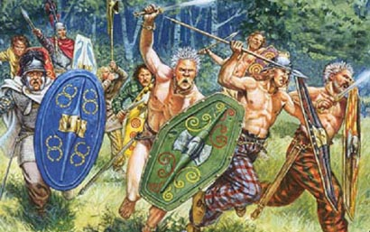
4. Revenge!
The Britons had been helping the Gauls (French) fight against the Romans.
The Romans wanted to punish the Britons for this and make sure that they could no longer do this.

Slide 17
Slaves
Other Raw Materials
Valuable Metals
Why did the Romans invade Britain?
Revenge
Power
Ambition

Slide 18



Tasks
Mind map all the reasons why the Romans invaded Britain.
Draw a tree map to show the reasons why they invaded
Do you think the Roman invasion was justified? Should the Romans have invaded? Children to answer the question in writing giving their reasons why.
Can it ever be justified to invade anywhere? Why?

