Slide 1
Thursday 2 December 2021
LO: To write with purpose
To use sentences appropriately
Organise writing appropriately
C: Non-Chronological Report
Link with History
Build an overview of world history

Slide 2
Today, our subheading is resistance.
Boudicca
Iceni
Roman Empire
Resistance
Watling Street

Slide 3
Listen to the information about Boudicca, the Iceni tribe and the Roman army. Write key facts on your whiteboard to help you with your bubble map.
Bubble map key information about Boudicca and the resistance between the Iceni and the Roman army.
Write a short paragraph for each idea including a mixture of simple, complex and compound sentences. Include a variety of conjunctions, adverbs/ adverbial phrases.

Slide 4
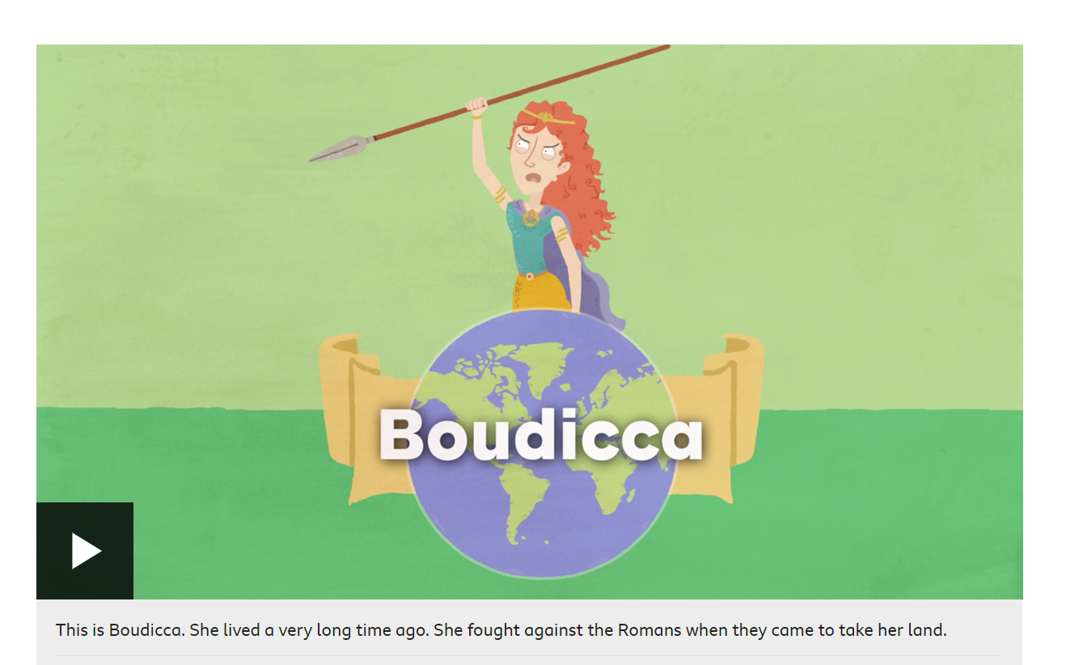
Who was Boudicca? - BBC Bitesize

Slide 5
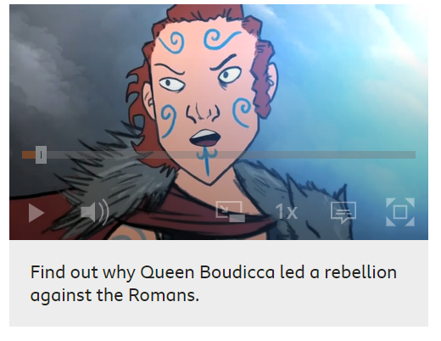
How did the Celts fight back?
When the Romans invaded, the Celtic tribes had to decide whether or not to fight back. If they made peace, they agreed to obey Roman laws and pay taxes. In return, they could keep their kingdoms. However, some Celtic leaders chose to fight.
After years of heavy taxes and the Romans taking their land, some Celtic tribes were desperate for revenge. In AD60, one leader who chose to fight was Queen Boudica of the Iceni tribe. She raised a huge army and went on a rampage, burning the Roman towns of Colchester and London, before heading north to St Albans.
When the Roman army heard about this, they turned back from their campaign in Wales to face Boudica. Even though the Romans were outnumbered by Boudica's 200,000 warriors, they were better trained and had better armour. Both sides clashed in a fierce battle, but the Romans won.
How the Romans conquered Britain - BBC Bitesize

Slide 6
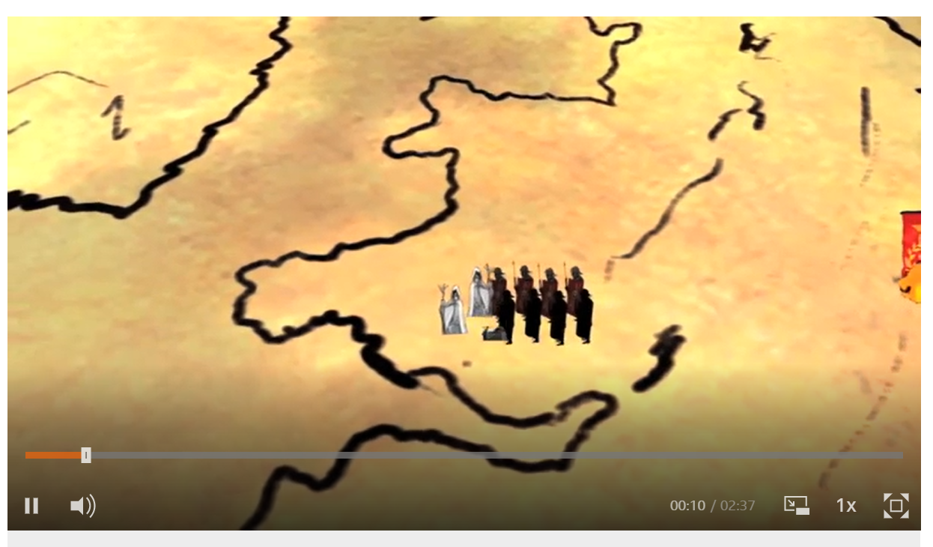
What happened when Boudicca faced the Roman army?

