Slide 1
Wednesday 1 December 2021
LO: To write with purpose
To use sentences appropriately
Organise writing appropriately
C: Non-Chronological Report
Link with History
Build an overview of world history

Slide 2

Over the next two weeks, we are going to be gathering information about why the Romans were successful and why they invaded Britain, in order to write a non-chronological report.
We will need to be like detectives and pick out the most important information to write as paragraphs under subheadings.

Slide 3
Why the Romans were successful and why they invaded Britain
Around 2,000 years ago, Britain was ruled by tribes of people called the Celts. But this was about to change. For around a century, the Roman army had been building an Empire across Europe. Now it was coming for Britain!
In AD43, the full might of the Roman army landed on the beaches in Kent. Over the next year it battled inland, storming through hillforts and chopping down anyone who stood in their way.
The Romans wanted Britain's precious metals. However, they weren't just a destructive force - they built new forts, new settlements and roads. They spread their culture, language and laws.
How the Romans conquered Britain - BBC Bitesize

Slide 4
The Roman Army
A precise military machine. Disciplined and well-trained, with superior armour and weaponry.
Roman army - KS2 History - BBC Bitesize

Slide 5
What Armour Did The Romans Wear?
The first type of Roman armour used was the lorica segmentata. It was made in a hooped metal arrangement. The lorica segmentata armour was used primarily in the early Roman Empire and was perfect because it was compact, making it easy to store.
lorica segmentata
A type of personal armour that was used by soldiers of the Roman Empire, consisting of metal strips fashioned into circular bands, fastened to internal leather straps.
There were two types of soldier in the Roman Army: the Roman legionary and the auxiliaries. The legionaries were the very best soldiers and the auxiliaries were actually non-Roman citizens.
Legionaries wore an undershirt made of linen and a woollen tunic. The linen helped the soldiers to stay cool while the wool helped to trap heat, keeping the soldiers warm.
To protect their heads from arrows, swords and injury they also wore Cassis-helmets. These were metal, with cheek pieces to cover most of their face. On the front of the helmet is a 3" rim that protrudes out to protect the forehead. These features of the helmet help to protect the soldier's skull from sword blows, arrows and injury.

Slide 6
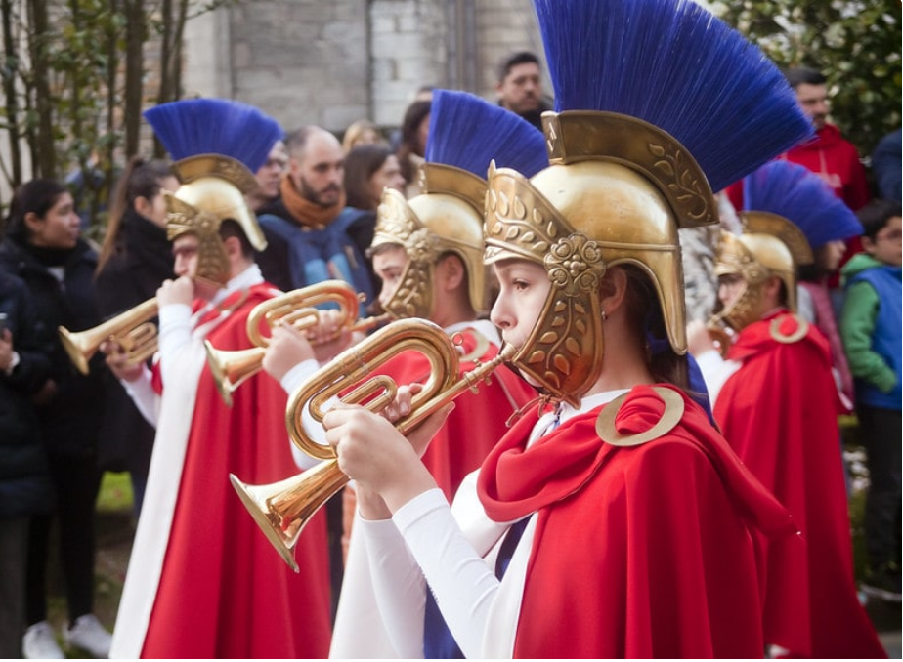

Slide 7
Like the helmets, the Romans wore metallic body armour that protected their flesh from being wounded. For the most effective protection, the armour was made up of overlapping iron strips. The overlapping strips allowed for swifter movement. These strips were fastened with laces and hooks, and were hinged on at the back for maximum strength. This allows for flexibility so the solider can bend and move. To cover all of the soldier's body, metal plates protected their back and front. For their shoulders, metal pieces curved round their shoulders, protecting them from sword blows.
The second type of armour is known as lorica hamata, used during the Roman Republic. This armour was worn by both legionaries (primary) and auxilary (secondary) soldiers. Lorica hamata was a type of chain mail armour, where lots of small interlocking metal rings linked together. Mail was durable and took months to construct, however a single shirt lasted for decades, making it sustainable and reliable.
The last type of Roman armour used was the lorica squamata. This was made of scaled metal plates that look like the skin of a fish. A fabric shirt provided the base for this armour where hundreds of iron or bronze metal plates were sewn into the shirt. Unlike the other two armours, this uniform was light and flexible as the metal was never thicker than 0.8mm. The overlapping plates provided the material with enough strength and resistance.

Slide 8
Why Was Roman Body Armour Useful?
Roman soldier armour was useful because it covered most of the body through roman breastplate, leather straps, chain mail armour and heavy metallic material. This also prevented deadly sword blows to the body. The Roman army uniform is known for its consistency, resilience and protection. Although Roman armour was known for its uniformity, often roman soldiers could add to their uniform. This meant that richer soldiers would buy their own gear to use and embellish their armour.

Slide 9
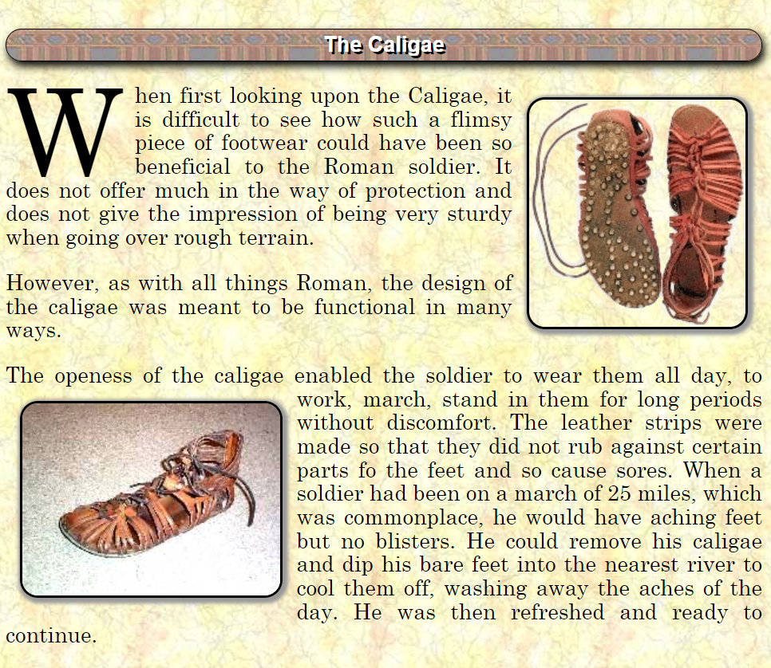
Footwear

Slide 10
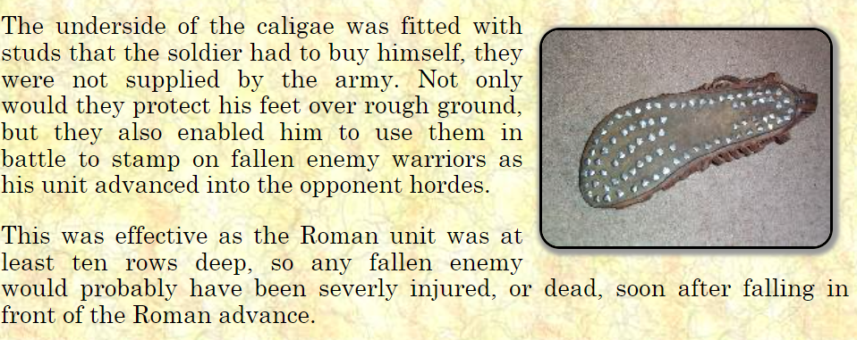

Slide 11
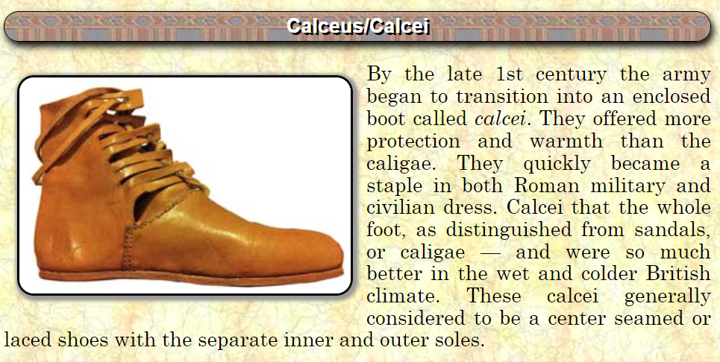
hobnailed leather boots

Slide 12
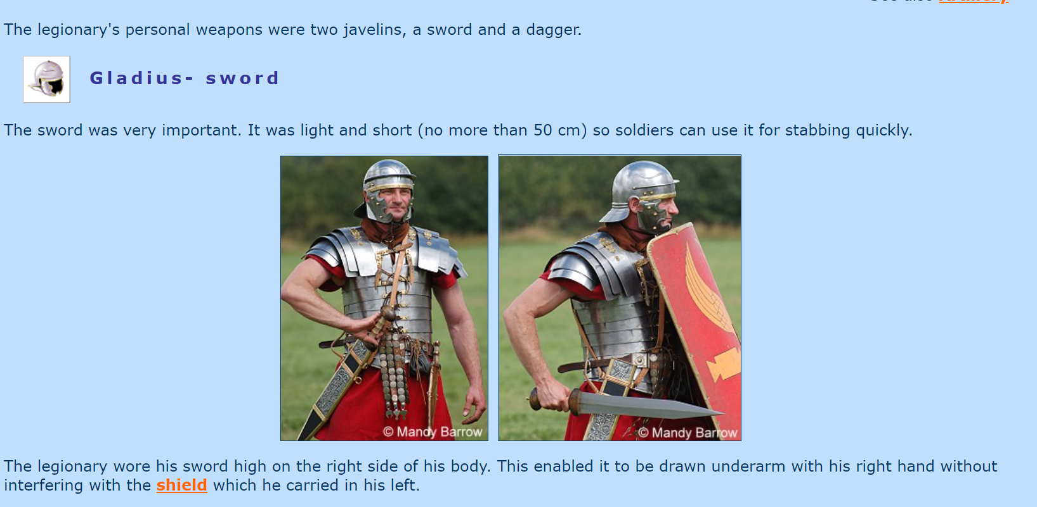

Slide 13
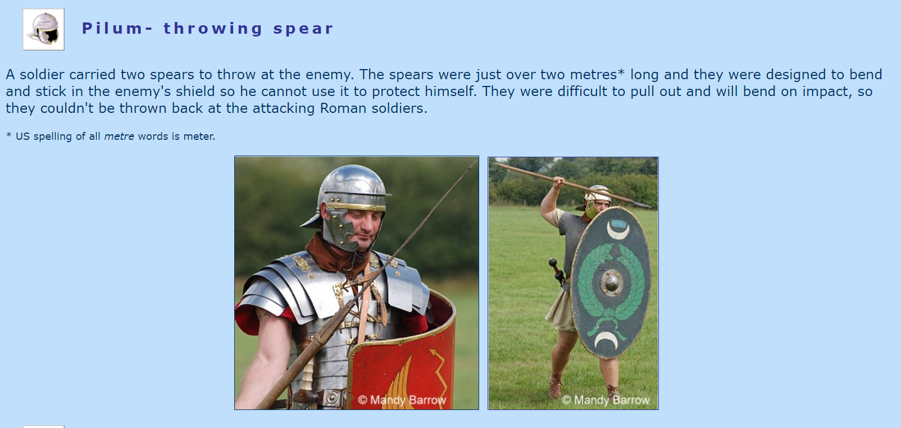

Slide 14
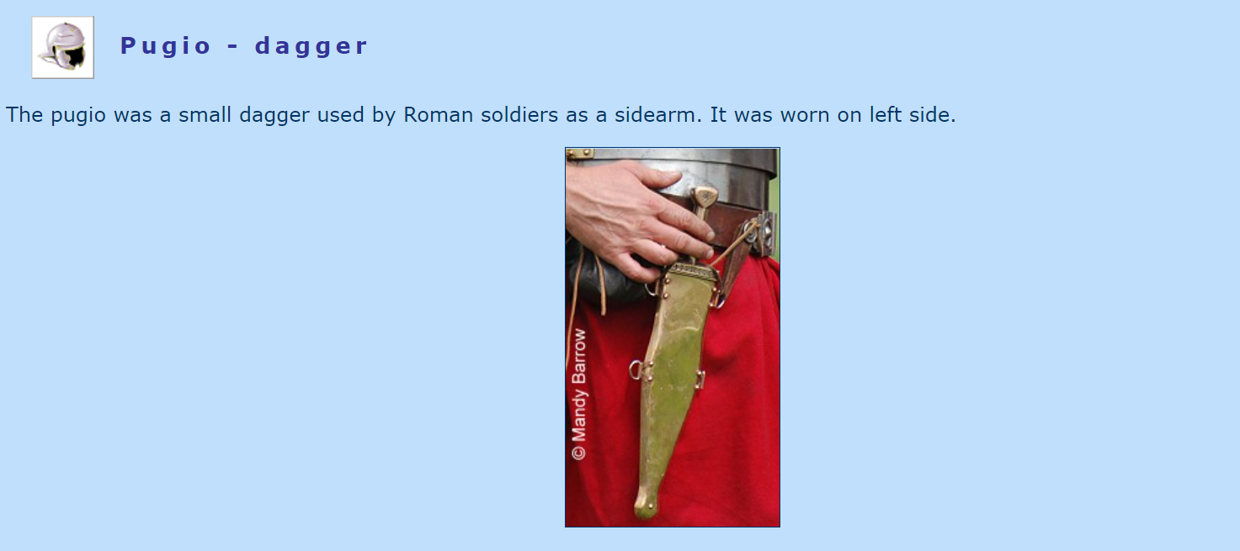

Slide 15
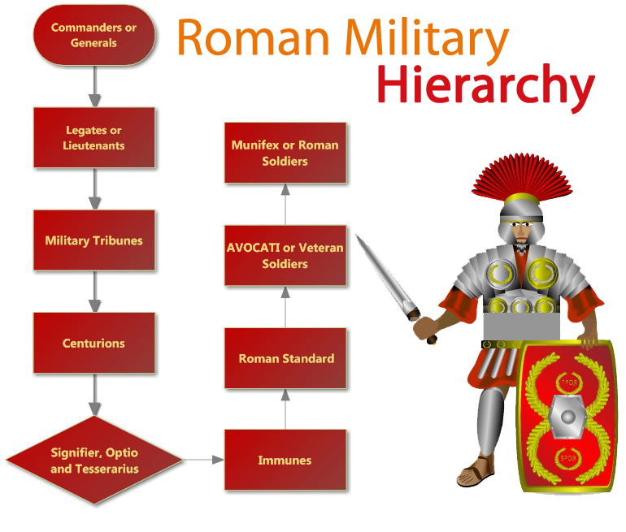

Slide 16
Military manoeuvres
Weapons
Clothes and armour
How
How organised were the Romans?
Organisation and skills
Hierarchy
Today, we are going to bubble map this key information relating to how organised the Romans were.

Slide 17
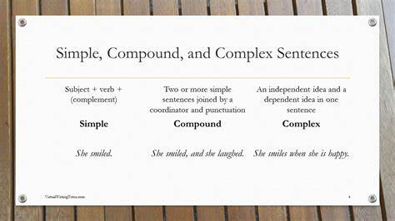
Write a short paragraph for each idea. Include a mixture of simple, complex and compound sentences. Include a variety of conjunctions, adverbs/ adverbial phrases.

