Slide 1
Monday 29 November 2021
LO: To write with purpose
Organise writing appropriately
C: Non-Chronological Reports

Slide 2
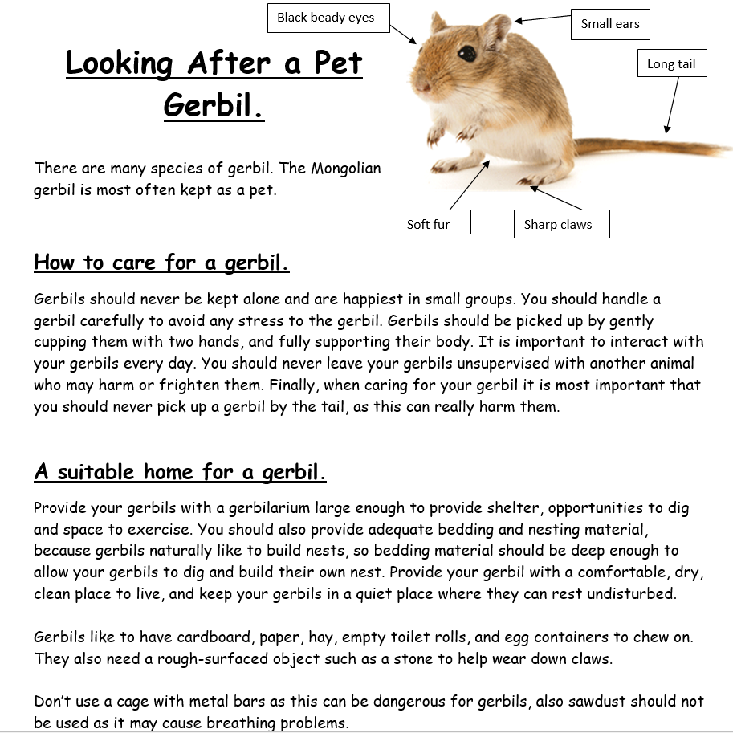
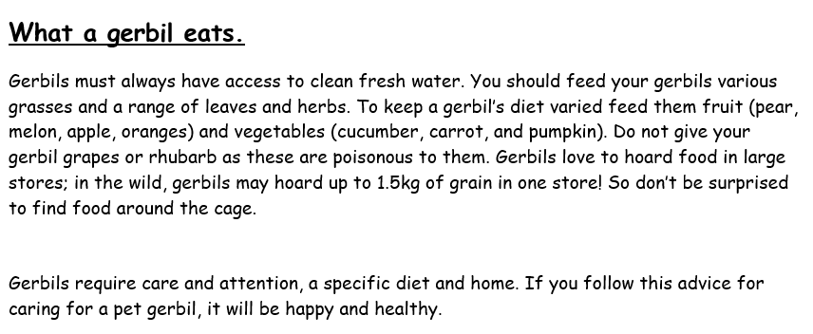
TSP: What kind of writing do you think this is?
Explain why

Slide 3
Non-Chronological Report- Non Fiction
A non-chronological report is like a factual story which does not need to be written in the order in which it happened. The information can be arranged in a way that is more interesting to the reader.
A structure helps the report to be presented in a clear and effective way.
How to write a non-chronological report - BBC Teach

Slide 4
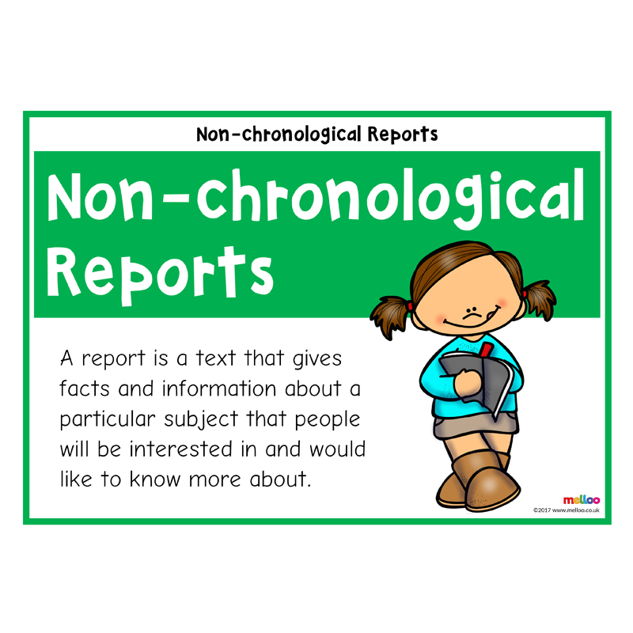
Structure
Title
Introduction
Main paragraphs- facts, present tense
Summary

Slide 5

What do you think the features of a non-chronological reports is?
In small groups, look through the examples of non-chronological reports on your tables. Discuss and highlight important features which you may notice as you read through the texts. We will share our findings as a group and bubble map the features of a non-chronological report.

Slide 6
Features of a non-chronological report
- a topic title which covers the whole subject​
- a brief introductory paragraph which gives a who/what/where overview​
- information grouped into paragraphs, with sub-headings​
- individual points supported by extra detail and examples or evidence​
- written in the present tense, unless the report is historical​
- written in the third person​- using pronouns like he/she/it or they
- formal tone

Slide 7
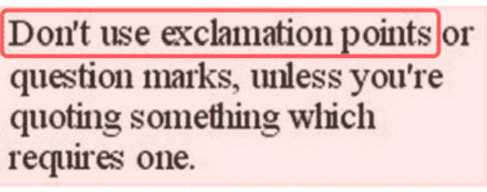
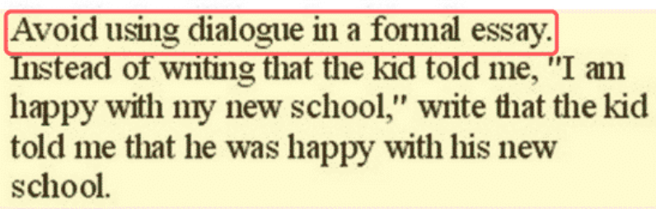
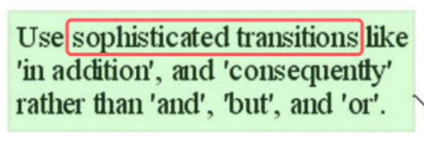
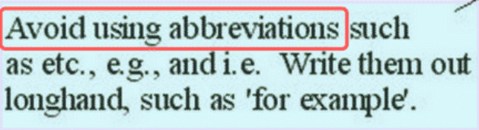
Avoid contractions
Formal Writing

Slide 8
Contractions
On your whiteboard, expand the following contractions:
aren’t
can’t
didn’t
don’t
he’ll
I’m
what’s

Slide 9
Answers
aren’t – are not
can’t- can not
didn’t- did not
don’t- do not
he’ll- he will
I’m- I am
what’s- what is

Slide 10
Activity
Paddling: Write out the expanded form of the contractions given.
Snorkelling and diving: Write a sentence with each contraction given and then write out the sentence again with the expanded contraction.
Can you include an adverbial/adverbial phrase and a conjunction?
E.G: Unfortunately, I didn’t go to the birthday party, as I was feeling rather unwell.
Unfortunately, I did not go to the birthday party, as I was feeling rather unwell.

Slide 11


