Slide 1

Friday 11 March 2022
LO: To understand the facts about smoking and its effect on health
To discuss how to become more assertive in peer pressure situations
C: Puzzle 4 Piece 3

Slide 2
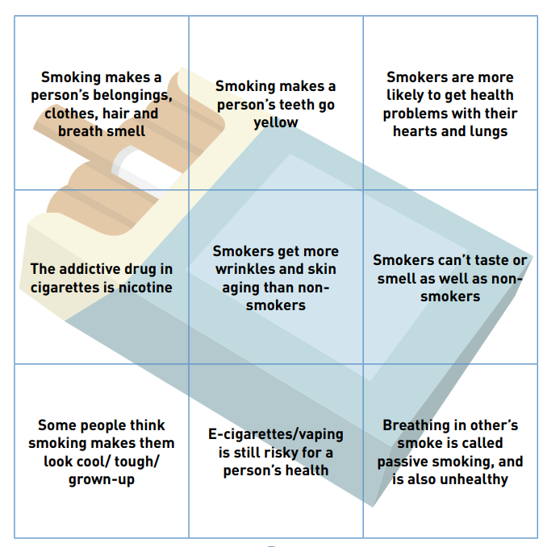

Read the facts about smoking.
Which facts did you not already know and which facts surprised you?

Slide 3
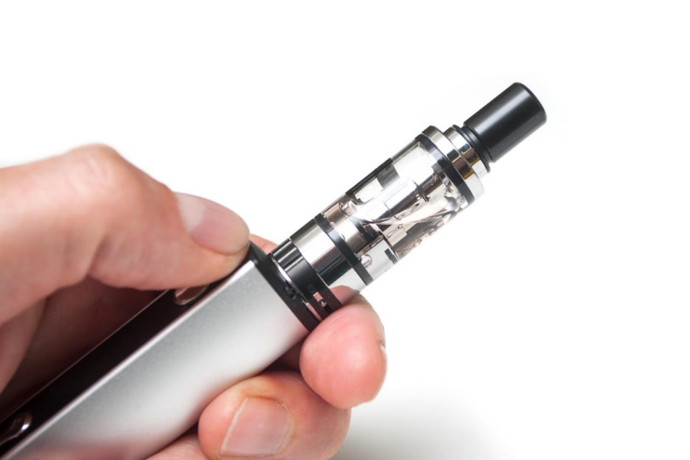

Vaping
E-cigarettes allow someone to inhale nicotine in a vapour instead of through tobacco smoke.
People sometimes use e-cigarettes when they are trying to give up smoking. However, vaping also carries risks, and no-one should start vaping unless they are trying to give up smoking, because:
• e-cigarette liquid/vapour still contains low levels of potentially harmful chemicals • the long-term health risks of vaping (e.g. to heart, lungs and blood vessels) are not known • most e-cigarettes contain addictive nicotine.

Slide 4
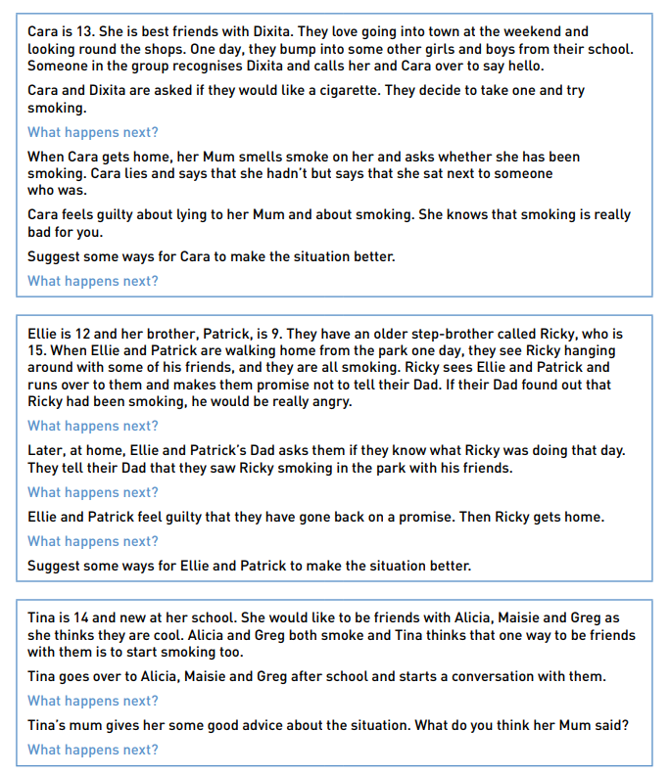
Have a look at the following scenarios.
Draw out the main messages and suggest ways to make each situation better.
You may wish to use the following questions as prompts to help you in your thinking:
Do you think everyone starts smoking for the same reason? Where is the pressure coming from in each scenario? What might the people be feeling in each situation? What are the roles of each person in the scenario? Can the people in the scenario choose their role? Can the situations be problem-solved assertively?

Slide 5


