Slide 1
LO:
*to understand practices and lifestyles
*to understand values
C: Christianity

Slide 2
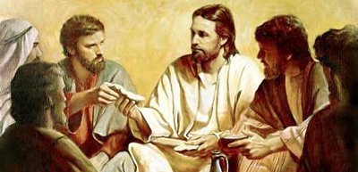
Remembering the events of the Last Supper is so important for most Christians that they take Communion regularly.
What links can you make between the Last Supper and Holy Communion?

Slide 3
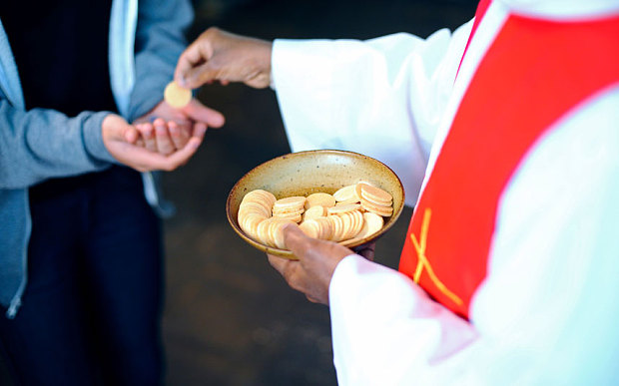
For Christians, Communion is one of the most important meals that they share together.
It is a time to reflect on what they have done wrong and to ask forgiveness from God.
It is also a time of thanksgiving when Christians remember what Jesus did on the cross and how he showed God’s love for the world by suffering and dying.

Slide 4
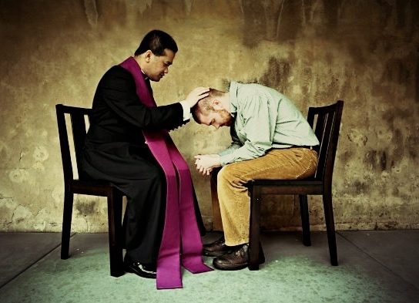
Before taking the bread and wine in the Communion service, Christians will think about any wrong things they may have done and say sorry to God.
This is called confession.
Catholic Christians may do this with the help of their priest.

Slide 5
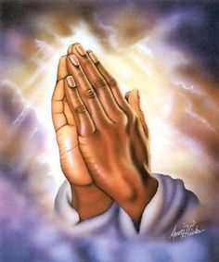
For example:
Almighty God, our heavenly Father,
we have sinned against you
and against our neighbour
in thought and word and deed,
through negligence, through weakness,
through our own deliberate fault.
We are truly sorry,
and repent of all our sins.
For the sake of your Son, Jesus Christ,
who died for us,
forgive us all that is past;
and grant that we may serve you
in newness of life
to the glory of your name.
Amen.

Slide 6

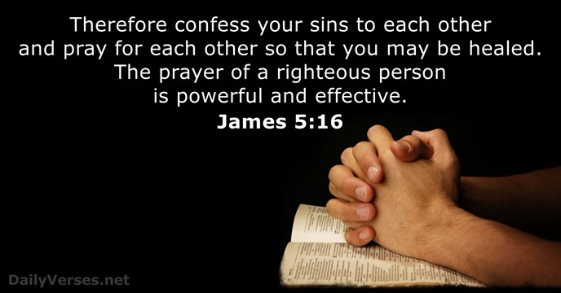
Why do you think that Christians confess their sins and say sorry to God before taking Communion?

Slide 7
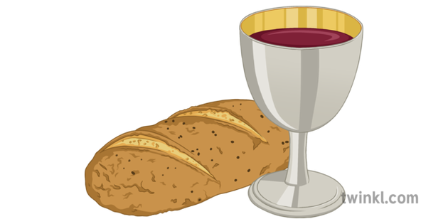
Christians in Catholic and Orthodox churches believe that the consecrated (holy) bread and wine used in communion become something very special and holy.
At the last Passover meal Jesus shared with His disciples, he said, “This is my body,” and “This is my blood.”
Catholic and Orthodox Christians believe this in a literal way – that the bread becomes Jesus’ actual body and the wine his actual blood.
In other (Protestant) churches, Christians believe that Jesus meant his words in a symbolic way – that the bread and wine are simply reminders of Jesus’ death.

Slide 8

Paddling | Snorkelling | Diving
How do Christians remember the events of the Last Supper? | How does Communion help Christians to remember the events of the Last Supper? Red Pen: Do all Christians share the same beliefs about the bread and wine at Communion? | Christians believe Communion helps them to remember the Last Supper. Do you agree? Red Pen: Christians may take Communion every week. Why do you think they would want to do this so often?

