Slide 1
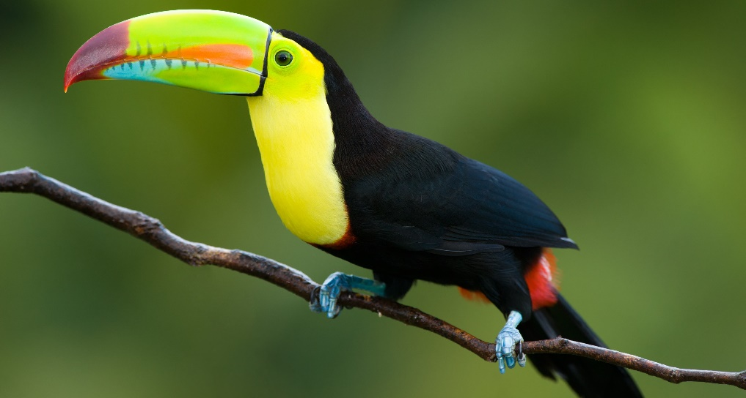
Monday 7 March 2022
LO: To write with purpose
To use sentences appropriately
Organise writing appropriately
C: Non-Chronological report

Slide 2
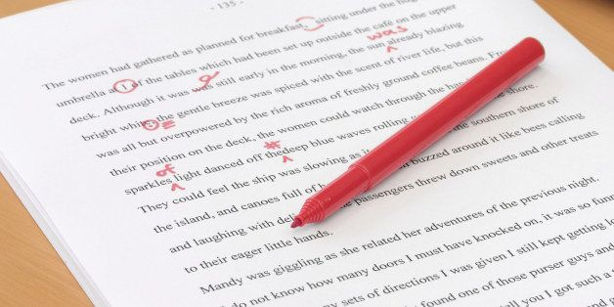
Starter: 5-10 minutes
Read over your subheadings and paragraphs from last week. Edit and Red pen. Tick off your success criteria.

Slide 3
Draw your bubble map and write down facts about the animals you wish to include in your report.

Slide 4
Capybara-
Anaconda
Birds
Sloths
One fifth of all known bird species live
in the Amazon Rainforest.
Macaws
Toucans
What animals can you find in the Amazon?
Pink dolphins
Harpy eagle
Insects and butterflies
Howler monkey

Slide 5
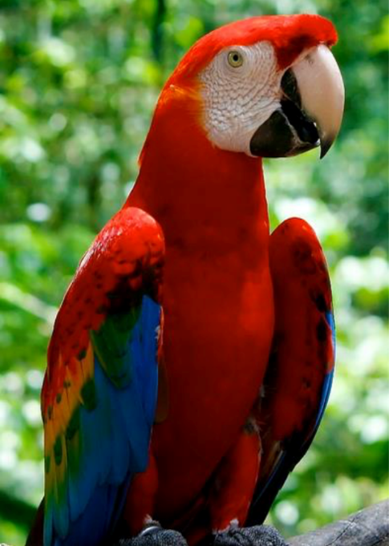
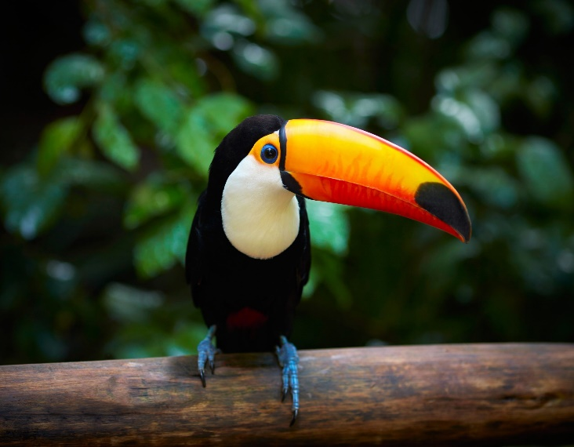
Macaws
The Amazonian rain forest is a bird lover's paradise, home to over a
thousand different species, including the blue-and-yellow macaw. Macaws are
highly intelligent, mate for life and can live up to 60 years. Proportionately
larger beaks, long tails, and relatively bare, light-coloured, medial (facial patch)
areas distinguish macaws from other parrots. They eat fruit, nuts, seeds and
insects. Macaws communicate between one another using loud vocal calls such as
squawking and screaming. Some species of Macaw are even known to be able to
mimic human sounds.
Toucans
Toucans are another icon of the Amazon Rainforest. Amazon Toucans feed on a range of things like insects, nestling birds, eggs and other small vertebrates but primarily eat a diversity of different fruits. They have a stereotypical behaviour when gulping down fruit and tilt the head back to feed. Toucans are very social and you will usually see two or more together. They have a characteristic large and usually colorful beak that helps regulate temperature. Males also use their showy beaks in dueling competitions over mates.

Slide 6
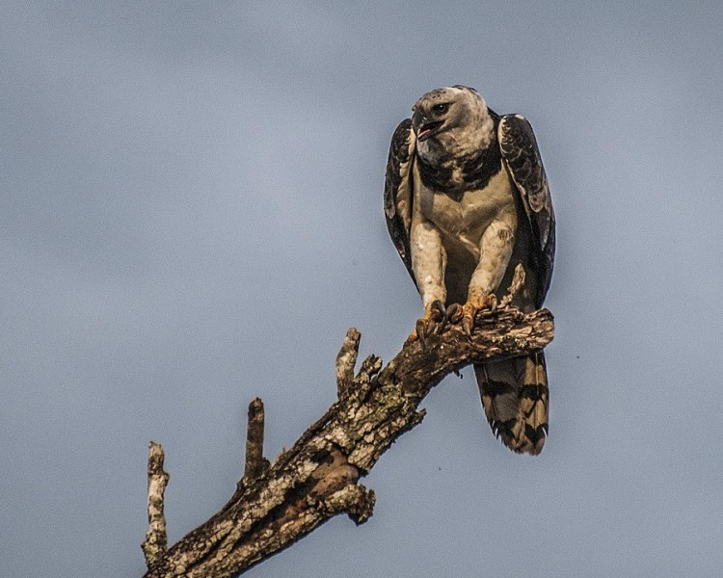
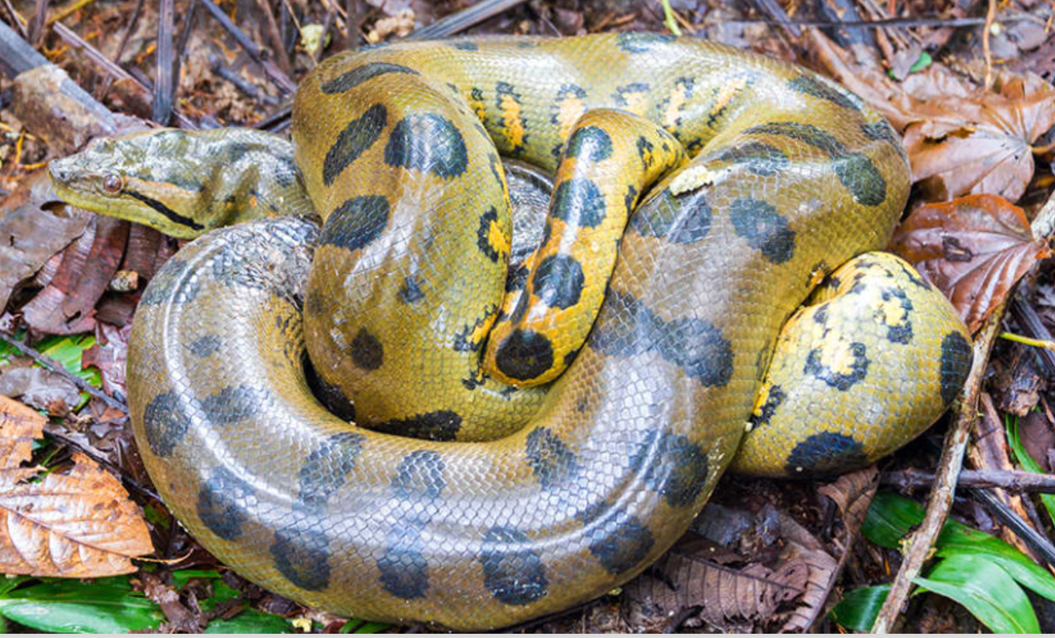
Harpy eagle
The Harpy eagle is the largest and most powerful and aggressive raptor found in the rainforest. It is among the largest remaining species of eagles in the world. The upper side of the harpy eagle is covered with slate-black feathers, and the underside is mostly white, except for the feathered tarsi (a bone in the lower leg of birds), which are striped black. A broad black band across the upper breast separates the grey head from the white belly. It eats small insects, snakes, reptiles, monkeys and sloths.
Anaconda
The Anaconda is the largest snake in the world. They feed on fish, birds, and small mammals as well as other reptiles and even Capybaras.

Slide 7
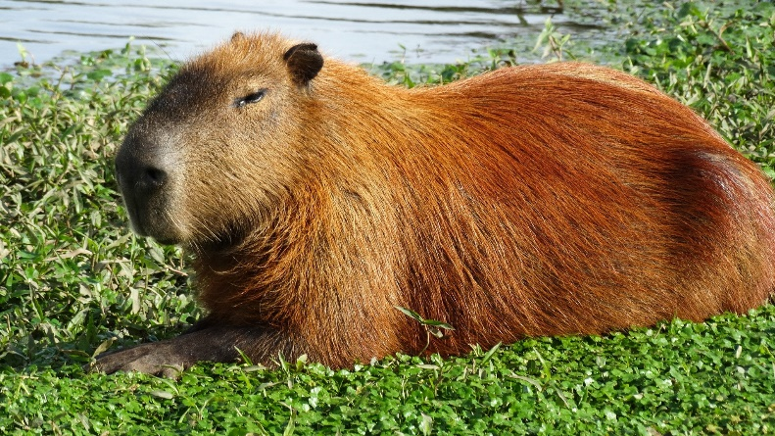
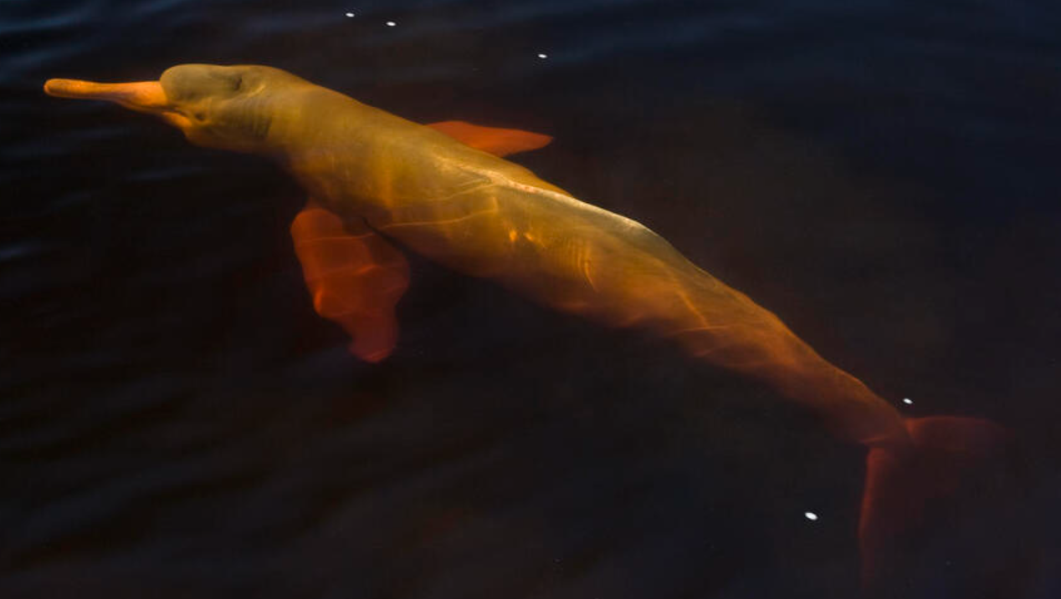
Capybara
The Capybara is a giant rodent native to South America. It’s closest relative is the guinea pig. The capybara inhabits savannahs and dense forests and lives near bodies of water. It is a highly social species and can be found in groups as large as 100 individuals, but usually lives in groups of 10–20 individuals. They are herbivores and eat a diet rich in grass, leaves and aquatic plants. Sometimes they also eat fruit and vegetables.
Pink Dolphins
The Amazon river dolphin, also known as the pink river dolphin or boto, lives only in freshwater. It is found throughout much of the Amazon Rainforest. Unlike most other types of dolphins, the pink river dolphin has a very specific diet. They eat primarily fish, crabs, and crustaceans. They’re also known to feed on small fresh-water fish.

Slide 8
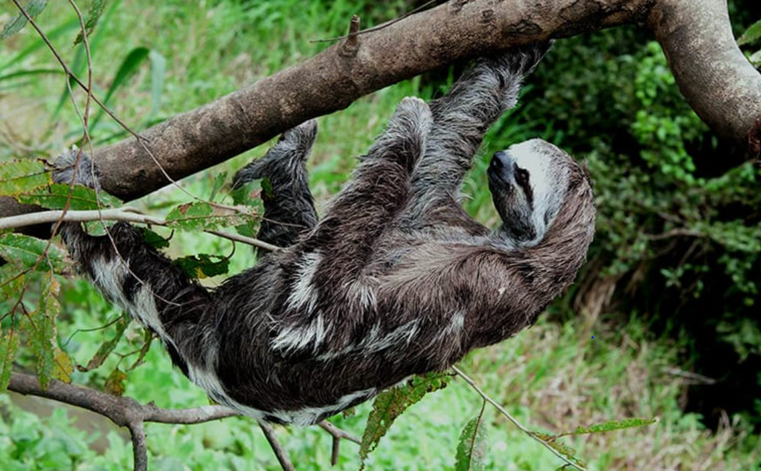
Sloths
There are two different types of sloths, two-toed and three-toed sloths. All sloths have three-toes (even the “two-toed” ones!). The difference is that the two-toed sloths only have two claws on their forelimbs, whereas the three-toed sloths have three claws on their forelimbs. However, they all have three claws on their hind-limbs.
Some of the least-active animals out there, sloths sleep for up to 20 hours each day! Some even stay in the same tree their entire life. They move so little that algae grows on them. Their body has a deep groove for housing the algae, whose colour is meant to help the animals camouflage with their environment in the Amazon’s rainy season
Part of that slothful persona is a very slothful diet. It takes so long for a sloth to digest the food it eats (and to eat enough to get the nutrients that it needs) that it only has to go to the bathroom about once a week! This is usually one of the few times the sloths will leave their tree.
Known to sometimes simply let go from
their tree branch and drop into the water
below for a quick swim, they can move three
times faster in water than they can on land.

Slide 9
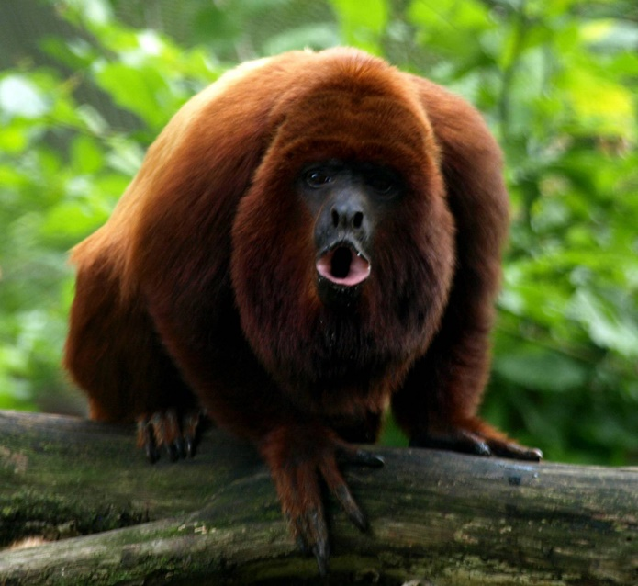
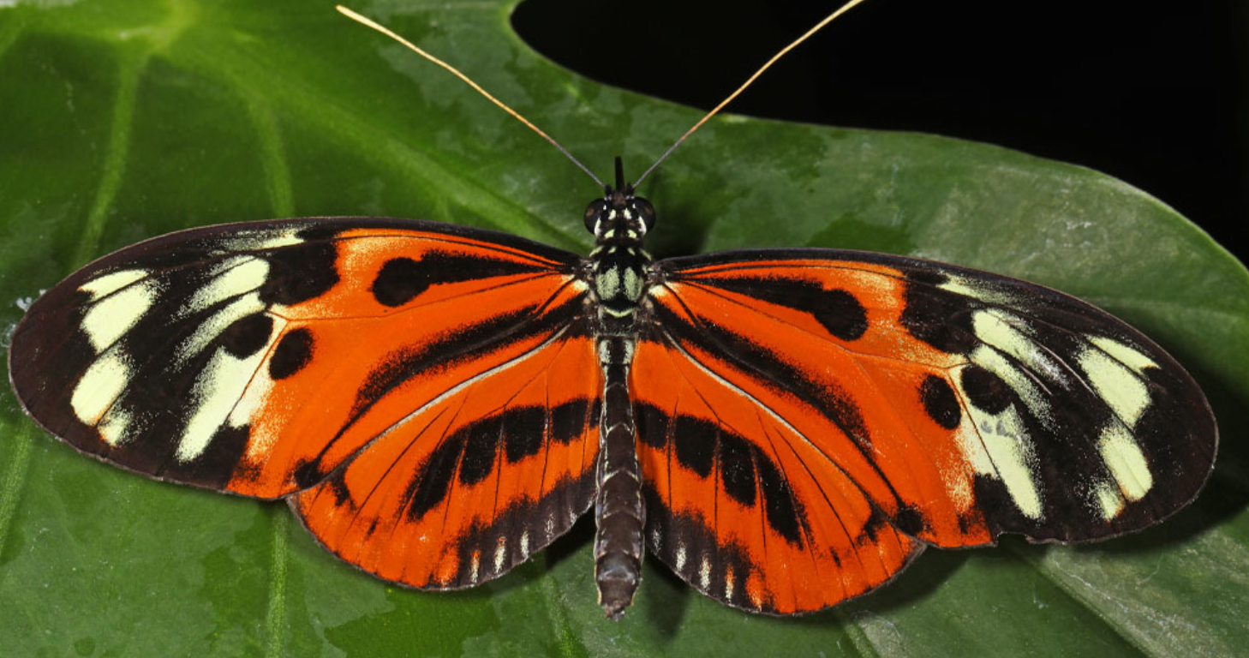
Howler Monkey
The Howler monkeys that live in the Amazon Rainforest are the loudest land animals in the entire world- They can be heard from over three miles away. Howler monkeys have beards and long, thick hair which may be black, brown, or red. The majority of howler monkeys are herbivorous in nature; their diet consists of leaves, plants, fruits, vegetables, flower and nuts.
30 million species of insects are estimated to live in the Amazon Rainforest, including 7,000 species of butterfly.

Slide 10
Fronted adverbials
How can we improve these sentences?
The Harpy eagle hunts in the canopy layer. They hunt animals from sloths to snakes.
Howler monkeys are the loudest animal in the world. They can be heard from over three miles away.
The capybara is a highly social species, and can be found in groups as large as 100 individuals.

Slide 11
Write your facts out in complete sentences and group similar ideas together as paragraphs. Use the word mat to help you with your paragraphs today.
Paddling: Animal facts for two animals
Snorkelling: Animal facts for three different animals
Diving: Animal facts for four animals

Slide 12
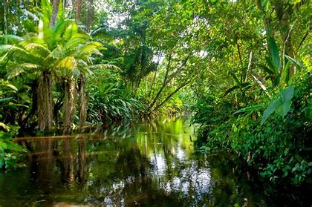
Tuesday 8 March 2022
LO: To write with purpose
To use sentences appropriately
Organise writing appropriately
C: Non-Chronological report

Slide 13
Subheading: The importance of plants and trees in the Amazon
Draw a bubble map and add key facts which you would like to include in your non-chronological report.

Slide 14

Can you remember the layers of the rainforest?

Slide 15
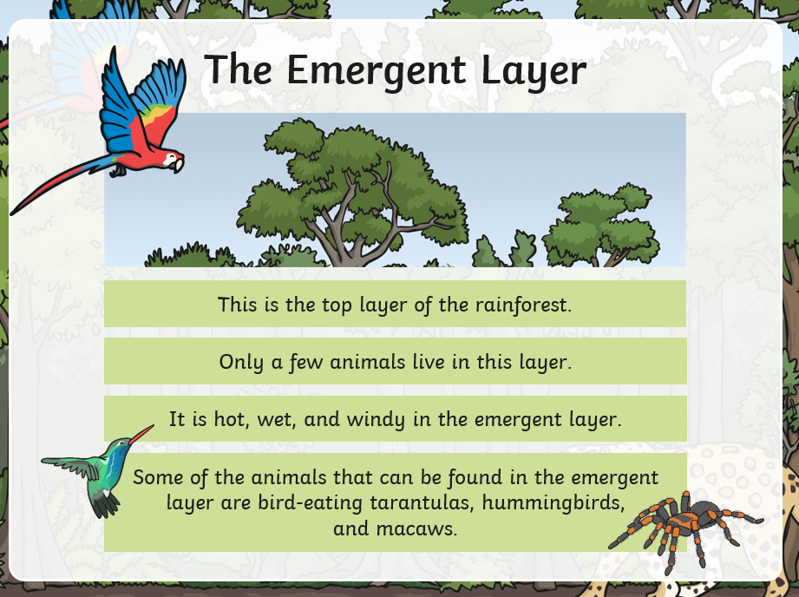

Slide 16
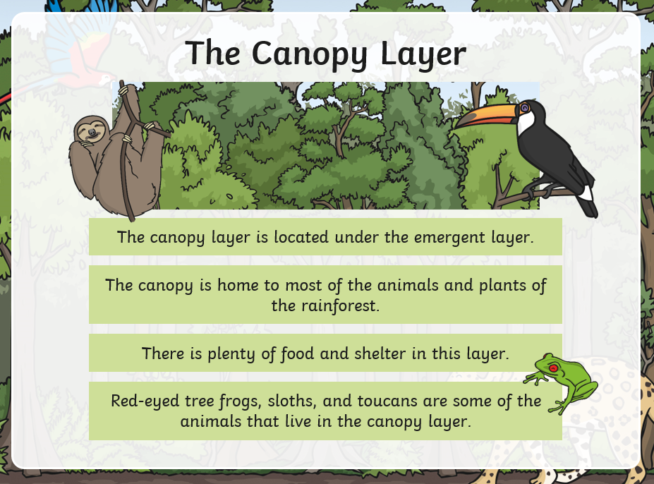

Slide 17
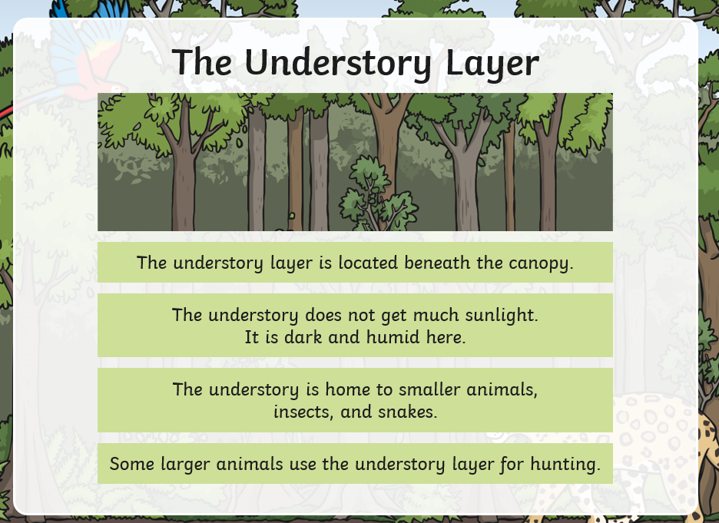

Slide 18
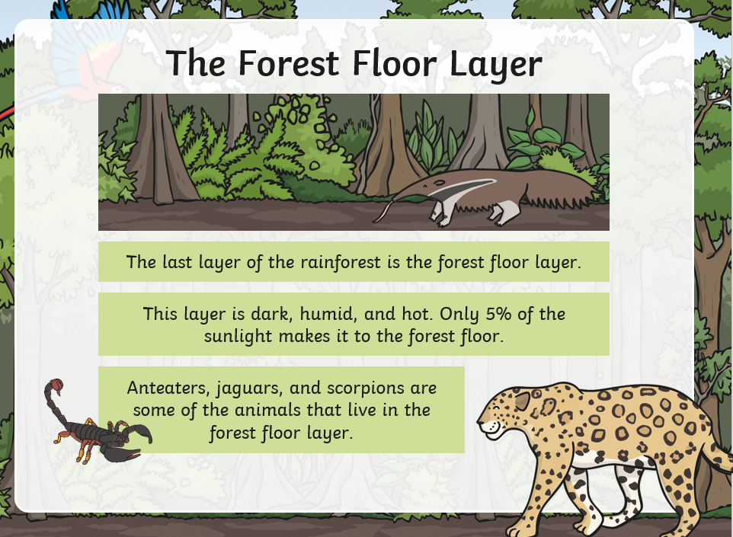

Slide 19
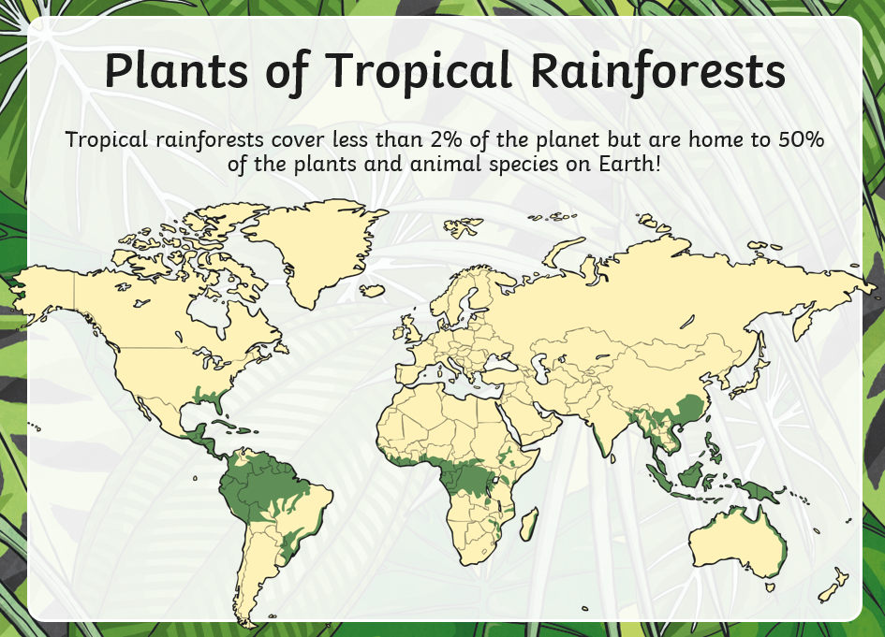

Slide 20
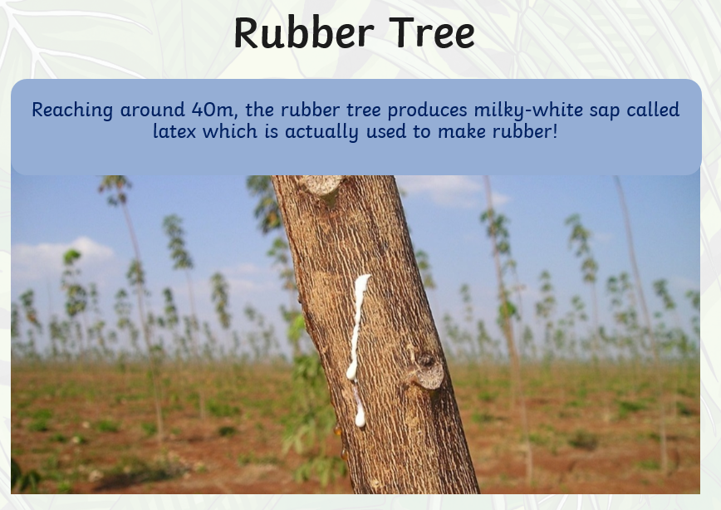

Slide 21
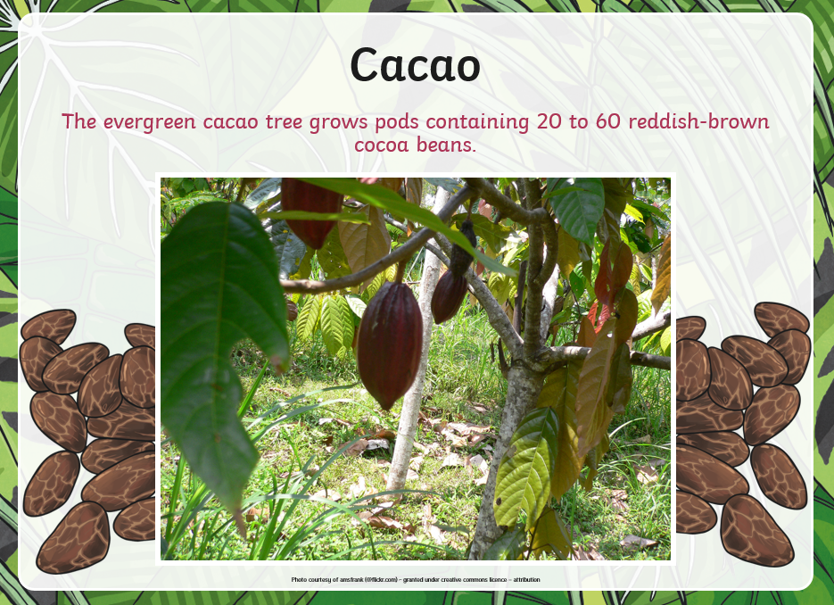

Slide 22
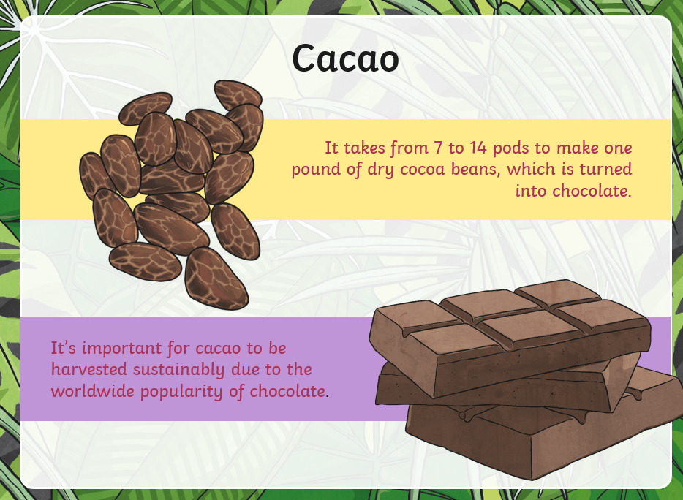

Slide 23
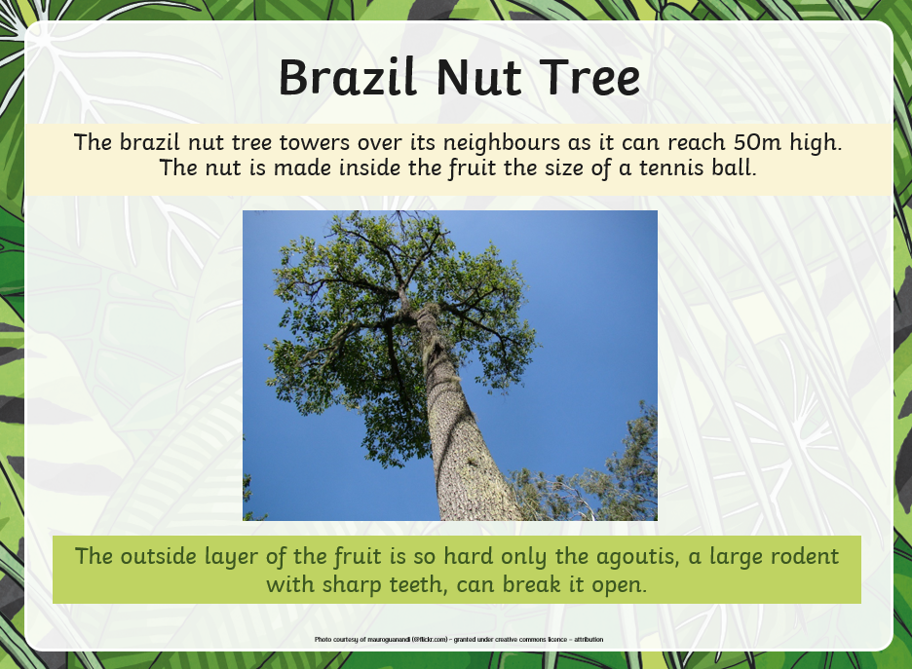

Slide 24
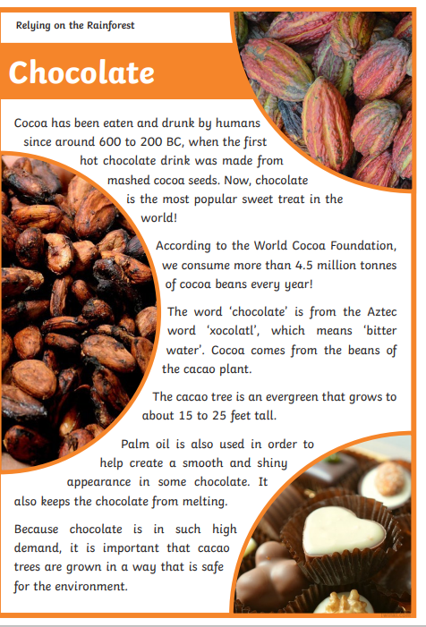
Share the ‘relying on the rainforest’ facts with your group. Include one or two facts in your bubble map.

Slide 25
Dark and damp, the understory is the perfect condition for insects and reptiles to breed and survive.
How can we improve on this piece of writing? Remember to include a fronted adverbial and a conjunction.
The emergent layer is the top layer of the rainforest. It is hot, and windy in this layer. There is bright sunlight and very little shade as the emergent layer towers above everything else.

Slide 26
Write out your chosen facts in complete sentences. Remember to include fronted adverbials and conjunctions.
Paddling: One paragraph about the layers of the rainforest.
Snorkelling: One paragraph about the layers of the rainforest and one paragraph including two plant facts.
Diving: One paragraph on the layers of the rainforest and another paragraph including plant facts.

Slide 27
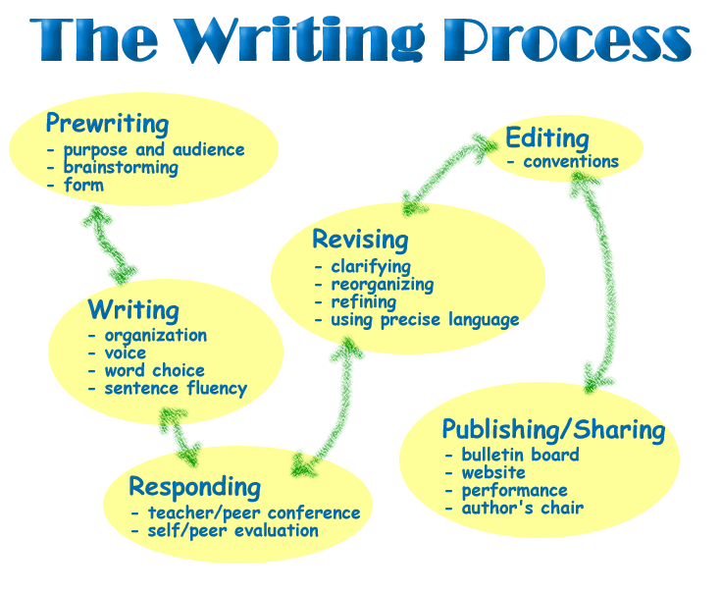
Wednesday 9 March 2022
LO: To write with purpose
C: Non-Chronological report

Slide 28
Over the next two days, we are going to be writing our non-chronological report out neatly for a display.
Today we are going to be writing out our introduction and first two subheadings from last week, neatly on a piece of paper. We will also be drawing and colouring pictures to match our paragraphs.
Subheadings: Where in the world is the Amazon Rainforest? What is the climate like?

Slide 29
Starter: In partners, we are going to share and evaluate our work. Read
Take turns to share and evaluate. Read your work to your partner.
Step 1: Decide who is going to be the listener and who is going to share their work first.
Step 2: The sharer will read aloud to the listener.
The listener will start the discussion by using positive language: Well done, I really like how you… It was so interesting when you… I can see that you have put a lot of effort into this, I particularly like…
Step 3: The listener needs to give constructive feedback. How can your partner improve on their writing?
Swap Roles

Slide 30
Step 4: Red pen editing
Edit your work using your success criteria as a checklist. Include any good ideas from your shared partner work.

Slide 31
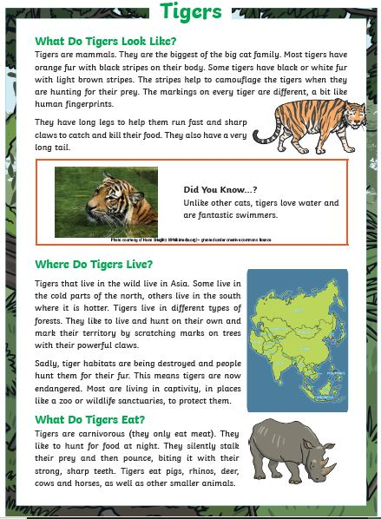
Write each subheading and the paragraph to match underneath. Draw and colour a picture to match each paragraph from your plan.

Slide 32
Thursday 10 March 2022
LO: To write with purpose
C: Non-Chronological report

Slide 33
Today we are going to be writing out our two subheadings from this week, neatly on a piece of paper. We will also be drawing and colouring pictures to match our paragraphs.
Subheadings:
What animals can we find in the Amazon Rainforest? The importance of plants and trees in the Amazon.

Slide 34
Starter: In partners, we are going to share and evaluate our work. Read
Take turns to share and evaluate. Read your work to your partner.
Step 1: Decide who is going to be the listener and who is going to share their work first.
Step 2: The sharer will read aloud to the listener.
The listener will start the discussion by using positive language: Well done, I really like how you… It was so interesting when you… I can see that you have put a lot of effort into this, I particularly like…
Step 3: The listener needs to give constructive feedback. How can your partner improve on their writing?
Swap Roles

Slide 35
Step 4: Red pen editing
Edit your work using your success criteria as a checklist. Include any good ideas from your shared partner work.

Slide 36
Write each subheading and the paragraph to match underneath. Draw and colour a picture to match each paragraph from your plan.

Slide 37
We will complete our non-chronological report next week, by writing a conclusion.

