Slide 1
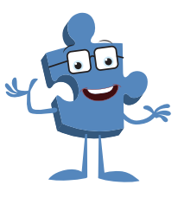
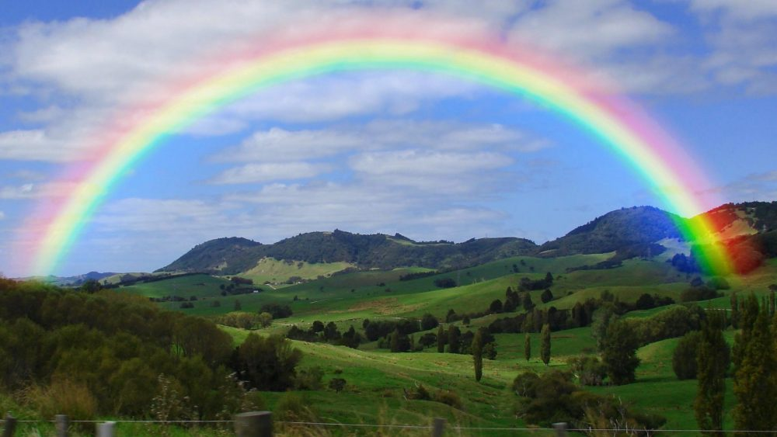
Monday 17 January 2022
Puzzle Piece 2
LO: To understand that sometimes hopes and dreams do not come true and that this can hurt
To know how disappointment feels and identify when I have felt that way
C: Hopes and dreams

Slide 2
Let’s take a look at the jigsaw song ‘For Me’.

Slide 3
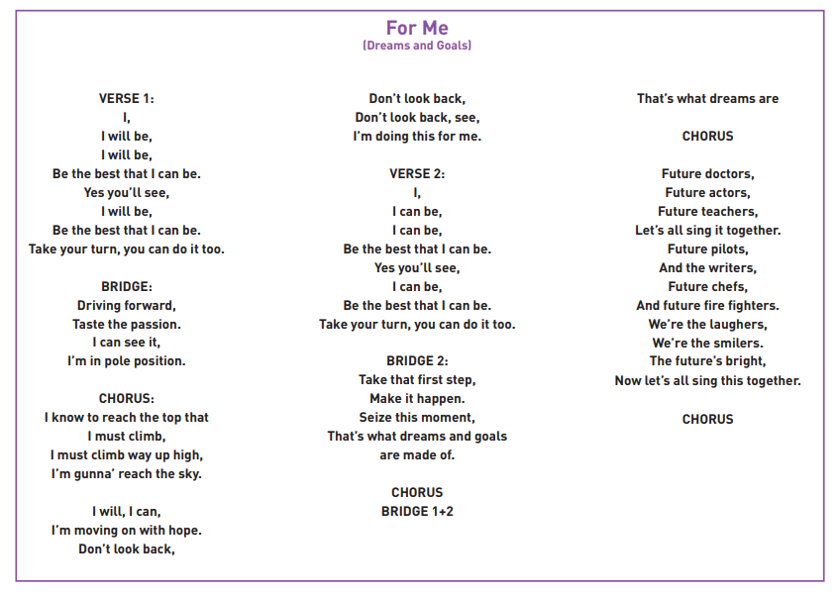

Slide 4
What is this song trying to teach us about hopes and dreams?
Does it teach us anything about being resilient?
Can you remember what it means to be resilient?

Slide 5
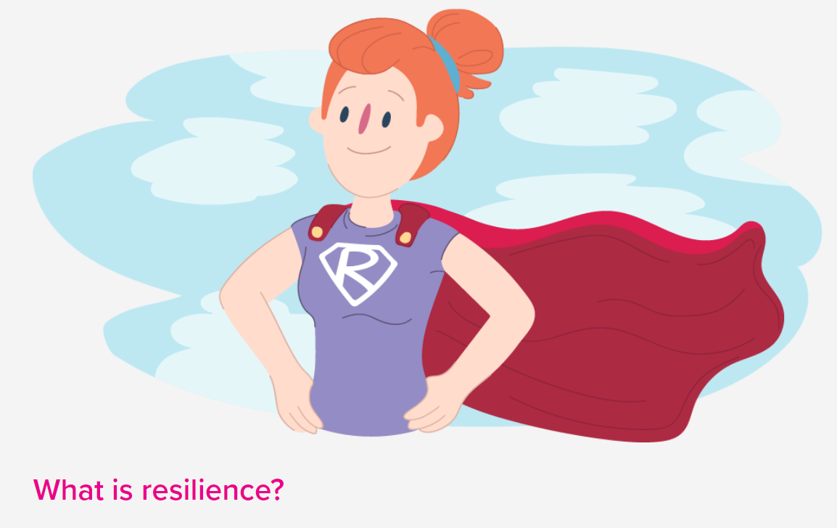

Slide 6
When things go wrong, resilience is what helps you to cope and get through hard times. Sometimes it makes you even stronger than you were before.
Resilience is the ability to cope when things go wrong.
Resilience can also be described as:
Bouncing back after difficult times
Dealing with challenges and still holding your head up
Giving things a go or trying your best
Being strong on the inside
Being able to cope with what life throws at you and shrug it off
Standing up for yourself
Getting back into shape after you have been bent or stretched

Slide 7
On the next slide, we will look at six different scenarios of hopes and dreams.
Think about the following questions:
How it might feel?
What might the person do in that situation?
How could they overcome the hurt that this situation might cause?
How could they be more resilient?

Slide 8
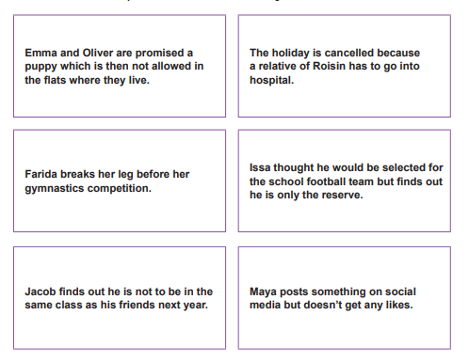
How it might feel?
What might the person do in that situation?
How could they overcome the hurt that this situation might cause?
How could they be more resilient?

Slide 9
Can you remember a time when you were disappointed or had a dream broken? How did it make you feel? What did you do to overcome that feeling?

Slide 10
Activity
On a piece of paper, write one piece of advice you would give to someone who is disappointed because a dream has been broken (like the children in the scenario). Focus on resilience.

Slide 11


