Slide 1
Tuesday 18th January 2022
LO: to identify the different types of teeth in humans and their simple functions.
C: Animals including humans

Slide 2
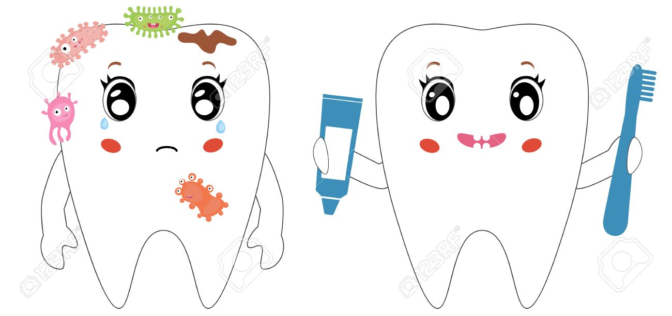
Is it important to keep your teeth healthy? Why?

Slide 3
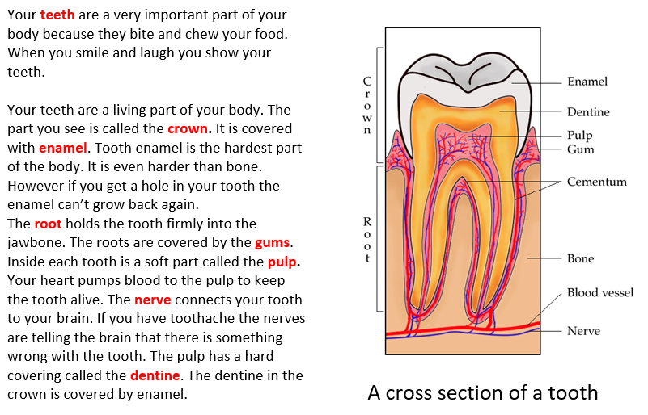

Slide 4
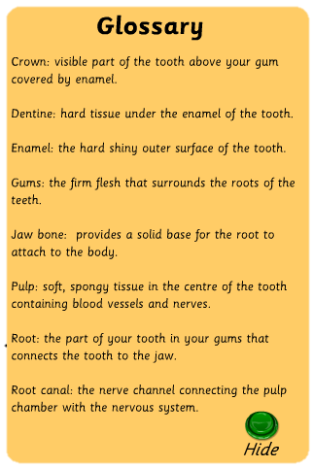
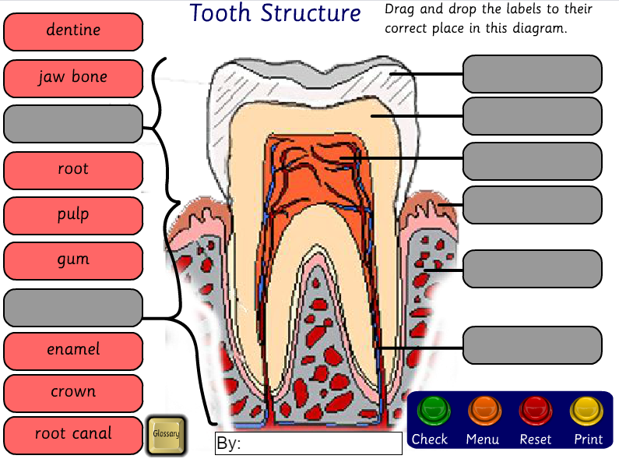
http://www.crickweb.co.uk/ks2science.html#teeth

Slide 5

Paddling | Snorkelling | Diving
Label the tooth cross-section. | Label the tooth cross-section. Red Pen: What can you tell me about the different parts of your teeth? | Label the tooth cross-section. Red Pen: What can you tell me about the different parts of your teeth?

Slide 6
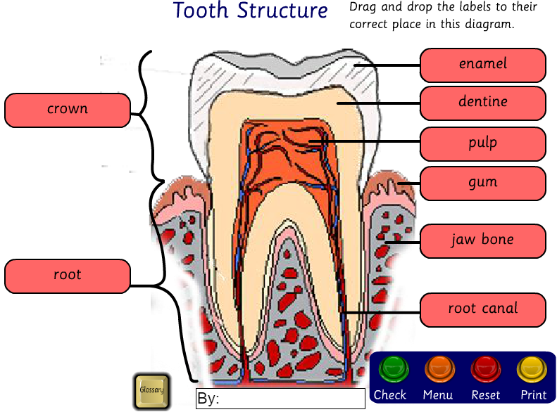

Slide 7
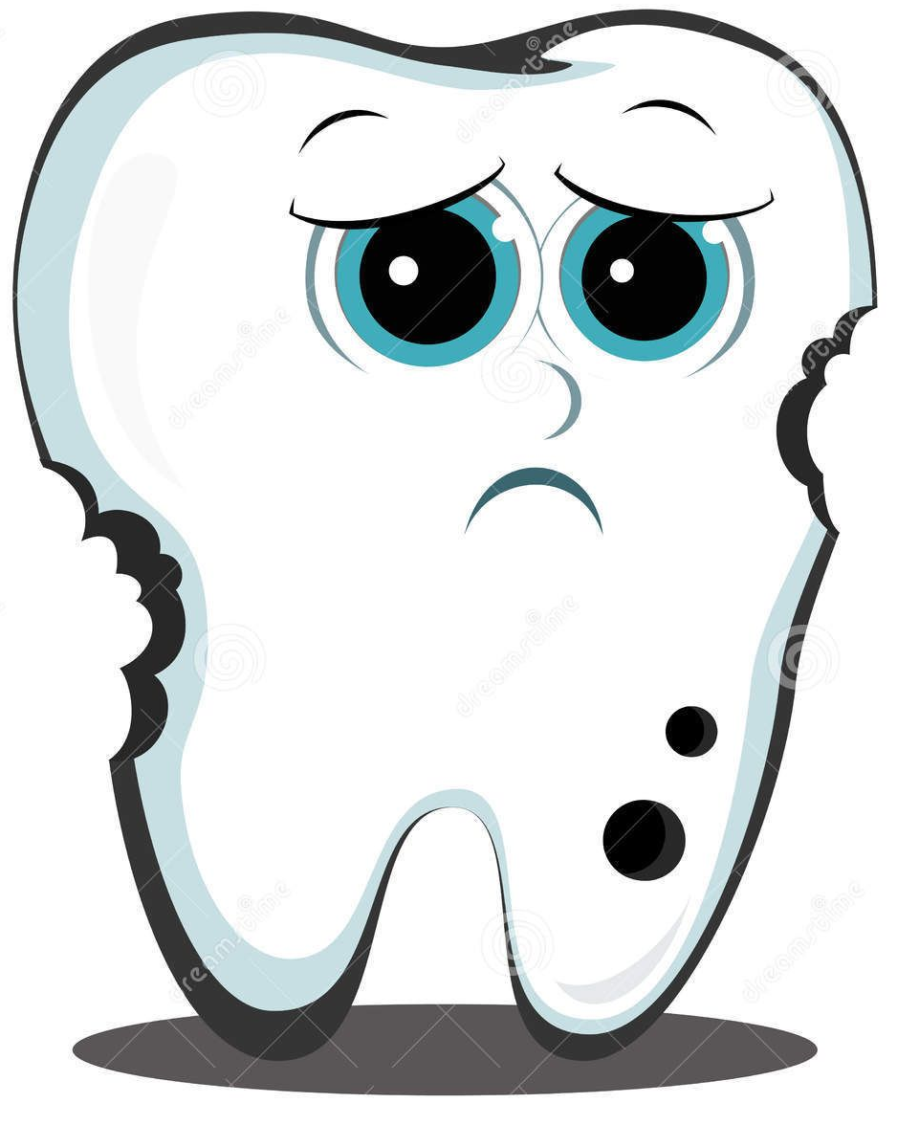
What is tooth decay?
Tooth decay is caused by plaque collecting around the gum line and the grooved surfaces of the teeth.
Plaque is made up of food debris, saliva and bacteria normally present in the mouth.
The acids generated when we are breaking food down can begin to attack tooth enamel within 20 minutes of a meal.
If plaque is allowed to collect over time it will harden into tartar. Both tartar and plaque contain acids which, over time, can dissolve away the protective, hard enamel coating of the tooth, and create holes, or cavities.

Slide 8
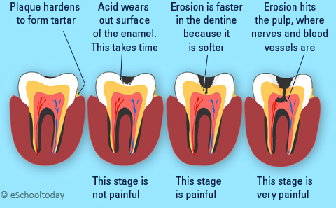
Tooth Decay

Slide 9
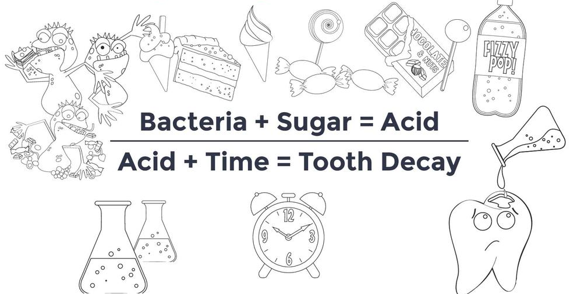
Tooth Decay

Slide 10
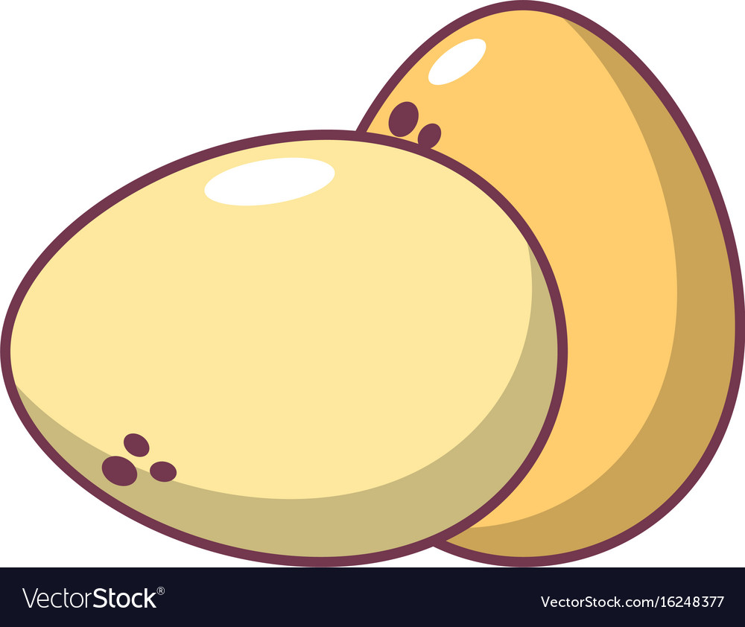
Which liquid does the least damage to eggshells?
We are going to investigate this questions over the next 2 weeks.
The eggshell protects the egg – just like the enamel on our tooth protects the living part inside.

Slide 11
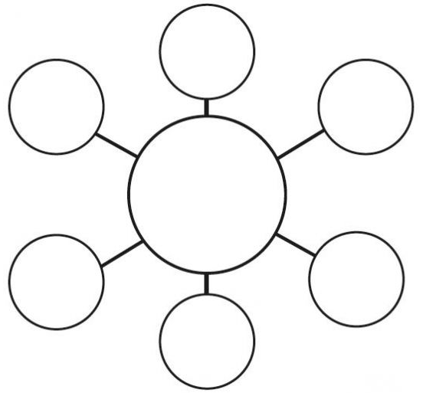
What do you drink?

Slide 12
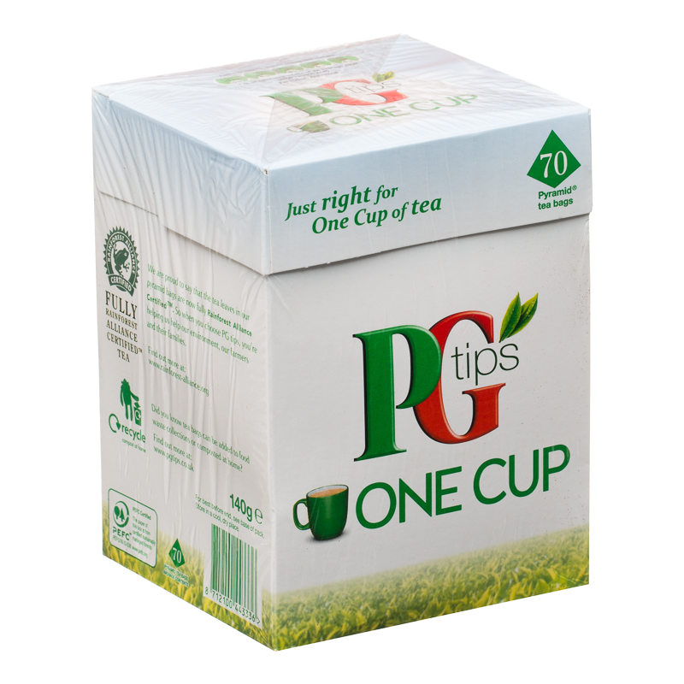
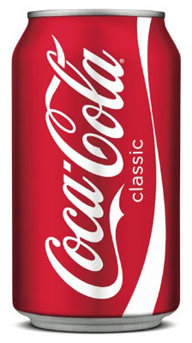
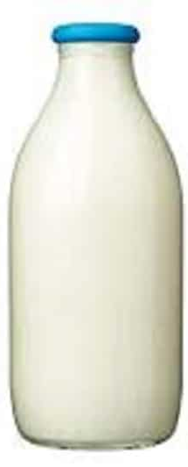
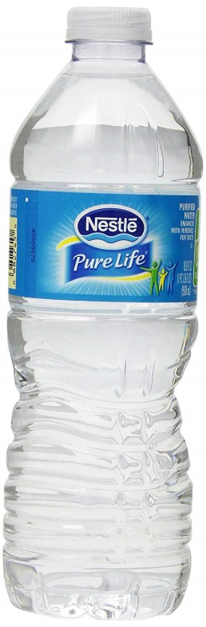
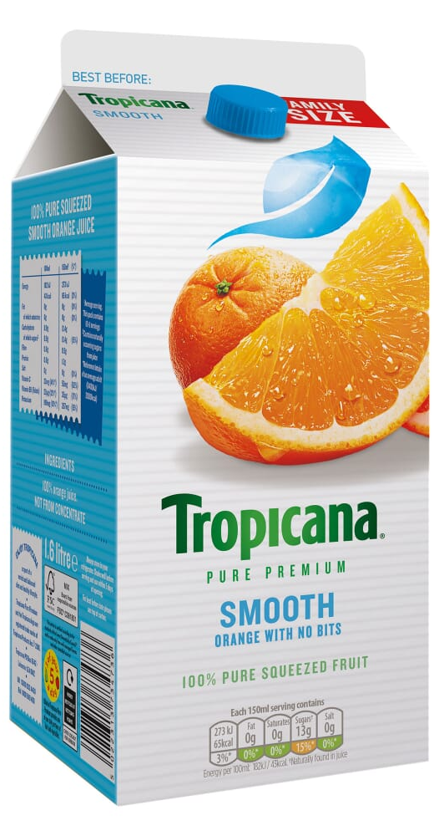
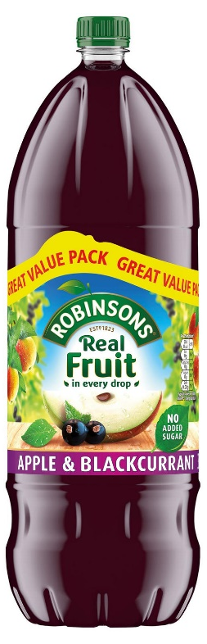
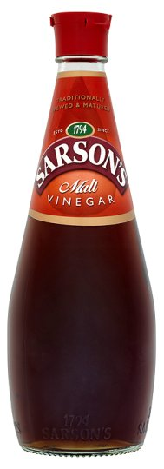
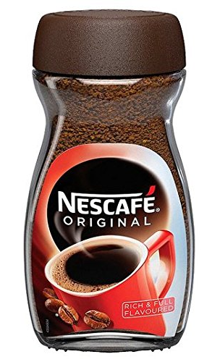
We are going to investigate:
Coca-cola (diet and normal), milk, water, orange juice, squash (sugar-free), tea, coffee and vinegar!

Slide 13
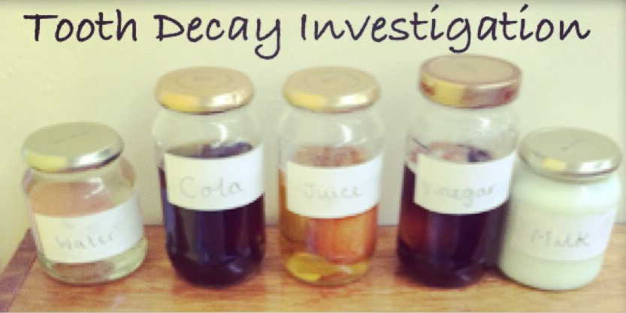
The Experiment
1. Carefully, put the hard-boiled egg into the glass jar by tilting the jar onto its side and pushing the egg through.
2. Fill the jar up with enough liquid to cover the egg.
3. Screw the lid onto the jar tightly.
4. Leave the jars for a week.

Slide 14
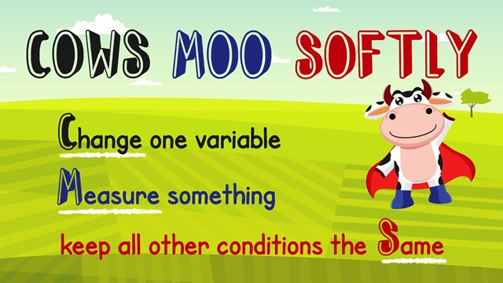
How will we make it a fair test?
https://www.bbc.co.uk/bitesize/topics/z2ddmp3/articles/zpctrwx
A fair test is one where only one variable is changed, while all other variables are controlled (kept the same).

Slide 15
How will we make it a fair test?
What will we keep the same?
What will we change?
What will we measure?

Slide 16
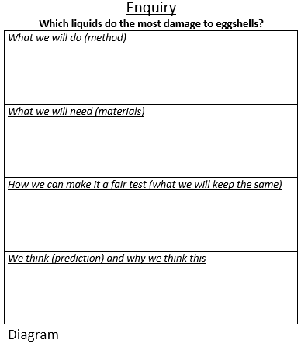

Slide 17
Paddling | Snorkelling | Diving
Complete the investigation planning sheet. Red Pen: why is it important to make our experiment a fair test? | Complete the investigation planning sheet. Red Pen: why is it important to make our experiment a fair test? | Complete the investigation planning sheet. Red Pen: why is it important to make our experiment a fair test?

