Slide 1
Monday 17th January 2022
LO: To write with purpose
C: Warning Story

Slide 2

What does this word mean?

Slide 3
Telling somebody that something bad or unpleasant may happen in the future so that they can try to avoid it.
What do you think it means if you have a warning?
What could a warning story be?

Slide 4
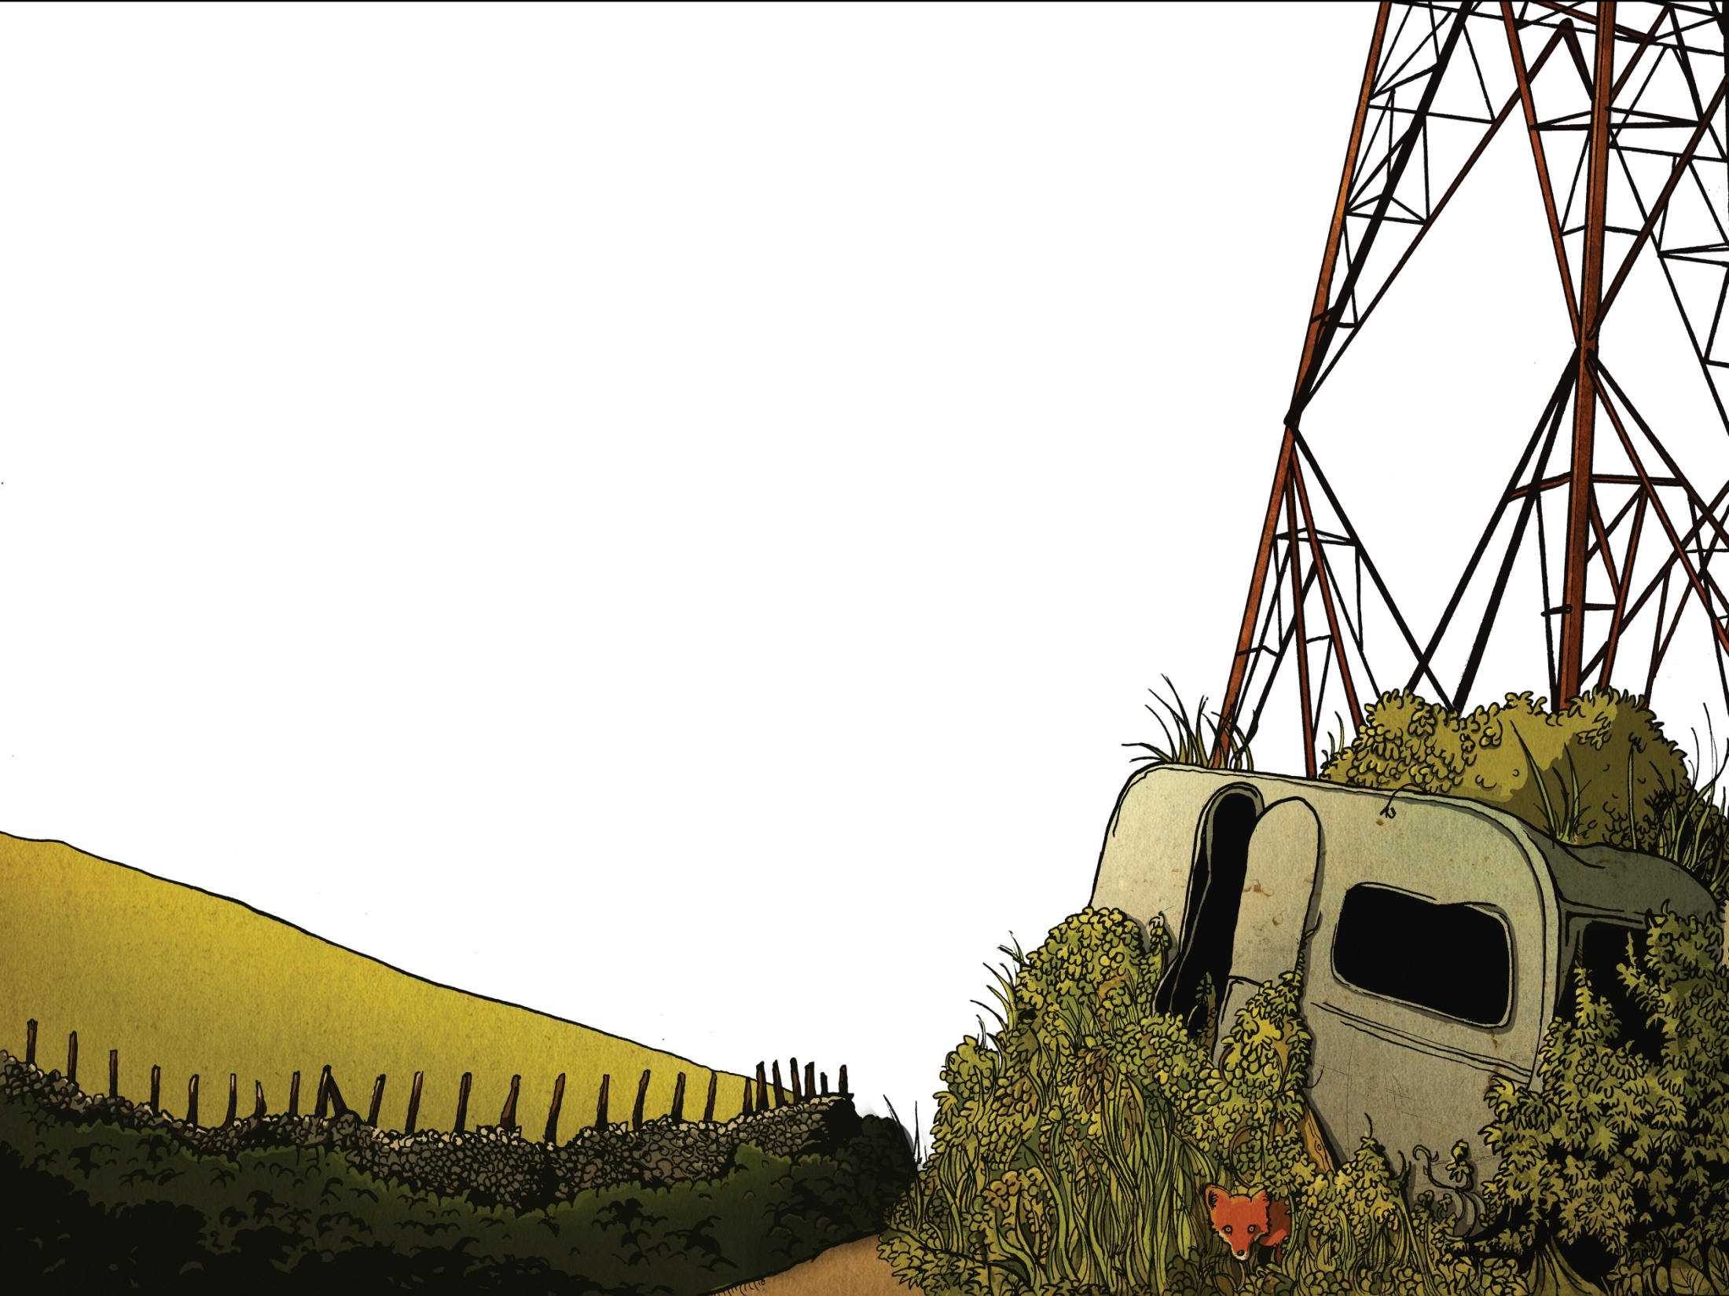
“Now Mitch, don’t go playing up by the pylon,” my Mum had warned me often enough. “It’s dangerous. You’ll get yourself electrocuted.” Did I listen? Of course I didn’t. Most days after school that was exactly where I went. Daft really, but she actually thought that I was doing my homework with Connor.

Slide 5
Mum worries too much. I’ve still not forgotten how she used to tell me not to play under Hanger Bridge by the railway in case the troll snatched me. Of course, I was younger then.

Slide 6
The pylon she was talking about stood at the end of Muggie Moss Road. Red and brown rust fluttered from its lean body and it made odd creaking sounds when the wind blew. It was there we found the caravan.

Slide 7
It had been empty for years. If you go past, you’ll just see a small patch of overgrown land under the pylon, a mess of brambles and nettles that smothered the van.

Slide 8
It was damp inside and the windows were smeared with green grime. Moss clung to its wheels. It was a place of dead spiders and dust but it was our special place. Most days after school we went straight there. Just to muck about.

Slide 9
That afternoon, a storm raged. It had been brewing all morning. The trees were like crazed zombies thrashing wildly. Rain lashed down, drumming on the metal roof. Inside the caravan it felt safe, almost cosy really. We shoved newspaper into any cracks to keep out the wind.

Slide 10
I’d found a bit of old carpet and Connor had brought along some cushions that his Mum had thrown out. He’d also found a candle and in the semi-gloom its flame flickered with a cheerful glow. Outside dusk shadowed the bushes. Soon the streetlights would come on, casting orange pools of light.

Slide 11
We were arguing over whether the last goal in the Man United game was the best yet when we heard it: a clap of thunder so close that it sounded like an explosion. Connor wiped the condensation from the window and we peered out.

Slide 12
At that very moment, there was another tremendous crack, and lightning struck the pylon. Sparks flew, the pylon shuddered and, as if in slow motion, it crashed down towards the caravan roof.

Slide 13
Instinctively, we both ducked down fast. There was an enormous crash and the caravan roof crumpled. The air prickled with electricity and rain lashed through the opening in the roof. For a moment, I was certain that I was about to be fried alive.

Slide 14
In the half-light, I could see Connor’s face. His eyes were wide with fright and he gulped like a fish. “Come on,” he hissed. We slithered like snakes across the floor with the rusted pylon creaking dangerously above us.

Slide 15
Luckily, the door had flown open when the pylon had struck. We slipped out onto the muddy ground and lay there with the thunder grumbling above us and the rain beating down. Then Connor started to laugh. He curled up into a ball and laughed so much that I thought he was crying.

Slide 16
I couldn’t help myself. The next thing I knew, I was laughing too. Inside, I just felt relief. On the outside, I was laughing crazily. Then we ran, through the brambles and out onto Muggie Moss Road.

Slide 17
Of course, Mum was furious. “I’m not made of money,” she said, eyeing the state of my school clothes. “Still, maybe a good wash will sort them out.” She glared at me suspiciously. “So, a tree nearly hit you?” I nodded, avoiding her icy stare. “You could have been killed,” she said. Shamefaced, I nodded. She was right. She’d been right from the start.

Slide 18

What do you think warning stories might be now?

Slide 19
Warning Stories
Warning stories are based around the main character being warned not to go somewhere or do something and disobeying what they are told. This leads to a disaster, rescue and in the end a lesson is learned.

Slide 20
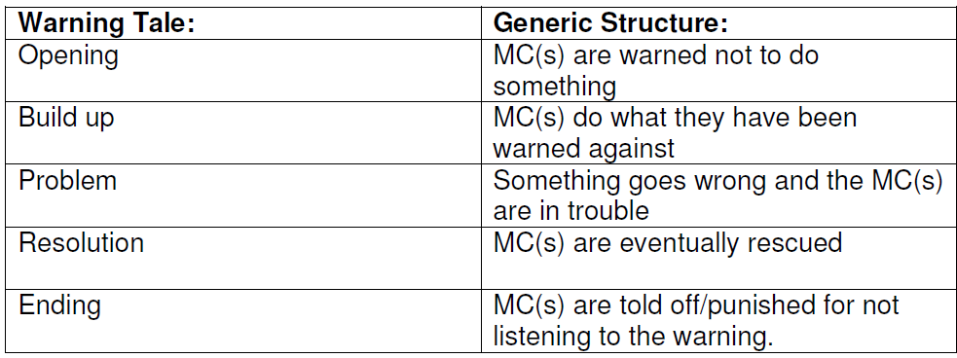

Slide 21
Can you link the events of the story to the structure?
Where was the main character warned not to go?
Did the main character obey this instruction?
What disaster did this lead to?
How was the main character rescued?

Slide 22

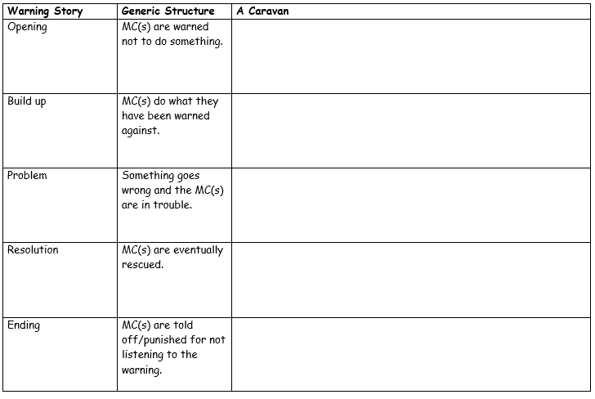
Paddling | Snorkelling | Diving
With CT. Activity 1 - Write a definition for a warning story in your books. Activity 2 – write the events of the story to the matching part of a warning story structure. | With LSA. Activity 1 - Write a definition for a warning story in your books. Activity 2 – write the events of the story to the matching part of a warning story structure. Red Pen: Draw a graph showing the ups and downs of Mitch’s feelings during the story – label with quotes from the text. | Activity 1 - Write a definition for a warning story in your books. Activity 2 – write the events of the story to the matching part of a warning story structure. Red Pen: Draw a graph showing the ups and downs of Mitch’s feelings during the story – label with quotes from the text.

Slide 23
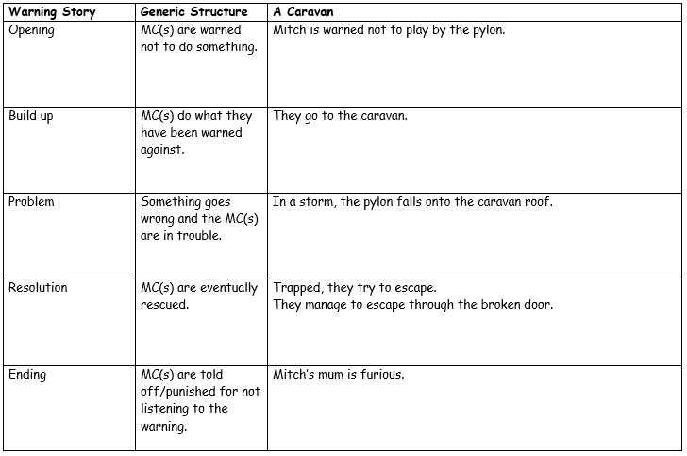

Slide 24
Wednesday 19th January 2022
LO: To write with purpose
C: Warning Story

Slide 25
Over the coming weeks, you are going to be writing your own warning stories!
Thinking about our learning in English and Geography this term – what might our warning story be about?
What could we warn someone not to do?

Slide 26
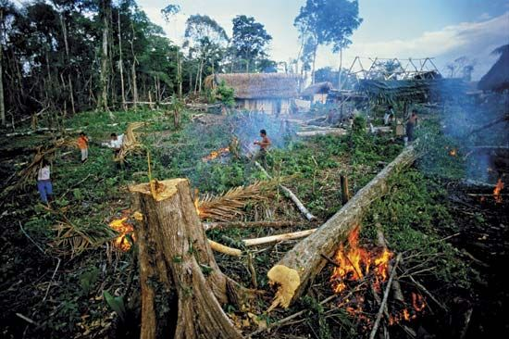
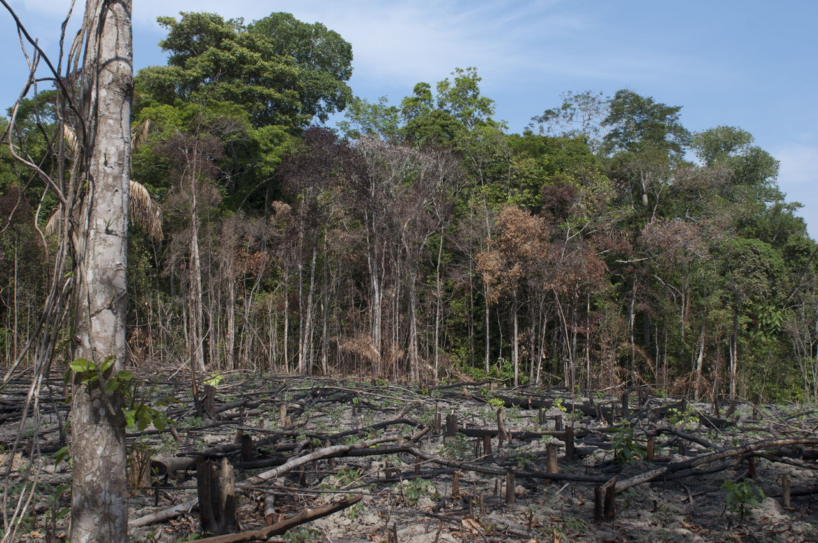
Warn humans not to destroy the rainforests!
Your warning story will be about someone warning the main character not to destroy the rainforests but they go and do it anyway!
What might happen if humans destroy the rainforest?
How might the main character or the rainforests be rescued?

Slide 27

Your story
Who is the main character?
What have they been warned not to do?
Who or what warned them?
Where are they?
What are they doing?
Why are they there?
How are they feeling?
In pairs/small groups – look at the questions and discuss how you would answer them.
You might like to write your answers on your whiteboard.

Slide 28
Your story
Who is the main character?
What have they been warned not to do?
Who or what warned them?
Where are they?
What are they doing?
Why are they there?
How are they feeling?
Let’s share some ideas with the class!
There might be some ideas we could magpie.

Slide 29
Paddling | Snorkelling | Diving
With LSA Activity 1 – Write down the answers to the questions about your warning story. Activity 2 – Walk around the classroom and ask the questions to different children. Has everyone answered the questions? Are there answers clear? Do they have enough detail? Is there anything they could add? Red Pen: Read A Caravan again from last lesson and look for any words/phrases you could use in your own warning story. Write these words/phrases in your books under today’s work. | Activity 1 – Write down the answers to the questions about your warning story. Activity 2 – Walk around the classroom and ask the questions to different children. Has everyone answered the questions? Are there answers clear? Do they have enough detail? Is there anything they could add? Red Pen: Read A Caravan again from last lesson and look for any words/phrases you could use in your own warning story. Write these words/phrases in your books under today’s work. | Activity 1 – Write down the answers to the questions about your warning story. Activity 2 – Walk around the classroom and ask the questions to different children. Has everyone answered the questions? Are there answers clear? Do they have enough detail? Is there anything they could add? Red Pen: Read A Caravan again from last lesson and look for any words/phrases you could use in your own warning story. Write these words/phrases in your books under today’s work.

Slide 30
Thursday 20 January 2022
LO: To write with purpose
C: Warning Story

Slide 31
You are going to box up your story today to make sure that it follows the generic structure of a warning story.
By boxing up, we can see the order we are writing in and gives us ideas for organising our writing in paragraphs.

Slide 32
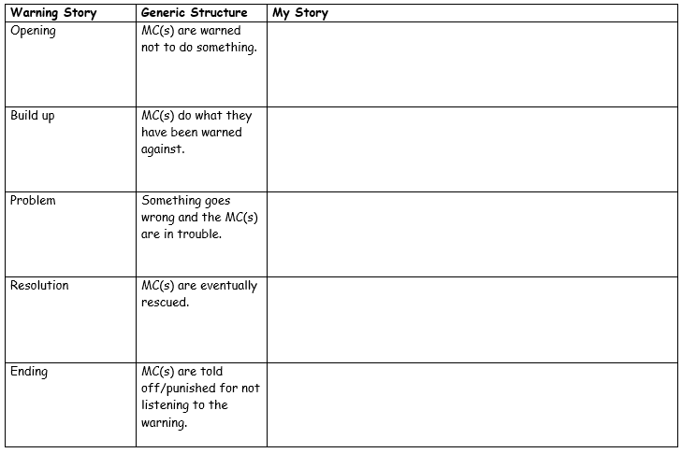
The first column is for what happens in any warning story, not just A Caravan.

Slide 33
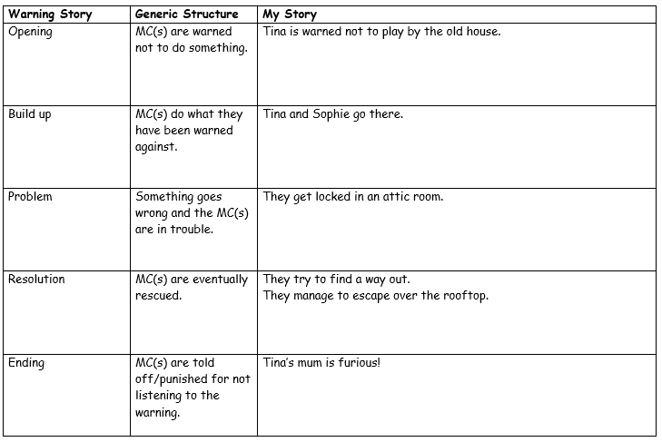

Slide 34
Let’s fill this in using your ideas.

Slide 35
Paddling | Snorkelling | Diving
Independently box up the story you planned last lesson with Mrs Kelley. | With LSA Box up your own warning story. | With CT Box up your own warning story. Red Pen: add more details to your plan to help you remember what is happening.

Slide 36
Friday 21st January 2022
LO: To use imaginative description
C: Warning Story

Slide 37
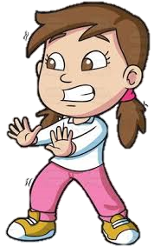
Before we can start writing our stories, we need to have a really clear picture of our main character.
What do they look like?
What kind of person are they?
Why do they ignore the warning?

Slide 38
What do they look like?
What kind of person are they?
Why do they ignore the warning?
In pairs/small groups, answer these questions for your main character.
You may like to quickly sketch a picture of your main character on your whiteboard to help you with your description.

Slide 39
For example:
Susan is small but mighty. Her little button nose wrinkles softly when she is thinking carefully. With her short, chocolate brown hair securely tied in unruly pig-tails, she is ready for anything. Her dark mud eyes are saucers and her smile is contagious. You will often find Susan dressed in pink, denim jeans and a stained, white top as they help her stand out from the crowd. On her weary feet, she wears scuffed, orange trainers which are always on the move. Susan is a stubborn, authoritative person who never does as she is told because she stupidly thinks she knows best. Despite this, she has a heart of gold. Her legs may be short and scrawny but she is as strong as solid rock. Do not underestimate Susan’s strength as her small features misleading! She is a courageous, young girl with no fear.

Slide 40
Paddling | Snorkelling | Diving
With LSA Draw a picture of your character and then label it with descriptions. Have you used adjectives to describe? | Draw a picture of your main character and write sentences underneath to describe them. Have you used: *expanded noun phrases *similes *metaphors Red Pen: Thesaurus any words you have repeated or used in your writing before! | With CT Draw a picture of your character and write a descriptive paragraph underneath, remembering to use expanded noun phrases, similes and metaphors. Red Pen: Thesaurus any words you have repeated or used in your writing before!

