Slide 1
When we have our PSHCE lessons
we need to be respectful of each other.
We use these rules to help us do that.

Slide 2
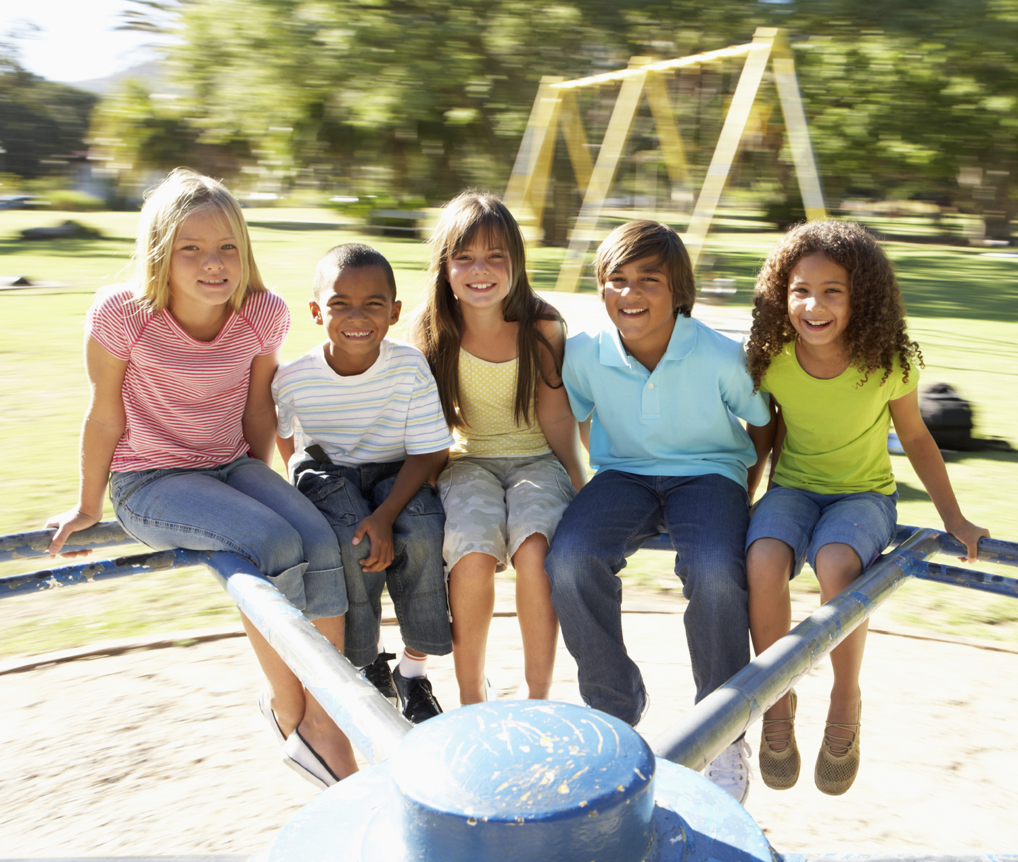
These children are all including
each other in their play.
Write down how you feel
when you’re included in
a game.

Slide 3
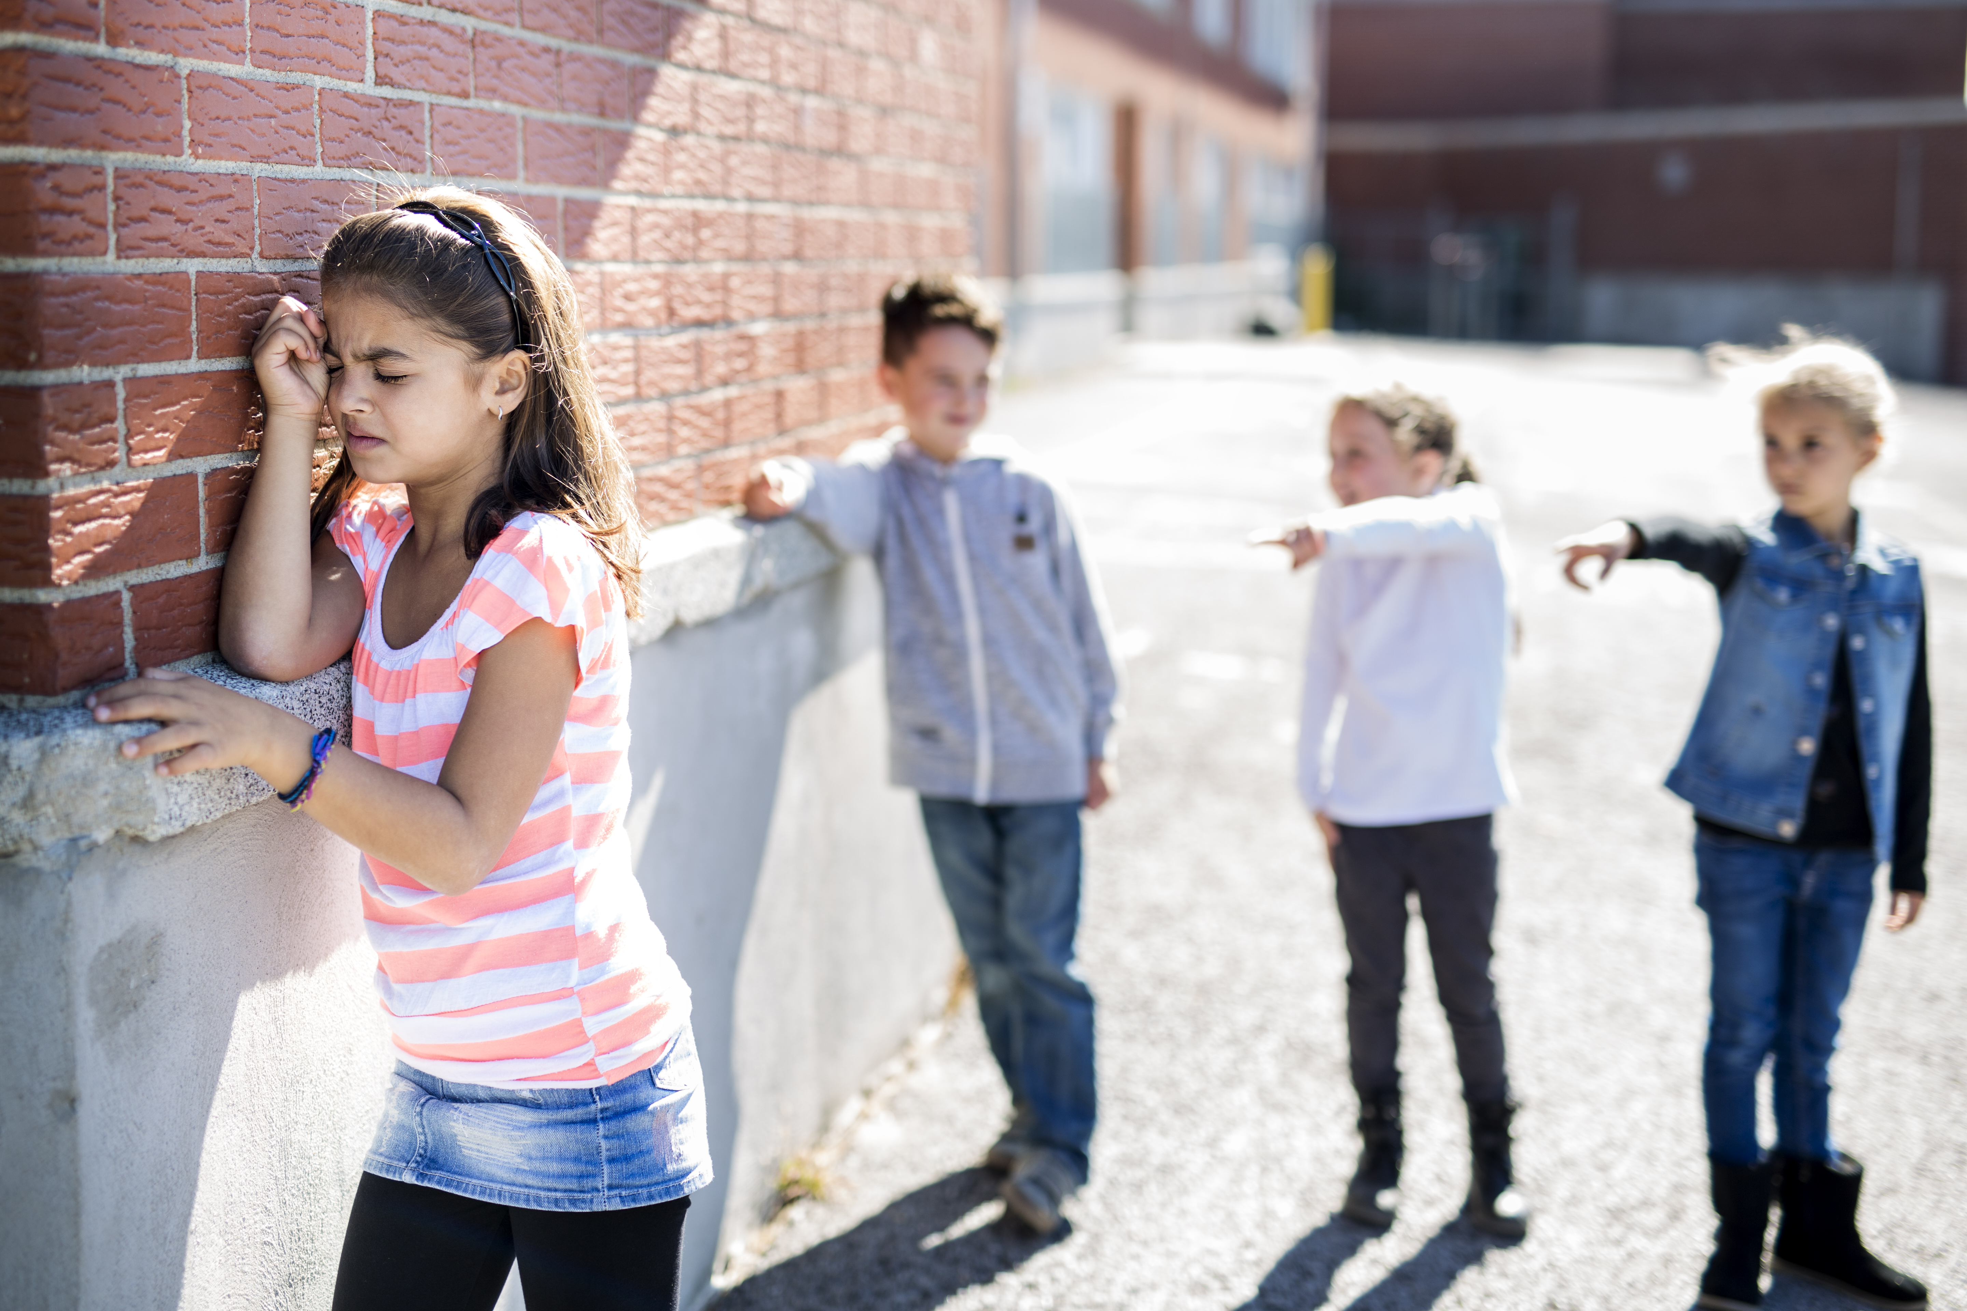
These children are excluding
Someone in their play.
Write down how you feel
when you’re excluded in
a game.

Slide 4
We all understand how it feels to be included and excluded from a group/team, so it’s important for everyone in our class to feel included and valued as part of our class team.

