Slide 1
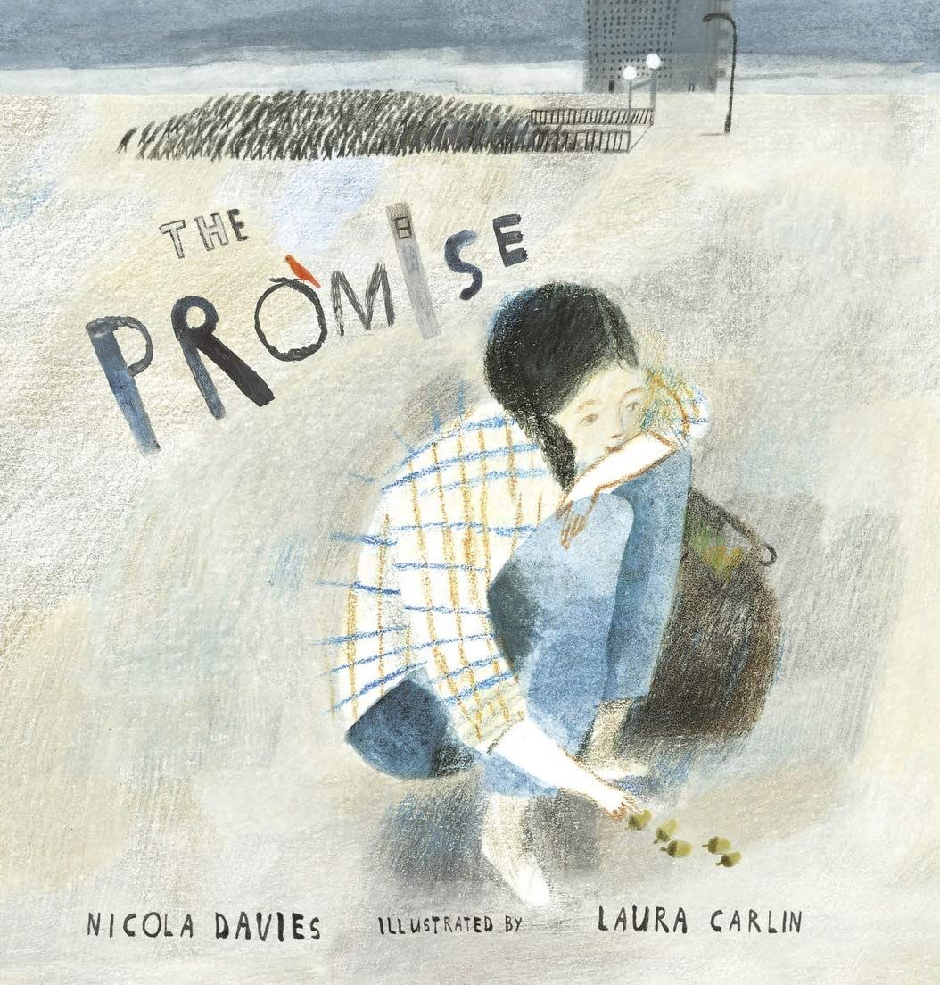
Our growing future
The Promise
By: Nicola Davies
Friday 10 September 2021
LO: To write a tree poem using your senses.

Slide 2
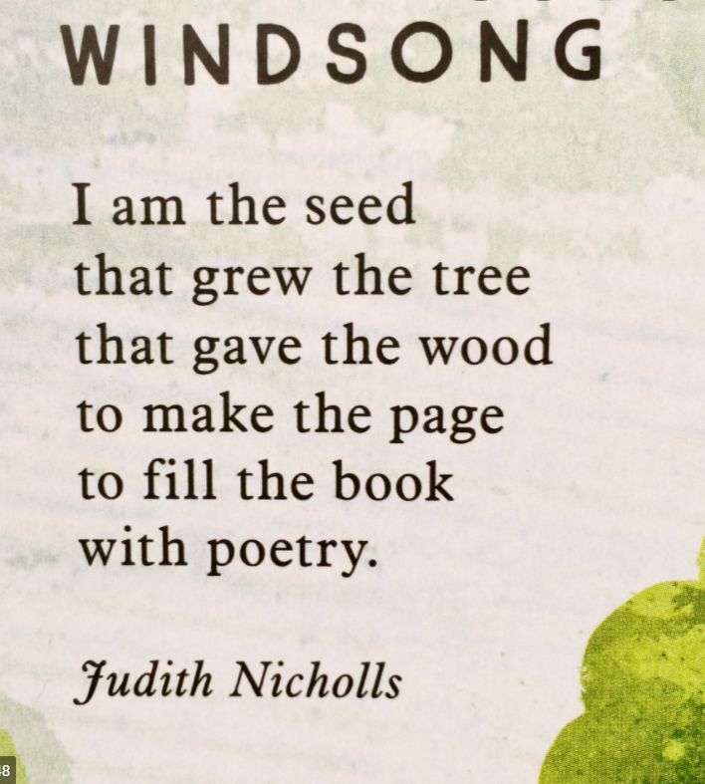
There are poems all around the room today. Read them.
When you have looked at all of them, stand by your favourite.

Slide 3
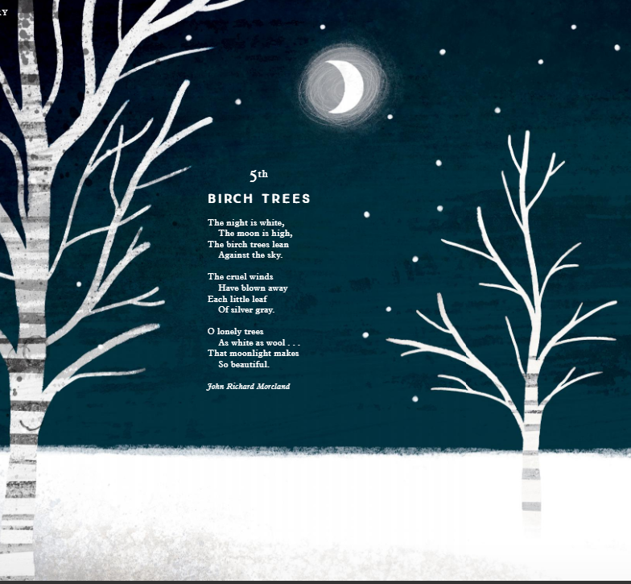
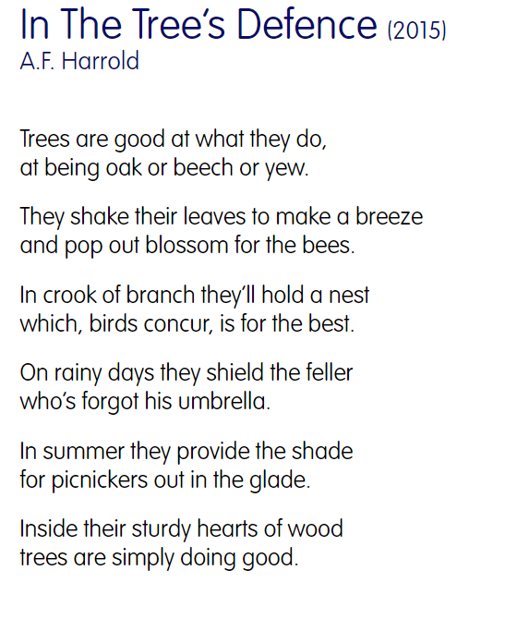

Slide 4
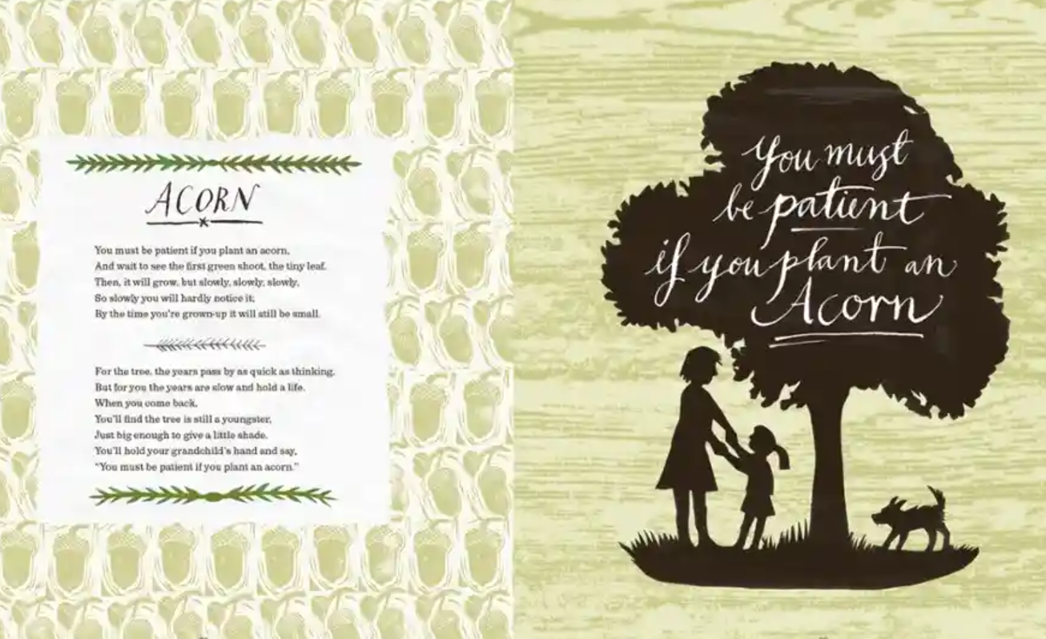

Slide 5
Who else picked this one?
Carefully take it off the wall and find somewhere to sit together.
Why did you select this poem?
How does it make you feel?
Do you have any personal connection to the poem?
What questions do you have about it?
Write your thoughts on the sugar paper provided.

Slide 6
What ‘secret strings’ does the poem contain?
Michael Rosen says that these are things you can’t always see but become apparent when you investigate.
Examples include:
Rhyming
Assonance (when the middle syllables rhyme)
Pattern (such as the length of lines)
Meaning or imagery (such as using lots of words referring to light)

Slide 7

Let’s share our ideas!

Slide 8
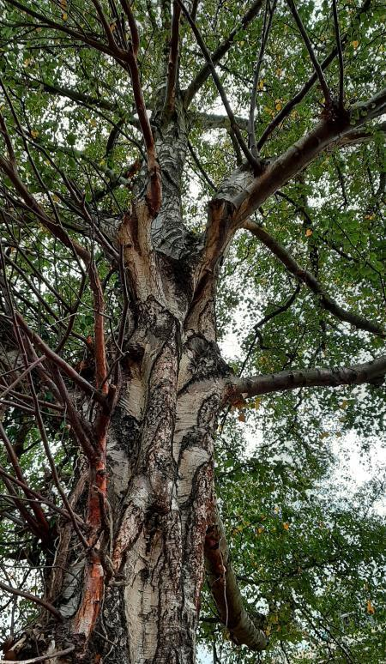
Tree Poem
We will now go outside and sit under the trees.
Look up into the branches and feel the texture of the bark.
Look at the colours, shapes and patterns of the flowers, seeds,
buds, fruits or leaves.
Can you find a living creature? Describe how it looks, what it does or
how it moves.
We will take stetches of what we see and take photographs.
Make notes of your thoughts, feelings or any words, phrases or images
that come to mind as you sit and focus on your surroundings.

Slide 9

Back in class- What did we find?
Let’s turn our impressions into a tree poem.
We will write the poems into our books.
Remember to give your poem a good heading!
Have fun!

