Slide 1
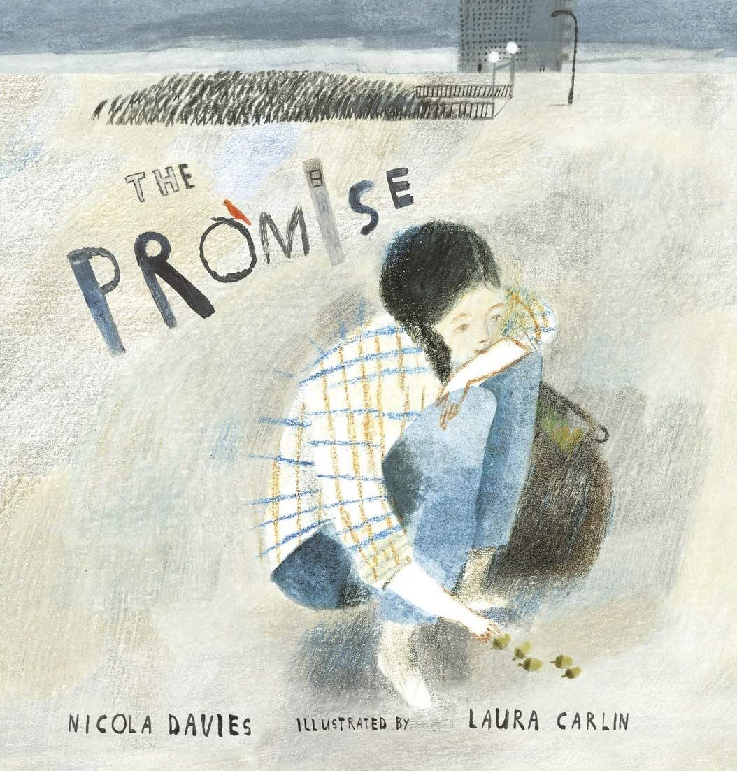
Our growing future
The Promise
By: Nicola Davies
Thursday 9 September 2021
LO: To write a short diary entry.

Slide 2
Reread from the start of the book to … ‘I began to keep my promise.’
What do you know or think about her life now?
Were you surprised when the girl stole the bag?
What did she think was going to be in the bag?
How do we know that the content of the bag is precious?
What do we think her dreams for the future might be?

Slide 3
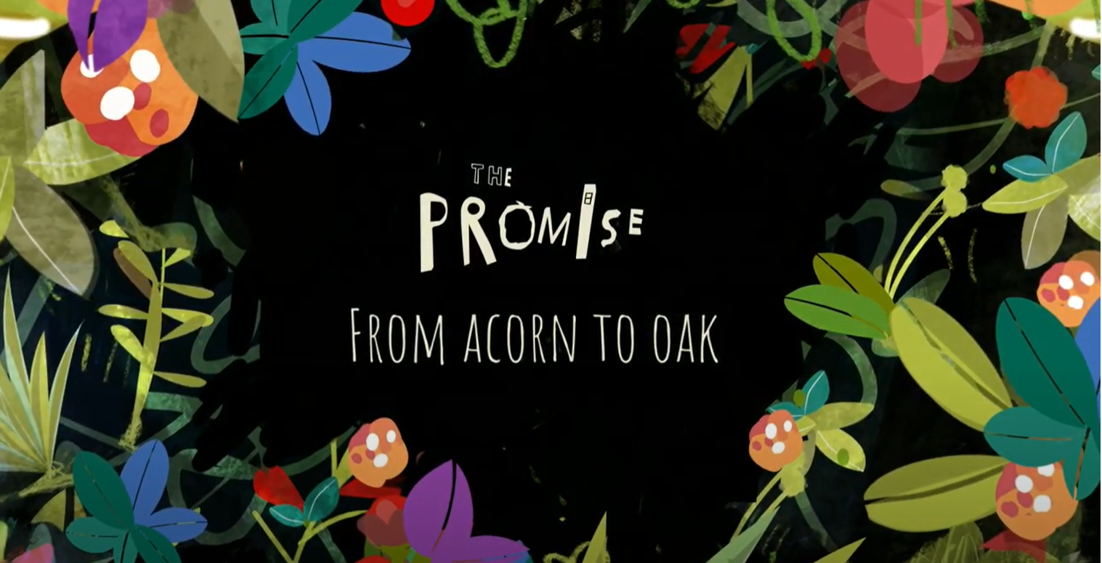
An acorn grows into an oak tree. It takes many, many years.
This is how much it grows in 8 months!
https://www.youtube.com/watch?v=moTbUwJyGQw
Will it be easy for the girl to honour her promise? Why?

Slide 4
Now that you know a bit more about the girl’s character,
what questions would you like to ask her?
How can we make sure we get really interesting answers?
What choices led you to…….?
Why did you think that……..?
What made you decide that……….?
Work in partners to compose questions that you would like to ask the girl.
Write them on your whiteboards.

Slide 5
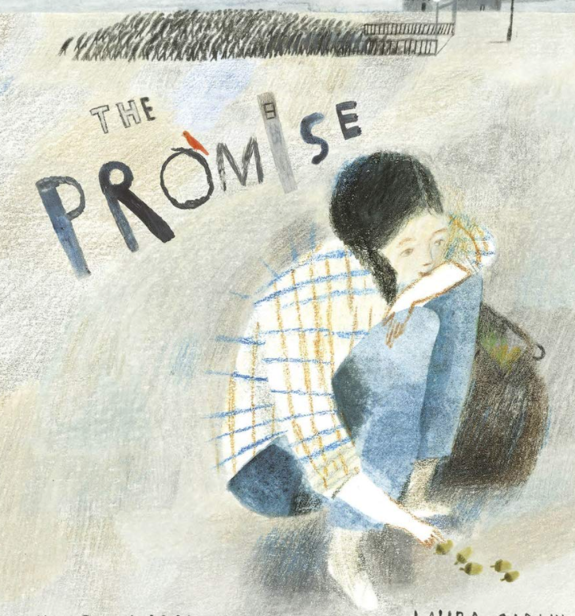
Hot Seating
Now, Let’s hot seat our questions!

Slide 6
The Promise – Diary Entry
We are going to turn the answers from the girl during our
hot seating into a short diary entry.
How does the girl feel having made her promise and what is she
hoping for?
What might the benefits be?
What might she be concerned about?

