Slide 1
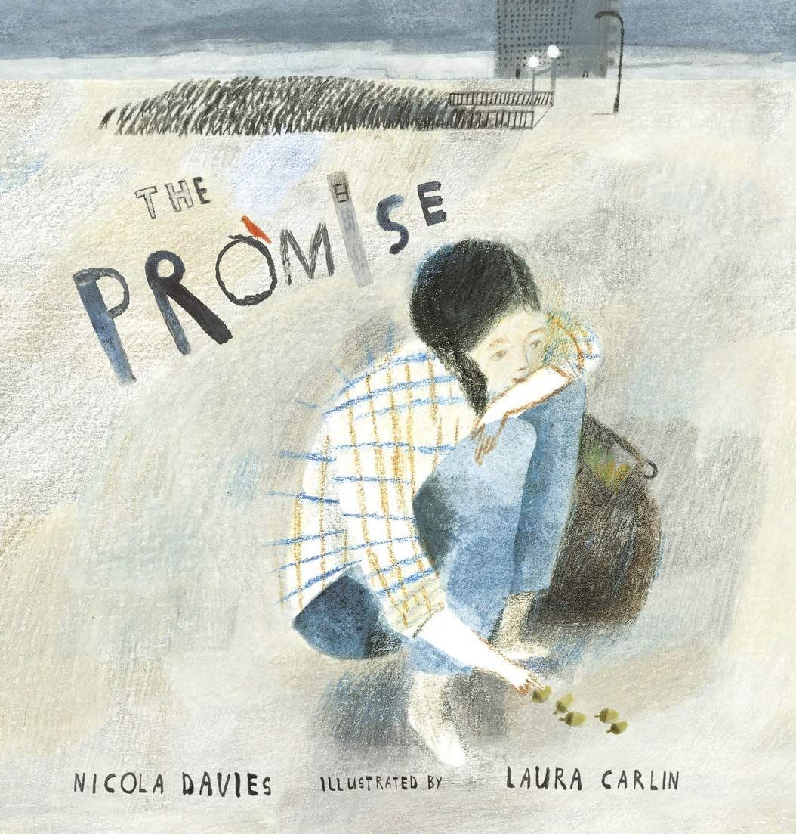
Our growing future
The Promise
By: Nicola Davies
LO: To write a pen portrait of a character in a book.
Wednesday 8 September 2021

Slide 2
Look at the photocopied pages 1 &2 on your tables.
What do you notice? Where could this be?
How do you imagine it feels to be in this place?
What words or phrases would you use to describe it?
What might you see, hear, feel or smell? Write ideas on post-it notes.
Look at the photocopied page 3
Where might this story take place? Discuss
Why might the character be walking here?
How do you think the character feels? Why?
Why do you think there are no other people in this illustration?
Discuss the impact of the composition, layout and colour.
What do you think the title ‘The Promise’ means?

Slide 3
Read as far as ‘the dead trees in the park.’
Talk about the text
What do you notice in these images?
How does it make you feel and why?
How does it compare to our local area?
How does it differ to the poems we wrote about?

Slide 4
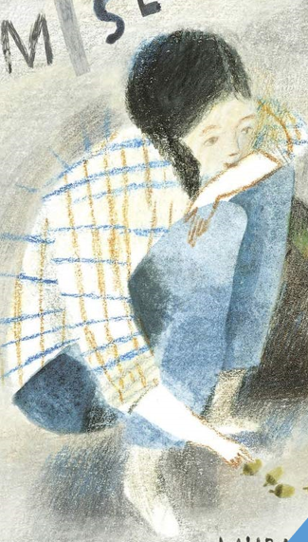
Let’s think about the unnamed girl.
What impact would the environment have on her?
How might the city affect the way she thinks, feels or behaves? Is that fair? Why/why not?
How would you feel to live in that environment?

Slide 5
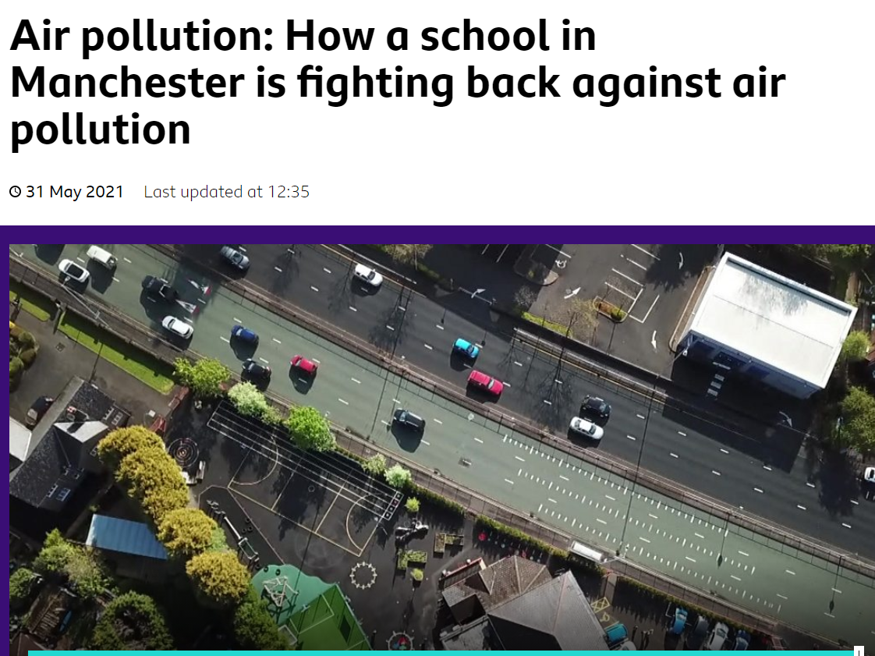
As a real world- but less extreme- example of the impact of an urban environment on children’s health, let’s watch and discuss this short Newsround item on the impact of air pollution on a school in Manchester and what the pupils are doing to protect their rights!
Article 24: Every child has the right to the
best possible health. Governments must
provide good quality health care, clean water,
nutritious food and a clean environment as well
as education on health and well-being
so that children can stay healthy.
https://www.unicef.org.uk/what-we-do/un-convention-child-rights/
https://www.bbc.co.uk/newsround/57228756

Slide 6
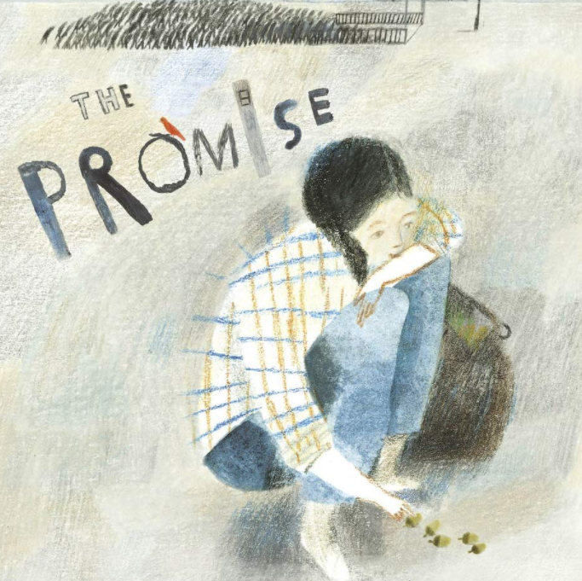
What do we know about her?
How does she feel about this city?
How did she come to be in this situation?
Why does she do the things she does?
How does she feel about it?
Remember: There is not one right answer to these questions!

Slide 7
Pen Portrait
We are going to create a pen portrait of the girl. This is an informal description of her/ character sketch in words.
Include:
Age
Gender
Name
Attitudes and appearance
Background
Relationship to other characters
Her role in the story
Likes and dislikes
Include your own opinion about the character and their situation and inferences about them from what you have read.

