Slide 1
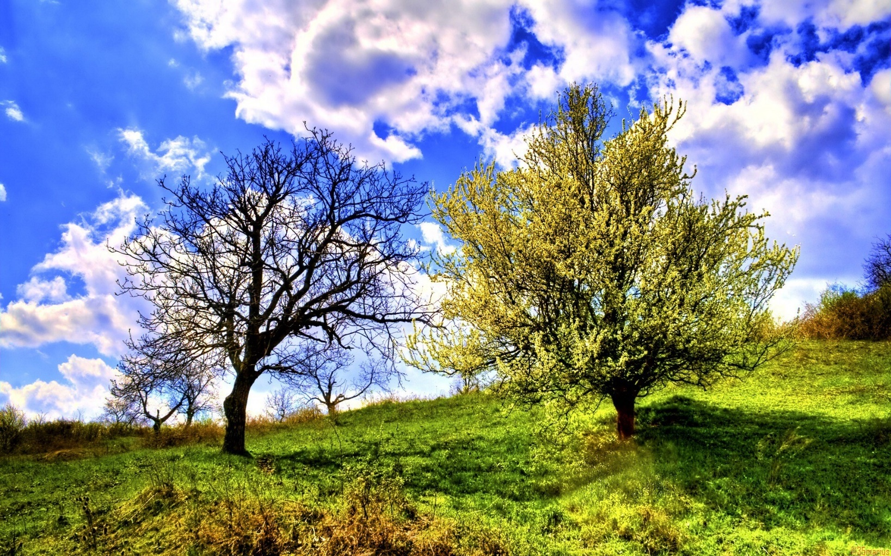
Tuesday 7 September 2021
LO: To write a poem about nature.
To edit and redraft a poem before finalizing it.

Slide 2

Let's read over our poems from yesterday. Continue to add ideas to them.
When you have finished your draft, read it to your partner. Discuss which parts are successful and why. Then talk about words or phases which could be changed to become more effective. Discuss ideas on how to improve the poem. Spend time editing and redrafting.
Use a thesaurus to improve vocabulary.

Slide 3
Final written product
Have you effectively communicated the feeling of
being in the outdoor space?
Once you are happy with your final draft,
it is time to publish your poem.
Write out your poem with your best handwriting.
Decorate around your poem with pictures that best
represent your thoughts and feelings.

Slide 4
Presentations
We will take turns to present our poems to the class.

