Slide 1
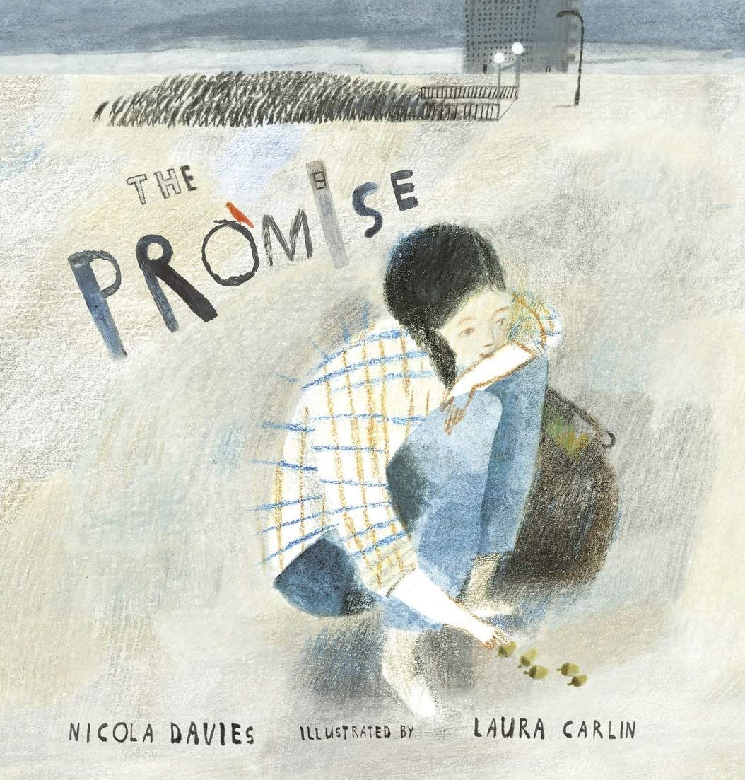
Our growing future
The Promise
By: Nicola Davies
Monday 6 September 2021
LO: To draft a nature poem.

Slide 2
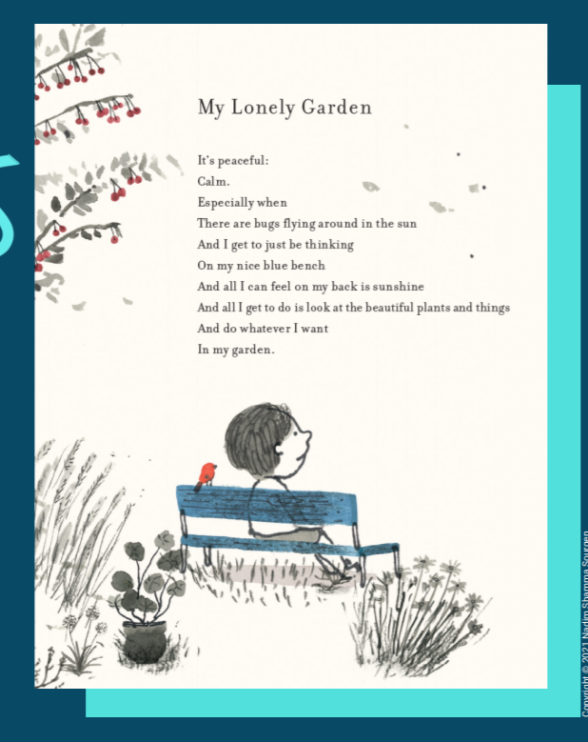

Slide 3
Would you be surprised if I told you that the poet, Nadim, is only four years old? He has this and other poems published in a collection by Walker Books.
How does he feel about this place and how can you tell? What does he see, feel and hear?
What words, phrases or lines are most memorable for you? Why is this? What words help you picture what the garden is really like?

Slide 4
Why do you think he has used the word lonely in this title?
Do you think this is a good or bad feeling?

Slide 5

Let’s go outside! We are going to be looking for nature, trees and plants.
Take in your surroundings and focus on what you can see, hear, smell and touch.
Think about how this place makes you feel!
We will also make observations of the human impact on the environment- Good and bad.
Have trees or flowers been planted? Has the grass been cut? Are there weeds growing? Is there damage to trees or other flora- accidental or deliberate? Do you see any litter? Are there enough bins around the surrounding area? Do you see wildlife?
We are going to record our observations including our thoughts, feelings and ideas.

Slide 6
What did you see, hear, see and smell? What did you touch?
How did it make you feel?
Did it remind you of anything?
In pairs... talk through your answers.

Slide 7
Poetry
We are going to write our own poem based on the observations we made outside. First, we need to think about the structure of our poems such as free verse, list poem or rhyming couplet.
Today we will start a draft and continue with our poems tomorrow.

Slide 8
Nature is where I am happiest,
Quiet, tranquil, contemplative
Alone in my thoughts.
Cool breeze whispering
Sends shivers down my spine.
Sunbeams like swords
Cutting through the trees
Warms my face and my heart.
Green leaves, tall trees
Pink and red flowers blossom
Ants crawling and butterflies fluttering.
I feel at peace and happy to be alive,
Nature is where I am happiest!
Free verse

