Slide 1
PSHE and Citizenship
Relationships | VIPs
PSHE and Citizenship | LKS2 | Relationships | VIPs | Fabulous Friends | Lesson 2

Slide 3
Aim
I can explain how to make and keep fabulous friends.
Success Criteria
I can explain why we need new friends.
I can suggest different ways we can make new friends.
I can describe ways to treat my friends to ensure we stay friends.
This resource is fully in line with the Learning Outcomes and Core Themes outlined in the PSHE Association’s Programme of Study.

Slide 4
The Big Questions

Slide 5

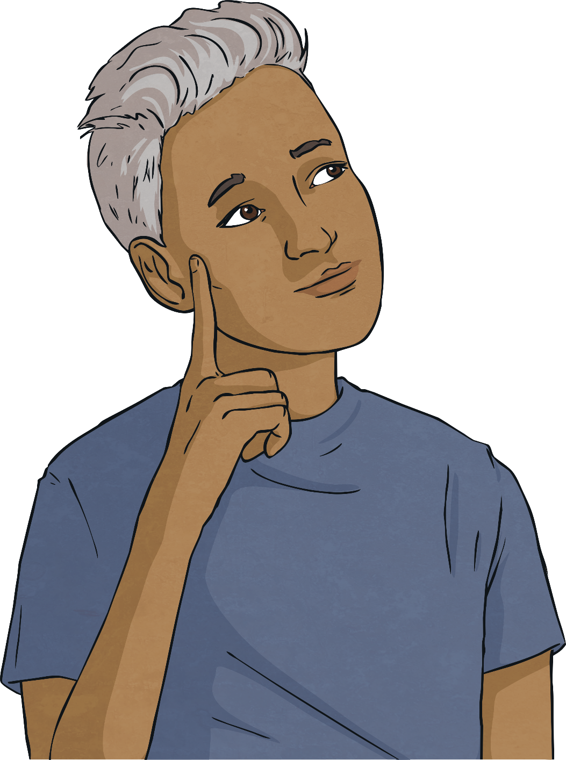
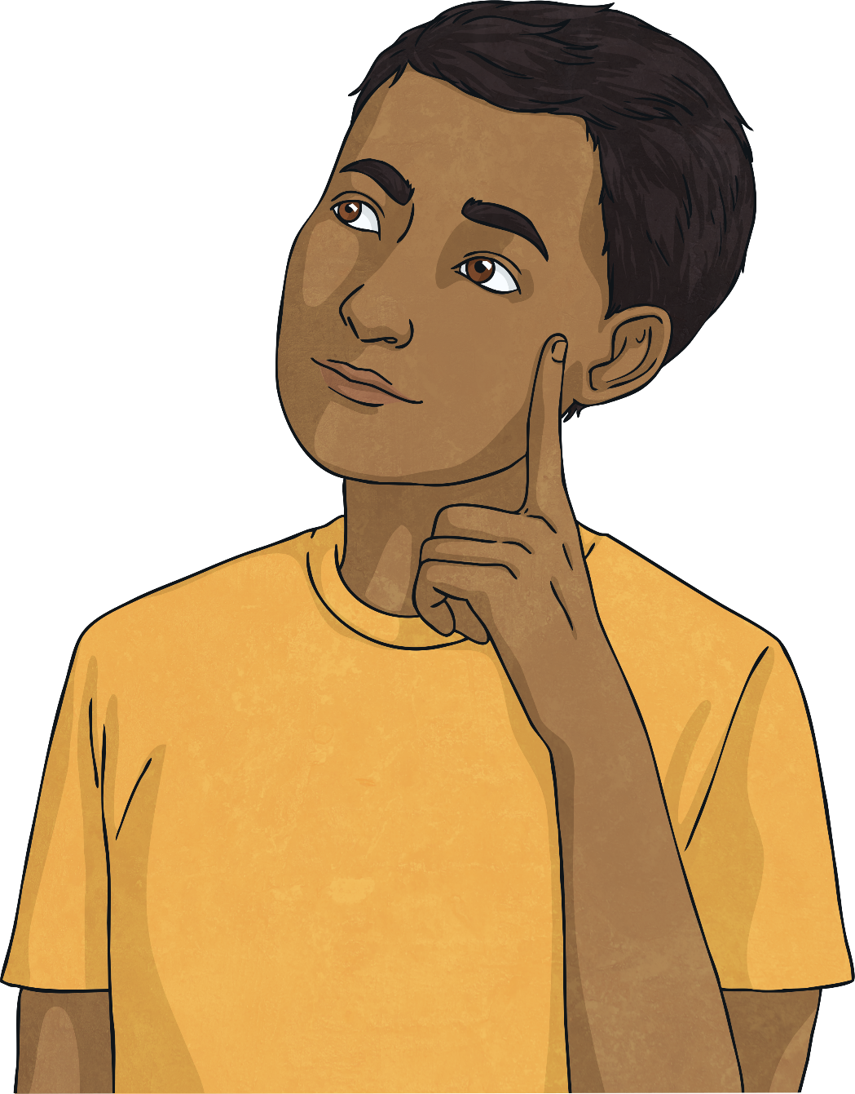


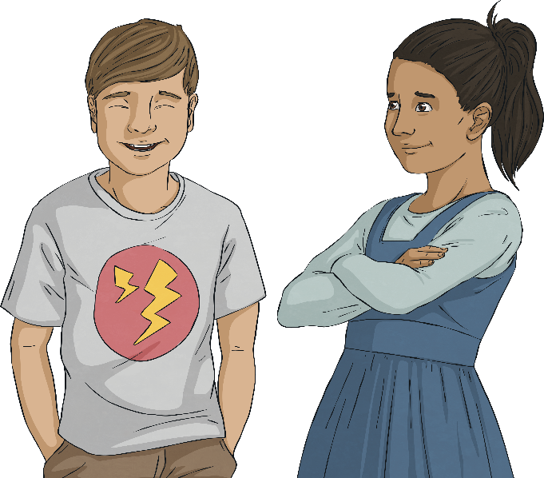
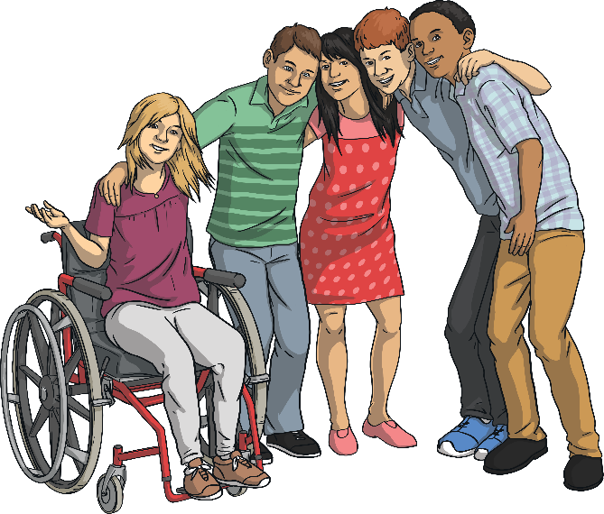
What makes a great friendship?
Why is friendship important?
Why is friendship important?
What makes a great friendship?

Slide 6
Reconnecting

Slide 7

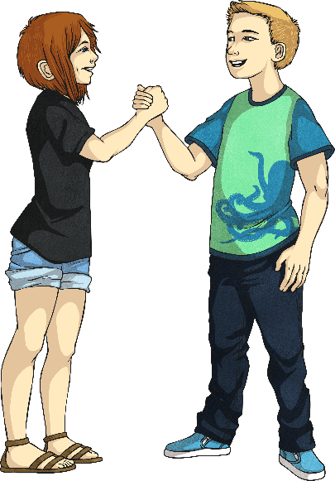
Friends
Friendship is defined as a relationship of mutual affection between people.
Do we ever get to a point in life where we don’t need any more new friends?
Or, should we always be open to the idea of making new friendships?
Who are
your friends?
How did you make your friends?
Sometimes we make friends with people because of our parents or carers, sometimes it is because we like the same things or because we have the same hobbies. Sometimes it can be because we have the same mutual friends and sometimes it is just down to chance, for example, who we are asked to sit next to.

Slide 8

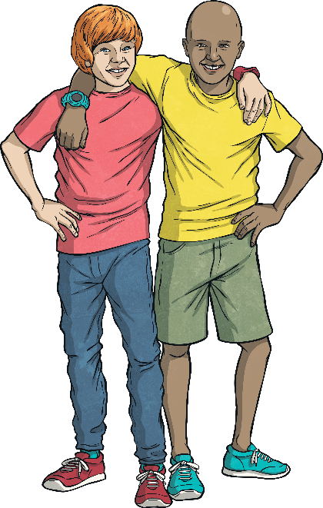
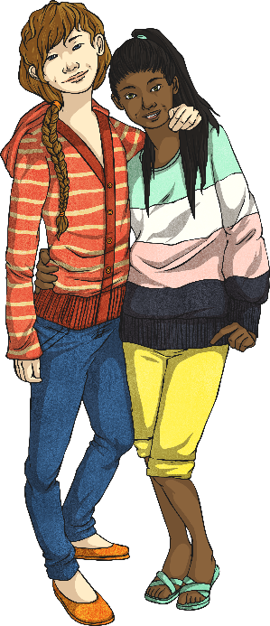
Friends
How can we make new friends?
Think about the things you enjoy and seek out someone else who enjoys those things.
Say ‘hello’ to new friends, showing you are open to their friendship.
Say something nice to your new friend about them.
Do something kind for your new friend.
Smile and have fun.
Be willing to share – your things and your friend; let them have other friends, too.
Be happy and proud of who you are – confidence will make others want to be friends with you, too.
Is it easy to make friends or is it a hard thing to do?

Slide 9
Exploring

Slide 10

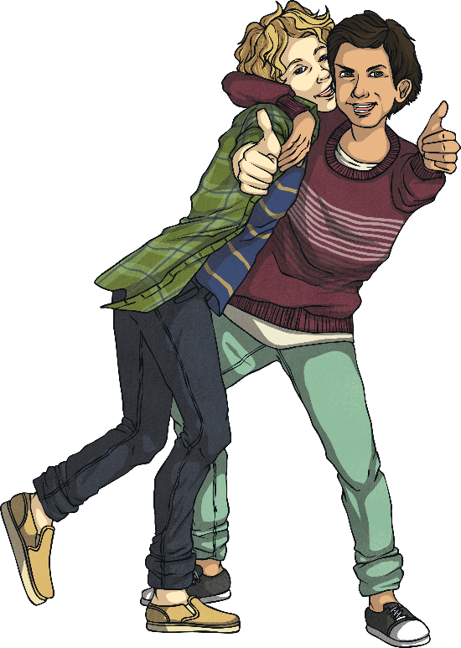
My Interests
One good way to make friends is by finding a common interest.
A common interest is something that you both enjoy. This could be something that you like doing, like dancing or reading, or something that you enjoy learning about, like animals or space.
If you and your friend have a common interest, then you will always have something to talk about!
Understanding what your interests are can help you to see good opportunities for making new friends.

Slide 11
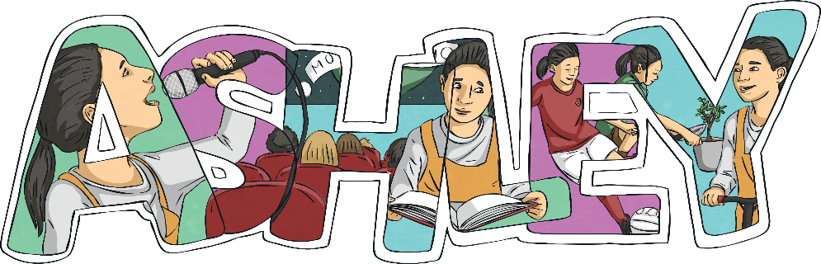
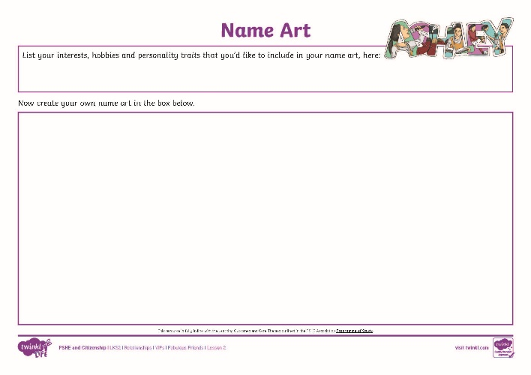
My Interests
Name art is where your name is written in the middle of a piece of paper. You then write, or draw your interests, hobbies or personality traits using the letters within your own name.
Here is an example of a piece of name art.
Using the Name Art Activity Sheet, can you create your own piece of name art?

Slide 12

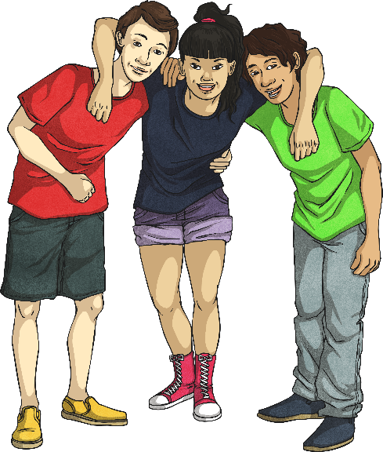
Friendships
Why might we need more than one friend in our life?
Through our lives, we will go through different experiences and we will have happy times and sad times. Different people will be important in our lives at different times.
For example, a friend we play netball with will be important when we are working hard to train for the netball team.
A friend who is funny will be important when we need cheering up.
A friend who is a good listener will be important when we need to talk.

Slide 13
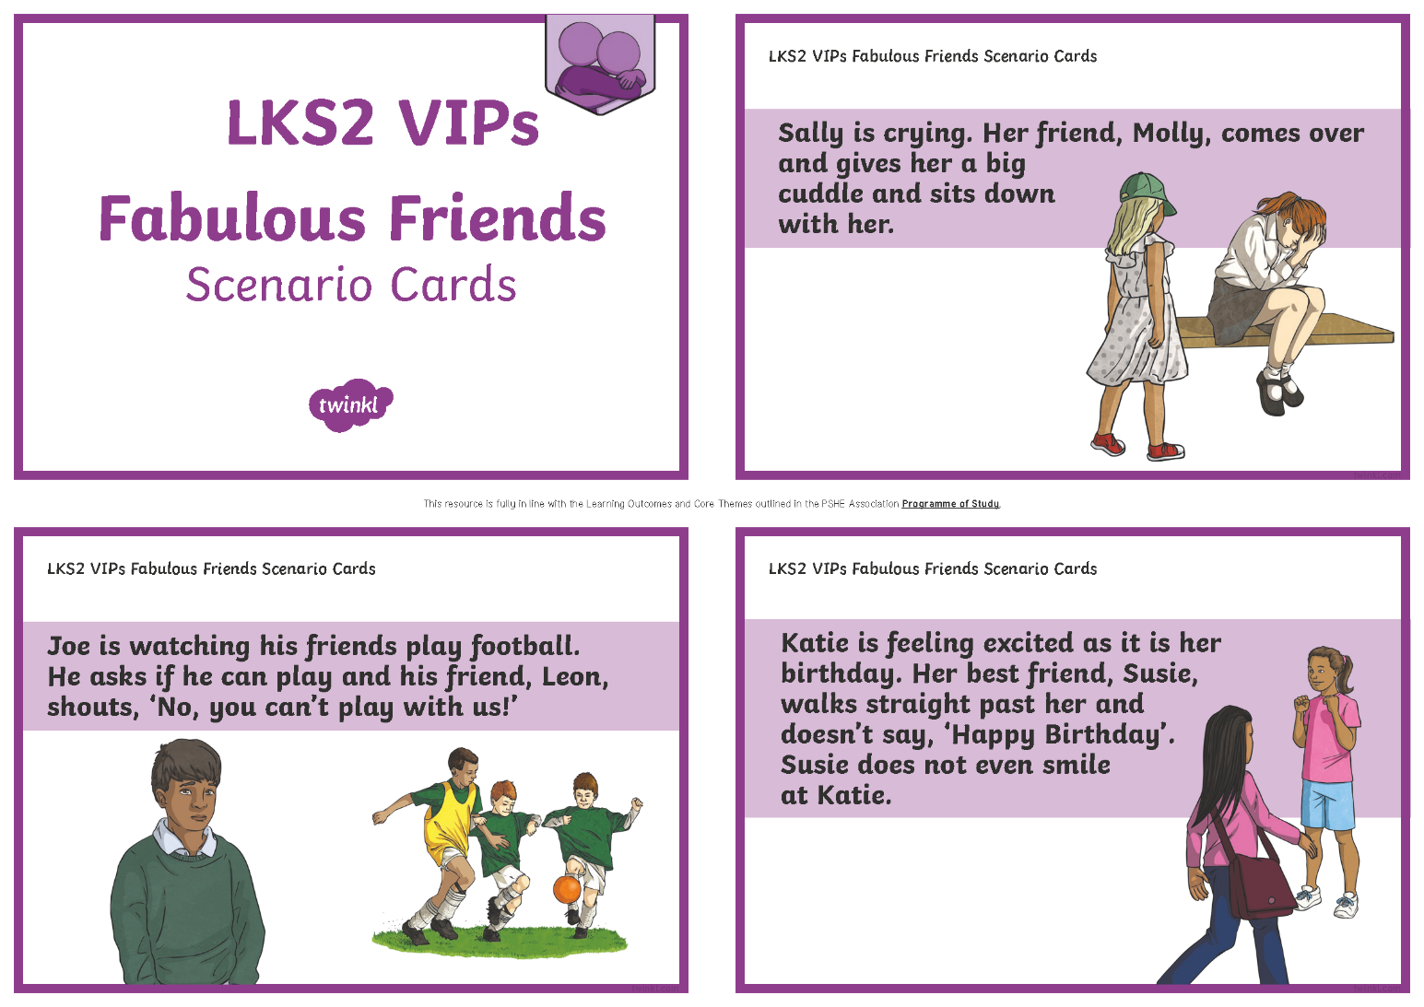
Friendships
We need lots of people around us for times when we need different things from our friends. In the same way, our friends will need us.
Our different personalities mean that we can be good friends to others at different times.
On the Friendship Scenario Cards, look at the need for new friends and how the attitude of the children will impact the friendship being made.
Discuss this in your groups.

Slide 14
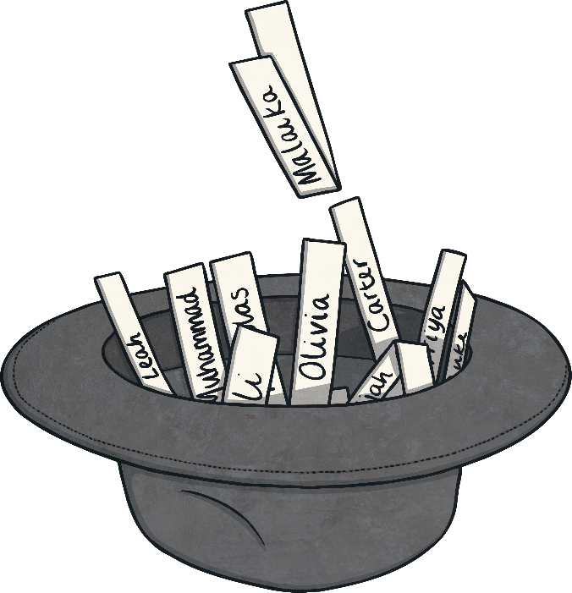
Anonymous Friends
Write your name on a piece of paper, fold the paper up and place it in the class hat.
Everyone will then pick a name out of the hat, one at a time.
The name written on the piece of paper is the person you have to be an anonymous friend to.
Do not tell anyone who you are being an anonymous friend to!

Slide 15
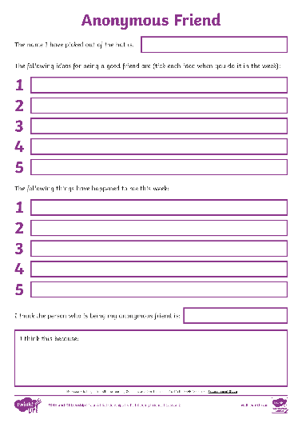
Anonymous Friends
This week you have to be a good friend as an anonymous friend. Doing something anonymously means not telling anyone it is you.
This could include being extra kind to them, looking out for them, complimenting them, playing games with them, etc.
At the end of the week, you will all have to guess the person who has been your anonymous friend. You will complete the Anonymous Friend Activity Sheet to focus on the ways to maintain friendships.
Consolidating
Reflecting

Slide 16
Consolidating

Slide 17
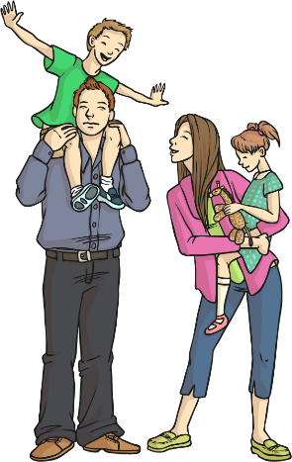
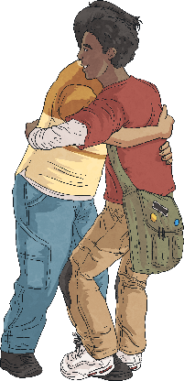


Old Friends
Why is it good to have old friends as well as new friends?
They will have
known you through good times and
bad times.
They are likely to know your other friends and family.
You know how
loyal they are if you've been friends for a long time.
You know what they are like in their good times and bad times.

Slide 18

Old Friends
How can we maintain our friendships with our older friends?
regular contact
being caring towards them
showing an interest in them
remembering key times, for example, their birthday
making time for them
In pairs, discuss which of the ideas above are the most important to maintaining friends.
Friendship is hard work at times and we need to make a conscious effort sometimes to keep the friendship going.

Slide 19
Reflecting

Slide 20
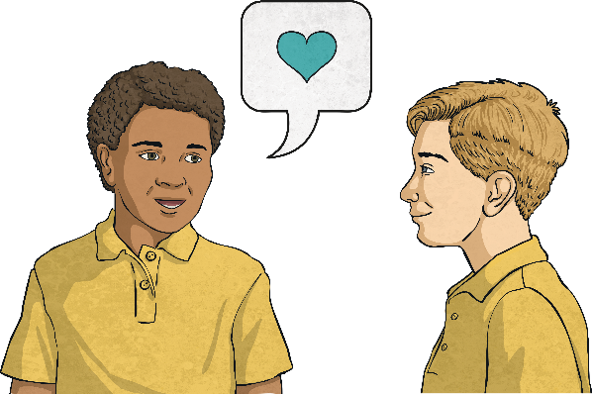
Kindness
Discuss with your partner why we need to be kind to our friends.
Why do we have friends?
Sometimes our friends go through difficult times. At these times our friends really need us to stick by them and help them through. This can include asking an adult for help if your friend is behaving differently from how they usually behave.
Why should we continue to be a
friend when our friend is going through a difficult time?

Slide 21
The Big Questions

Slide 22
Why is friendship important?
What makes a great friendship?

Slide 23
Aim
I can explain how to make and keep fabulous friends.
Success Criteria
I can explain why we need new friends.
I can suggest different ways we can make new friends.
I can describe ways to treat my friends to ensure we stay friends.

