Slide 1

Monday 21 February 2022
ENRICHMENT WEEK WORDS WORDS WORDS!
LO: To present neatly
C: Fine motor and spelling activities
BOLE

Slide 2


WOW Word Of The Week:
surreptitiously
Clap out the syllables: sur-rep-ti-tious-ly

Slide 3
surreptitious- adjective
add ly-
surreptitiously to make it an adverb
surreptitiously definition:
In a way that attempts to avoid notice or attention; secretively.
In a secret or unauthorised way.

Slide 4
This week for enrichment week, we are working on spelling and handwriting in FUN and creative ways.
Our spelling pattern of the week is –cian
politic- politician
music- musician
mathematics- mathematician
magic- magician
optic- optician

Slide 5
We are sending home 10 spellings which need to be learnt each night. On Friday we will be taking part in a Spelling Bee against the other Year 4 class! We will spin the wheel of names to choose the children to face each other.
1. friend
2. beautiful
3. their
4. there
5. they’re
6. where
7. were
8. which
9. because
10. piece

Slide 6
BOLE
Binfield Cursive Handwriting and Spelling Bee words
ªa ¶b ªc ªd â ¶< ªü ¶h ¶i ¶ý ¶„ ¶l ¶m ¶n ª‹ ¶p ªq ¶r ¡ ¶t ¶u ¶v ¶w ¶ˆ ¶þ ¶z
In groups of 10 or less, rotate around the fine motor, handwriting and spelling activities set out in the BOLE. Make sure that you have a go at each activity set out. We will take photos for your books.

Slide 7
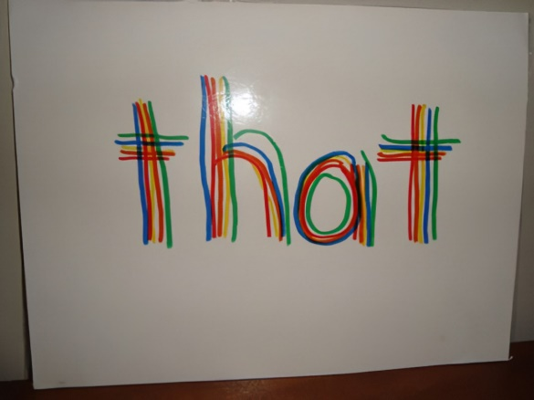
Practise your neatest individual cursive letter shapes and then write out the spelling Bee words. Ensure that they are spelled correctly and that each letter is formed carefully with the correct lead in lines, ascenders and descenders.
Activity 1: Shaving foam
Activity 2: Chalkboard and chunky chalks
Activity 3: Whiteboards and pens
Activity 4: Paintbrushes and coloured water
Activity 5: Drawing letter shapes and Spelling Bee words in the mud with sticks- ensure you form your letters carefully- it will be tough!
Activity 6: Felt tips and large paper- Rainbow writing

Slide 8
Remember to take turns, form your letter shapes carefully and most importantly HAVE FUN!

Slide 9
Wednesday 23 February 2022
ENRICHMENT WEEK WORDS WORDS WORDS!
LO: To present neatly
C: Fine motor and spelling activities
BOLE

Slide 10
Today in the BOLE, we are practising the Spelling Bee words and our pattern of the week –cian words
1. friend
2. beautiful
3. their
4. there
5. they’re
6. where
7. were
8. which
9. because
10. piece
cian
politic- politician
music- musician
mathematics- mathematician
magic- magician
optic- optician
How to spell the 'shun' sound - BBC Bitesize

Slide 11
Practise your neatest Spelling Bee words and pattern of the week cian words. Ensure that they are spelled correctly and that each letter is formed carefully with the correct lead in lines, ascenders and descenders.
Activity 1: Sand and scrabble letters
Rice and scrabble letters
Work with your group to take turns to pick out scrabble letters. Place them on the ground and see if you can spell a Spelling Bee word or a cian word.
Activity 2: Drawing words in the mud
Activity 3: Spelling Bee and cian word building with laminated letter cards
Activity 4: Threading with pipe cleaners and cut up straws. Each make a letter to put together to create a word of the week
Activity 5: Tweezers and buttons- pinch the tweezers together to pick up a button. Make a Spelling Bee word or cian word with the buttons
Activity 6: Use leaves, twigs and natural resources to make Spelling Bee words or cian words

Slide 12
Remember to take turns, form your letter shapes carefully and most importantly HAVE FUN!

Slide 13
Thursday 24 February 2022
ENRICHMENT WEEK WORDS WORDS WORDS!
LO: To spell correctly
To present neatly
To use sentences appropriately
C: Sentences using Wow word of the week

Slide 14
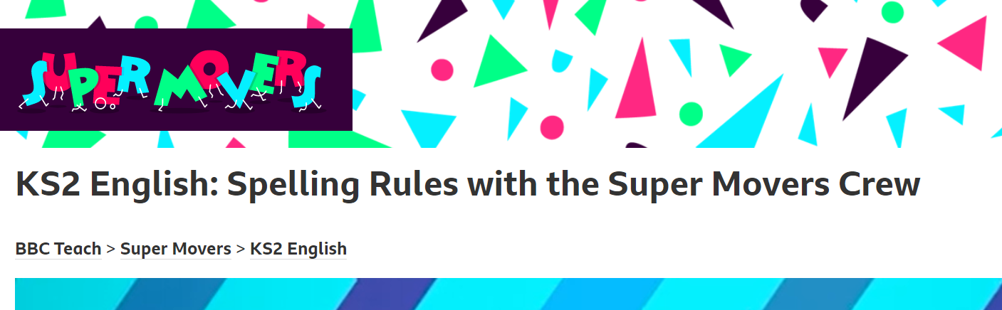

Starter
KS2 English: Spelling Rules with the Super Movers Crew - BBC Teach
Everyone needs a ball of dough for this fun fine-motor activity!
Dough Disco - YouTube

Slide 15
WOW Word Of The Week:
surreptitiously
Clap out the syllables: sur-rep-ti-tious-ly
How many can you count?
Write it in the air, on your knee, on the table with your finger
and on your partners back.

Slide 16
surreptitious- adjective
add ly-
surreptitiously to make it an adverb
surreptitiously definition:
In a way that attempts to avoid notice or attention; secretively.
In a secret or unauthorised way.

Slide 17
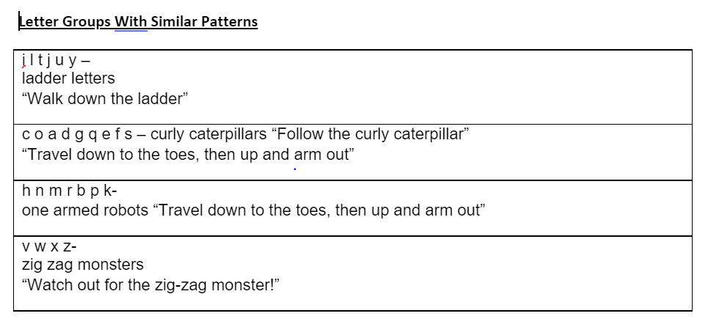
Using the handwriting paper provided, practise forming each letter shape with the correct lead in line. We are going to clear up any misconceptions about forming particular letter shapes today.
ªa ¶b ªc ªd â ¶< ªü ¶h ¶i ¶ý ¶„ ¶l ¶m ¶n ª‹ ¶p ªq ¶r ¡ ¶t ¶u ¶v ¶w ¶ˆ ¶þ ¶z

Slide 18
Now, let’s write each letter shape again carefully into our English books, ensuring that the down strokes of letters are parallel and equidistant and that the ascenders and descenders of letters do not touch.
In your neatest Binfield handwriting, write out the following sentence:
The nervous, young girl surreptitiously wiped the tears from her eyes before entering class.

Slide 19
TSP: Think about interesting sentences using our WOW word surreptitiously. Can you include a Spelling Bee word?
Share with the class.
Lets try to extend our sentences using conjunctions.
Can you add adjectives to make it sound more exciting?
Can you use any emotion synonyms from mental health week?
My wonderful friend surreptitiously snuck a delicious, caramel chocolate into my bag, as I was feeling rather glum in the morning.

Slide 20
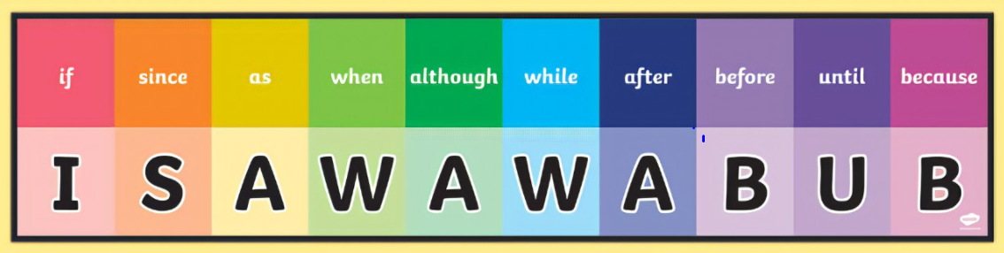
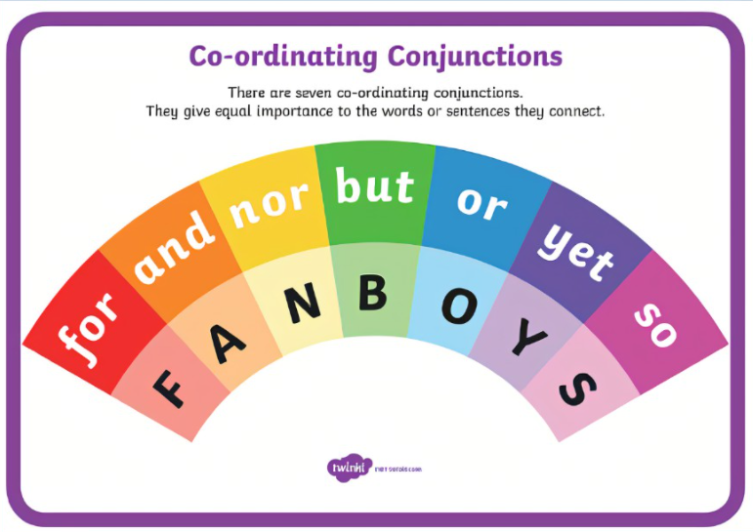

Slide 21
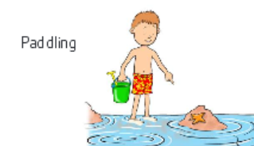
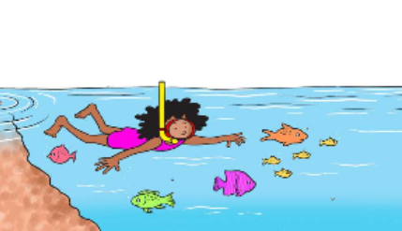
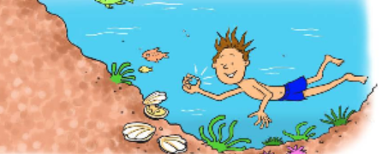
Write four or more interesting sentences using our WOW word of the week, surreptitiously, in each sentence.
Include Spelling Bee words, conjunctions and adjectives. Can you use any emotion synonyms from mental health week?
Write four interesting sentences using our WOW word of the week- surreptitiously in each sentence.
Include conjunctions and adjectives.
Write four interesting sentences using our WOW word of the week- surreptitiously in each sentence.
Include Spelling Bee words, conjunctions and adjectives.

Slide 22
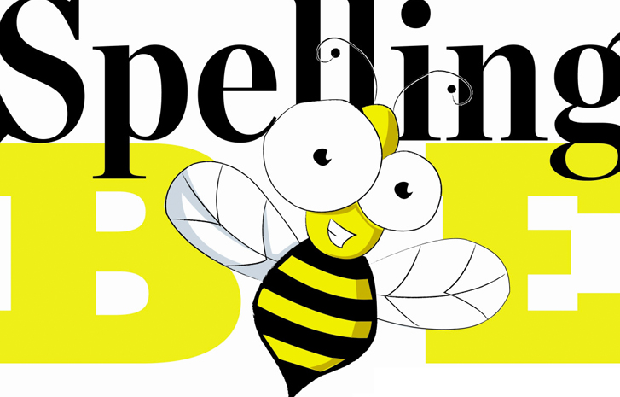
Friday 25 February 2022
ENRICHMENT WEEK WORDS WORDS WORDS!
SPELLING BEE
LO: To spell correctly
C: Spelling Bee

Slide 23

4TC VS 4RN!
Wheel of names
Each class teacher will spin the wheel of names for their class. Once the names are chosen from each class, the two contestants will go head to head to spell a Spelling Bee word or cian word correctly on their whiteboard. The contestant with the correct spelling will earn a point for their class. If both are correct, then both classes earn a point.
At the end of the Spelling Bee, the points will be totalled to see which class wins the 2022 Year 4 Spelling Bee cup!

