Slide 1


Wednesday 15 December 2021
LO: Know that witnesses can make the situation better or worse by what they do.
C: Bullying
Puzzle piece 4

Slide 2
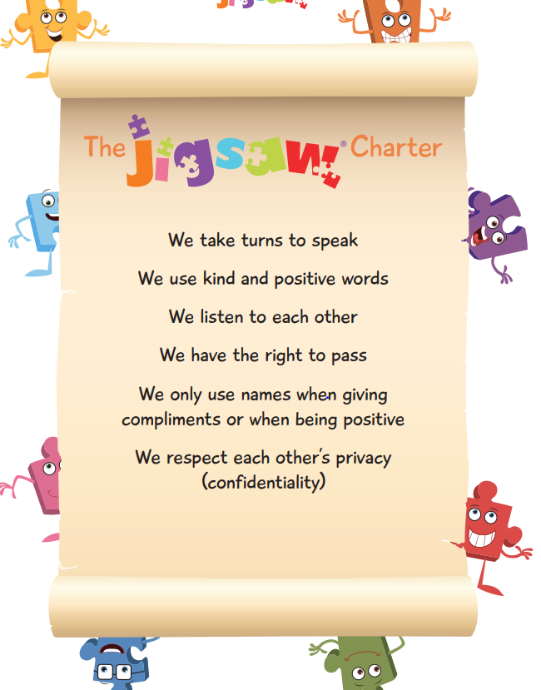

Slide 3
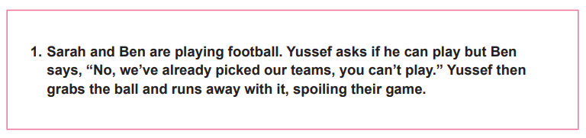
Open my mind
Scenario 1

Slide 4
Tell me or show me
Witnesses to bullying are often referred to as bystanders.
Bystanders could:
• Help the person being bullied in some way
• Do nothing and ignore that it’s happening
• Join in with the bullying
Briefly discuss in pairs why you think that some bystanders choose to ignore or join in?
Slide 1: Recap the Solve it Together technique.
Let’s go through the steps for the scenario we have just discussed.

Slide 5
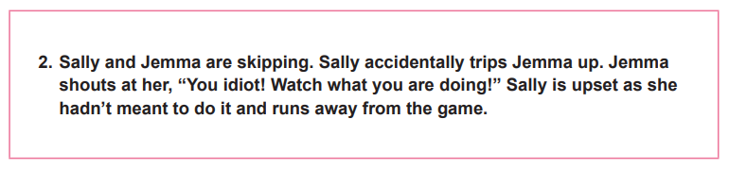
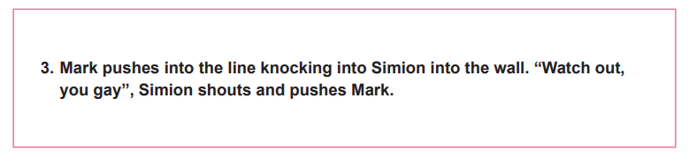
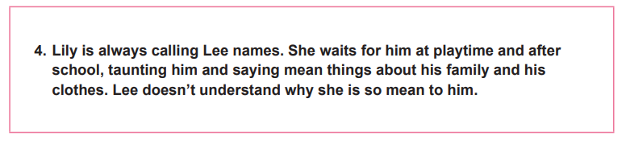
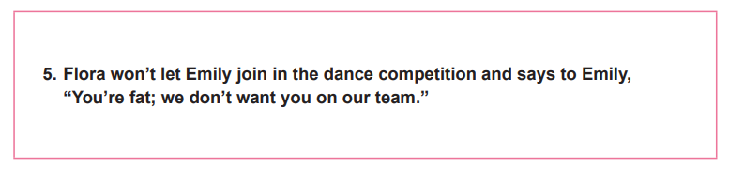
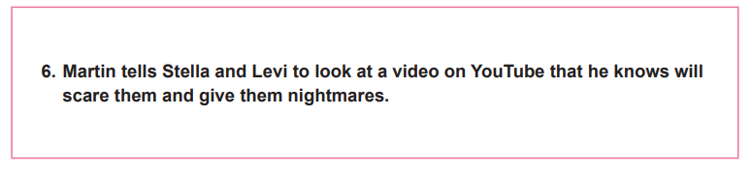
Let me learn
Decide if you think each scenario is bullying or not. Can you tell? If it isn’t bullying, could it become bullying? How? Use the ‘Solve It Together’ technique to solve each problem.

Slide 6
STOP
Breathe
Identify your feelings!

Slide 7


