Slide 1
Thursday 22nd April 2021
L.O: To understand texts- comparison skills
C: Boy

Slide 2

Today we are continuing to explore our new book! We are going to explore a major event in Roald’s childhood.
We are going to use our comparison skills to help us understand the differences between then and now.

Slide 3
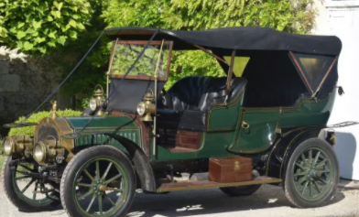
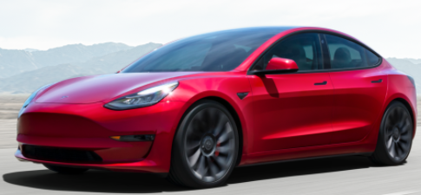
Starter: Game
Let’s look at cars from 1925 and 2021. What similarities and differences can you spot?

Slide 4
Class Read
Class Read p.114-127
“Take some nice deep breaths”
Let’s focus on the character’s emotions.
How are they feeling?
How do their emotions compare?

Slide 5
Our task: talking question
If a car crash happened now, how would the following events differ? (Ambulances/seat-belts/airbags etc.)

