Slide 1
13/9/21
LO: Round to the nearest 10.
C: To know and use number.

Slide 2
Year 4 | Week 1 | Day 4

Slide 4

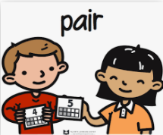
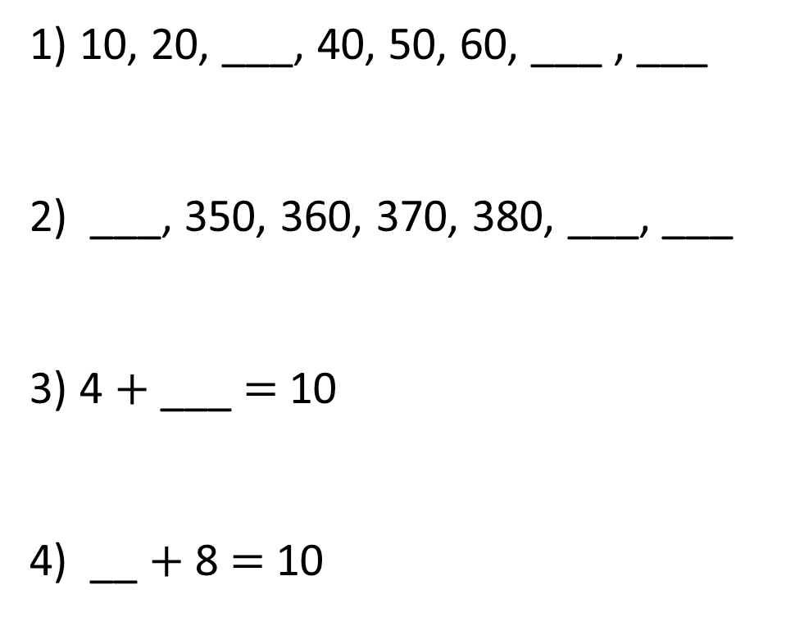
Let’s warm our brains!
1) 10, 20, ___, 40, 50, 60, ___ , ___
2) ___, 350, 360, 370, 380, ___, ___
3) 4 $+$ ___ $=$ 10
4) __ $+$ 8 $=$ 10

Slide 5
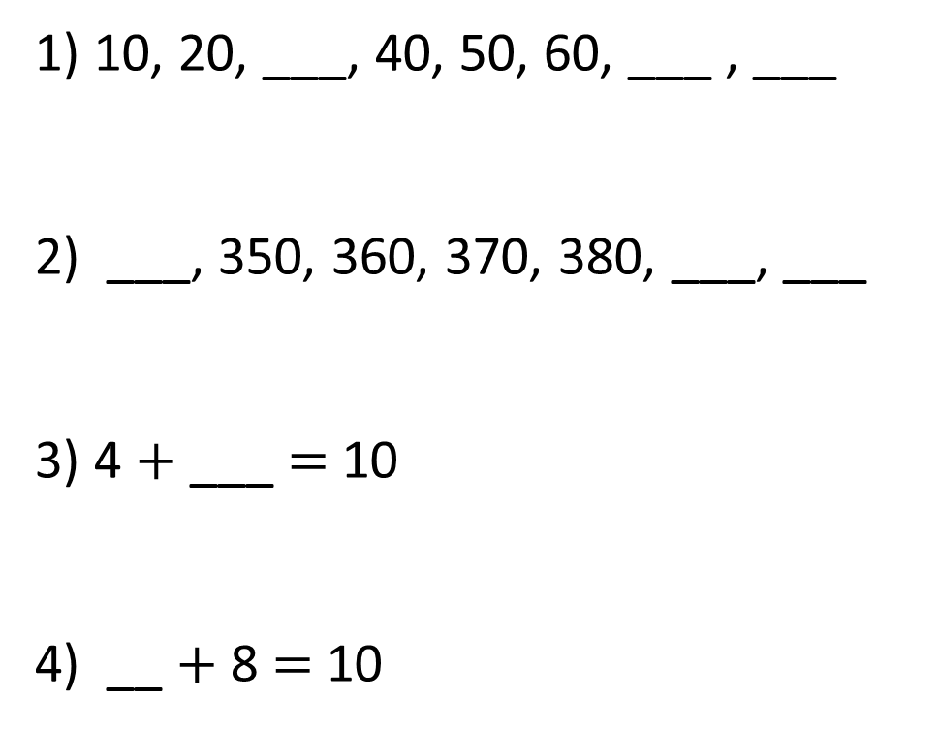
1) 10, 20, ___, 40, 50, 60, ___ , ___
2) ___, 350, 360, 370, 380, ___, ___
3) 4 $+$ ___ $=$ 10
4) __ $+$ 8 $=$ 10
30
70
80
340
390
400
6
2

Slide 7
Round 73 to the nearest 10
10
70
71
72
73
74
75
76
77
78
79
80
Things to think about:
- What two 10’s numbers does 73 sit between?
- What ‘interval’ is each line?

Slide 8
Round 73 to the nearest 10
3
7
70
71
72
73
74
75
76
77
78
79
80
73 is closer to 70 than 80
73 rounded to the nearest 10 is 70

Slide 9
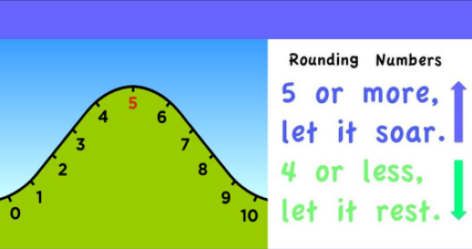
If the number ends in 1, 2, 3 or 4 we round down to the ten we just passed
If the number ends in 5, 6, 7, 8, or 9 we round up to the next 10.

Slide 10
Round 35 to the nearest 10
5
5
30
31
32
33
34
35
36
37
38
39
40
35 rounded to the nearest 10 is 40

Slide 11
Round these numbers to the nearest 10.
Draw out the number lines.
78
23
92
98
12
3

Slide 12
14/9/21
LO: Round to the nearest 10.
C: To know and use number.
**recap and application

Slide 13
Year 4 | Week 1 | Day 5

Slide 15
Round 73 to the nearest 10
3
7
70
71
72
73
74
75
76
77
78
79
80
73 is closer to 70 than 80
73 rounded to the nearest 10 is 70

Slide 16
Round 78 to the nearest 10
8
2
70
71
72
73
74
75
76
77
78
79
80
78 is closer to 80 than 70
78 rounded to the nearest 10 is 80
Things to think about:
- What two 10’s numbers does 78 sit between?

Slide 17
Round 35 to the nearest 10
5
5
30
31
32
33
34
35
36
37
38
39
40
35 rounded to the nearest 10 is 40

Slide 18
Task
Neatly with a ruler, draw a number line for each question making
sure that you write your answers clearly.
Remember: Think about what two 10s numbers each one sits between.
41
19
25
79
9
4
Remember:
This isn’t about how hard the task is,
it’s to show correct setting out of
work

Slide 19
15/9/21
LO: Round to the nearest 10.
C: To know and use number.

Slide 20
Year 4 | Week 2 | Day 1

Slide 22
The same rules apply for rounding hundreds numbers to the nearest 10

Slide 23
Round 144 to the nearest 10
4
6
140
141
142
143
144
145
146
147
148
149
150
144 is closer to 140 than 150
144 rounded to the nearest 10 is 140

Slide 24
Which numbers round to 240 to the nearest 10?
235
236
237
238
239
240
241
242
243
244
245
5
6
7
8
9
1
2
3
4
What patterns do you notice when rounding to 10?

Slide 25
Round these numbers to the nearest 10.
Draw out the number lines.
172
239
693
498
525
802

Slide 26
16/9/21
LO: Round to the nearest 10.
C: To know and use number.
**recap and application

Slide 27
Year 4 | Week 2 | Day 2

Slide 29
Remember, the same rules apply for rounding hundreds numbers to the nearest 10

Slide 30
Round 144 to the nearest 10
4
6
140
141
142
143
144
145
146
147
148
149
150
144 is closer to 140 than 150
144 rounded to the nearest 10 is 140

Slide 31
Which numbers round to 240 to the nearest 10?
235
236
237
238
239
240
241
242
243
244
245
5
6
7
8
9
1
2
3
4
What patterns do you notice when rounding to 10?

Slide 32
Neatly, in your books, round the following numbers to the nearest 10.
456
231
897
102
735
636
Remember:
This isn’t about how hard the task is,
it’s to show correct setting out of
work.

Slide 33
16/9/21
LO: Round to the nearest 10.
C: To know and use number.

Slide 34
Find the rounding to the nearest 10nuggets on Century Tech and complete them.
If you scored less that 80% have another try.

