Slide 1
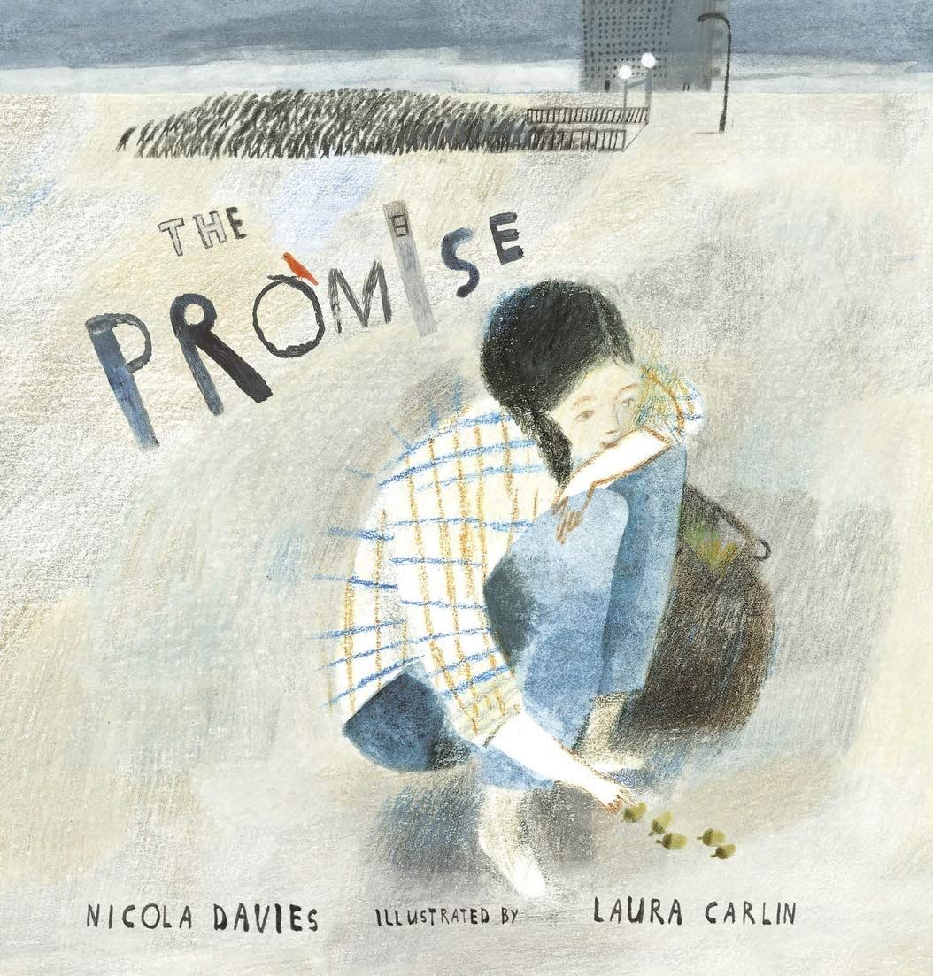
Our growing future
The Promise
By: Nicola Davies
Thursday 16 September 2021
LO: Understand texts
C: Talk about the text making inferences and predictions.

Slide 2
Watch from the beginning of the story to the end.
First, let’s compare these final endpapers with those
at the beginning.
How do you feel now that we have finished the story?

Slide 3
We are going to answer these four questions on whiteboards:
likes
dislikes
puzzles
connections

Slide 4
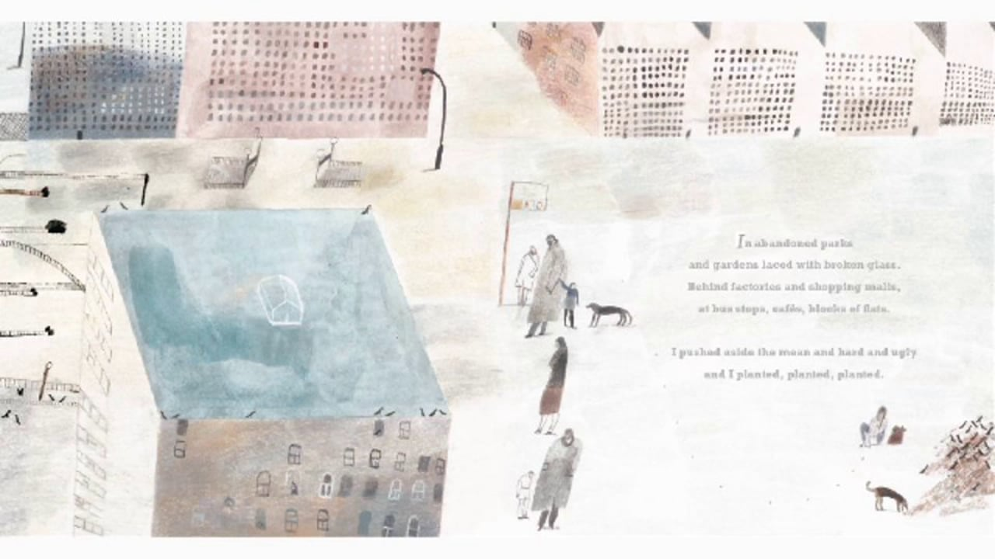
How did you feel as each page turned?
What did you notice? What did it make you think about?
How do these images and the use of colour within them
compare with the earlier spreads in the book?
What has change the most- the city, the character,
the world beyond the city?

Slide 5

Talk Time!
Look back at your pen portrait. How did her experiences change her?
What decisions does she make in the book?
What is the impact of her decisions?
How does the girl bring about change?

Slide 6
Did you enjoy the book?
When you think about the future, what do you see?
What would you like the future to look like?
Activity
Today you are going to describe your dreams for the future.
You could draw a picture, write a letter, create a slogan
or write a poem. What will you choose?

