Slide 1

Our growing future
The Promise
By: Nicola Davies
Wednesday 15 September 2021
LO: To write with purpose.
C: Persuasive article.

Slide 2
Persuasive Article
Today we are going to finalise our persuasive article about
the benefits of planting trees.
Read your draft and think about what works and what areas could be improved.
Is the language suitable? Is it persuasive enough?
Are the paragraphs broken up correctly?
Think about what might make the best headline and by-line.
What would be a good featured quote?
What images would best accompany your article?
Let’s write our article out neatly!

Slide 3
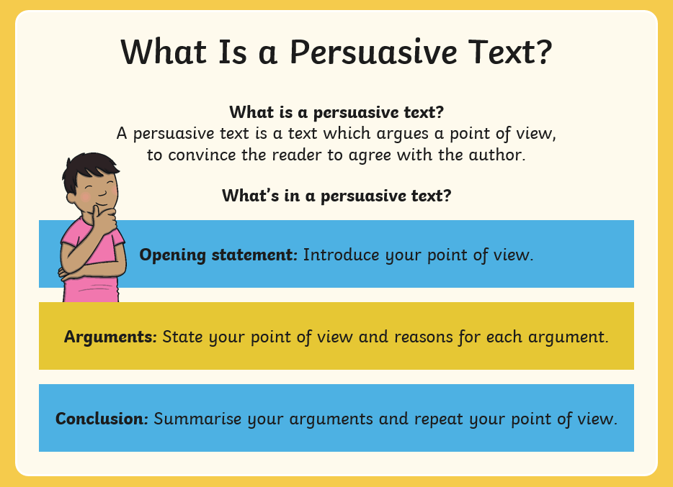

Slide 4
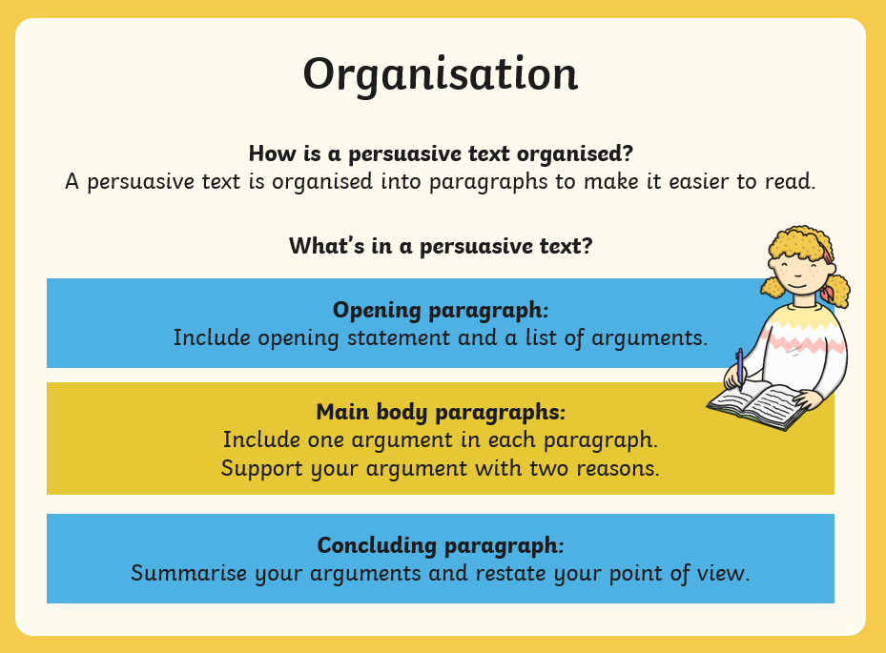

Slide 5
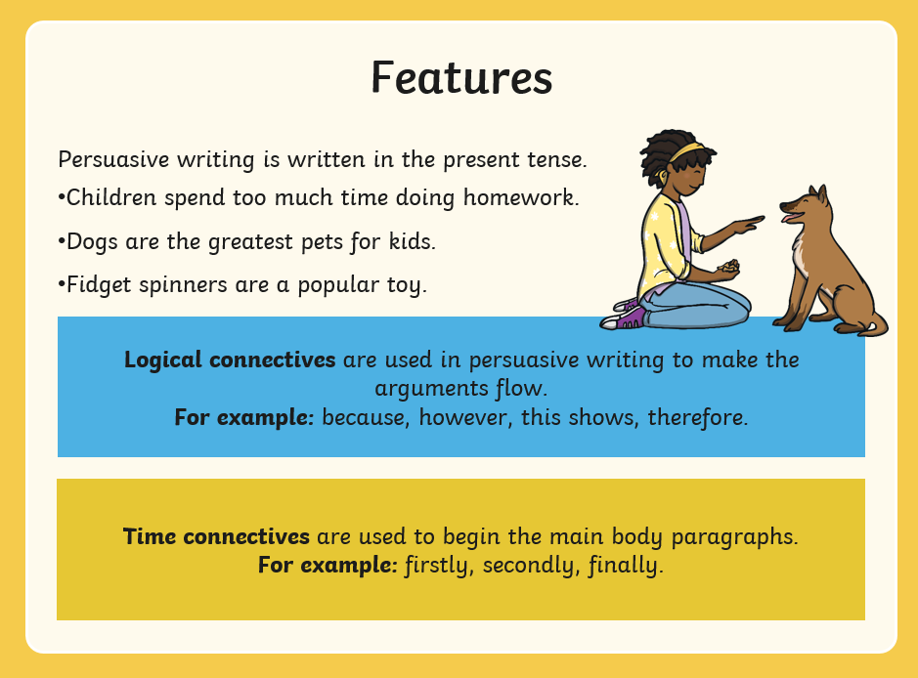

Slide 6
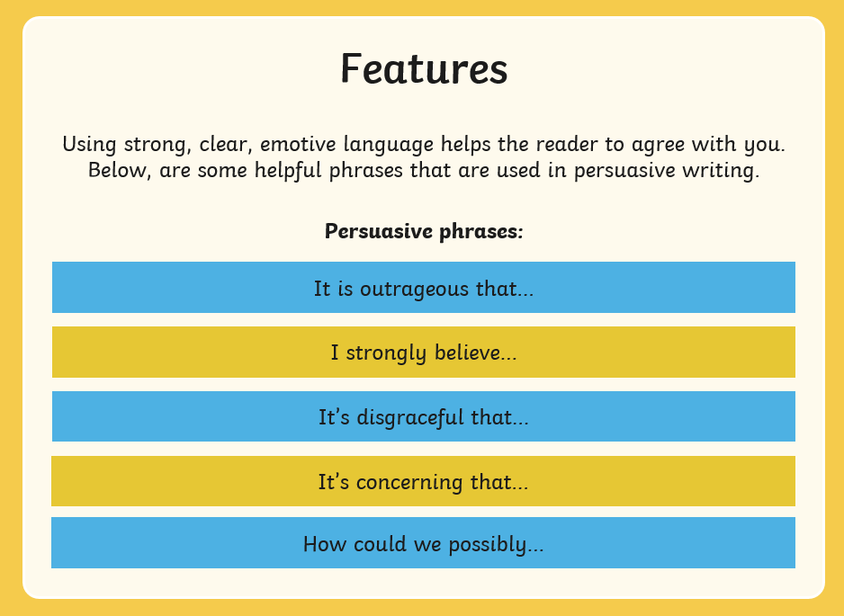

Slide 7


