Slide 1

Our growing future
The Promise
By: Nicola Davies
Tuesday 14 September 2021
LO: To write with purpose.
C: Plan a persuasive article.

Slide 2
Discuss with an adult What do you know about trees?
What types of trees do you know?
Can you name the parts of a tree?
How do they grow?
What grows on trees?
What are trees used for by people and animals?
How do trees help the planet?
Name the different types of wildlife in and around trees.

Slide 3
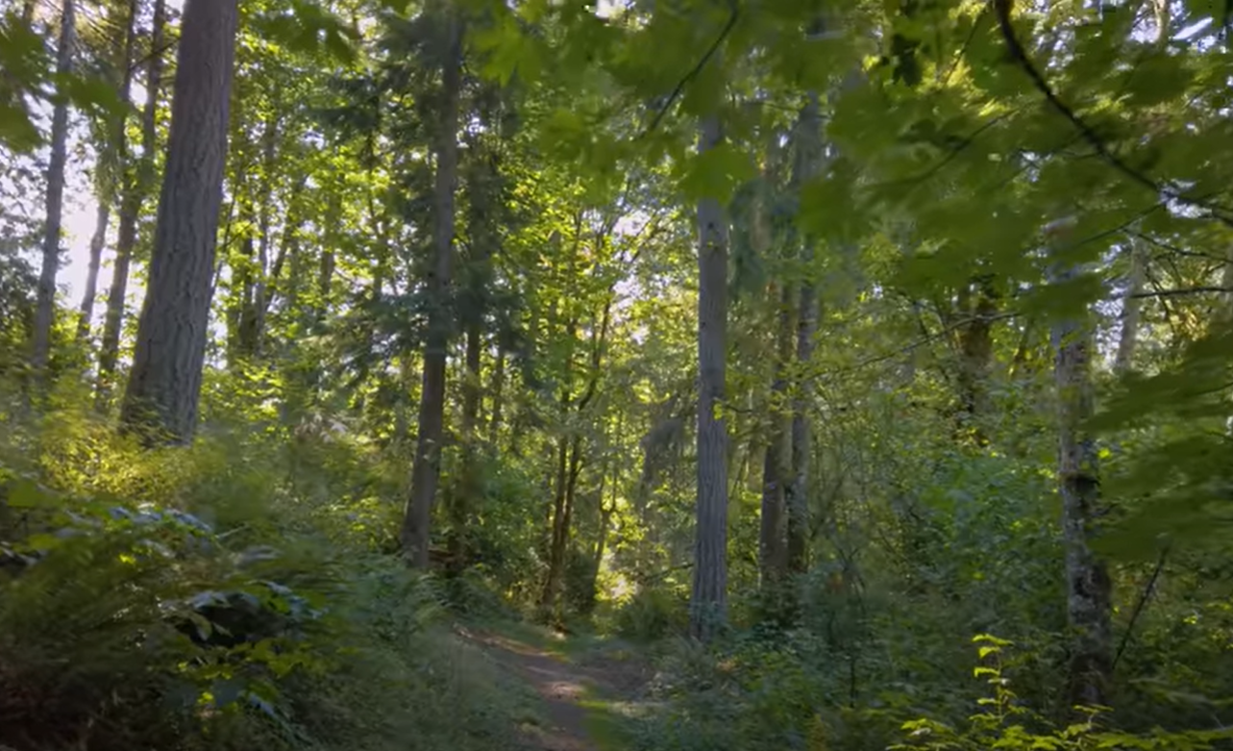
How do you feel about trees after watching a snippet of this video?
Write what you know and how
you feel about trees on the
post-it notes provided. We will
Stick them onto our display.
https://www.youtube.com/watch?v=cm8qZWDjsr4

Slide 4
Do you remember what happened in the story so far?
What do you feel the consequence of the girl’s promise
is going to be?
What do you know about trees growing in urban and
rural environments. Can you make connections?
Continue listening to the story up until ‘I planted, planted, planted.’

Slide 5
How do you think the environment will change after the trees have grown?
How do you think the people in the city will feel?
Will their behaviour change?

Slide 6
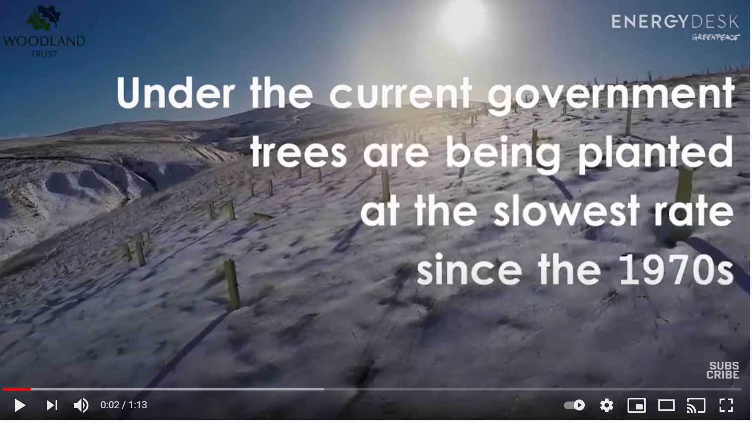
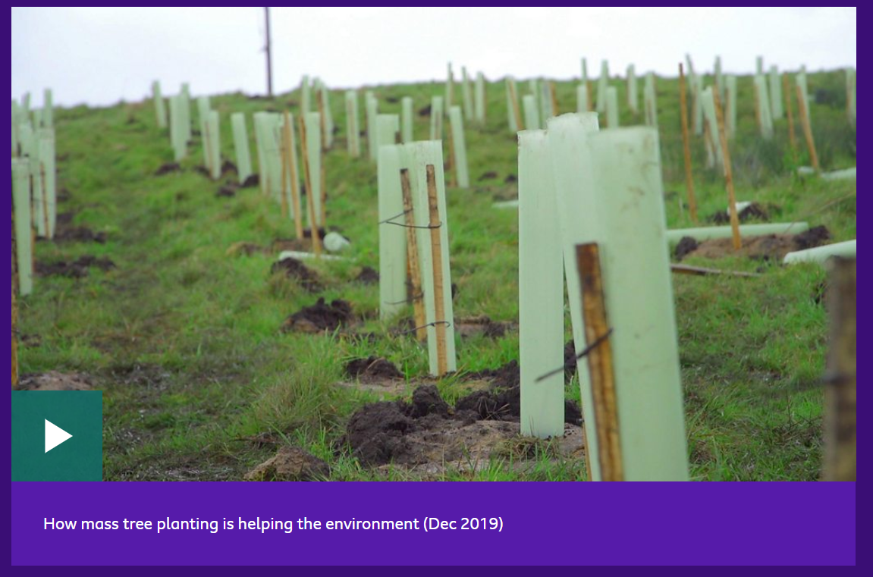
Let’s learn more about trees and their impact on the environment.
Take notes on your whiteboard to help you with your writing later.
https://www.youtube.com/watch?v=Y8W3qWnRRUI
https://www.bbc.co.uk/newsround/57141026

Slide 7

Trees clean the air of pollution.
Trees provide shade, reducing ground temperatures.
Trees release water vapour from their leaves,
creating rain and clouds.
Trees absorb carbon dioxide, locking it away for years.
Trees emit oxygen, which almost all living things need
to survive.
Trees prevent flooding and keep soil nutrient-rich.

Slide 8
Persuasive Article
Today we are going to write a persuasive article about
the benefits of planting trees.
What tone and style of language is most suitable for this piece
of writing? We need to hook our readers and keep them reading!
What language will persuade the reader of the benefits of
planting trees and engage them as interested potential advocates?
How should the article be set out?
How will you organise the paragraphs and make the writing cohesive?
What additional features should the article have?
Let’s start our draft!

Slide 9
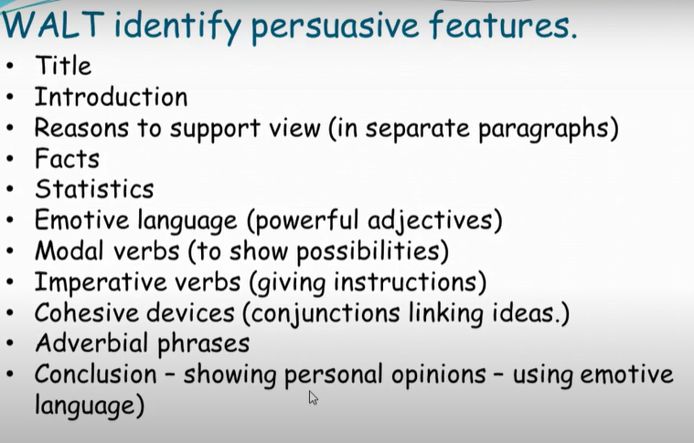

Slide 10
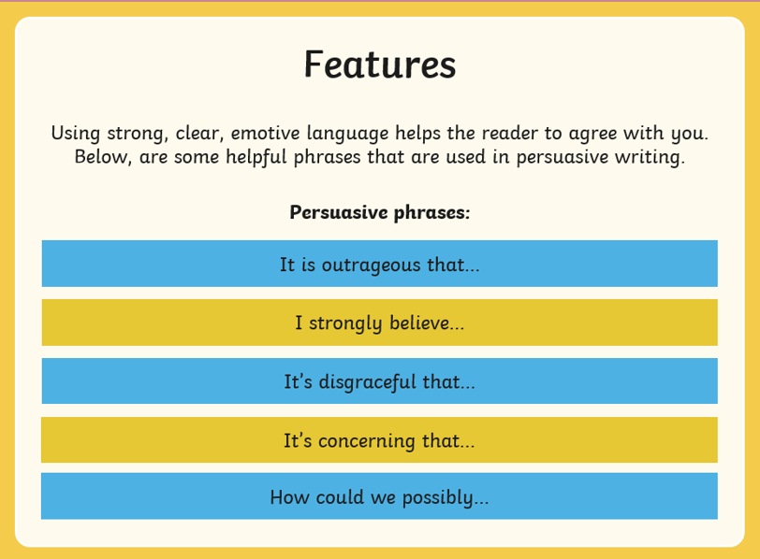

Slide 11


