Slide 1
Monday 13 September 2021
LO: To use and understand grammatical terminology
C: Nouns, verbs and adjectives
KS1 English: Adjectives & Adverbs with Johnny & Inel - BBC Teach

Slide 2

https://www.youtube.com/watch?v=JeognSU6wfU

Slide 3
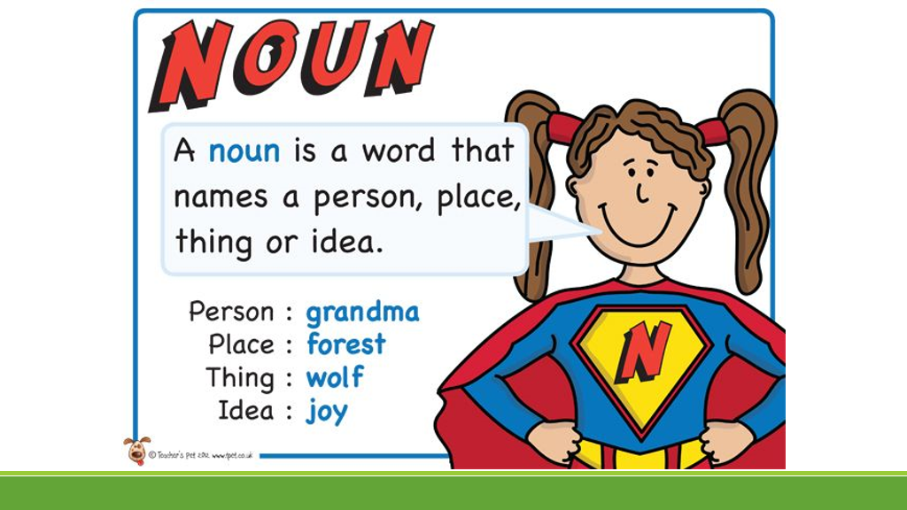

Slide 4
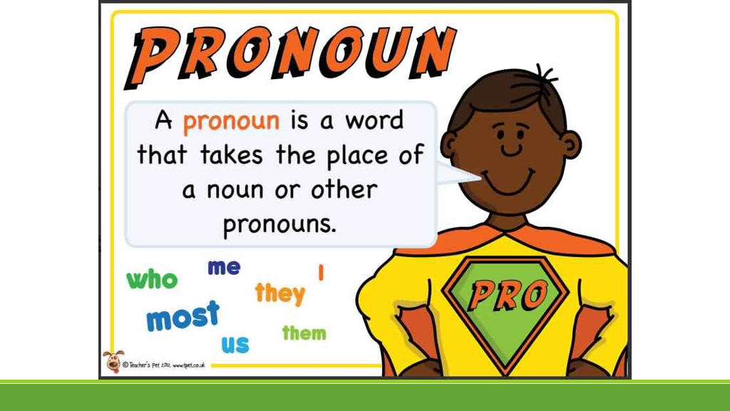

Slide 5
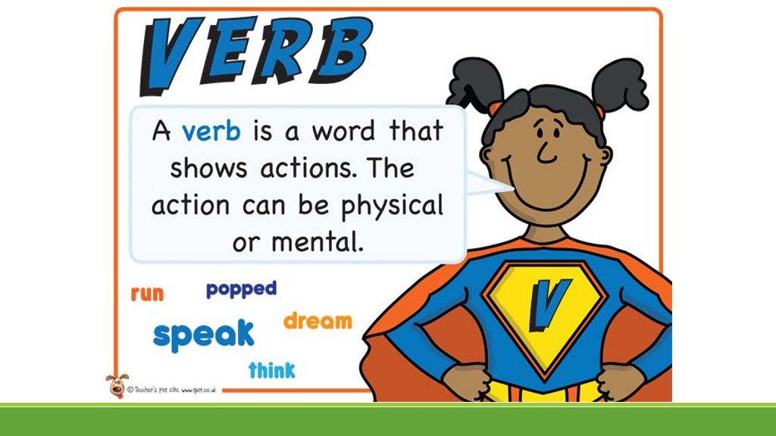

Slide 6
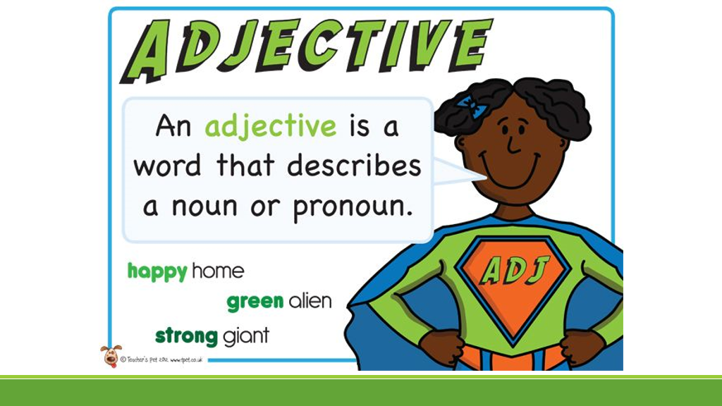

Slide 7
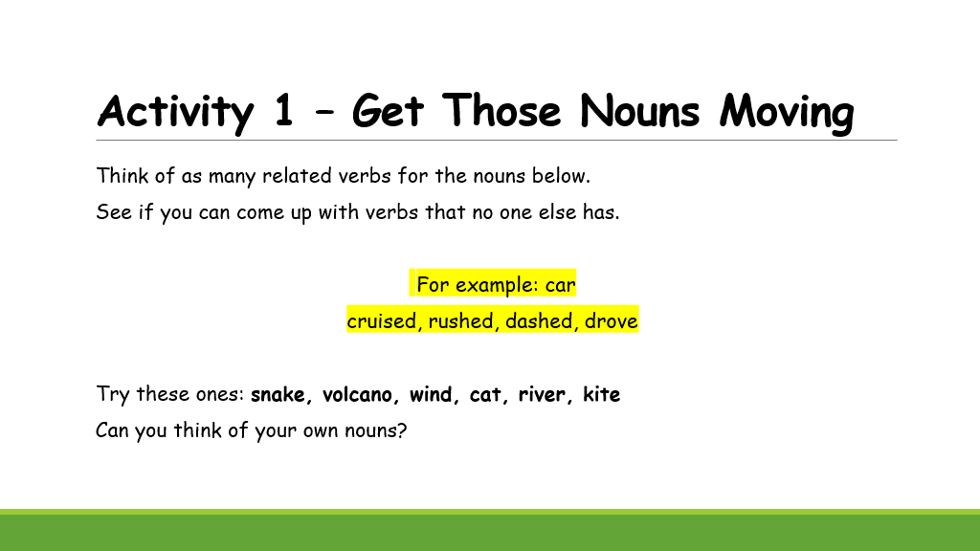

Slide 8


