Slide 1
PSHE and Citizenship
Health and Wellbeing | Think Positive
PSHE and Citizenship | LKS2 | Health and Wellbeing | Think Positive | Happy Minds, Happy People | Lesson 1

Slide 3
Aim
I understand that having a positive attitude is good for our mental health.
Success Criteria
I can explain what having a positive attitude means.
I know lots of things I can do to increase my levels of happiness.
I understand how having a positive attitude can make a difference to our lives.
This resource is fully in line with the Learning Outcomes and Core Themes outlined in the PSHE Association’s Programme of Study.

Slide 4
The Big Questions

Slide 5

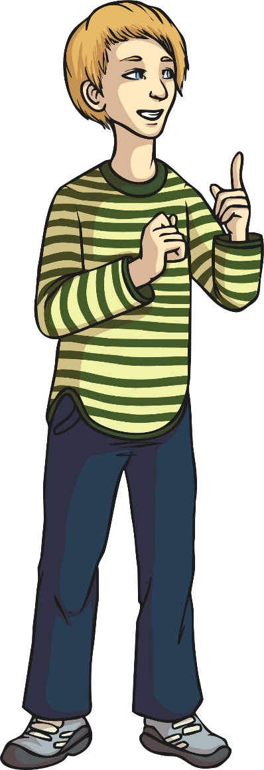
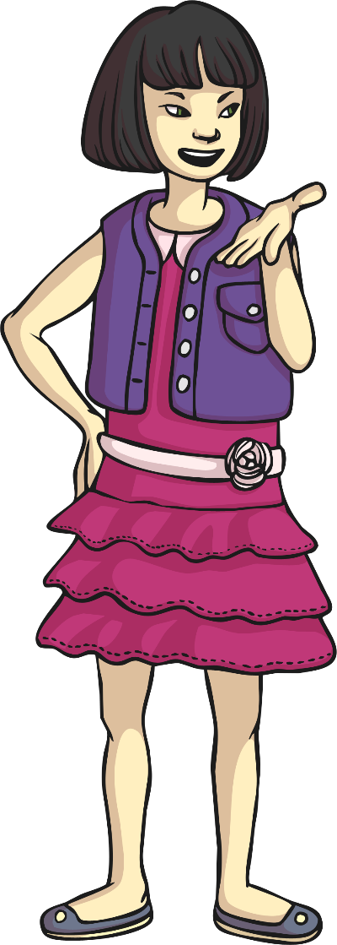
What is
a happy mind?
How can it make a difference to our lives?

Slide 6
Reconnecting

Slide 7

What Is Positive Thinking?
Using the words below, work with a partner to compose a positive statement to share with the class.
great
enjoy
brilliant
smile
special
nice
good
amazing
better
best
fantastic
laugh
love

Slide 8
Exploring

Slide 9

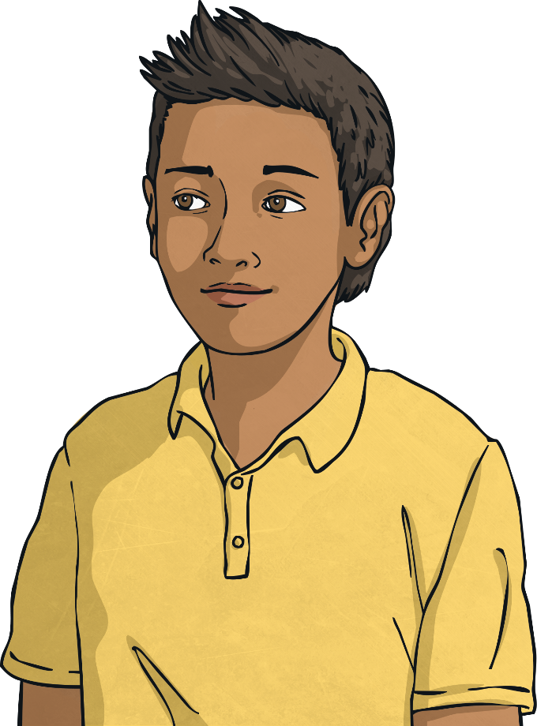
A Positive Attitude
Thinking positive thoughts and always seeing the best in a situation is called having a positive attitude to life. It can make you a happier person and plays an important part in having good mental health.

Slide 10
A Positive Attitude
Read the quotes below and discuss with your partner what they mean. See if you can choose the one you like the best.
“Every day may not be good, but there is good in every day.”
“Having a positive attitude is asking how something can be done, instead of saying it can’t be done.”
“We can complain because rose bushes have thorns or rejoice because thorn bushes have roses.”
“A positive attitude will lead to positive outcomes.”
“A bad attitude is like a flat tyre; you can’t go anywhere until you change it.”
“Attitude is a little thing that can make a big difference.”

Slide 11

A Positive Attitude
Which quote was your favourite?
Can you explain why you chose it?
Why are quotes like these helpful?
Will you remember and use the quote you liked?
How can positive thinking or having a positive attitude help us to have happy minds?

Slide 12

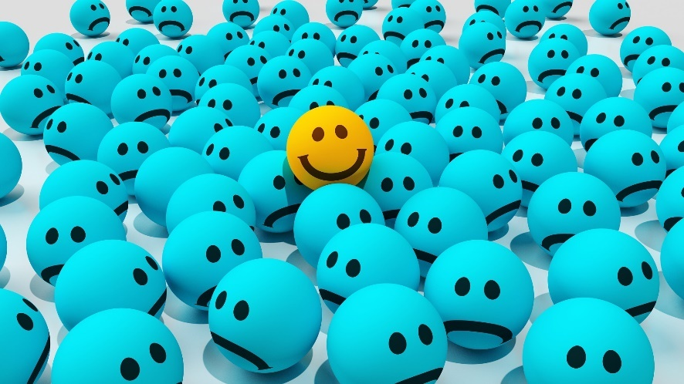
The Science of Happiness
Never before has there been more research into happiness and how it affects our whole lives.
Scientists have found that happy people are more successful – that means that they are more likely to achieve their goals.
In schools, research shows that happy children learn better and make more progress.
However, one study found that only 17% (that’s 17 out of 100) of the people in the world are living truly happy lives.

Slide 13

The Science of Happiness
Our brains are in charge of our feelings and emotions.
There are chemicals in our brains that actually make us feel happy.
There are four main chemicals. They have tricky names…
dopamine
oxytocin
serotonin
endorphins
The fantastic news is that there are things we can do to trigger our brains to release these ‘feel-good’ chemicals!

Slide 14
How to be Happy
Find ways to relax your mind.
Get plenty of sleep.
Smile and laugh.
Spend time with family and friends.
Exercise regularly.
Eat healthily.
Be fair and honest.
Listen to music.
Care for others.
Accept yourself and be proud of who you are.
Take up a hobby or join a club.
Work hard to achieve a goal.
Next

Slide 15
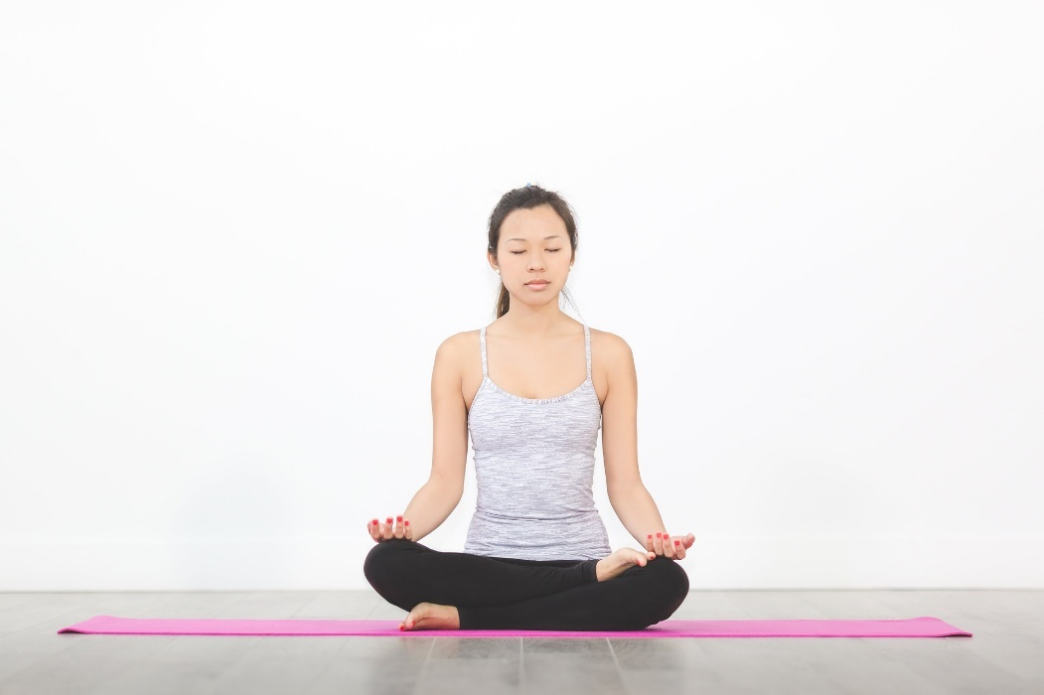
Find Ways to Relax Your Mind
Back
Your mind needs rest, just like your body, so try doing calm quiet activities.
You could sit quietly and focus on your breathing, practise meditating or yoga, do some quiet colouring, read a book or do a jigsaw puzzle.

Slide 16
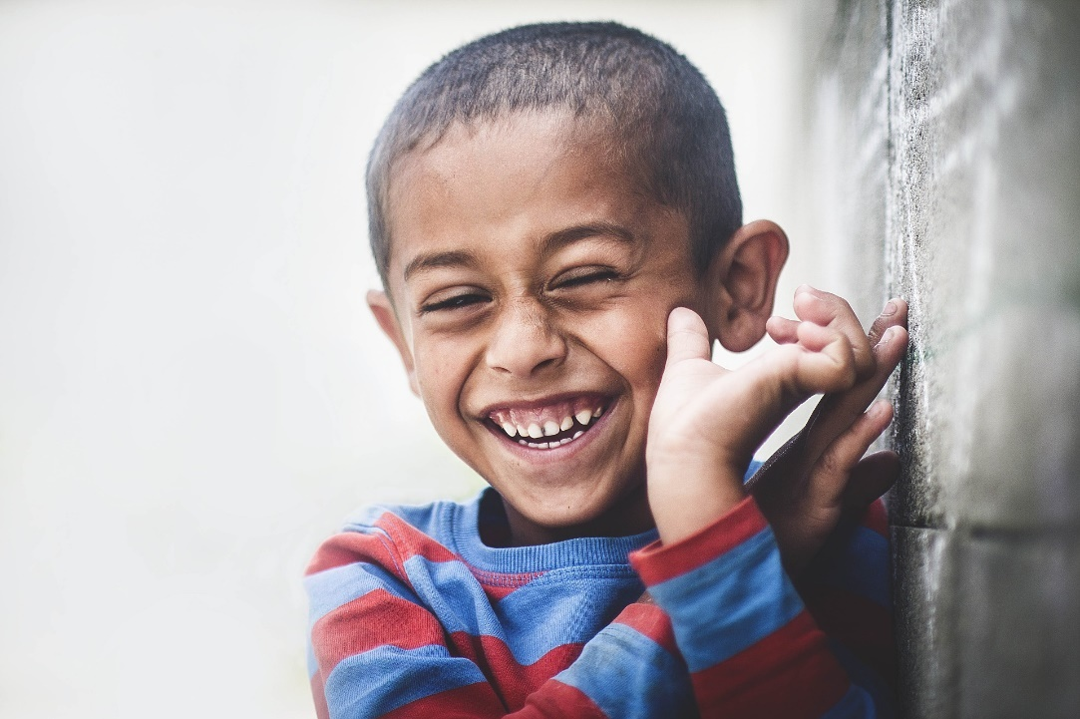
Smile and Laugh
Back
Did you know that laughing and even just smiling releases ‘feel-good’ chemicals in our brains?
Being a smiley person will draw others to you, too!

Slide 17

Eat Healthily
Back
Putting the right things into our bodies can make us feel good, giving our bodies all the nutrients it needs and helping us fight off illnesses.
Eating the wrong kinds of food can actually make us grouchy.

Slide 18
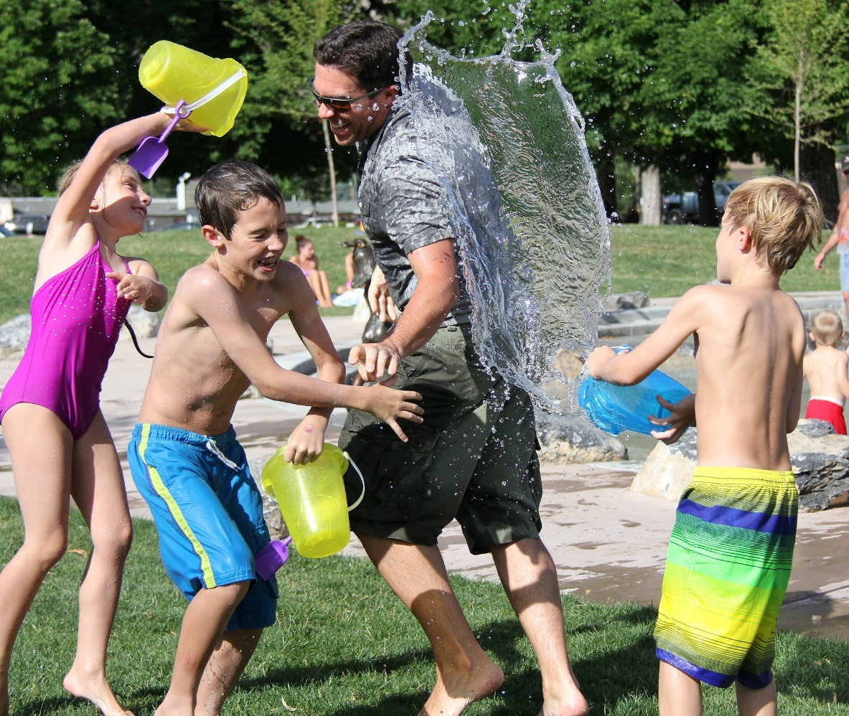
Spend Time with Family and Friends
Back
Being around those we love, care about and feel safe with makes us feel happy.
These are also the people who can help cheer us up with a hug or make us laugh.

Slide 19
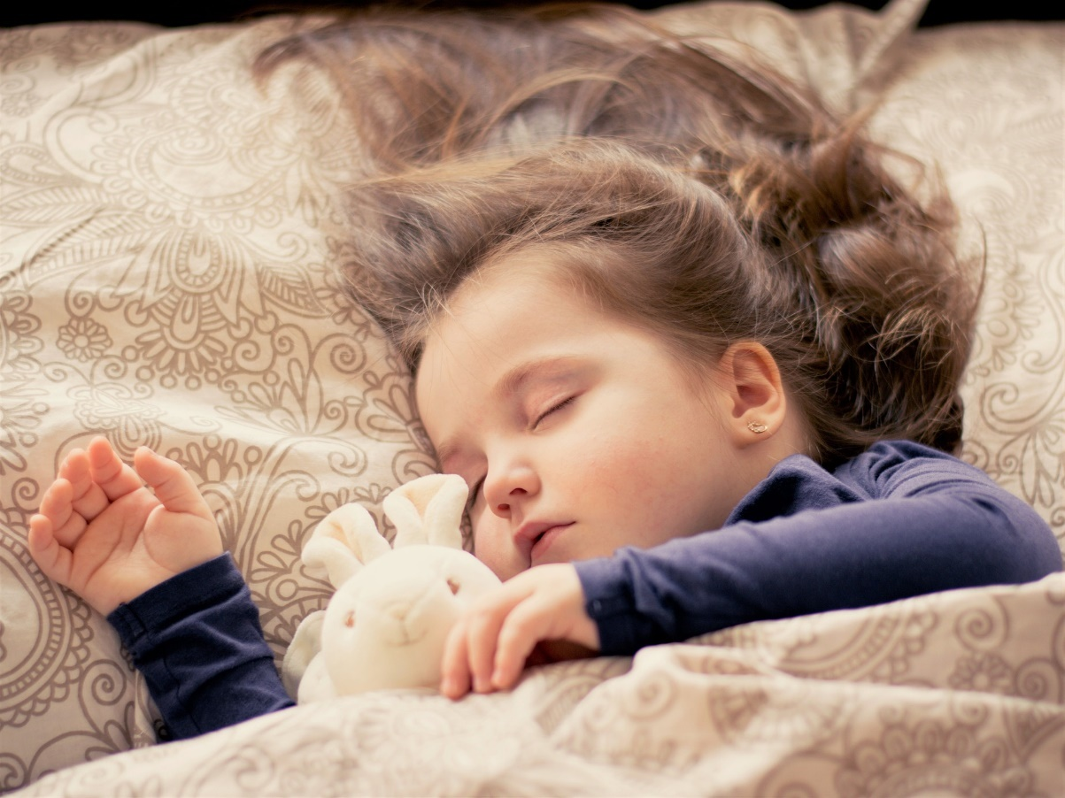
Get Plenty of Sleep
Back
It’s hard to feel happy when we are tired and grumpy, so getting enough sleep is really important.

Slide 20

Be Fair and Honest
Back
Knowing you are doing the right thing and being a good person feels great and makes other people want to be around you.

Slide 21

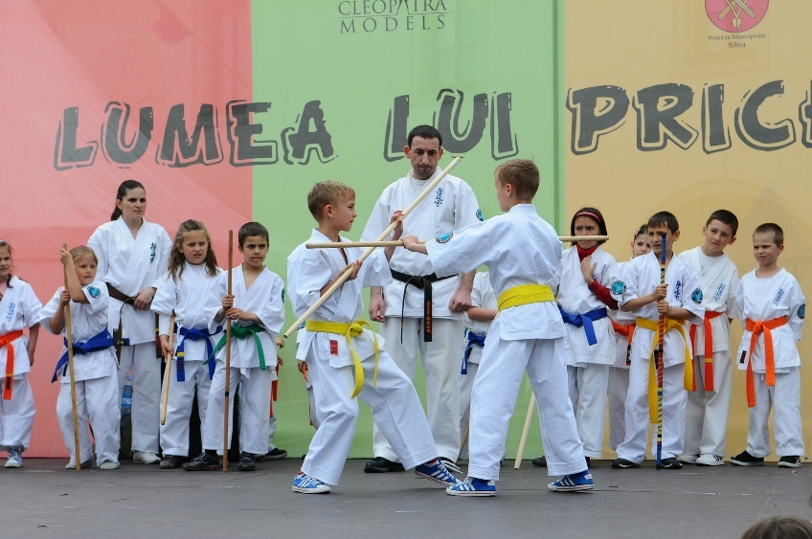
Take Up a Hobby or Join a Club
Back
Finding something you really enjoy doing and doing with others who love it too, can make us feel really happy.
It also keeps your mind busy, meaning there is less room for
negative thoughts.

Slide 22

Listen to Music
Back
All around the world music is a big part of festivals, celebrations
and parties.
This is because music can make you feel really happy.

Slide 23

Work Hard to Achieve a Goal
Back
It feels OK when you do something you find easy…
But it feels great when you succeed at something you had to really try at!

Slide 24

Care for Others
Back
Doing things for others not only makes them happy but it makes us feel better too.

Slide 25

Exercise Regularly
Back
Regular exercise has been shown to improve our mental health and make us feel good!

Slide 26

Accept Yourself and Be Proud of Who You Are
Back
Feeling good about ourselves is a really important part of good mental wellbeing. You are the only person in the whole world who is just like you.
You are unique and this is fantastic!

Slide 27
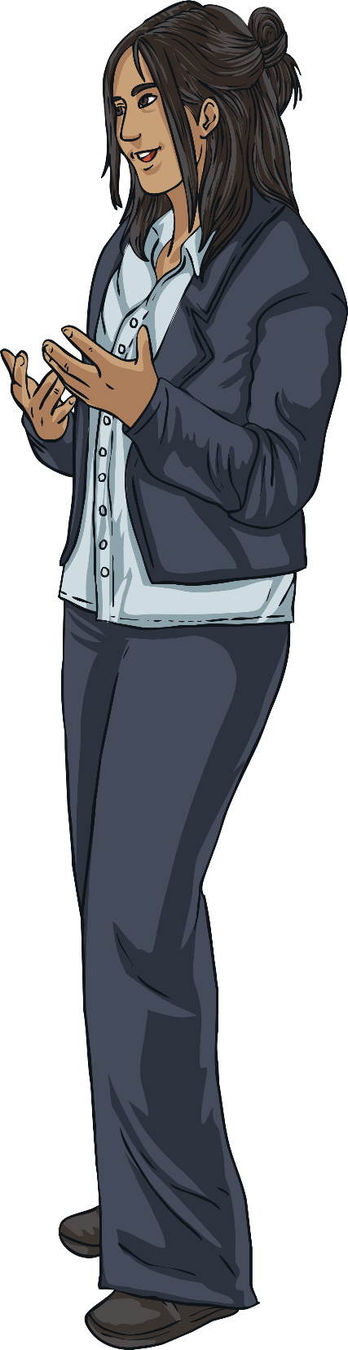
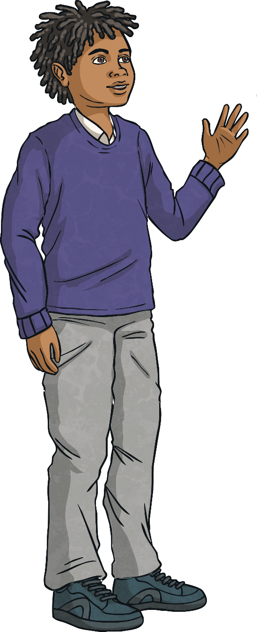
How to Be Happy
There are lots of ways we can help ourselves to feel happy but sometimes people struggle with mental health and this can be difficult.
There are lots of ways people can get support
if this happens and talking to a
trusted adult is a really important
thing to do.
Who are your trusted adults?
Consolidating
Reflecting

Slide 28
Consolidating

Slide 29



Happiness Is…
What does happiness mean to you? Different things make different people happy.
Whatever it is that makes you happy, it is good for your mental health to spend time thinking about it and doing it!

Slide 30

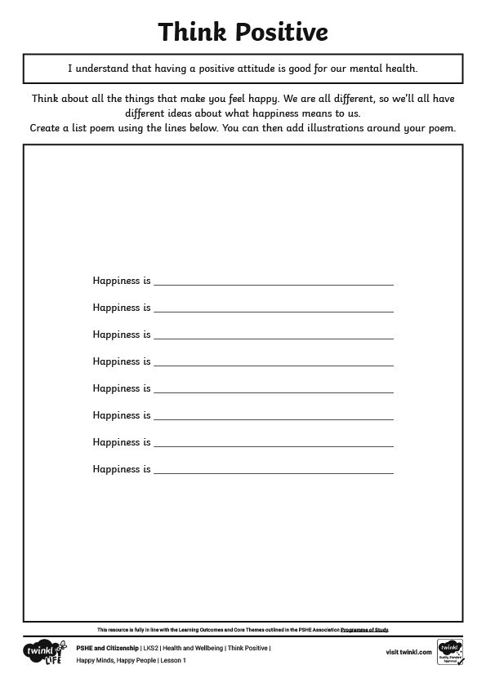

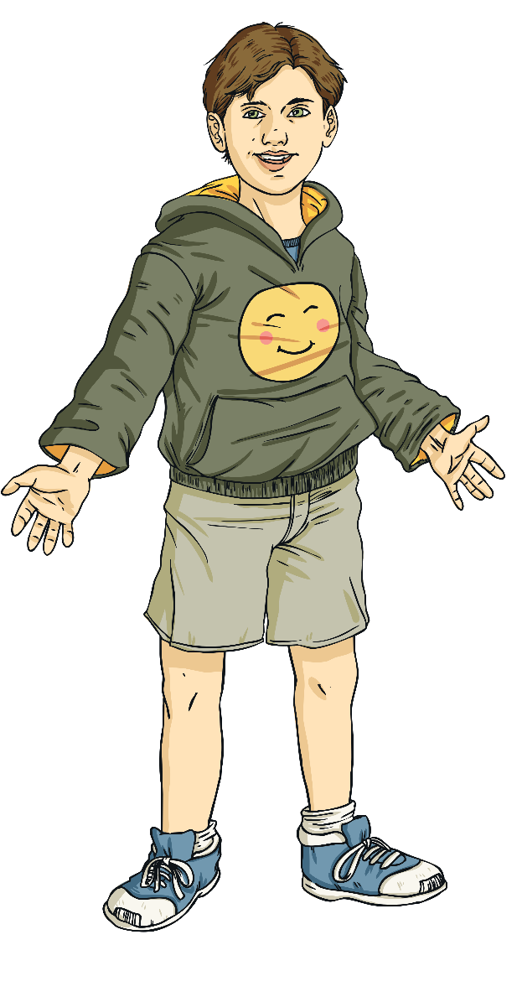

Happiness Is…
Today you are going to create list poems, where every line starts with the words “Happiness is…”
You can illustrate your poems once you have written down all the things that make you happy.

Slide 31
Reflecting

Slide 32
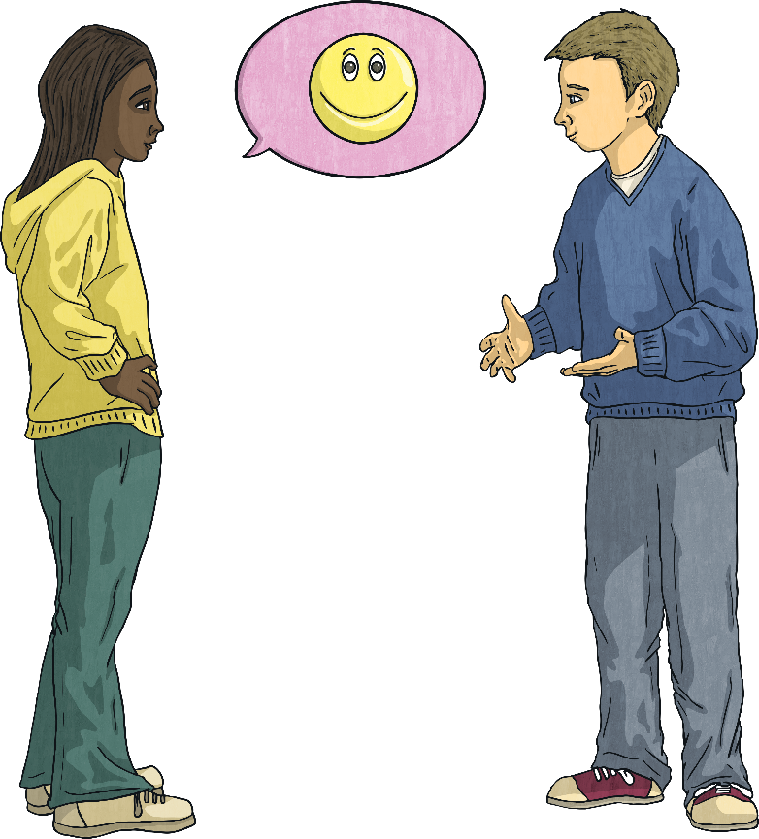
Share a Happy Thought
Different things make different people happy. Let’s get into a circle and share some happy thoughts. When it is your turn, you can share a happy thought. It could be a place or person that makes you feel happy, something that you are grateful for, a happy memory or a positive thought that you would like to share with others.
If you do not wish to share a happy thought, then you can pass.
Remember to listen carefully and respectfully to others’ ideas.
As we share these happy thoughts, think about how having a happy mind can impact our lives and make us feel good.

Slide 33
The Big Questions

Slide 34
What is
a happy mind?
How can it make a difference to our lives?

Slide 35
Aim
I understand that having a positive attitude is good for our mental health.
Success Criteria
I can explain what having a positive attitude means.
I know lots of things I can do to increase my levels of happiness.
I understand how having a positive attitude can make a difference to our lives.
This resource is fully in line with the Learning Outcomes and Core Themes outlined in the PSHE Association’s Programme of Study.

