Slide 1
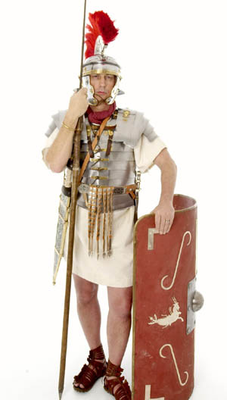
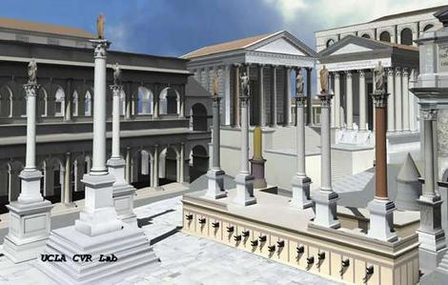
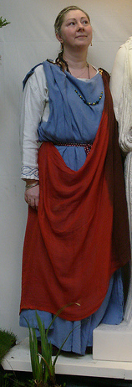
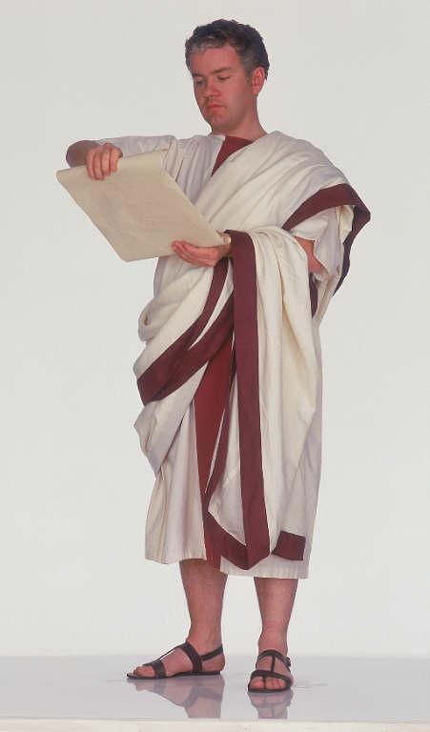
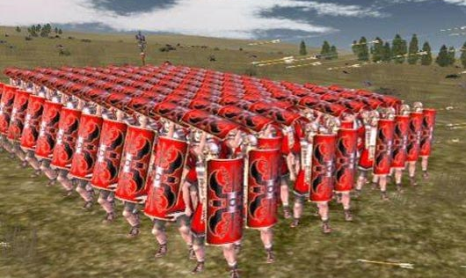
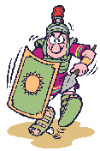
Who were
The Romans?

Slide 2
LO: Build an overview of world history.
Understand chronology.
Communicate historically
Investigate places
C: Who were the Romans?

Slide 3
Topic enquiry question:
What did the Romans ever do for me?

Slide 4
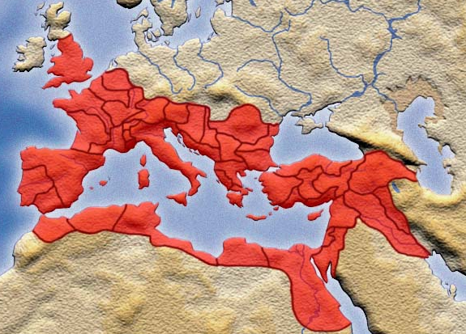
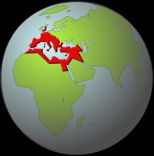

The Romans were one of the most powerful, clever and successful ancient civilizations ever. They ruled over nearly all of Europe and most of north Africa, including Egypt. If you counted all the modern countries that would have been in the Roman Empire, then you would be counting 48 different countries ruled by the Romans.
BRITAIN
The World
EUROPE
ROMAN EMPIRE
ROME
NORTH AFRICA
EGYPT

Slide 5
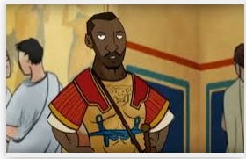
During the 3rd century AD, a unit of North African Roman soldiers were garrisoned in a fort here, making this the first known African community in Britain. They helped to defend Hardrian’s wall. They brought with them their family and lived near Scotland. Many of the black Roman families were quite rich.
BRITAIN
EUROPE
ROMAN EMPIRE
ROME
NORTH AFRICA
EGYPT

Slide 6
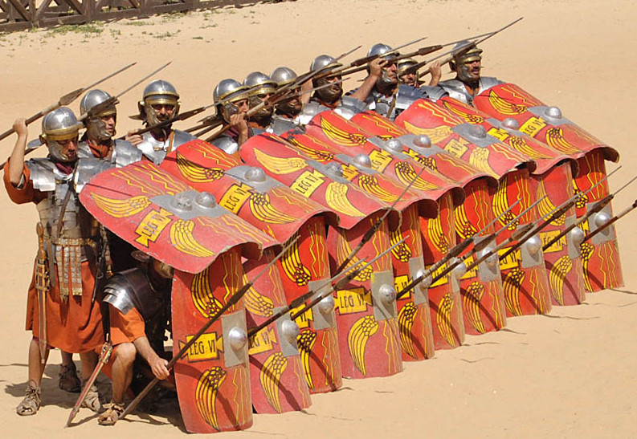
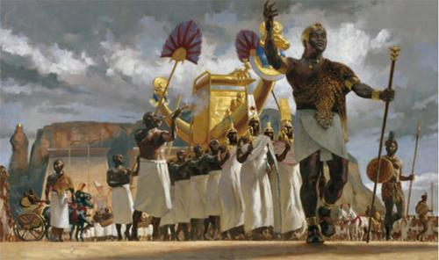
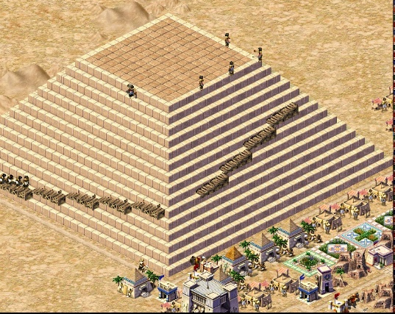
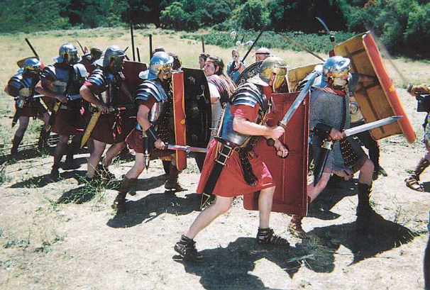
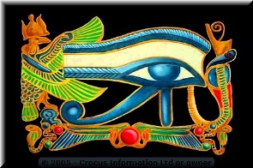
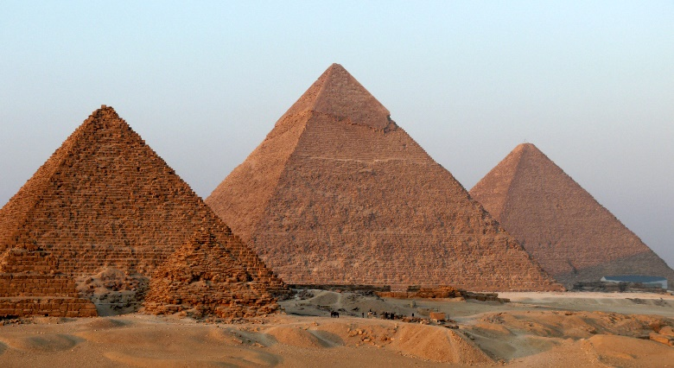
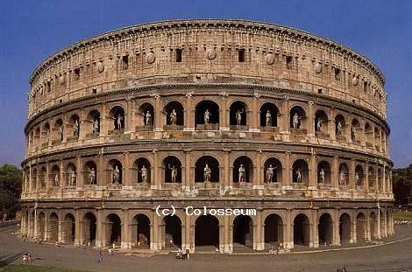
The Roman Empire lasted for over 1000 years. When the Roman civilization began in 753 B.C. the Egyptian civilization had already been going for 3000 years! Yet the Roman civilization was more advanced in its technology than Egypt; and the Romans had the best fighting army in the history of the ancient world.
Ancient Rome; 753 BC – 450 AD
Ancient Egypt; 5000 BC – 100AD

Slide 7
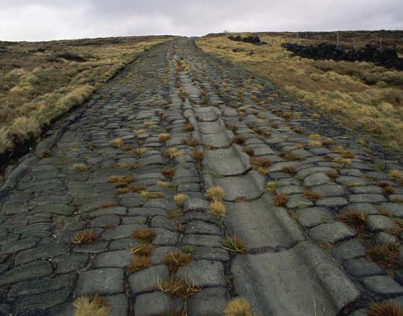
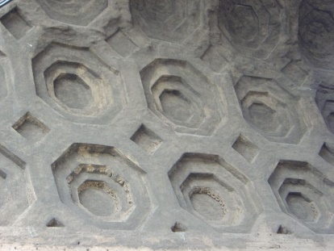
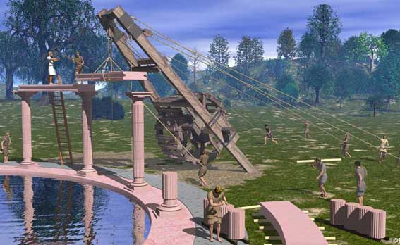
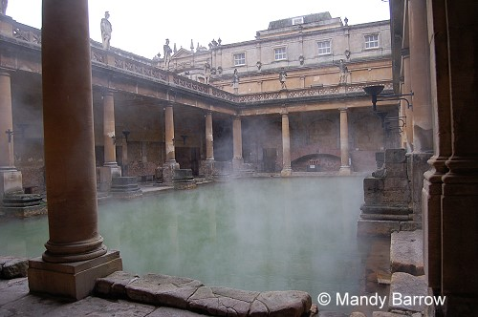
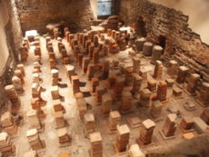
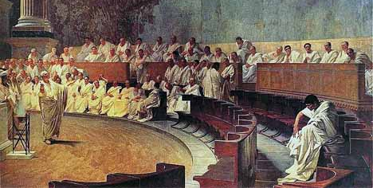
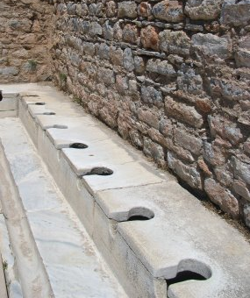
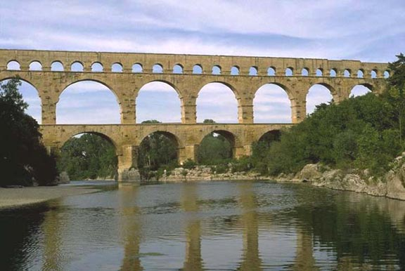
The Romans were very clever at inventing things – they were so technologically advanced that many of their inventions would not be used again in Europe for nearly 1000 years after the Roman Empire had disappeared!
The Romans invented things such as:
Click to reveal
Roads
Concrete
Human-powered Cranes
Public Baths
Central Heating
Laws – The Roman Senate
Aqueducts – bridges for running water
Toilets

Slide 8
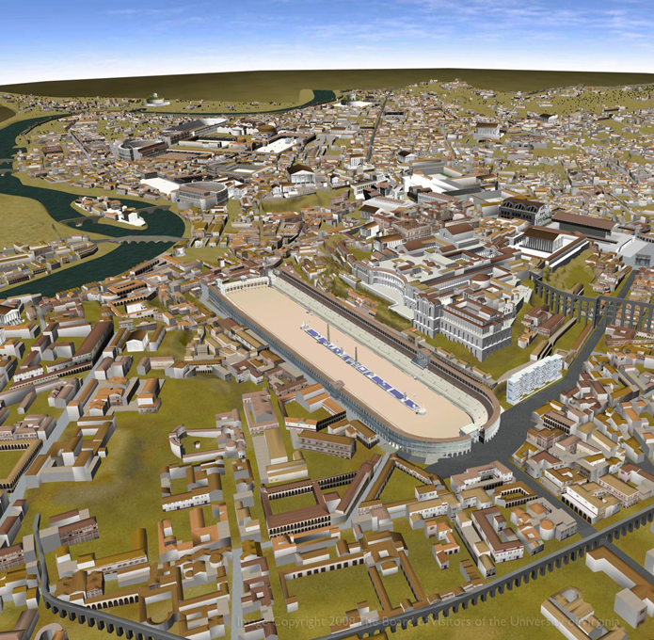
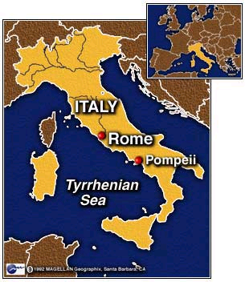
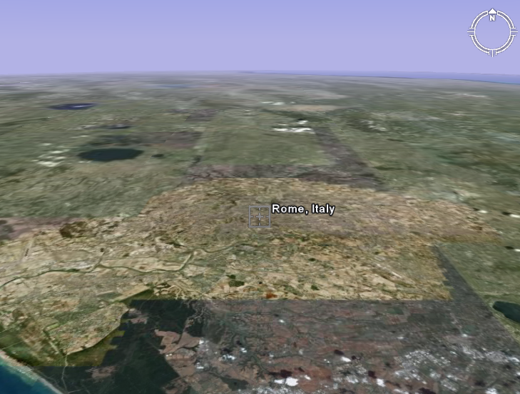
Where did the Romans come from?
The Romans lived in Rome, a city in the centre of the country of Italy. Rome started to grow from a small town into a larger and larger city around the year 753 B.C. (753 years before Jesus was born)
EUROPE
The city of Ancient Rome
Rome

Slide 9
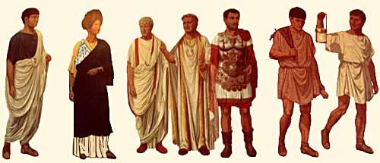
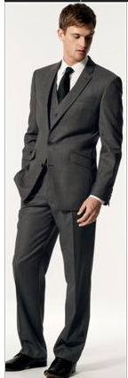
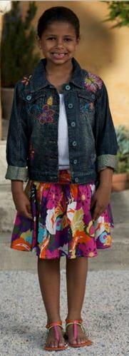
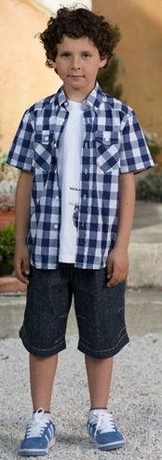
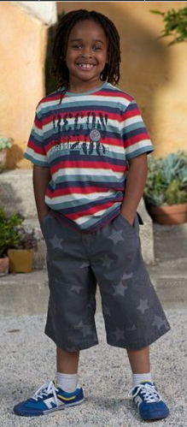
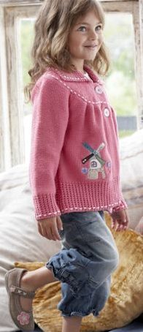
In many ways the Romans lived their lives very differently to us today. They dressed differently to us.
Ancient Roman clothing
Modern clothing
What is different about Ancient Roman clothing and the clothes we wear today?

Slide 10
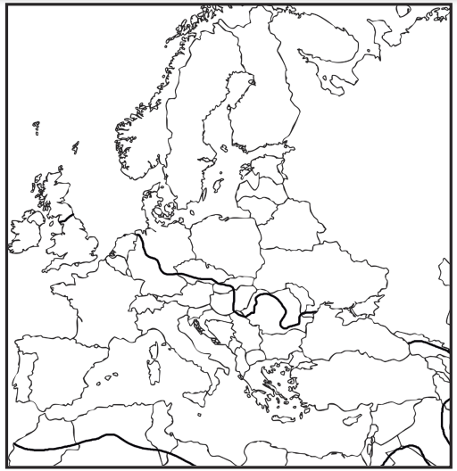
Padding: Label the UK, France, Germany, Spain, Portugal and Belgium.
Snorkelling: Label the UK, France, Germany, Spain, Portugal and Belgium,
Italy, Greece, Bulgaria.
Diving: Label the UK, France, Germany, Spain, Portugal and Belgium,
Italy, Greece, Bulgaria, Luxembourg, Czech Republic,
Albania
RP – In your opinion, why do you think the Romans
invaded the countries you coloured?

