Slide 1

Key Stage 2
Our music term of the day is “beat”!
The beat determines the pace of the music.
Which do you think has a faster beat? Lord of the Harvest or Cauliflowers Fluffy?

Slide 2
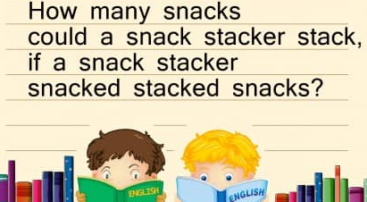
Let’s start with a warm up game!
Can you try this tongue twister?

Slide 3
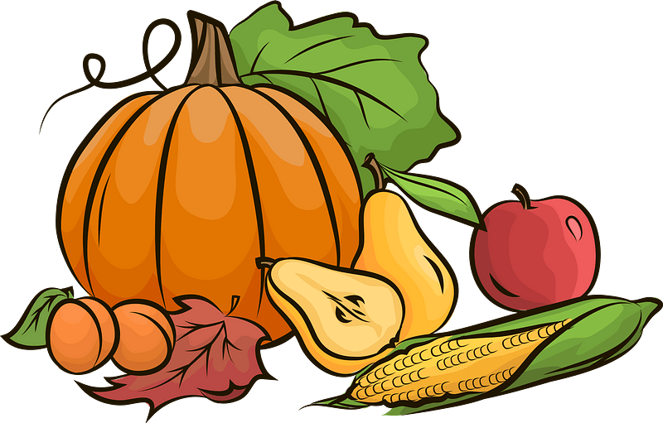
Let’s practise Lord of the Harvest!
Come and Praise
https://www.youtube.com/watch?v=Njkm9jEW7cc

Slide 4
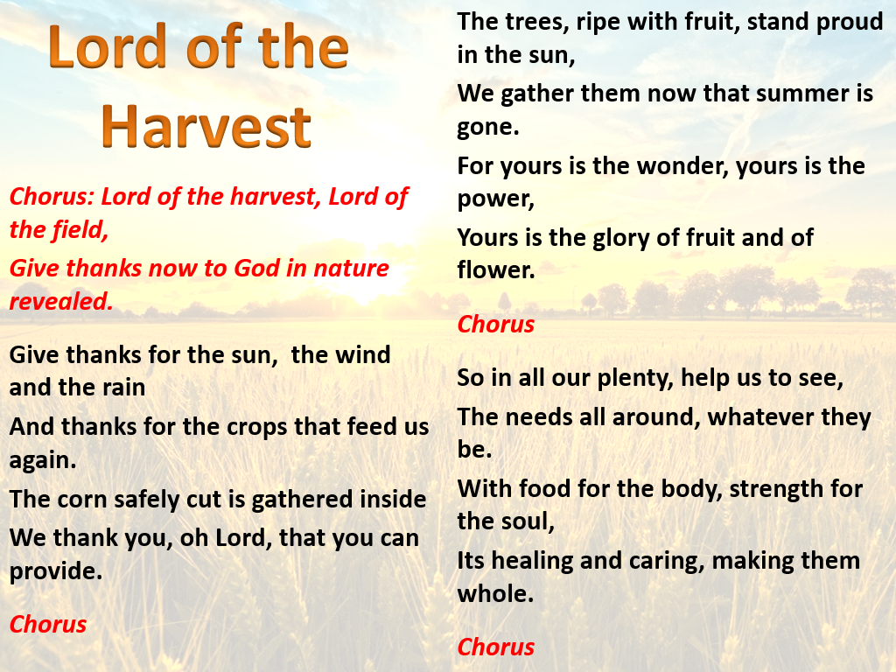
Come and Praise CD2 Track 112

Slide 5

Let’s learn I planted a seed!
Come and Praise
https://www.youtube.com/watch?v=ckwpn-fOZ4U
(Backing track)
Please singing along if you know it- a backing track with singing is coming soon!

Slide 6
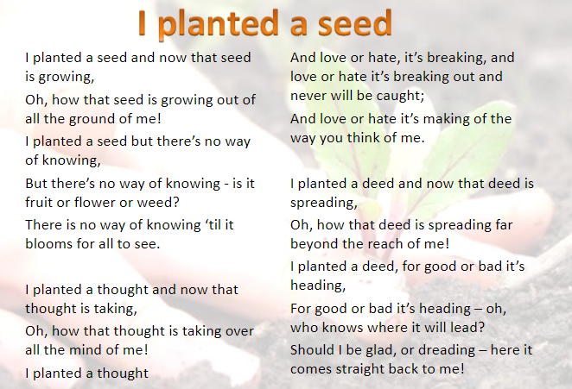
Come and Praise CD2 Track 112

Slide 7


