Slide 1
To understand beliefs and teachings.
To understand practices and lifestyles.
To understand how beliefs are conveyed.
C: Christianity.

Slide 2
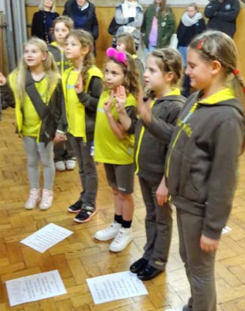
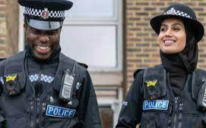

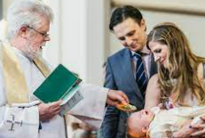
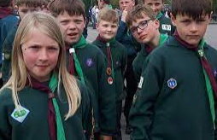
What kind of promises would these people have made?

Slide 3
What do Christians promise when they get married?
Let’s watch part of a Christian wedding when people are taking their vows (making life long promises to each other). Make sure you watch the 5 minute video not the 10 minute one.
https://request.org.uk/resource/life/rites-of-passage/marriage/

Slide 4
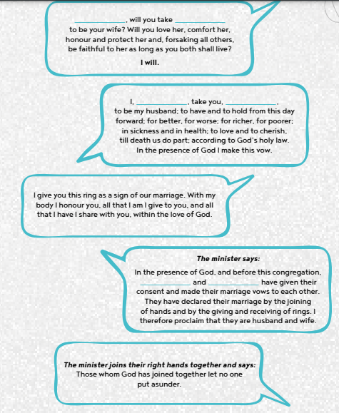
So very much like the promises in the story of Noah, the Christian ceremony creates a partnership between two people and God.
Look at the words/promises (vows) that are said on
The resource that is on the webpage.

Slide 5
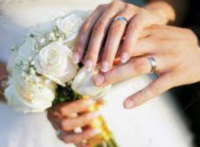
This is like a covenant because both parties make a promise to each other like Noah and God did.
They make these promises to each other and to God, and this might help a Christian couple in their married life.
Why might that be?
Can you remember the symbol God sends to show he will never again destroy all life?

Slide 6
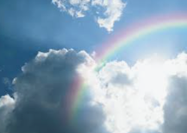
When we see a rainbow in the sky we remember that God promised never again to destroy life again.

Slide 7
Symbol…what does this word mean?
A thing that represents or stands for something else. Like the rainbow.
What symbols can you think of that you would see at a Christian wedding?

Slide 8
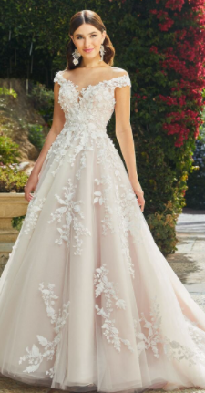
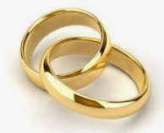
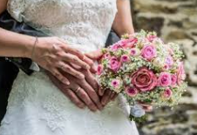
Eternal love and commitment
within a relationship.
Purity and innocence.
New beginnings.

Slide 9
For Christians, the Noah story is about getting rid of evil and also about how God will always stick with people even when they do bad things.
However, in marriages and other areas of life, it’s important to say sorry when you do something wrong in order to get forgiveness.
Sometimes, we need to say sorry to people.
Christians and other religious believers say sorry at other times to God.
When do you think this might be?

Slide 10
Paddling: Draw and label the symbols of marriage.
Snorkelling and Diving: Write a short paragraph explaining how marriage is like a covenant. Make links between symbols at weddings and the symbol God sent to remember the covenant with Noah.
Paddling Red Pen: Create a new symbol to use in weddings to symbolise the covenant between a husband and wife.
Snorkelling and Diving Red Pen: Do you think a ring is a good symbol of the covenant between a husband and wife? Explain your thinking.

