Slide 1
Thursday 14 October
LO: To write for purpose.
​​C: Tenses

Slide 2
Captions
When we look at newspapers there are often photos. Under the photos there is writing that tells us what is happening in that picture. ​
​These are called captions.

Slide 3
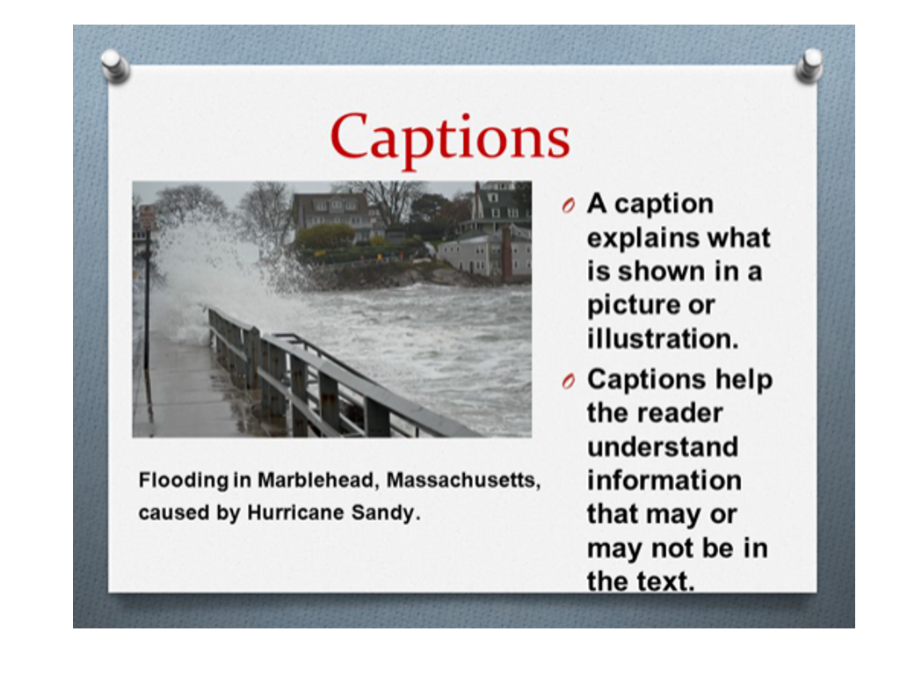

Slide 4
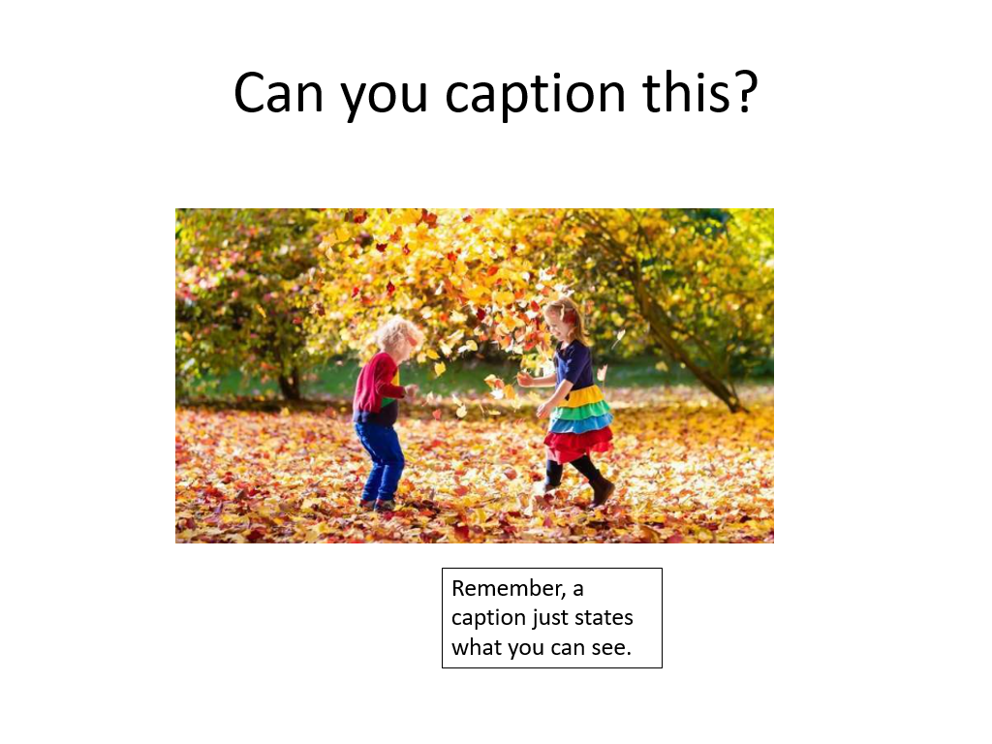

Slide 5
Tenses
Newspapers are written mainly in past tense
​
The last paragraph tends to look towards the future and what will happen next
​
https://www.bbc.co.uk/bitesize/topics/z88t97h/articles/z3dbg82​
​
https://www.bbc.co.uk/bitesize/topics/z4hrt39/articles/z7t2vk7

Slide 6
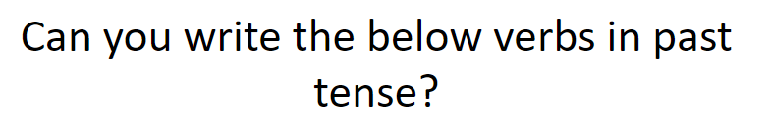
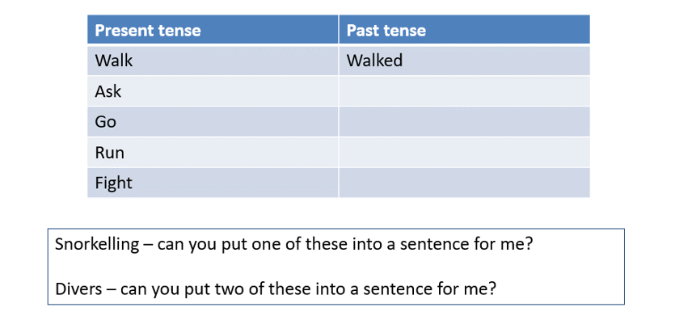
Please set your work out in two columns.

Slide 7
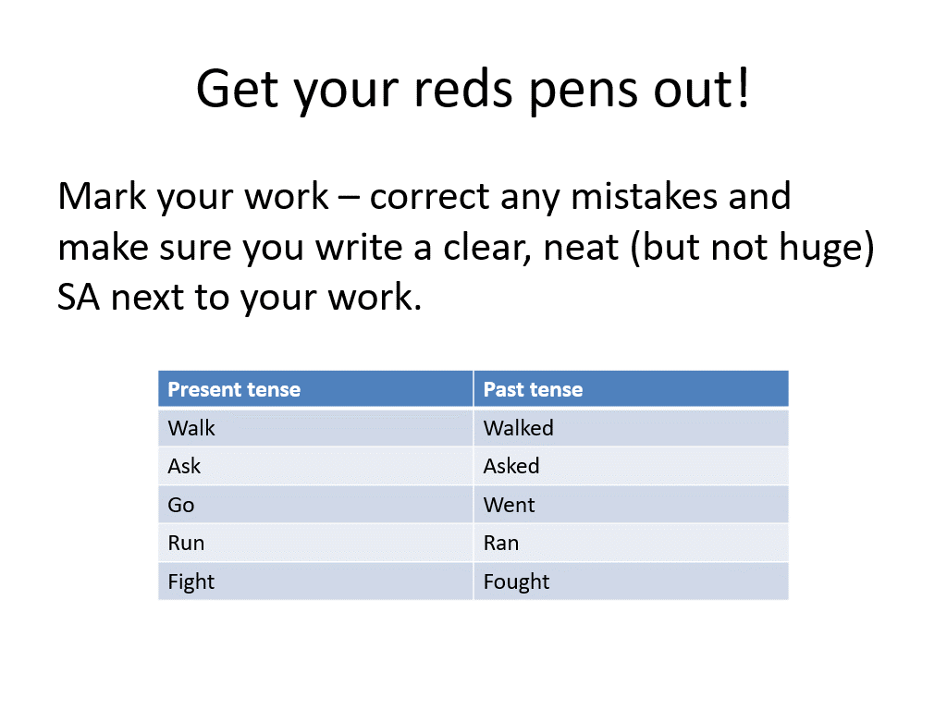

Slide 8
Can you write a sentence about Robin Hood climbing a tree using 1st, 2nd or 3rd person.
1st – I (You are Robin Hood).​
​
2nd – You (You are talking to Robin and telling him what he did).​
​
3rd – Him, He, Her, She, They (You are talking about what Robin did).

