Slide 1
Wednesday 13 October 2021
LO: To write for purpose.​
C: Time Adverbials

Slide 2

What is an adverbial?
Think carefully about your answer.
Try to be as accurate as possible in your explanation.

Slide 3
What is a fronted adverbial? - BBC Bitesize

Slide 4
What is a time adverbial?
It is an adverbial that helps us tell when something happened, how long for and how often. ​
Yesterday, Goldilocks went to the three bears house.​
She stayed at her friends house all day.​
I always wear my seatbelt.

Slide 5
Time adverbials
Sometimes, you can even add them at the front! ​
Who can remember what that is called?

Slide 6
Fronted adverbials
Yesterday, Goldilocks went to the three bears house.​
​
All day, she stayed at her friends house.​
​
However, sometimes they don’t quite work…​
​
Always, I wear my seatbelt.

Slide 7
What might they look like in a newspaper report?
Late last night, there was an incident in Binfield park. An alien space craft, carrying strange purple men, was seen landing in the field. Before long, these peculiar purple men were seen playing on the slide and the swings and were reported by one eye witness as having the time of their lives. Tomorrow, alien investigators are expected to arrive to the scene and spend all day piecing together this puzzle.

Slide 8

Now it’s your turn…
What time adverbials can you think of, linked to Robin Hood, that would work well in a newspaper report?

Slide 9
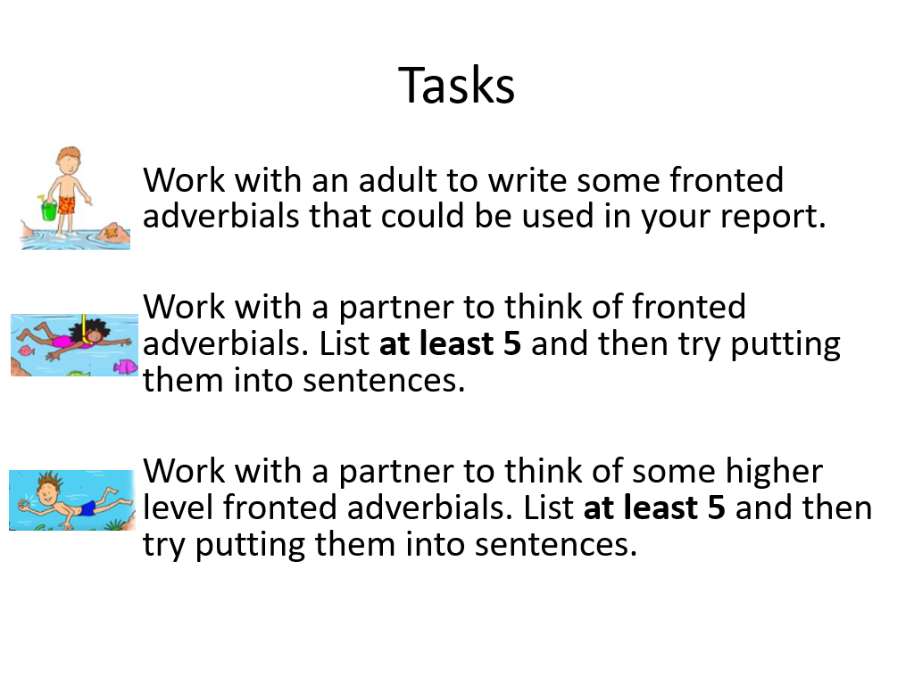

Slide 10


