Slide 1
Tuesday 20th April 2021
L.O: To write with purpose.
C: Instructions

Slide 2
For the next two weeks we are going to be writing our own instructions!
What is the purpose of instructions?

Slide 3
Let’s stick in our knowledge organiser.
How many different things can you think of that require instructions?

Slide 4
Today we are going to practice our instruction giving!

Slide 5

Fact Match Up Game
More games
I am a mouse!
Many people buy mice as companion pets. They can be playful, loving and can grow used to being handled
Teacher transforming…

Slide 6
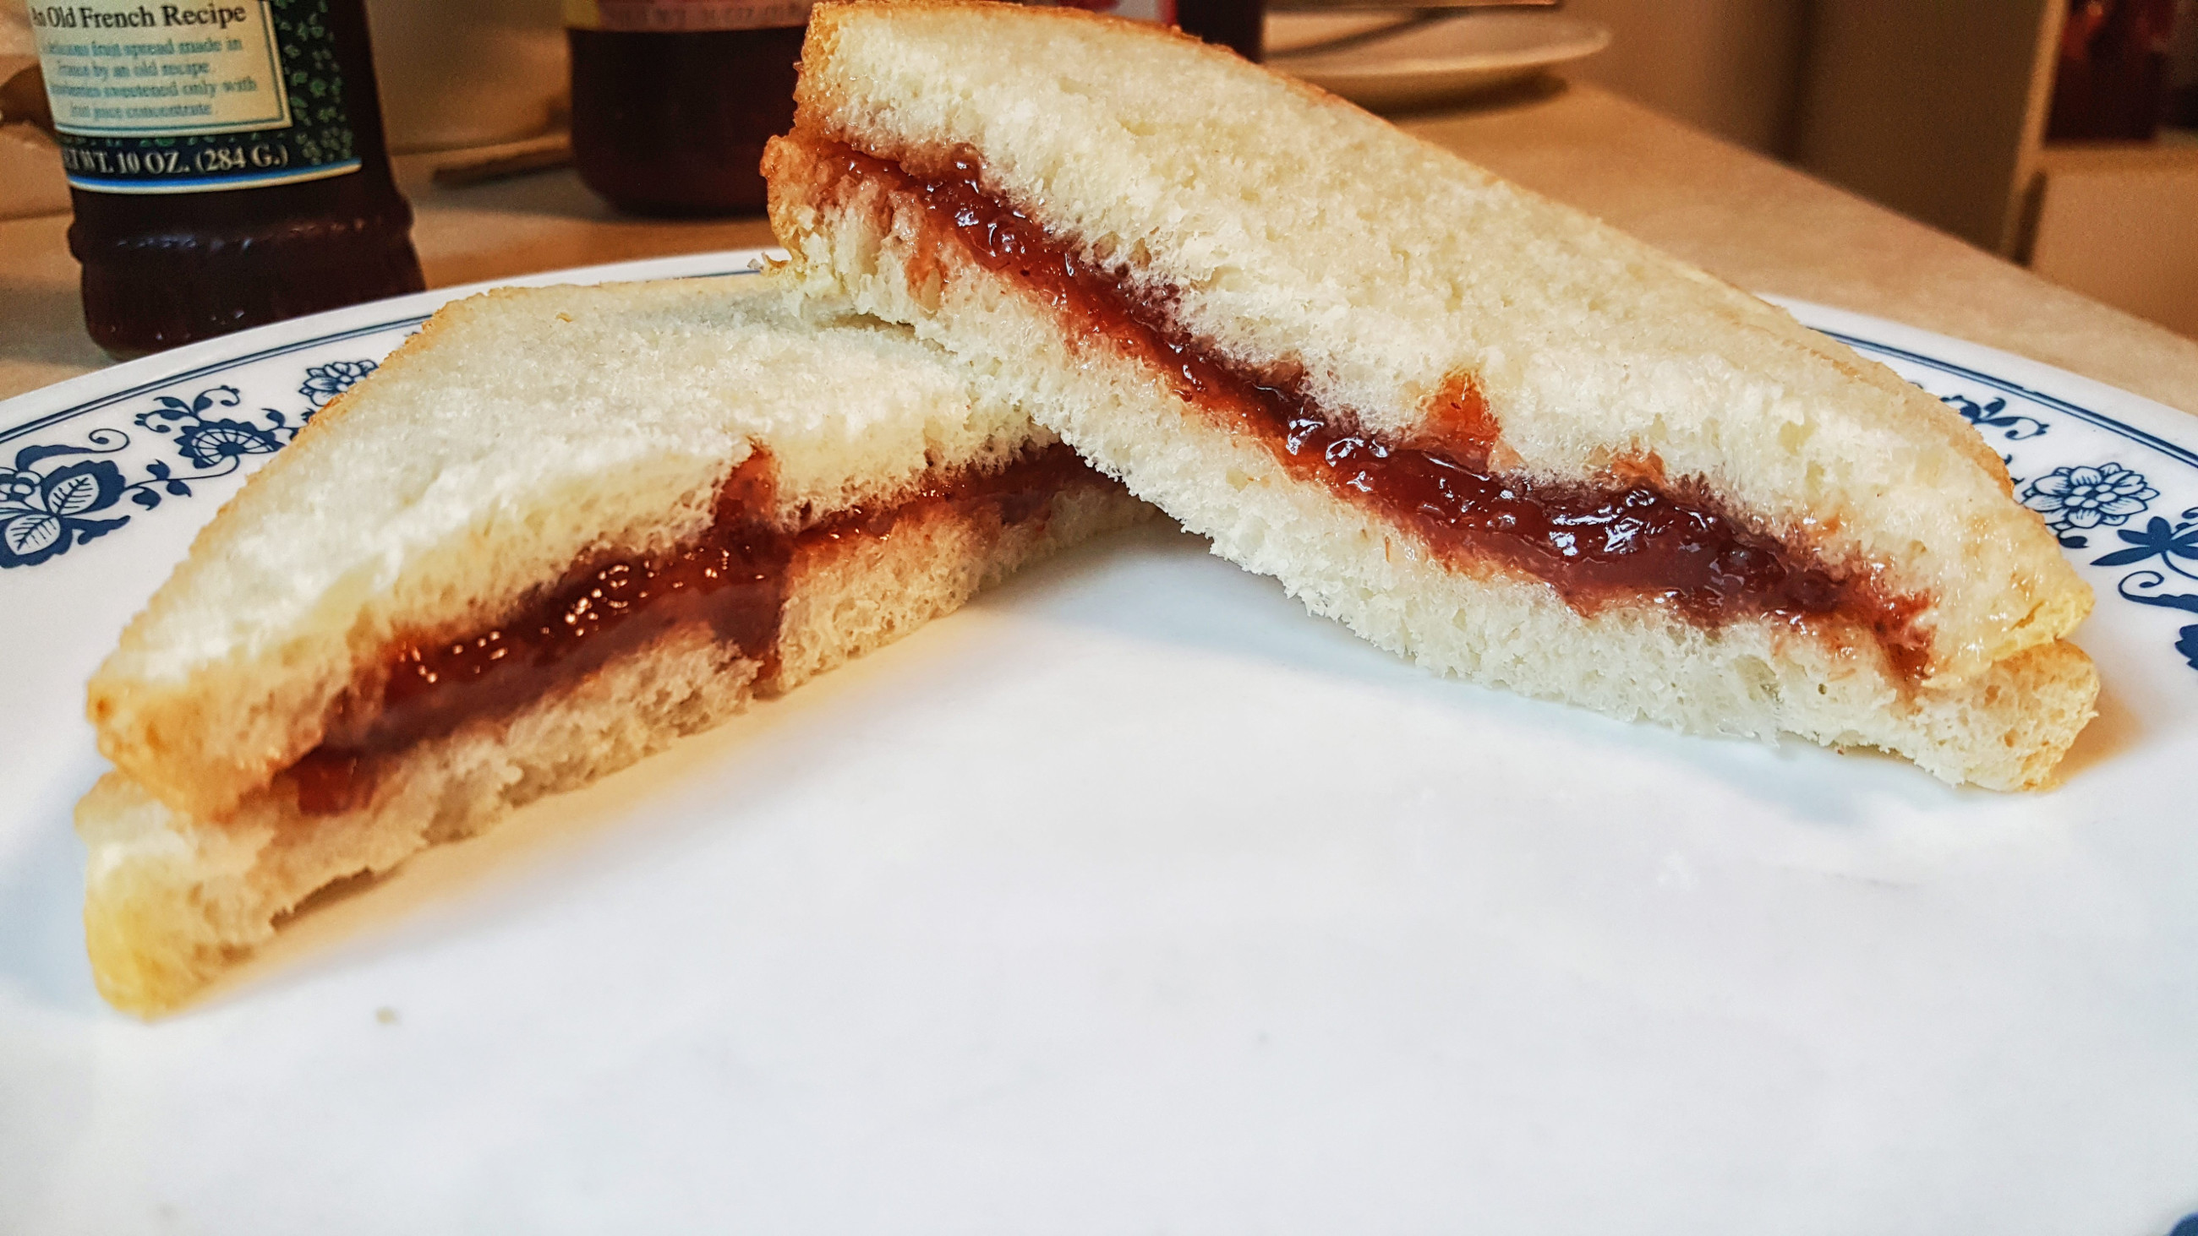
Your robot teacher wants to make a jam sandwich. Can you work with the TA to help them make one?

Slide 7
RED PEN QUESTION:
Paddlers: Can you write 3 top tips for giving successful instructions?
Snorkellers: What went well? What could we improve on?
Divers: Write 3 instructions you heard during this activity. Number them from most to least successful. Why did you order them this way?

