Slide 1
Monday 11 October 2021
LO: To understand texts
C: Understanding features of a newspaper article

Slide 2
Features of a Newspaper
Today we are going to look at the features of a newspaper article.
Look at the newspaper articles provided.
Think, pair, share: How are they set out? What stands out to you?
What language do you notice? Can you spot any
fronted adverbials or expanded noun phrases?
15 minutes

Slide 3
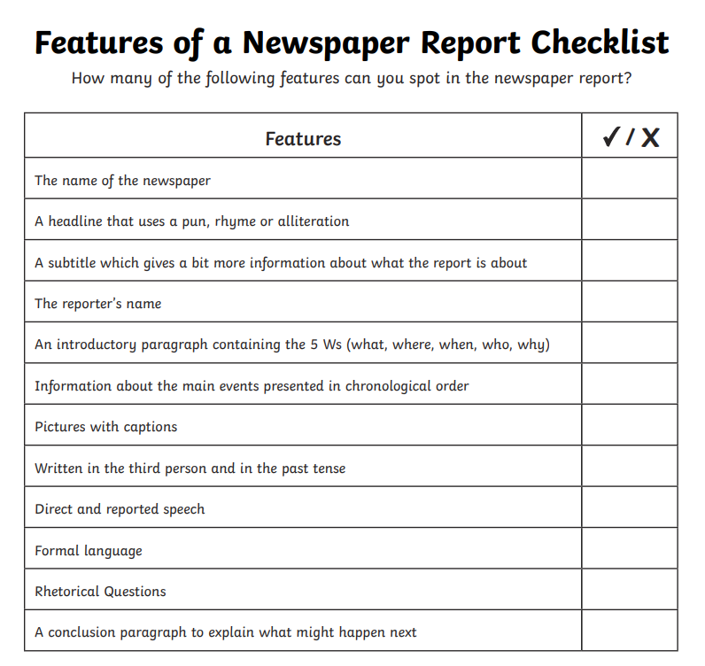
Features of a newspaper report - Year 4 - P5 - English - Home Learning with BBC Bitesize - BBC Bitesize

Slide 4
Now that we know what to look for, look back over the newspaper reports. Use a highlighter to highlight any important features and language that you notice. Annotate with a pencil.
Share your work with your family.

Slide 5
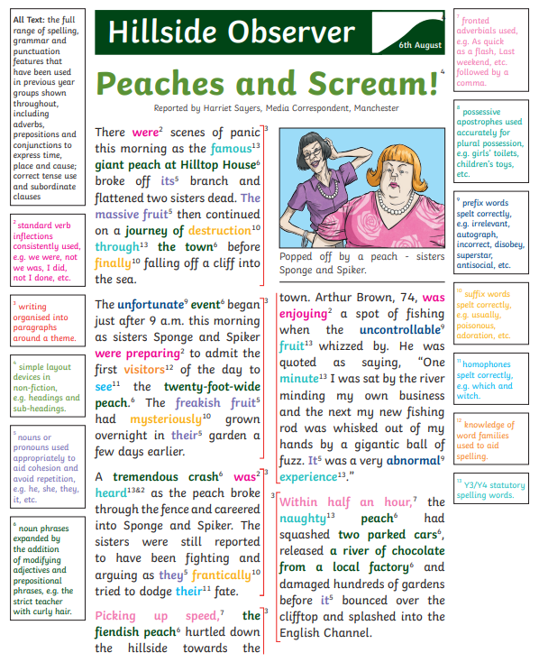
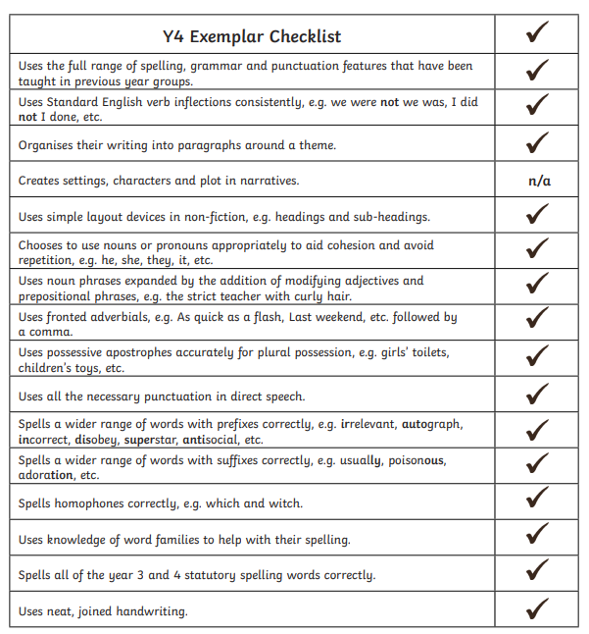

Slide 6
Tuesday 12 October 2021
LO: To write for purpose.
To organise writing appropriately​
​
C:Headlines

Slide 7

EXTRA! EXTRA! READ ALL ABOUT IT! ​
Year 4 become fantastic feature spotters!!​
Newspapers have a range of features that attract the reader.​
​
​
​
​
​
Does anyone remember any of them?

Slide 8
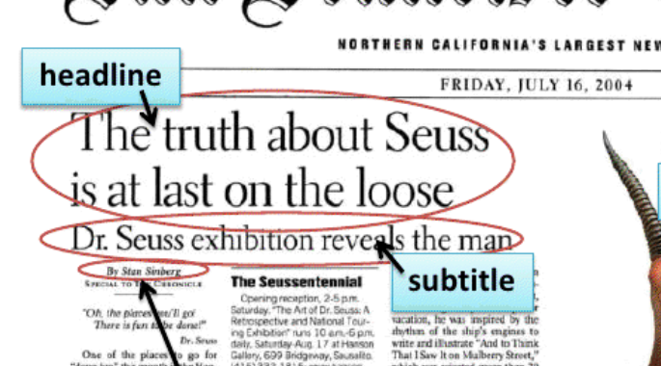
Headline: Include a pun, rhyme or alliteration
Subtitle: A short title that gives more information about the report
1st paragraph: An introductory paragraph containing the 5 W’s
Quotes
2nd and 3rd paragraph which include quotes (main body)
Details of what actually happened (main body)
Photo and caption
Conclusion paragraph: End of report summary (tail)

Slide 9
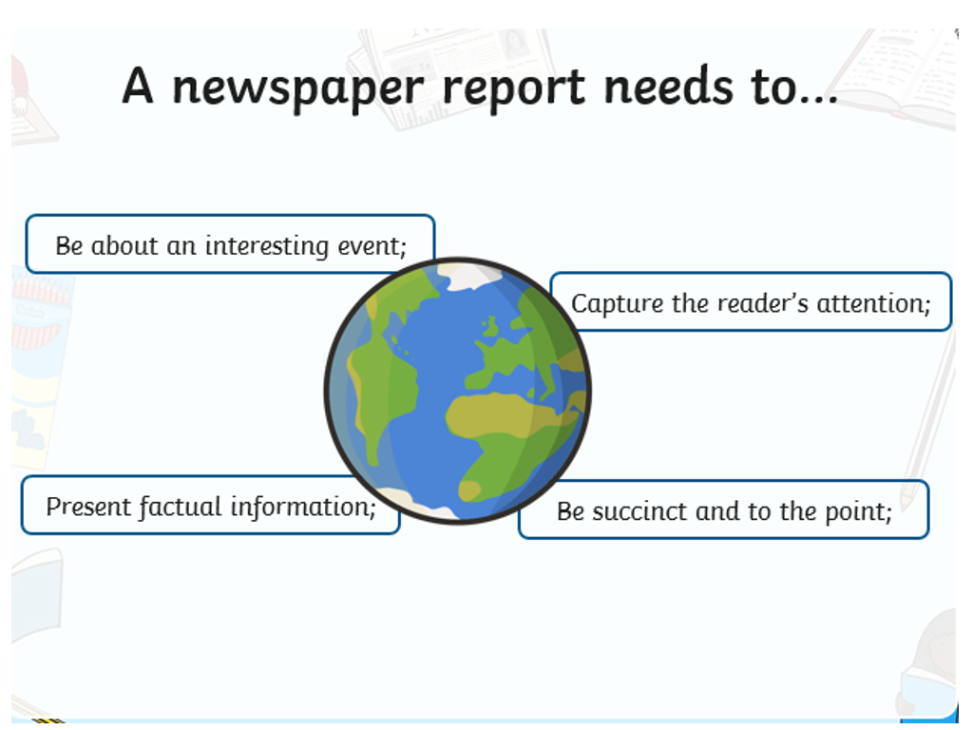

Slide 10
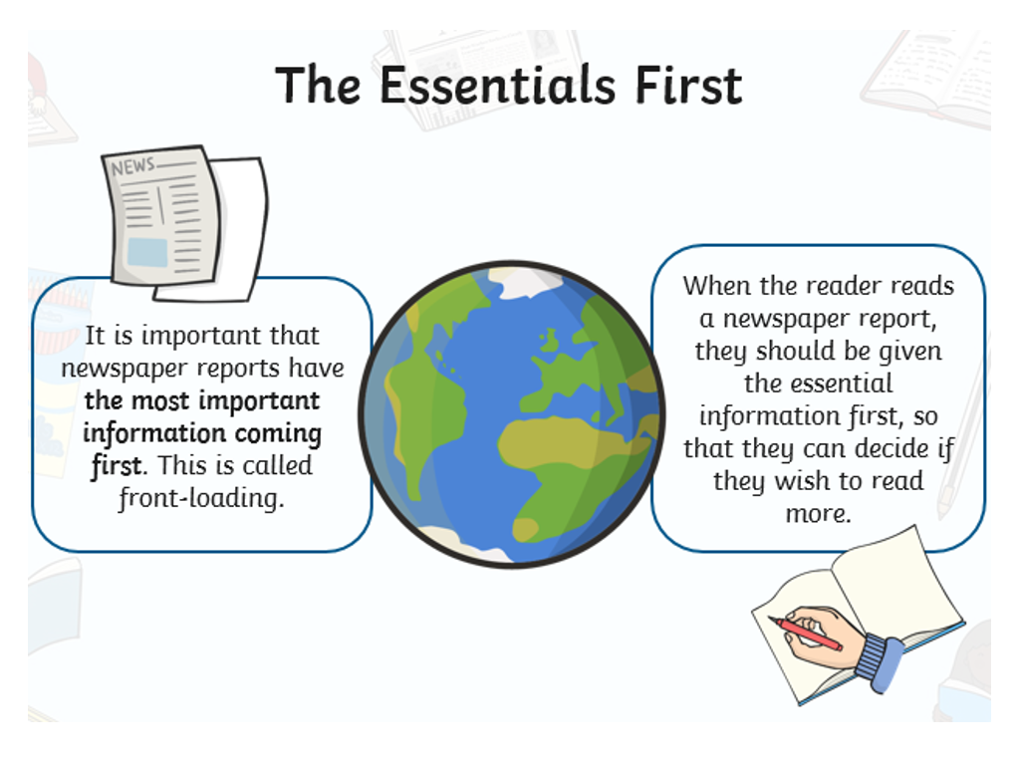

Slide 11
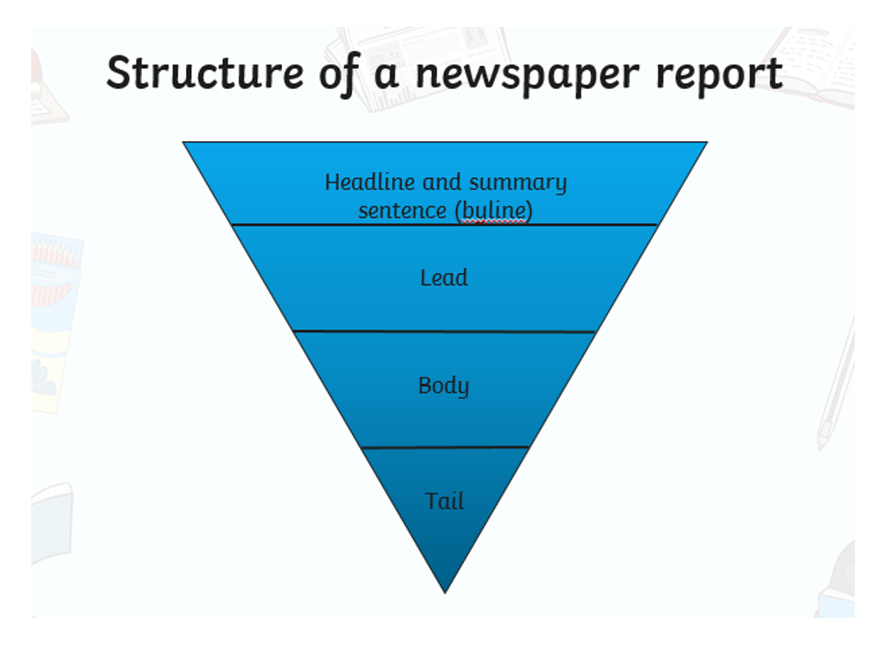

Slide 12
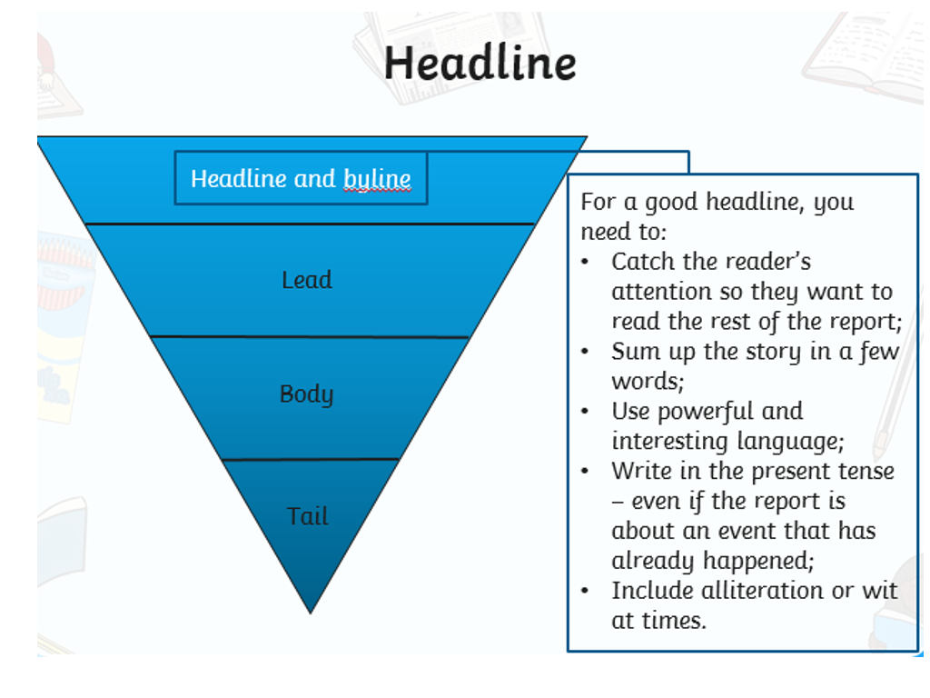

Slide 13
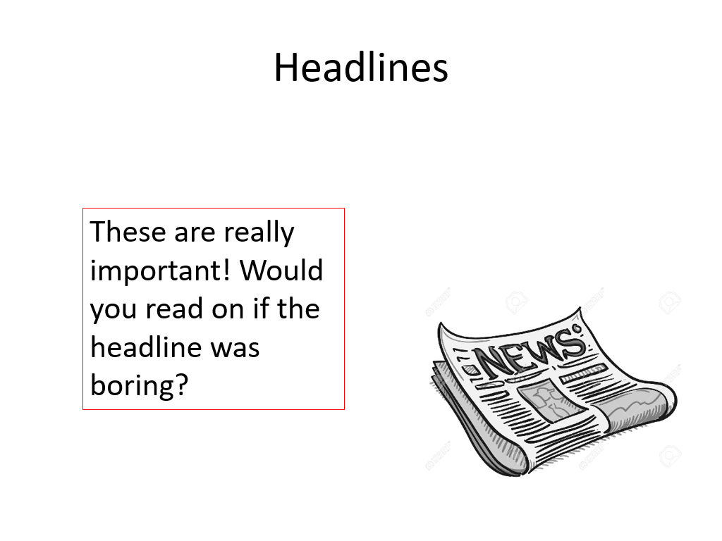

Slide 14
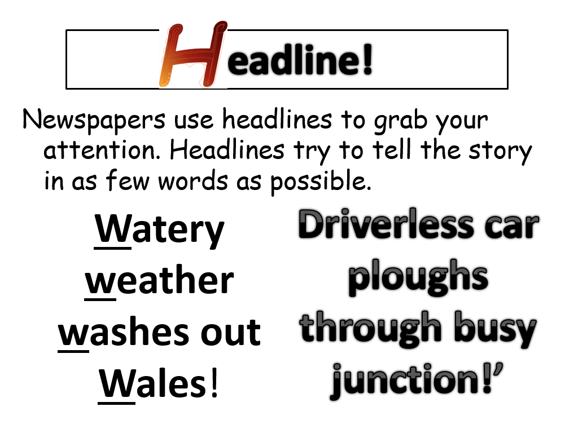

Slide 15
Headlines
Can you think of possible headlines for the following news stories?​
Alice finds a rock at the park that turns out to be a solid gold nugget.​
Sienna finds a new species of cow on her holiday in Scotland.​
Mrs Celliers bakes a record breaking sausage roll for charity.

Slide 16
Headlines!
Gold nugget windfall for Wells!​
​
‘Moo’ving moment for cow girl!​
​
Mighty meat treat for charity!

Slide 17
Task
Look at the news stories provided.
Write them out and think of a snappy headline to go with each.

