Slide 1

Monday 28 February 2022
Puzzle 4: Healthy Me - Ages 8-9 - Piece 2
The healthy, happy me recipe book

Slide 2
Discuss two animal from the list below. Discuss the qualities/ characteristics of your animals. Are there words or phrases that are associated with these animals e.g. quiet as a mouse, cats are sometimes thought of as sly, dogs loyal etc.
• Mouse
• Dog
• Cat
• Crocodile
• Great white shark
• Wolf
• Chimpanzee
Make a list of the words you have used.

Slide 3
The words you have used to describe your animals can also be used to describe the way humans can act or feel sometimes, especially when we are in groups. In groups there are often people who are leaders and some who are followers.

Slide 4
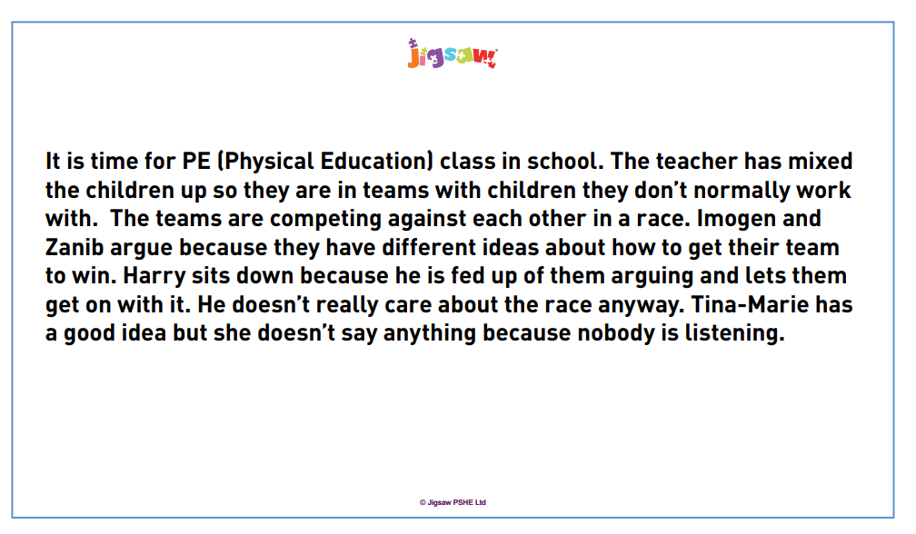
Use the words from
the class list you have
created to describe the
characteristics
of the different children
in the scenario.

Slide 5
Discuss the different roles the children have adopted. Is there more than one leader? Has this caused a conflict? What roles have Harry and Tina-Marie chosen? Can the children problem-solve this situation? How could the group work better? Can anyone be more assertive?

Slide 6
Look at the following scenarios. Can you identify the different characteristics and roles the children in the scenarios have chosen? Can you problem-solve to try and work out a solution to the problems in the scenario?

Slide 7
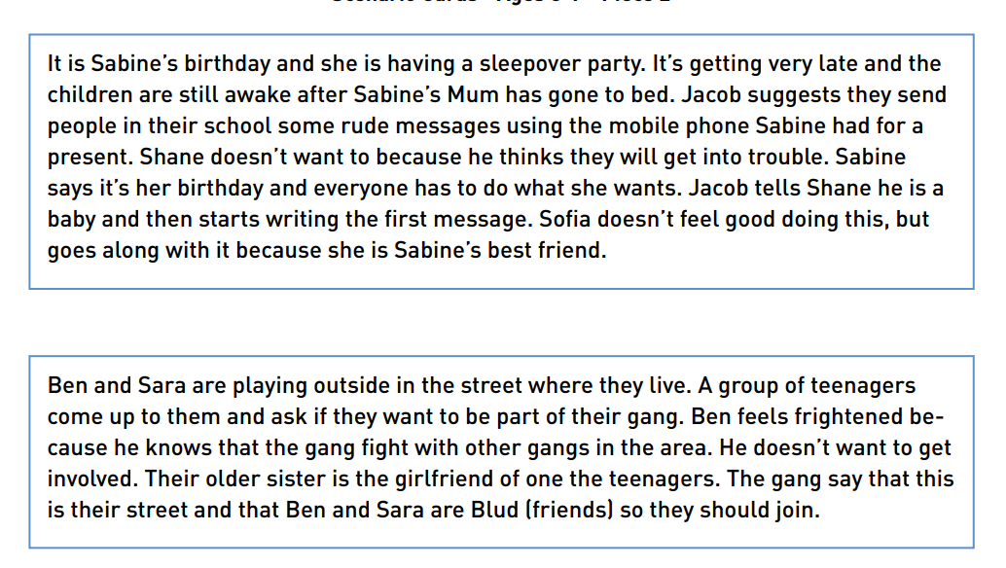

Slide 8
Debrief
Think about the following questions:
Were the scenarios solved in the same way? Was one more difficult to resolve than the other or were they both difficult but in different ways? Why might this be? Could you recognise ‘peer-pressure’? Are some ‘peer-pressure’ situations trickier than others?

