Slide 1
Thursday 3rd March
LO: To identify how plants and animals are suited to and adapt to their environment in different ways
C: Living Things and their Habitats

Slide 2

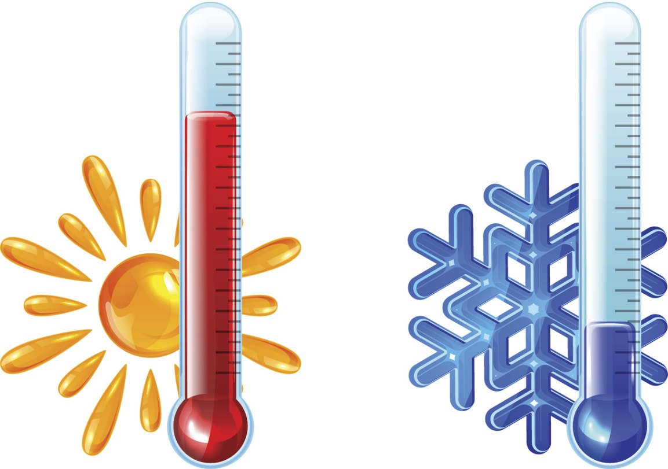
Starter: What would you do….?
When the weather gets cold?
When the weather gets hot?

Slide 3
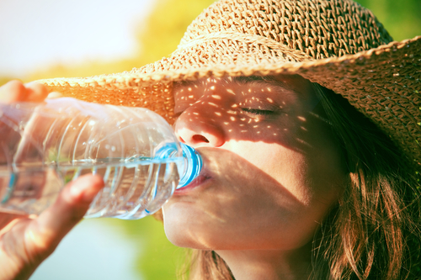

You may put a coat on to keep warm or wear a sunhat to cool down.
Your suggestions are all ways of adapting or changing to your habitat or environment.

Slide 4
Animals adapt to their habitats too.
While animals don’t have clothes, they do have built-in ways of keeping the right temperature and protecting themselves in the habitat they life in.
https://www.bbc.co.uk/bitesize/topics/zvhhvcw/articles/zxg7y4j

Slide 5
Over many years and generations, animals and plants have changed in order to survive and thrive in the environments they live in. this process is called adaptation.
There are a number of ways that animals adapt – these can be inside or outside their bodies, in ways that they act or even ways that they work with other animals in their habitat.
If you suddenly took an animal outside its habitat into something completely different, all those adaptations wouldn’t work anymore, and it wouldn’t be good for the animal.
It’s the same as if you dressed in your warmest coat and woolly hat and scarf in the middle of August – you’d be much too hot!
Every habitat on our planet is home to different animals and plants who are uniquely adapted to live there.

Slide 6
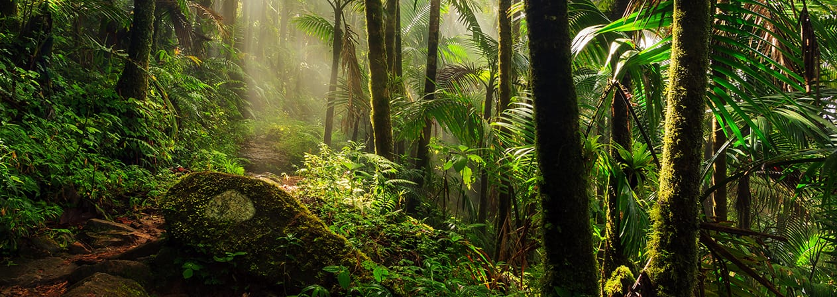
We are going to be looking at how plants and animals have adapted to live in the rainforest environment.
Adaptation is a change in a living thing that helps it live in its environment.
Plants, animals, and humans all have special adaptations that allow them to survive.
The rainforest is a specific type of forest that has an extreme amount of rainfall.
Rainforests are warm and humid all year long.
They also have many plants and thick trees.

Slide 7
Adaptations are extremely important in the rainforest because it is such a unique environment.
Rainforests get hundreds of inches of rain every year, so the plants and animals that live there must be able to deal with tat.
They must also be able to handle hot, humid weather.
Because of the thick, dense trees, the ground level in a rainforest does not get much sunlight.
Over time, the animals that call rainforests home have adapted, or changed, in order to survive.

Slide 8
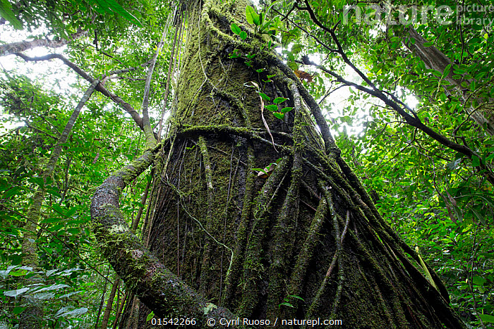
Plant Adaptations
Lianas - these are woody vines that have roots in the ground but climb up the trees to reach the sunlight. Their leaves and flowers grow in the canopy.

Slide 9
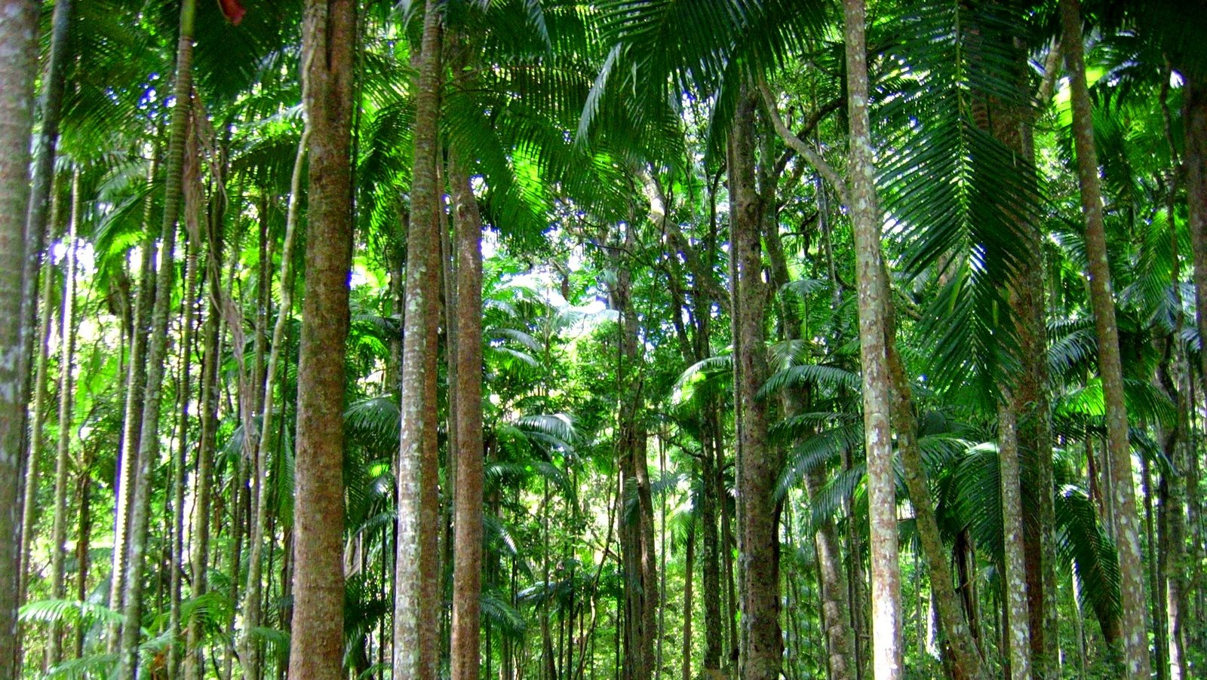
Plant Adaptations
Tree trunks - these are tall and thin to allow trees to reach the sunlight. The bark on these trees is smooth to allow water to flow down to the roots easily.

Slide 10
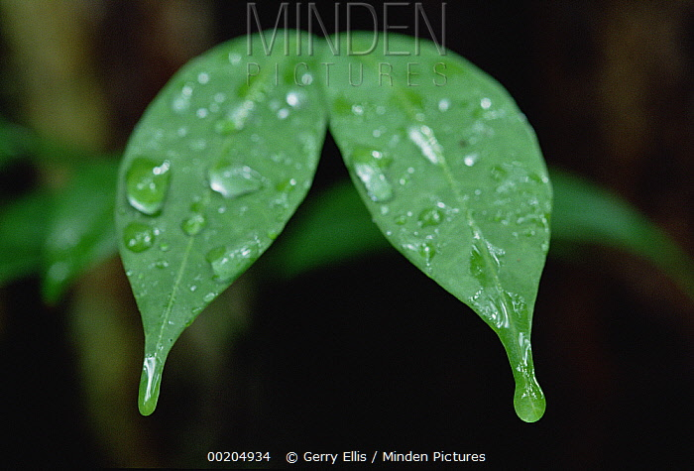
Plant Adaptations
Drip tips - plants have leaves with pointy tips. This allows water to run off the leaves quickly without damaging or breaking them.

Slide 11
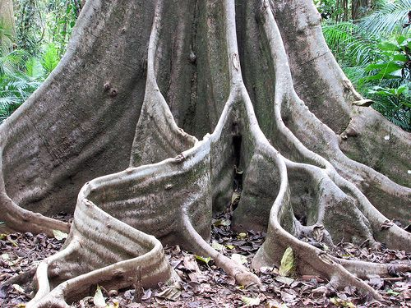
Plant Adaptations
Buttress roots - large roots have ridges which create a large surface area that help to support large trees.

Slide 12
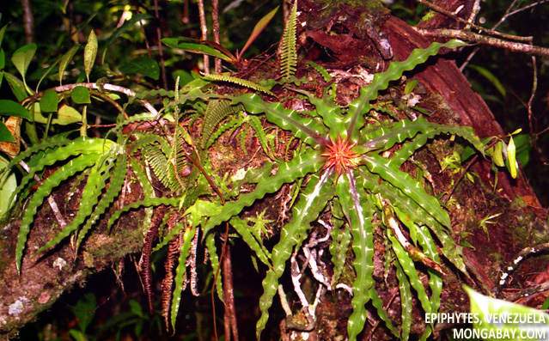
Plant Adaptations
Epiphytes - these are plants which live on the branches of trees high up in the canopy. They get their nutrients from the air and water, not from the soil.

Slide 13
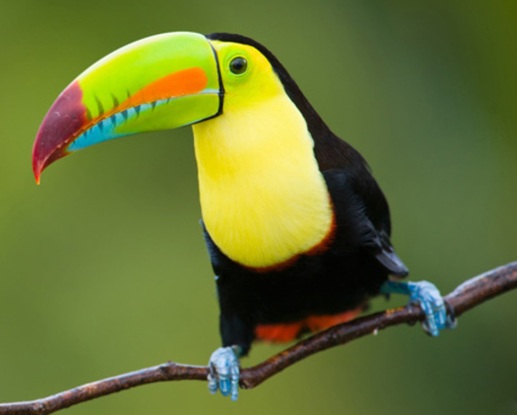
Animal Adaptations
Toucans have very long beaks which have blood vessels in them and release body heat, helping to keep them cool. Toucans keep balanced on trees in the rainforest by using their claws – two on the front and two on the back – to get a good grip that keeps them from falling down.

Slide 14
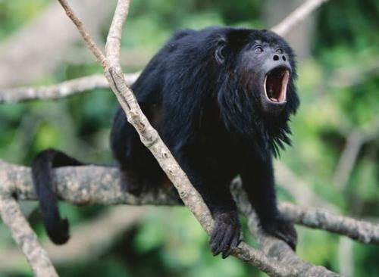
Animal Adaptations
Howler monkeys are one of the loudest animals on earth, which is how they get their name! They live up in the rainforest canopy, where it can be difficult to see very far around because there are lots of leaves and branches in the way. So, they use their loud voice to call out to other howler monkeys, and to make sure other animals know where their territory is. They need to communicate with other howler monkeys because they all live in large communities – howler monkeys don’t move around very quickly, so they need friends to help protect each other from predators. Howler monkeys also wrap their tails around tree branches to keep from falling down.

Slide 15
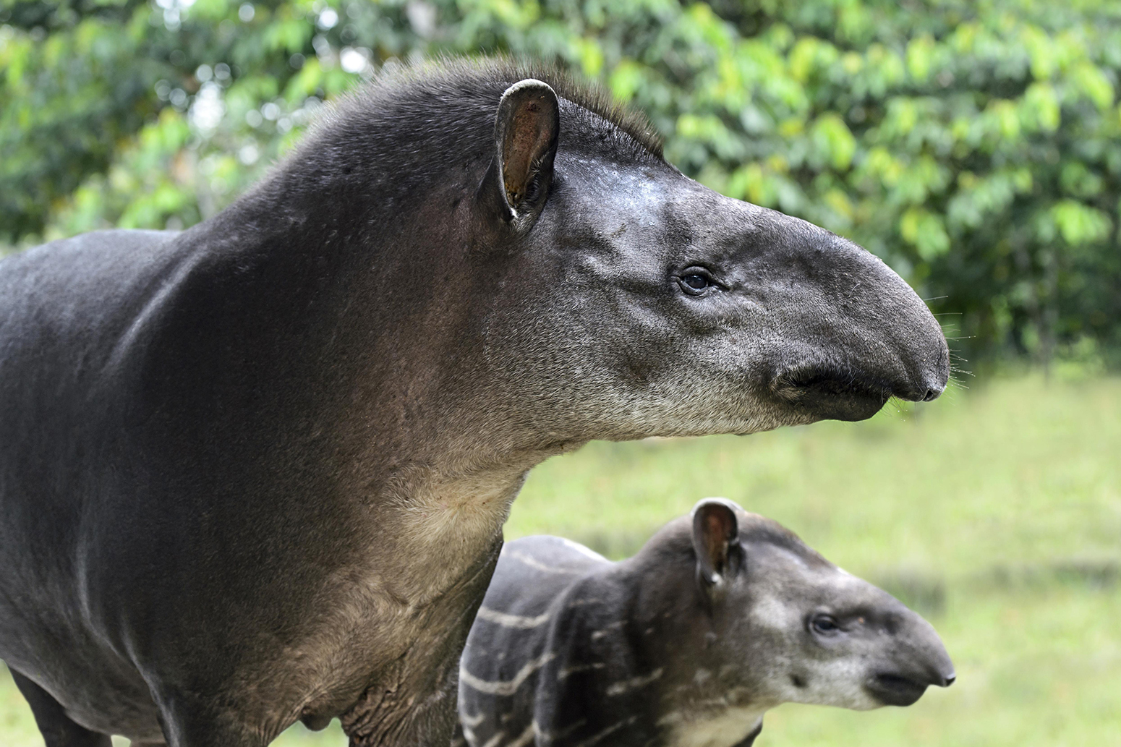
Animal Adaptations
Tapirs are larger rainforest animals that live on the forest floor. They are herbivores, so it’s easy for them to find leaves, twigs and fruits to eat as they wander around. They have sloped shoulders that allow them to move around under bushes and shrubs, and small eyes deep in sockets that protect them from insects and bits of trees getting in. Tapirs have a long, flexible nose that can root into trees and bushes to grab food. They can go into shallow water, and use their noses as a snorkel to breathe!

Slide 16
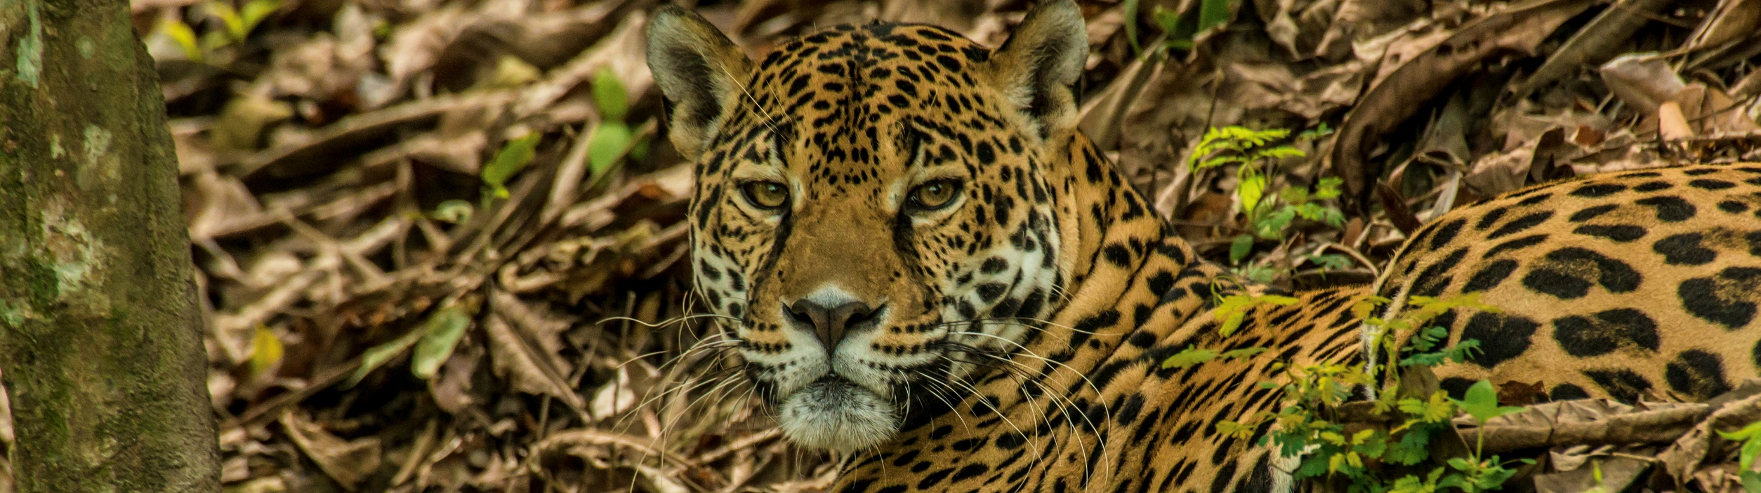
Animal Adaptations
Jaguars have colouring that is perfectly adapted for their rainforest home. The dark spots on their coats allow them to blend in with the shadowy forest so that they can hunt for food without being seen.

Slide 17
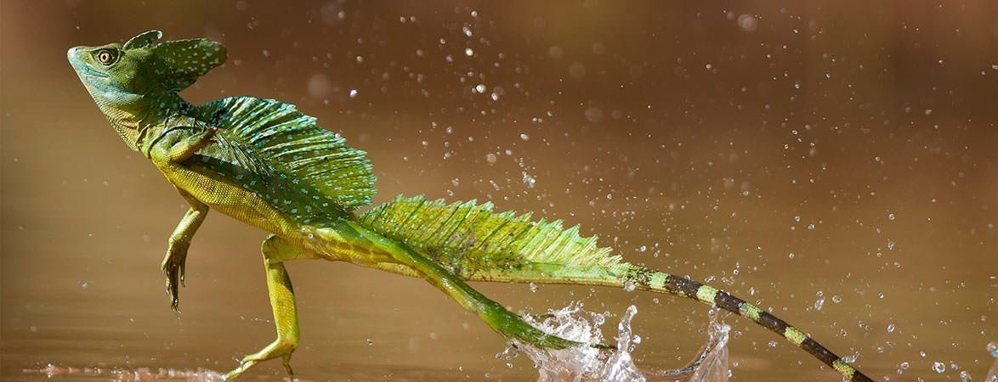
Animal Adaptations
The basilisk is a special lizard that is found in tropical rainforests. Like many lizards, they can climb through trees. The basilisk is also incredibly fast. In fact, it's so fast that it can run across water when it needs to escape danger! This special adaptation allows it to stay safe in its tropical home.

Slide 18
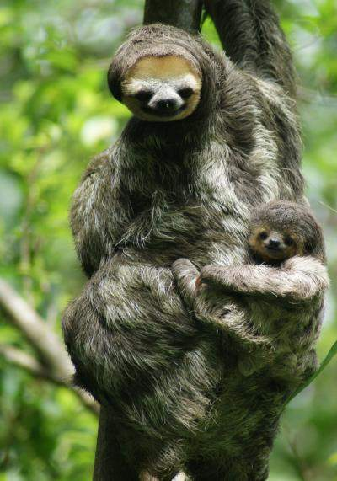
Animal Adaptations
The sloth uses camouflage and moves very slowly to make it difficult for predators to spot.

Slide 19
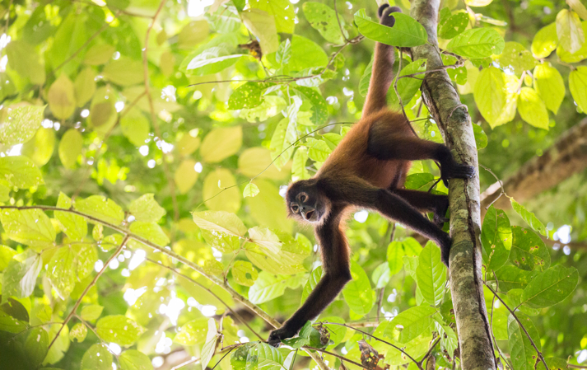
Animal Adaptations
The spider monkey has long, strong limbs to help it to climb through the rainforest trees.

Slide 20
In groups:
Create a plant or animal that you think would be well adapted to life in the rainforest.
You should label your organism with how it is adapted to the rainforest.
Red Pen:
Paddling – How would you need to adapt in order to live in the rainforest?
Snorkelling – Imagine a sunflower has moved to the rainforest. How would it need to adapt to survive?
Diving – Some plants are carnivorous in tropical rainforests. Why has this adaptation evolved?
Things to consider:
Where does it live in the rainforest?
Remember, the challenges on the forest floor will be different to those found higher up in the understory, canopy and emergent layer.
What are the conditions like there? What are the main challenges?
What adaptations has it evolved to meet these challenges?

