Slide 1
Tuesday 1st March 2022
LO:
*to understand beliefs and teachings
*to reflect
C: Christianity

Slide 2
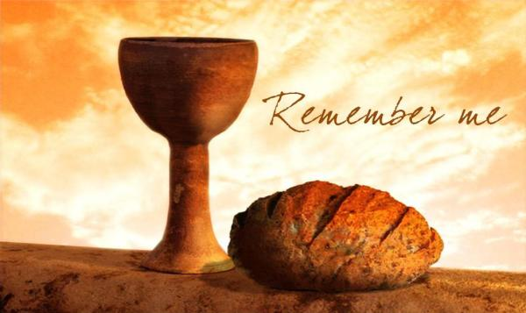
Christians call the day of the Last Supper ‘Maundy Thursday.’
There are different theories for why it is called ‘Maundy’ Thursday.
Some people believe it relates to the money that was given out to poor people before services on this day – related to the word ‘beg’
Others believe it relates to the word for ‘commandment’ – connecting it with Jesus’ instruction to: Love one another as I have loved you. (John 13:34-35).

Slide 3
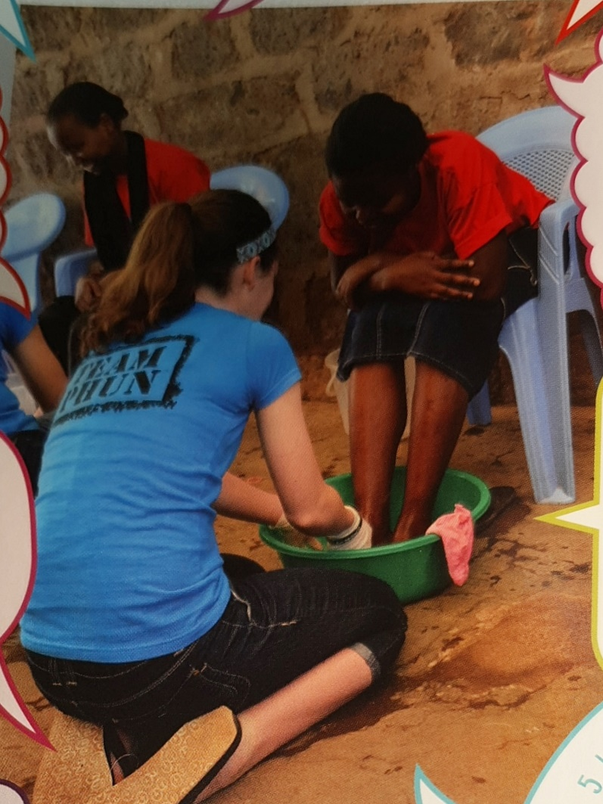

Activity 1:
Think about what might be going on in the picture.

Slide 4
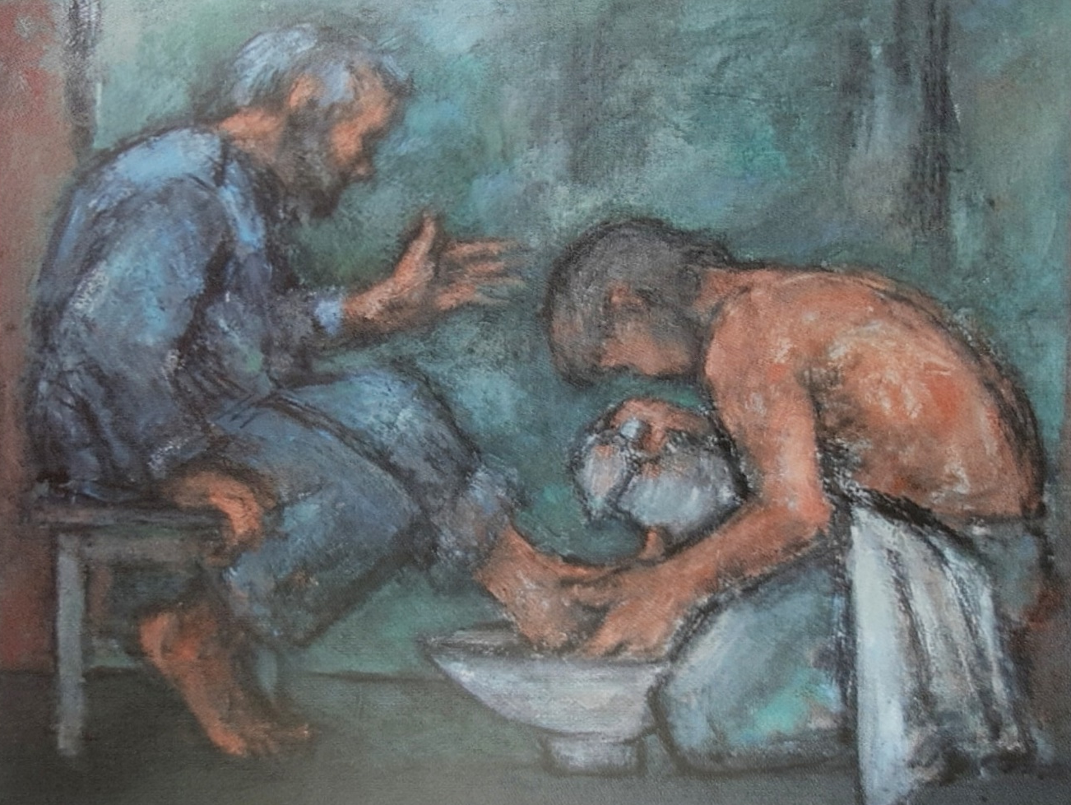
Activity 1:
Think about what might be going on in the picture.

Slide 5
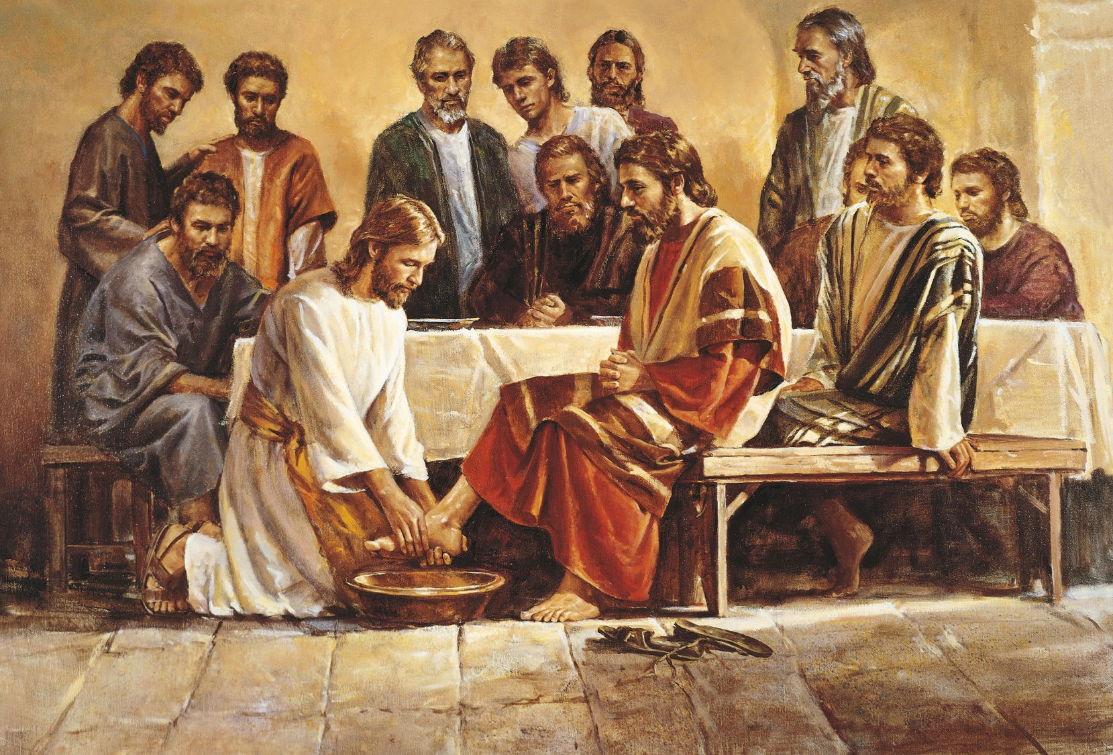
In John’s Gospel, the writer includes an episode not in Matthew’s account: Jesus washing the feet of the disciples.

Slide 6
John 13: 4-17
⁴ so he got up from the meal, took off his outer clothing, and wrapped a towel around his waist. ⁵ After that, he poured water into a basin and began to wash his disciples’ feet, drying them with the towel that was wrapped around him.
⁶ He came to Simon Peter, who said to him, “Lord, are you going to wash my feet?”
⁷ Jesus replied, “You do not realize now what I am doing, but later you will understand.”
⁸ “No,” said Peter, “you shall never wash my feet.”
Jesus answered, “Unless I wash you, you have no part with me.”
⁹ “Then, Lord,” Simon Peter replied, “not just my feet but my hands and my head as well!”
¹⁰ Jesus answered, “Those who have had a bath need only to wash their feet; their whole body is clean. And you are clean, though not every one of you.” ¹¹ For he knew who was going to betray him, and that was why he said not every one was clean.
¹² When he had finished washing their feet, he put on his clothes and returned to his place. “Do you understand what I have done for you?” he asked them. ¹³ “You call me ‘Teacher’ and ‘Lord,’ and rightly so, for that is what I am. ¹⁴ Now that I, your Lord and Teacher, have washed your feet, you also should wash one another’s feet. ¹⁵ I have set you an example that you should do as I have done for you. ¹⁶ Very truly I tell you, no servant is greater than his master, nor is a messenger greater than the one who sent him. ¹⁷ Now that you know these things, you will be blessed if you do them.

Slide 7
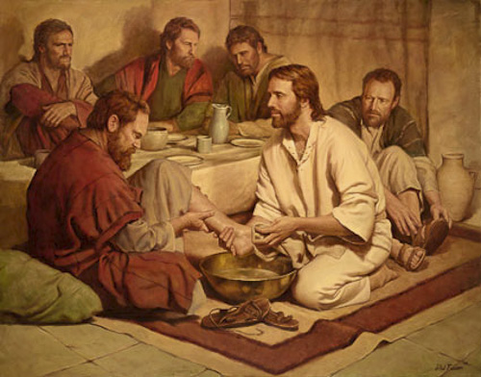
At the time, washing feet was a menial (boring/lowly) task that would normally have been performed by a servant.
People needed their feet washing y servants because they wore sandals and the roads were dusty.

Slide 8

Why did Jesus wash the disciples’ feet?
Why did they not want Jesus to wash their feet?
What was Jesus trying to teach the disciples by washing their feet?
What do Christians believe because of this story and Jesus’ actions?

Slide 9
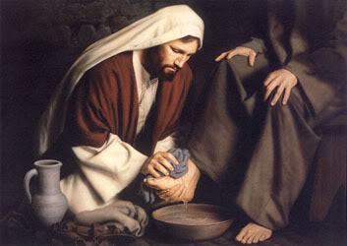
Jesus doesn’t wash the disciples’ feet as they come through the door, but as part of the meal, to make his point about the importance of service.
Jesus wanted the disciples to understand the importance of selfless service, and this showed how he was going to be a servant for all when he was crucified.

Slide 10

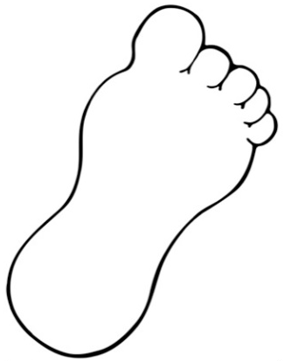
Paddling | Snorkelling | Diving
On your foot outline: On one side, write about what Jesus washing the disciples’ feet teaches Christians On the other side, write how Christians could follow the example of Jesus by being a selfless servant. Red Pen: During the Last Supper, Peter would not allow Jesus to wash his feet. Why do you think this was? | On your foot outline: On one side, write about what Jesus washing the disciples’ feet teaches Christians On the other side, write how Christians could follow the example of Jesus by being a selfless servant Red Pen: During the Last Supper, Peter would not allow Jesus to wash his feet. Why do you think this was? | On your foot outline: On one side, write about what Jesus washing the disciples’ feet teaches Christians On the other side, write how Christians could follow the example of Jesus by being a selfless servant You should think of ways of serving those close to them, people you don’t know in the local area and people around the world. Red Pen: During the Last Supper, Peter would not allow Jesus to wash his feet. Why do you think this was?

