Slide 1
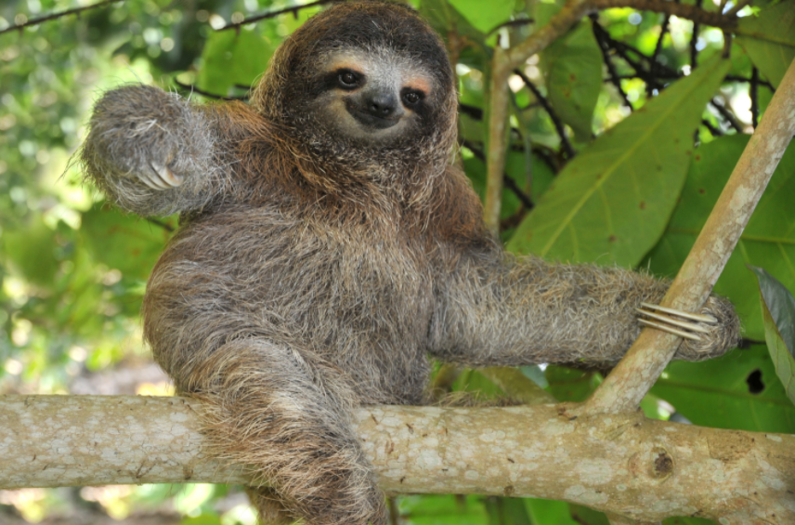
Thursday 3 March 2022
LO: To write with purpose
To use sentences appropriately
Organise writing appropriately
C: Non-chronological report

Slide 2
We are going to find out a few more facts about some of the animals in the Amazon Rainforest. Use your whiteboard to take notes of any facts that you may want to use in your report. We will also use our Geography books for the facts that we have already learned.

Slide 3
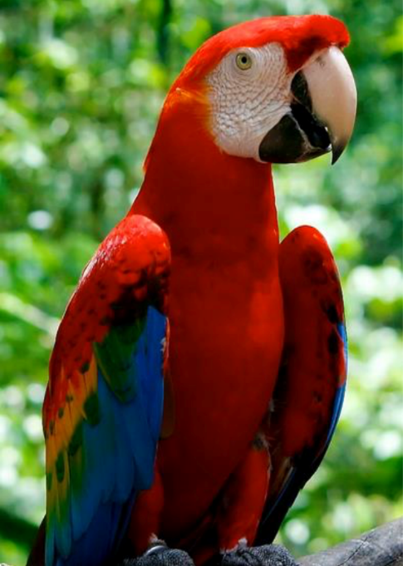
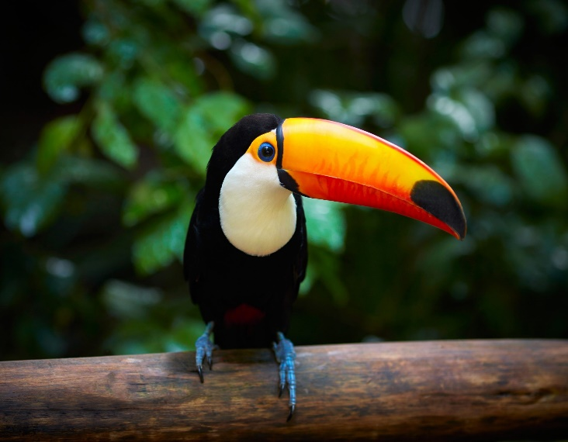
Macaws
The Amazonian rain forest is a bird lover's paradise, home to over a
thousand different species, including the blue-and-yellow macaw. Macaws are
highly intelligent, mate for life and can live up to 60 years. Proportionately
larger beaks, long tails, and relatively bare, light-coloured, medial (facial patch)
areas distinguish macaws from other parrots. They eat fruit, nuts, seeds and
insects. Macaws communicate between one another using loud vocal calls such as
squawking and screaming. Some species of Macaw are even known to be able to
mimic human sounds.
Toucans
Toucans are another icon of the Amazon Rainforest. Amazon Toucans feed on a range of things like insects, nestling birds, eggs and other small vertebrates but primarily eat a diversity of different fruits. They have a stereotypical behaviour when gulping down fruit and tilt the head back to feed. Toucans are very social and you will usually see two or more together. They have a characteristic large and usually colorful beak that helps regulate temperature. Males also use their showy beaks in dueling competitions over mates.

Slide 4
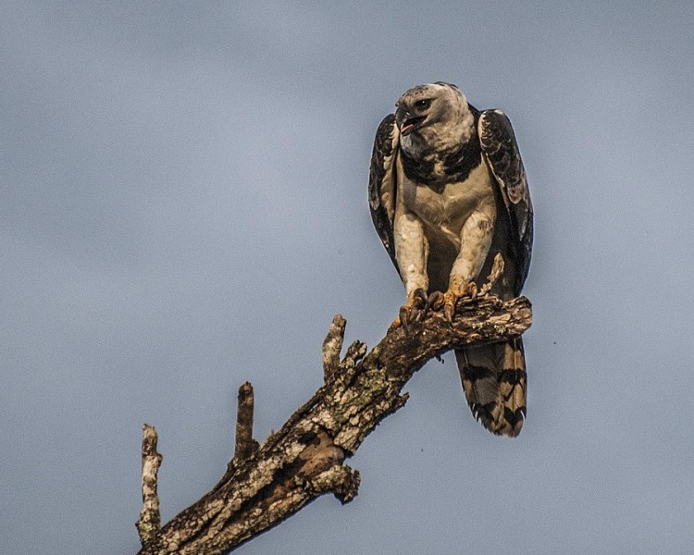
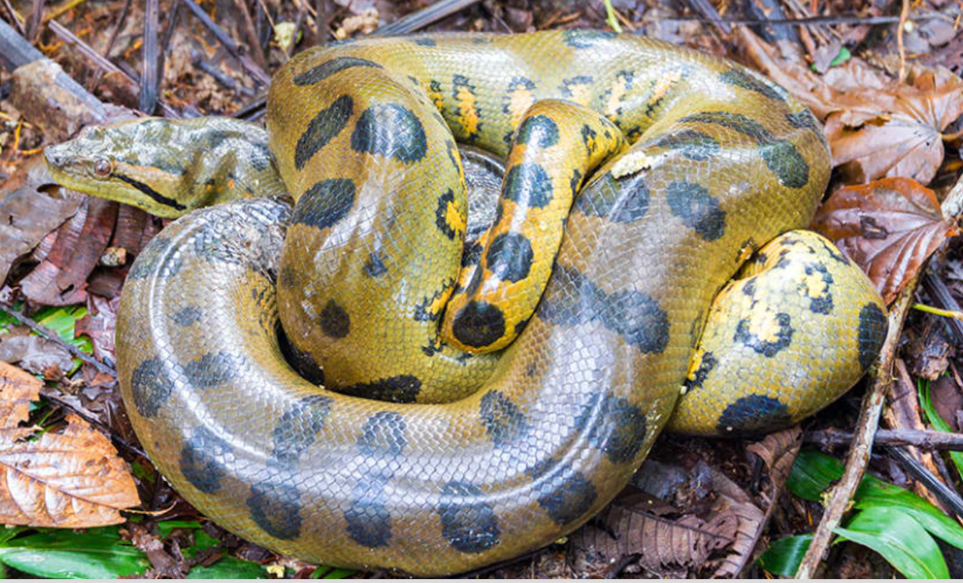
Harpy eagle
The Harpy eagle is the largest and most powerful and aggressive raptor found in the rainforest. It is among the largest remaining species of eagles in the world. The upper side of the harpy eagle is covered with slate-black feathers, and the underside is mostly white, except for the feathered tarsi (a bone in the lower leg of birds), which are striped black. A broad black band across the upper breast separates the grey head from the white belly. It eats small insects, snakes, reptiles, monkeys and sloths.
Anaconda
The Anaconda is the largest snake in the world. They feed on fish, birds, and small mammals as well as other reptiles and even Capybaras.

Slide 5
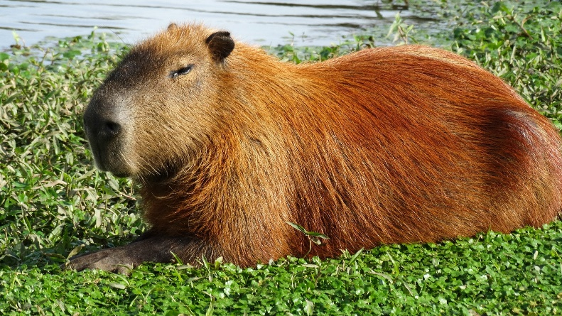
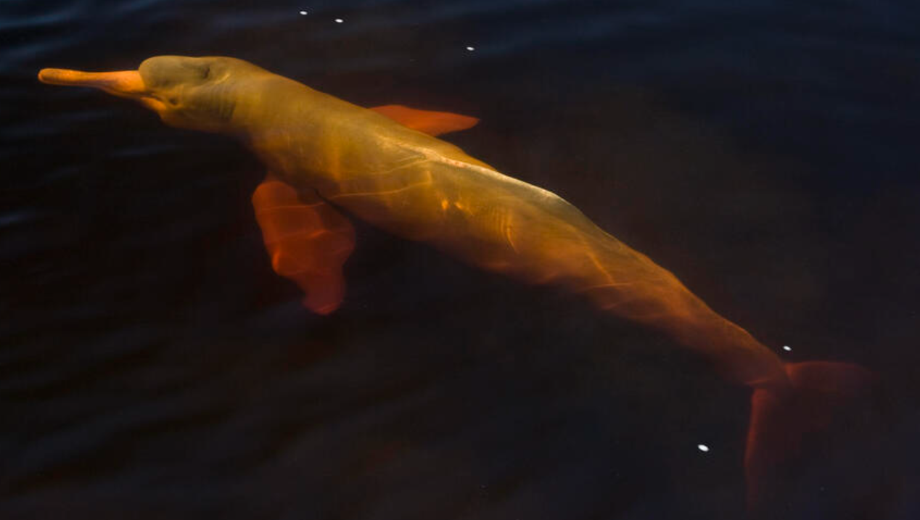
Capybara
The Capybara is a giant rodent native to South America. It’s closest relative is the guinea pig. The capybara inhabits savannahs and dense forests and lives near bodies of water. It is a highly social species and can be found in groups as large as 100 individuals, but usually lives in groups of 10–20 individuals. They are herbivores and eat a diet rich in grass, leaves and aquatic plants. Sometimes they also eat fruit and vegetables.
Pink Dolphins
The Amazon river dolphin, also known as the pink river dolphin or boto, lives only in freshwater. It is found throughout much of the Amazon Rainforest. Unlike most other types of dolphins, the pink river dolphin has a very specific diet. They eat primarily fish, crabs, and crustaceans. They’re also known to feed on small fresh-water fish.

Slide 6
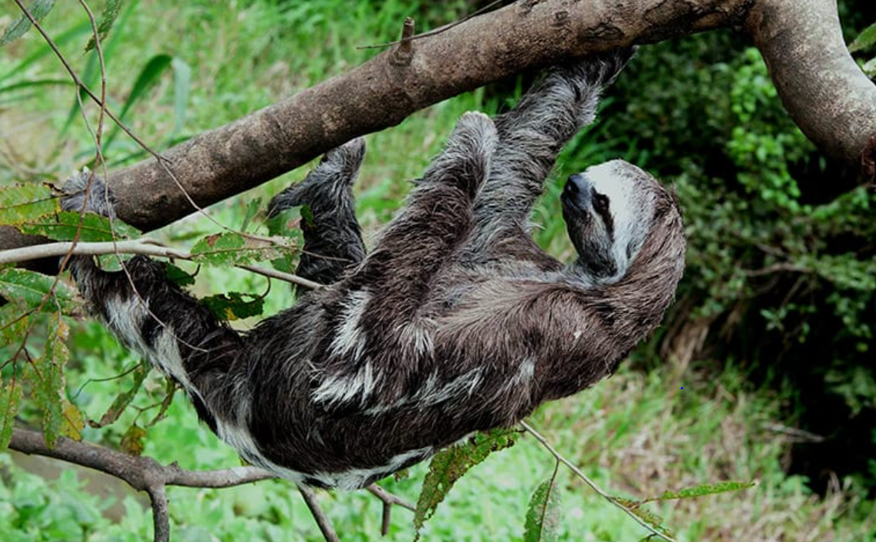
Sloths
There are two different types of sloths, two-toed and three-toed sloths. All sloths have three-toes (even the “two-toed” ones!). The difference is that the two-toed sloths only have two claws on their forelimbs, whereas the three-toed sloths have three claws on their forelimbs. However, they all have three claws on their hind-limbs.
Some of the least-active animals out there, sloths sleep for up to 20 hours each day! Some even stay in the same tree their entire life. They move so little that algae grows on them. Their body has a deep groove for housing the algae, whose colour is meant to help the animals camouflage with their environment in the Amazon’s rainy season
Part of that slothful persona is a very slothful diet. It takes so long for a sloth to digest the food it eats (and to eat enough to get the nutrients that it needs) that it only has to go to the bathroom about once a week! This is usually one of the few times the sloths will leave their tree.
Known to sometimes simply let go from
their tree branch and drop into the water
below for a quick swim, they can move three
times faster in water than they can on land.

Slide 7
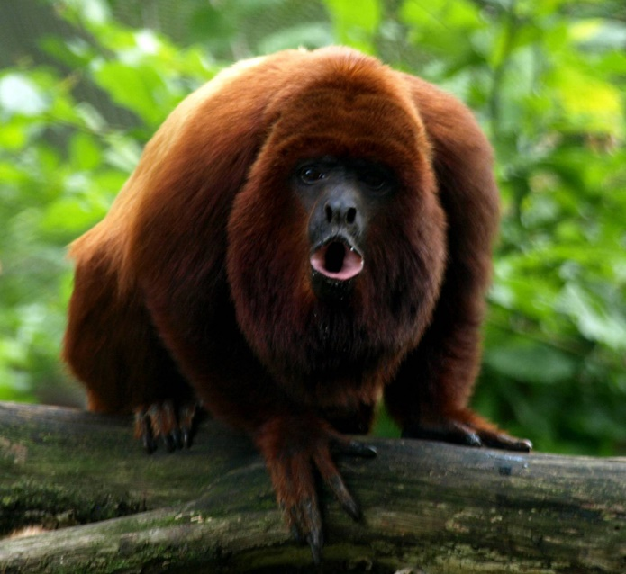
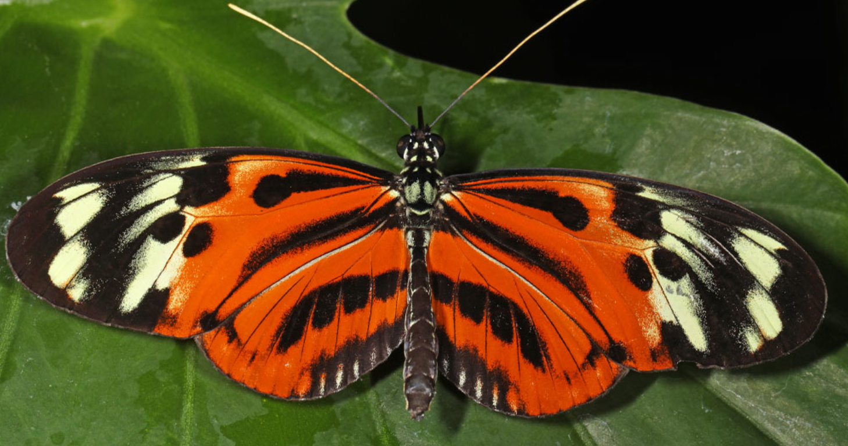
Howler Monkey
The Howler monkeys that live in the Amazon Rainforest are the loudest land animals in the entire world- They can be heard from over three miles away. Howler monkeys have beards and long, thick hair which may be black, brown, or red. The majority of howler monkeys are herbivorous in nature; their diet consists of leaves, plants, fruits, vegetables, flower and nuts.
30 million species of insects are estimated to live in the Amazon Rainforest, including 7,000 species of butterfly.

Slide 8
Use your facts about Amazon animals and plot them in a bubble map. We will be using the facts from the bubble map to write our paragraphs for our non-chronological report.

Slide 9
Capybara-
Anaconda
Birds
Sloths
One fifth of all known bird species live
in the Amazon Rainforest.
Macaws
Toucans
What animals can you find in the Amazon?
Pink dolphins
Harpy eagle
Insects and butterflies
Howler monkey

Slide 10

Write a short paragraph for each of your animals that you chose to include. Include a mixture of simple, complex and compound sentences. Include a variety of conjunctions, adverbs/ adverbial phrases.

