Slide 1
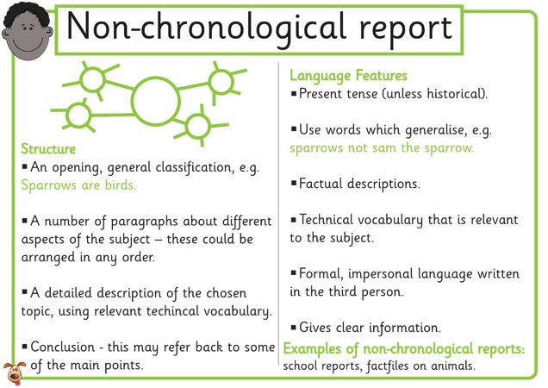
Wednesday 2 March 2022
LO: To write with purpose
To use sentences appropriately
Organise writing appropriately
C: Non-chronological report

Slide 2
Today we are going to be writing about the location and size of the Amazon Rainforest and about the climate. We are going to use our Geography facts to help us bubble map our ideas and then write paragraphs for each idea.

Slide 3
Subheading: Where in the world is the Amazon Rainforest?
Location
Size
Where in the world is the Amazon Rainforest?

Slide 4
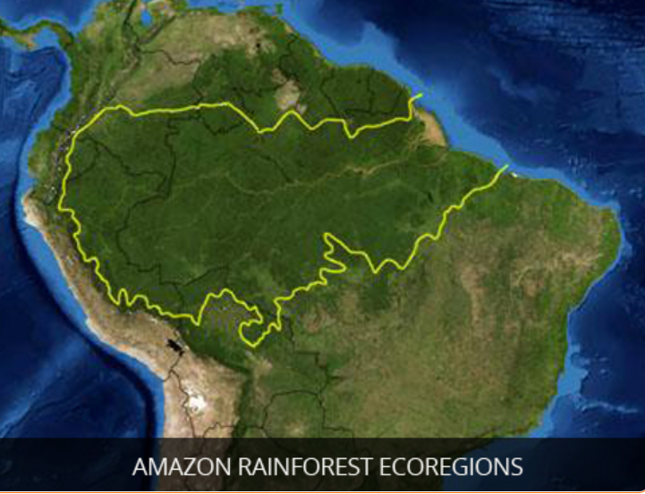
The Amazon Rainforest is the largest rainforest in the world and is located in the continent of South America. It stretches over 9 countries, which are: Brazil, Peru, Bolivia, Ecuador, Colombia, Venezuela, Guyana, Suriname and French Guiana. The majority of the rainforest is contained within Brazil. The Amazon makes up over half of the rainforest land coverage in the world, covering 2,100,000 square miles. This is nearly as big as the continent of the USA.

Slide 5
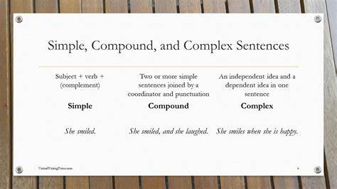
Write a short paragraph for each idea. Include a mixture of simple, complex and compound sentences. Include a variety of conjunctions, adverbs/ adverbial phrases.

Slide 6
Subheading: Climate
Temperature
Rainfall
What is the climate like?
Temperate and Tropical Rainforests
Humidity
Situated near the equator

Slide 7
There are two different types of rainforests; Temperate and Tropical. Temperate rainforests are cool and mild, whereas tropical rainforests are hot and humid. The Amazon Rainforest is a tropical rainforest, as it is located close to the equator. As a result of being a tropical rainforest, the Amazon’s weather and climate is very hot, humid and damp. The Amazon Rainforest experiences 80-400 inches of rainfall a year and the dense trees keep the moisture in. This is why the rainforest is filled with dense plant life. The average daily temperature in the Amazon Rainforest is 28 degrees. It is so humid, frogs don’t have to live near bodies of water. There are not many seasonal changes in the climate and the temperature remains the same for most of the year.

Slide 8
Write a short paragraph for each idea. Include a mixture of simple, complex and compound sentences. Include a variety of conjunctions, adverbs/ adverbial phrases.

